Slide 1
JumpDeath
Josiah Burchard, Tyler Chapman, and Steven Sebastian

Slide 2
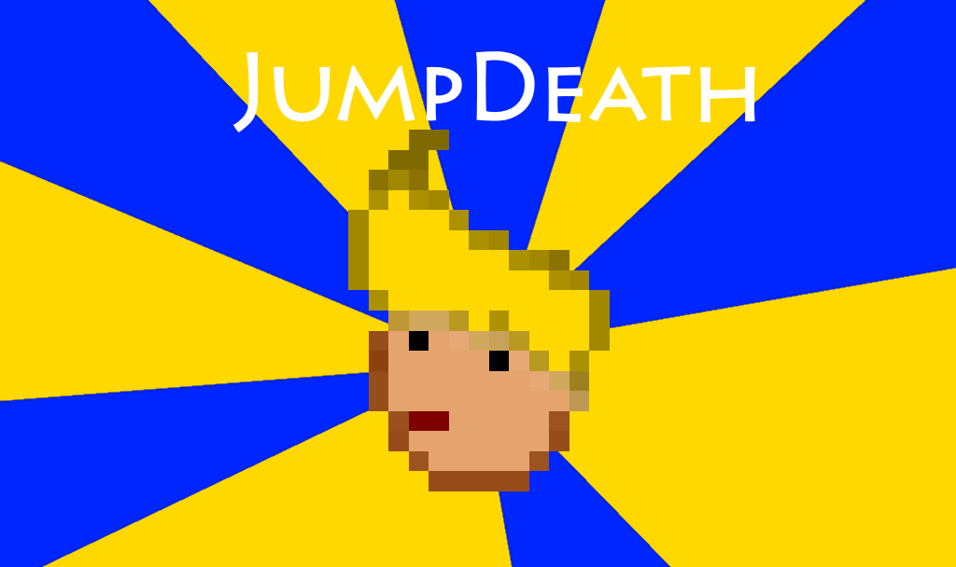
JumpDeath Description
Platforming game where the player must get to the door placed somewhere in the level
Player must clear a total of nine levels to win the game

Slide 3
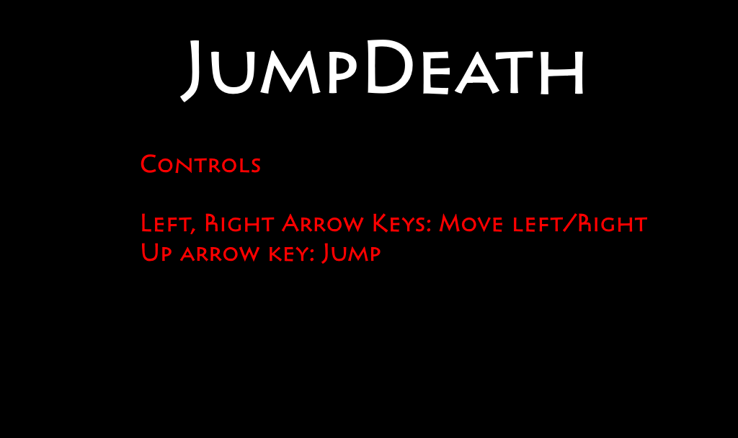
Design Features
Level generation from files
Simple controls
Three different types of enemies: frog, emu, soda guy
Finite state machine AI implemented for enemies
Enemy AI reacts to player jumping (not soda guy)
Scrolling background and randomly generated clouds
Somewhat forgiving death system (must start level over, but infinite continues)

Slide 4
AI: Frog
Idle State
Attack State
Hops around left or right randomly
Jumps occur every couple seconds
Does not react to player until player jumps
If player jumps, frog will try to jump to where player will go (intercept AI)
Frantically hops towards player until player retreats

Slide 5
AI: Emu
Idle State
Attack State
Wanders in one direction
Changes direction when touching a wall or upon reaching the edge of a platform
When looking at player and player is close enough:
Speeds up to “chase” player
Stops short of player when player jumps to make player miss
Resumes “chase” when player is on the ground

Slide 6
AI: Soda Guy
Idle State
Attack State
Drinks soda can and gets ready to throw it
After about a second of idling, goes to attack state
Throws soda can, then returns to idle state
Soda Can AI:
Spins in the air and bounces on platforms and walls
Slides on ground after done bouncing, slowing until it stops

Slide 7
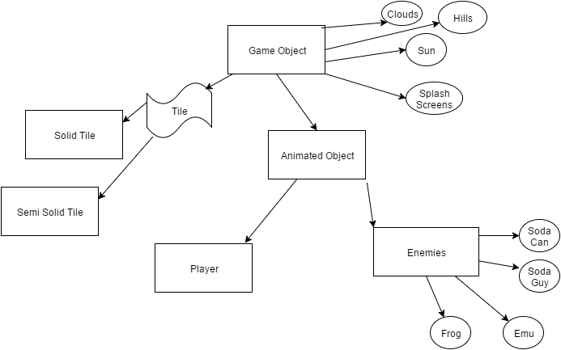
Inheritance
Implementation

Slide 8
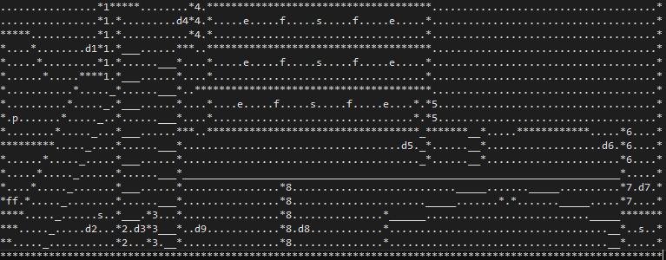
Map Maker
Implementation

Slide 9
Game Flow
Implementation
private void Update_ThreadSafe(double elapsed, Rectangle updateBounds)
{
List<AnimatedObject> gameObjects =
GamePlay.LevelObjects
.Where(i => i.IsThreadSafe && i.Alive && i.Rectangle.Intersects(updateBounds)
&& i is AnimatedObject && !(i is Player))
.Select(i => (AnimatedObject)i).ToList();
Parallel.ForEach(gameObjects, i => i.Update(GamePlay.LevelObjects, elapsed));
}

Slide 10
Game Flow
Implementation
drawableObjects
.Where(i => i.Alive
&& (i.Rectangle.Intersects(GamePlay.ViewPort) || i.AlwaysDraw))
.OrderBy(i => i is Player)
.ThenBy(i => i is Enemy)
.ThenBy(i => i is Door)
.ThenBy(i => i is PlayerLife)
.ThenBy(i => i is Tile)
.ThenBy(i => i is Hill)
.ThenBy(i => i is Cloud)
.ThenBy(i => i is Sun)
.ToList().ForEach(i =>
{
i.Draw(SpriteBatch,
i.Position.GetDrawablePosition(GamePlay.ViewPort),
SpriteEffects.None);
});

Slide 11
Contributions of Team

Slide 12
Josiah Burchard: Team Leader
Worked on game project framework (created most of the classes in the project) and wrote code for game elements not related to enemy AI
Refactored code (mainly to maintain object oriented programming)
Drafted basic AI algorithms for enemies (and addressed logical issues with enemy AI)
Debugged issues related to graphical display
Implemented scrolling, explosion, particles, etc.
Added level selection capabilities
Parallel processing

Slide 13
Steven Sebastian: AI
Wrote AI functions for frog, emu, soda guy, and soda can enemies (and often modified for logical purposes or increase challenge)
Created sprites for solid and semi-solid tiles
Added player health, mercy invincibility, and player death (and Game Over)
Debugged issues related to enemy AI or Game Over
Added additional levels to the game

Slide 14
Tyler Chapman: Graphics
Custom sprite work
Background objects, scenery, player and enemies
Sprite transparency
Animation frames
Obtained/Implemented sound effects
Created splash screens for project
Created Game Trailer

