Slide 1
Is the Customer Always Right?
An exploration of customer feedback through Natural Language Processing.
By @josiahjdavis

Slide 2
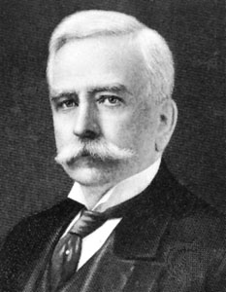
Within the U.S., the slogan is often attributed to Marshall Fields.
“Assume that the customer is right until it is plain beyond all question he is not.”

Slide 3
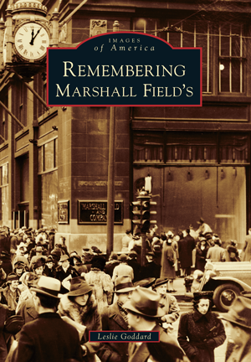
Marshall Field’s pioneered many retail practices now considered standard: - One-price price tag - Any product can be returned - No aggressive salespeople - Bridal registry - Personal Shopper - Escalators

Slide 4
The customer is always right, but all slogans deserve qualification.

Slide 5
Some customer feedback is more useful than others.

Slide 6
Challenge The volume and unstructured nature of textual information makes text mining a formidable task. Insight Structured data can be used to frame the analysis of unstructured data.

Slide 7
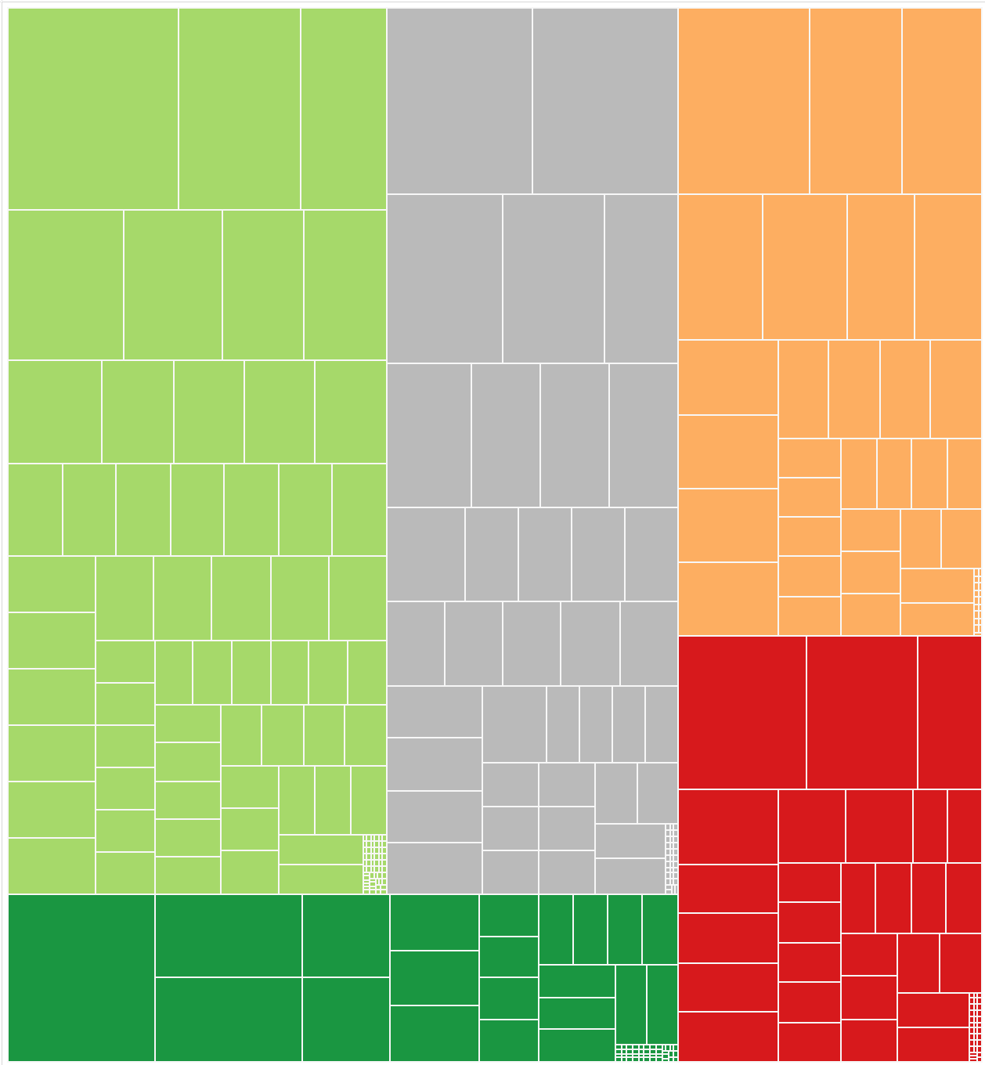

Usefulness
Each node in the treemap corresponds to a review. The size is proportional to the number of usefulness votes received.
5 Stars
4 Stars
3 Stars
2 Stars
1 Star
Size corresponds to number of reviews.

Slide 8
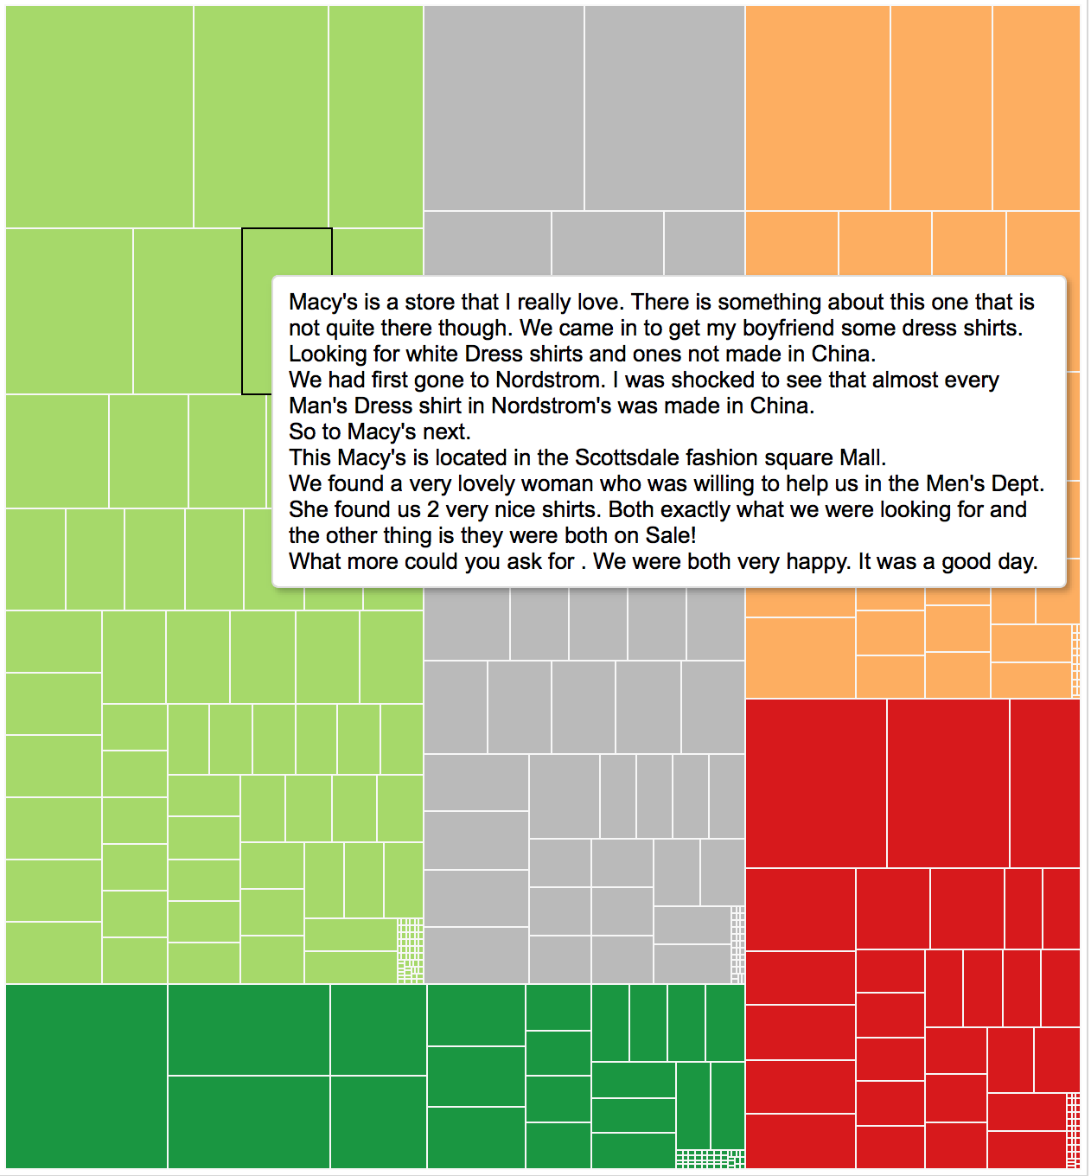
Usefulness
Each node in the treemap corresponds to a review. The size is proportional to the number of usefulness votes received.
5 Stars
4 Stars
3 Stars
2 Stars
1 Star

Slide 9
Some customer complaints are more frequent than others

Slide 10
Challenge Written text is fraught with misspellings, and full of synonyms (e.g., employee, associate). Insight Using a dictionary of word patterns to define terms provides greater flexibility than mere tokenization.

Slide 11
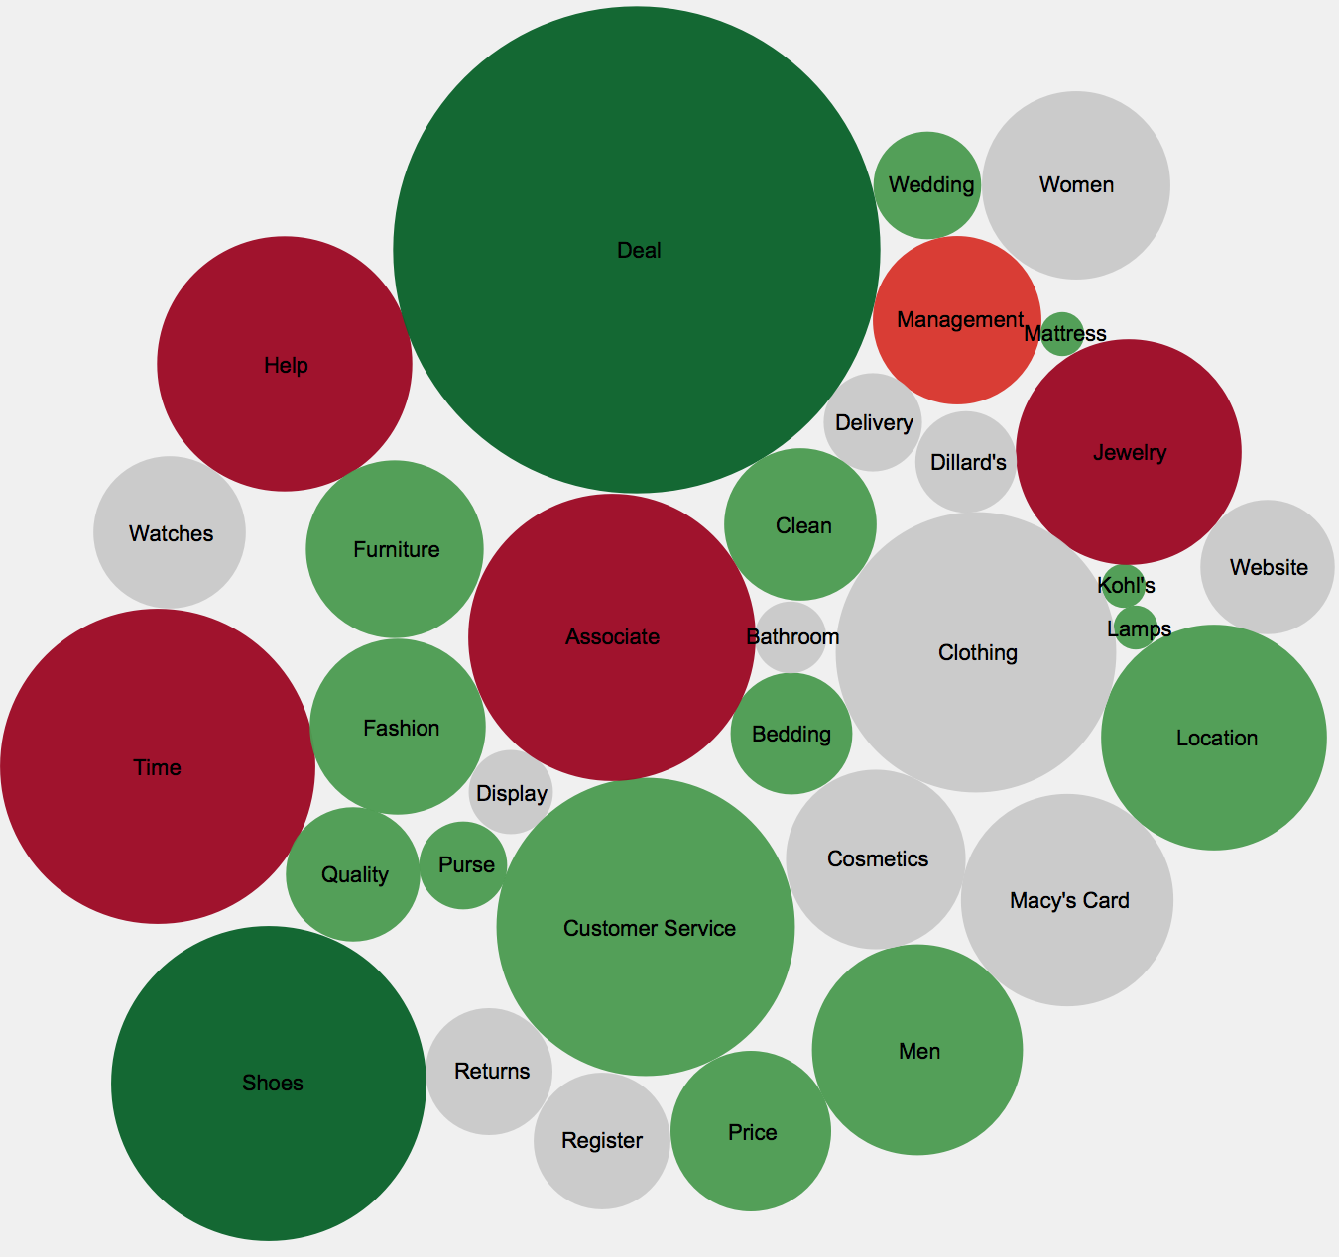

Frequency
Each bubble in the chart represents one word pattern defined from a custom dictionary. The size corresponds to the frequency, and the color corresponds to the ratio of positive and negative reviews.
Size corresponds to number of reviews.
More Positive
More Positive
Positive
Positive
Neutral
Neutral
Negative
Negative
More Negative
More Negative

Slide 12
Some customers are more nuanced than others.

Slide 13
Challenge Human beings are easily biased by un-related factors (e.g., Halo/Horns Effect). Insight Evaluating sentiment at both the document and token level can be more insightful than either one in isolation.

Slide 14
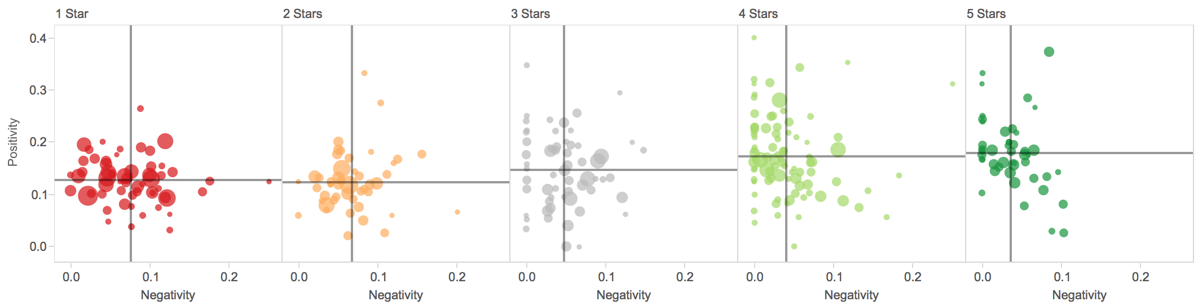
Nuance
Each point in the scatter chart below corresponds to a review. The y- and x-axes are defined as the number of positively and negatively scored words divided by the number of total words. Words are scored using an off-the-shelf sentiment library.

Slide 15
Nuance
Each point in the scatter chart below corresponds to a review. The y- and x-axes are defined as the number of positively and negatively scored words divided by the number of total words. Words are scored using an off-the-shelf sentiment library.
Positive sentiments in negative reviews.
Negative sentiments in positive reviews.

Slide 16
Is the customer always right?

Slide 17
Yes, but some customers are more right than others.

Slide 18
Thank you

Slide 19
Appendix

Slide 20
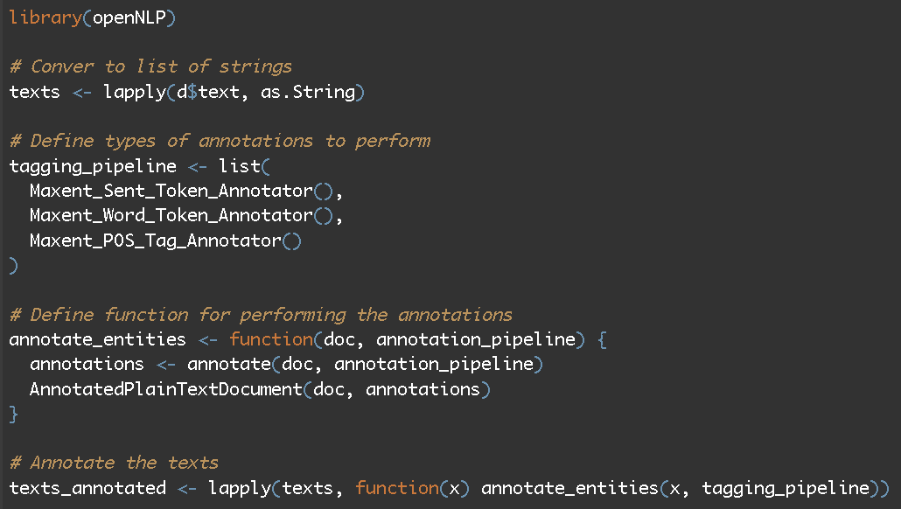
Parts of Speech
https://github.com/josiahdavis/earl/blob/master/posTagger.R

Slide 21
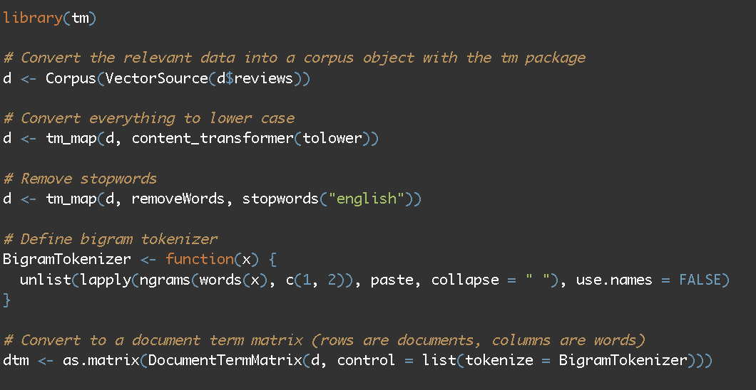
Tokenization
https://github.com/josiahdavis/earl/blob/master/dtm.R

Slide 22
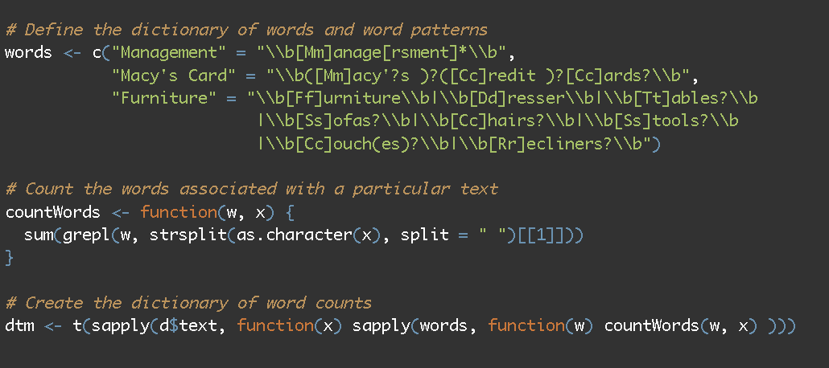
Using a Custom Dictionary
https://github.com/josiahdavis/earl/blob/master/dictionary.R

Slide 23
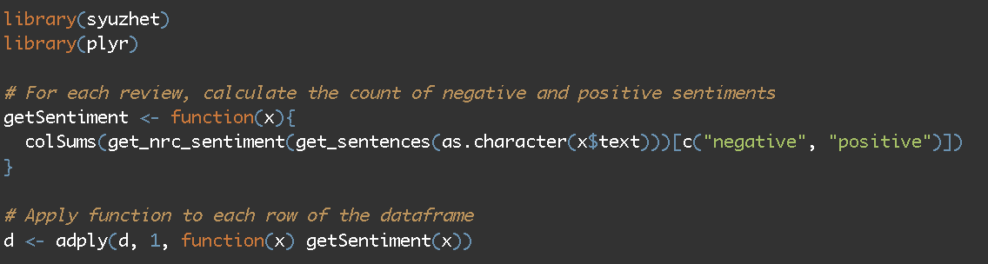
Sentiment Analysis
https://github.com/josiahdavis/earl/blob/master/reviewSentiment.R

