Slide 2


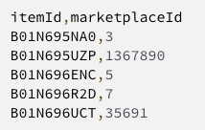






Build a Container Image
Create the job queue and compute environment
Create a Register a job definition
Submit an AWS Batch Array Job
Decode ASIN Embeddings
0
2
3
4
5
AWS Account
US East 1
Role
Bucket
Topic

Slide 3

Build a Container Image
0
AWS Account
AWS Region
Input Arguments
Registry
EC2 Role
Input Bucket
Output Bucket
Batch Role

Slide 4








AWS Account
AWS Region
Input Arguments
Container Image
Amazon ECR
Python program
Amazon S3
AWS Batch
Amazon S3
Batch Role
EC2 Role
Amazon EC2

