Slide 1
Is the Customer Always Right?
An exploration of customer feedback through Natural Language Processing.
By @josiahjdavis

Slide 2
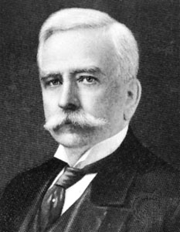
Within the U.S., the slogan is often attributed to Marshall Fields.
“Assume that the customer is right until it is plain beyond all question he is not.”

Slide 3
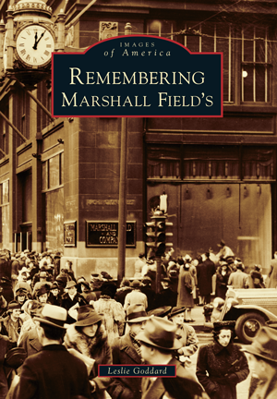
Marshall Field’s pioneered many retail practices now considered standard: - One-price price tag - Any product can be returned - No aggressive salespeople - Bridal registry - Personal Shopper - Escalators

Slide 4
Is the customer always right?

Slide 5
The customer is always right, but some customers are more right than others.

Slide 6
Some customer feedback is more useful than others.

Slide 7
Challenge The volume and unstructured nature of textual information makes text mining a formidable task. Insight Structured data can be used to frame the analysis of unstructured data.

Slide 8
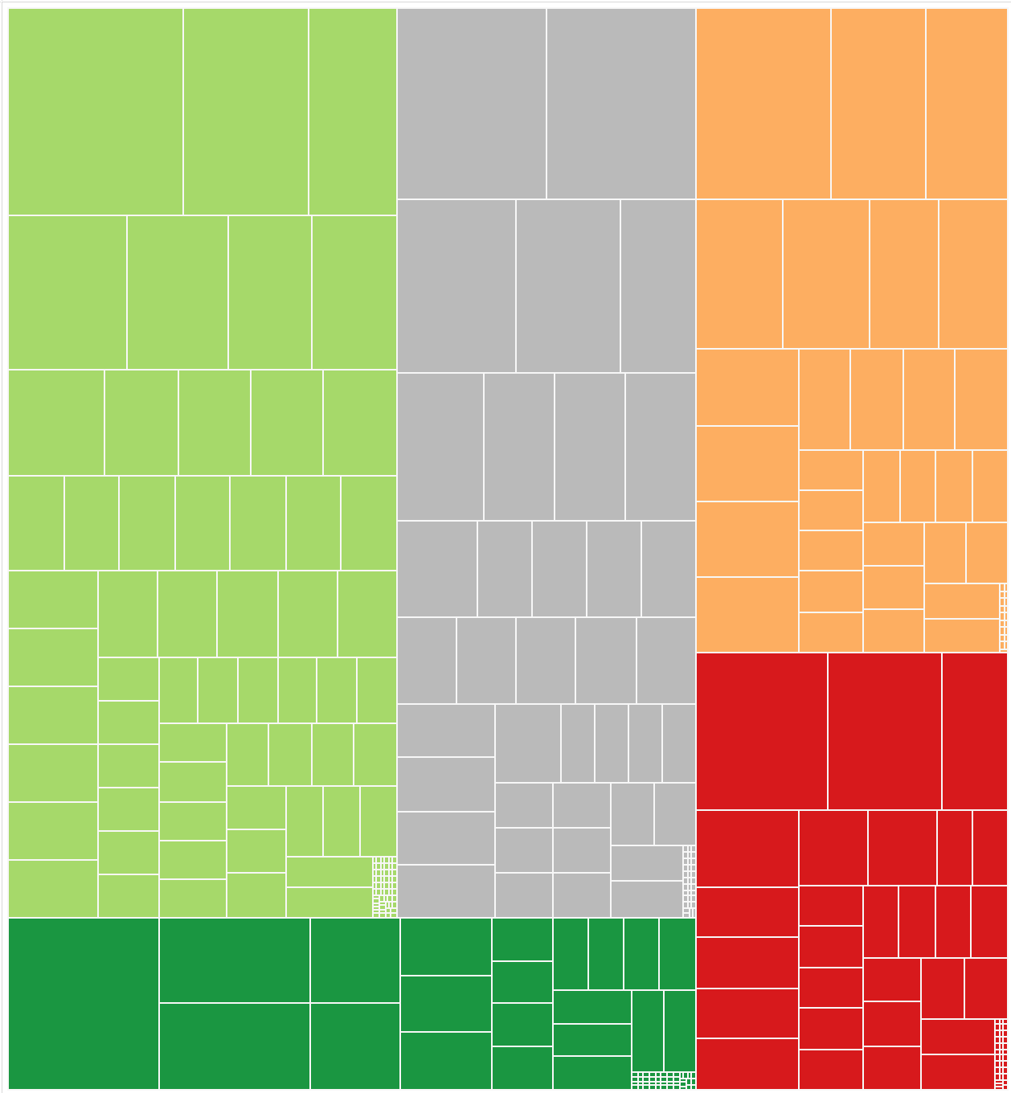

Usefulness
Each node in the treemap corresponds to a review. The size is proportional to the number of usefulness votes received.
5 Stars
4 Stars
3 Stars
2 Stars
1 Star
Size corresponds to number of reviews.

Slide 9
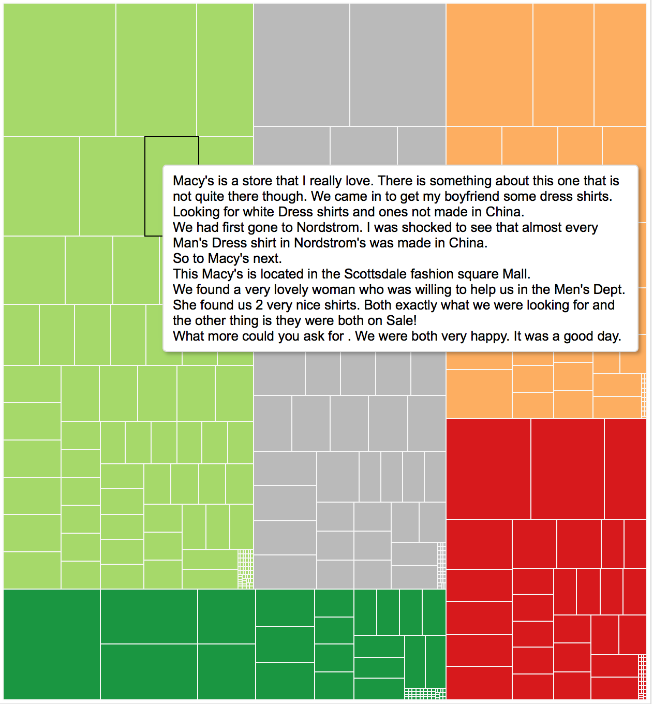
Usefulness
Each node in the treemap corresponds to a review. The size is proportional to the number of usefulness votes received.
5 Stars
4 Stars
3 Stars
2 Stars
1 Star

Slide 10
Some customer complaints are more frequent than others

Slide 11
Challenge Written text is fraught with misspellings, and full of synonyms (e.g., employee, associate). Insight Using a dictionary of word patterns to define terms provides greater flexibility than mere tokenization.

Slide 12
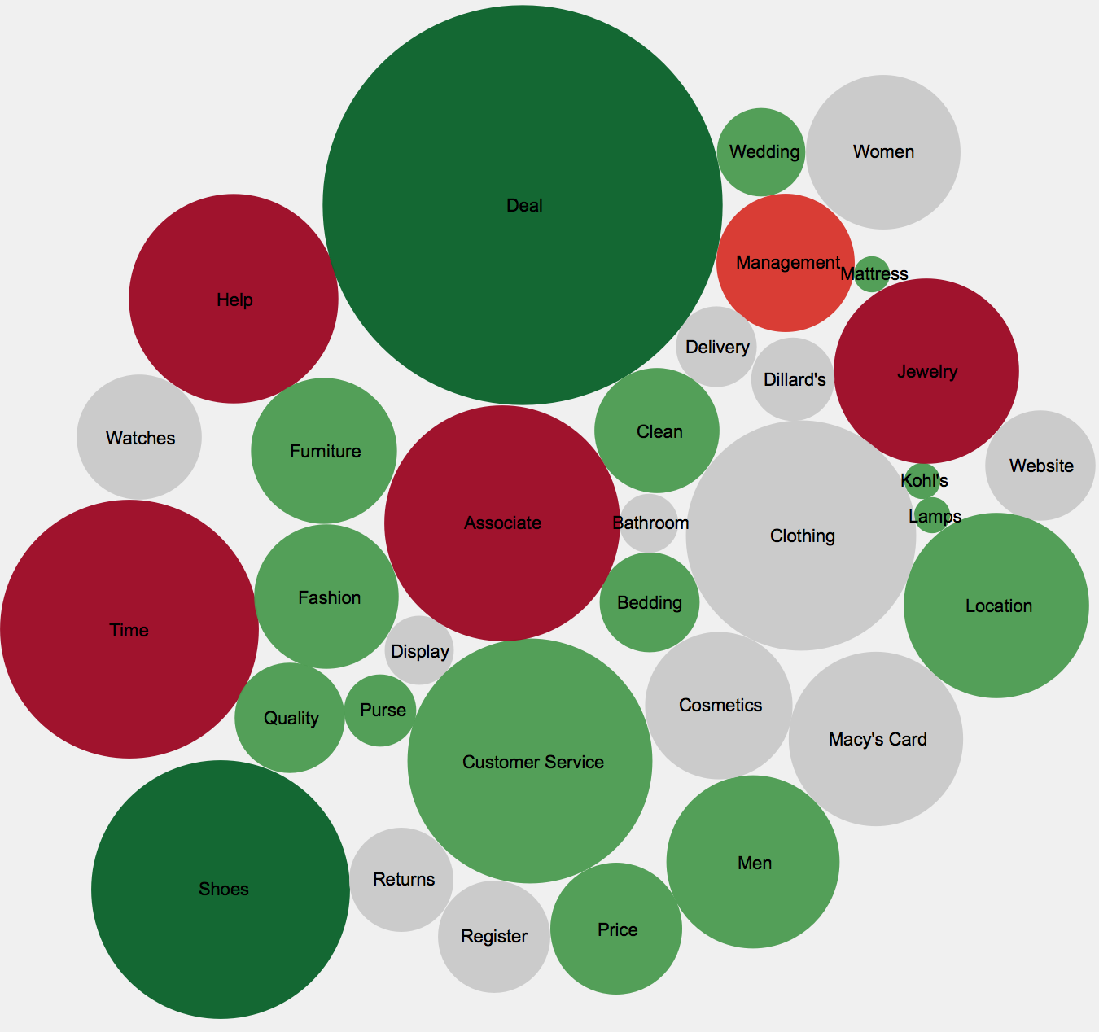

Frequency
Each bubble in the chart represents one word pattern defined from a custom dictionary. The size corresponds to the frequency, and the color corresponds to the ratio of positive and negative reviews.
Size corresponds to number of reviews.
More Positive
More Positive
Positive
Positive
Neutral
Neutral
Negative
Negative
More Negative
More Negative

Slide 13
Some customers are more nuanced than others.

Slide 14
Challenge Human beings are easily biased by un-related factors (e.g., Halo/Horns Effect). Insight Evaluating sentiment at both the document and token level can be more insightful than either one in isolation.

Slide 15
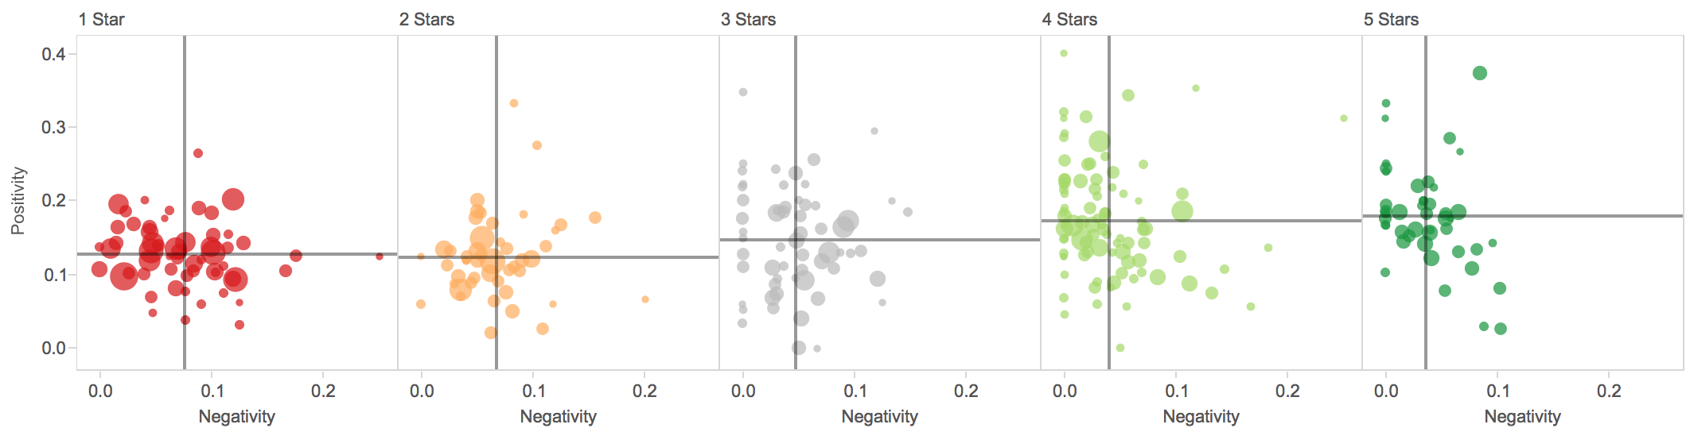
Nuance
Each point in the scatter chart below corresponds to a review. The y- and x-axes are defined as the number of positively and negatively scored words divided by the number of total words. Words are scored using an off-the-shelf sentiment library.

Slide 16
Nuance
Each point in the scatter chart below corresponds to a review. The y- and x-axes are defined as the number of positively and negatively scored words divided by the number of total words. Words are scored using an off-the-shelf sentiment library.
Positive sentiments in negative reviews.
Negative sentiments in positive reviews.

Slide 17
Is the customer always right?

Slide 18
The customer is always right, but all slogans deserve qualification.

Slide 19
Thank you

Slide 20
Appendix

Slide 21
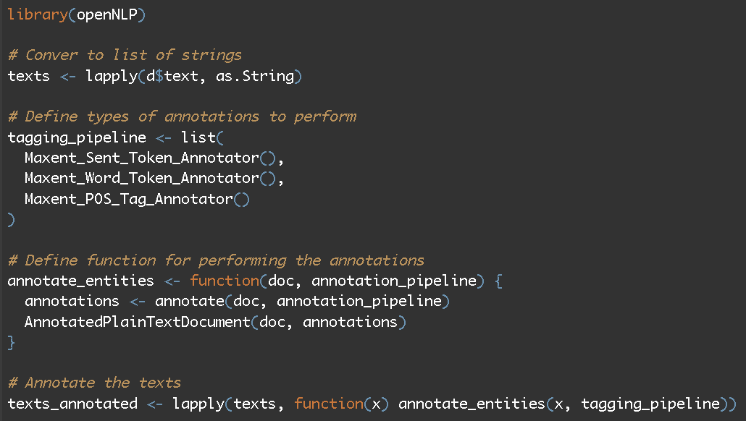
Parts of Speech
link

Slide 22
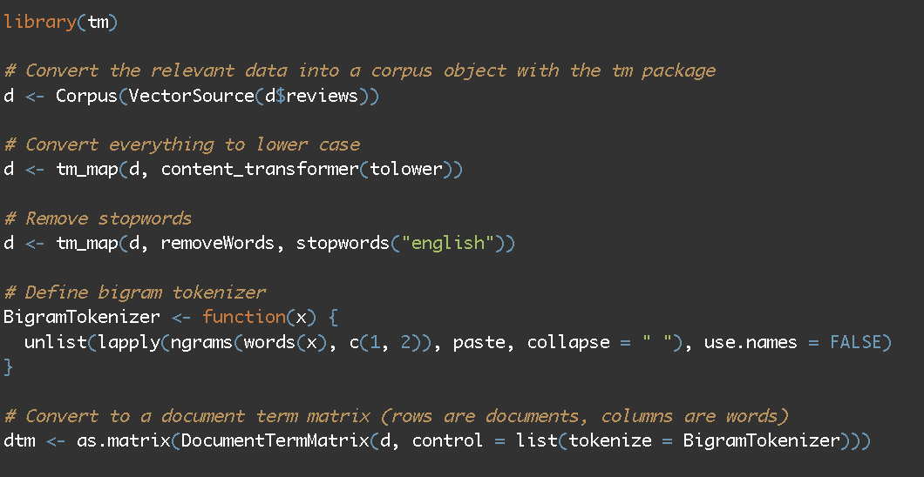
Tokenization
link

Slide 23
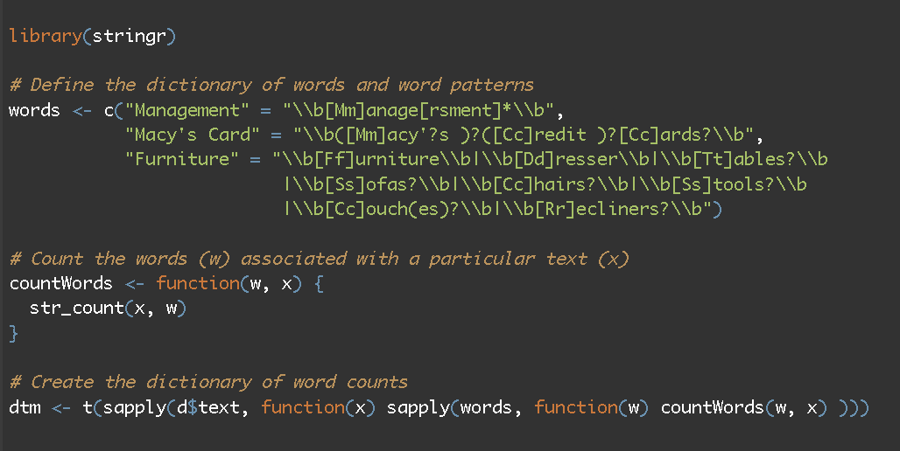
Using a Custom Dictionary
link

Slide 24
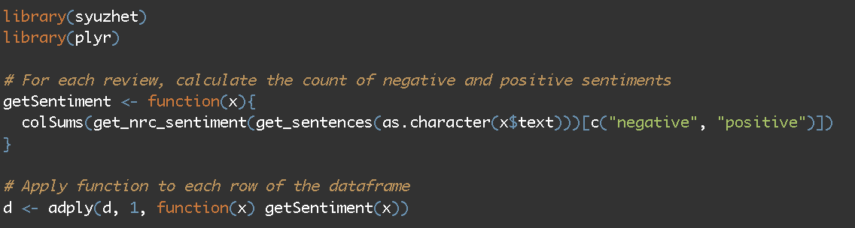
Sentiment Analysis
link

