Slide 1

Python for Data Analysis

Slide 2
Agenda
What is data analysis?
Why learn to program?
Why learn to program in python?
Code Walkthrough & Exercise
Resources

Slide 3
What is
data analysis?

Slide 4

Data analysis is the process by which data becomes understanding, knowledge and insight.
Hadley Wickham
Define
Collect
Transform
Explore
Model
Communicate

Slide 5
Why learn to program?

Slide 6
#1
Provides liberation to analyze data on its own terms

Slide 7
#2
Provokes knowledge sharing and reproducibility

Slide 8
#3
Promotes continuous improvement through automation

Slide 9
Why program in Python?

Slide 10
#1
Python is free

Slide 11
#2
Python is a general purpose language

Slide 12
#3
Python is designed for ease of use

Slide 13
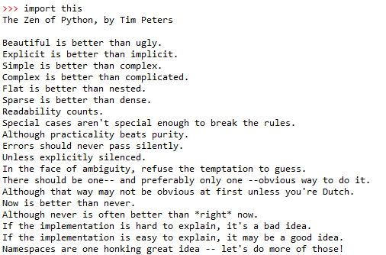

Slide 14
#4
Python has an organized development community

Slide 15
Python has a rich and cohesive package ecosystem for conducting data science
Analysis
Extraction
Modeling
NumPy
[Arrays]
Beautiful Soup
[Web-Scraping]
Scikit-learn
[Machine Learning]
Pandas
[Data Frames]
NLTK
[NLP]
StatsModels
[Statistics]

Slide 16
Code Walkthrough & Exercises

Slide 17
Resources

Slide 18
Data Science in Python
Python for Data Analysis
scikit-learn.org
General Assembly’s Data Science
Introduction to Statistical Learning
Coursera Data Science Specialization
Data Science

