Slide 1

Python for Data Analysis

Slide 2
Agenda
Introduction
Code Walkthrough
Code Exercise
Resources

Slide 3
What is
data analysis?

Slide 4

Data analysis is the process by which data becomes understanding, knowledge and insight.
Hadley Wickham

Slide 5
Define
Collect
Transform
Explore
Model
Communicate
Notes:
Strengths of visualization is to reveal the unexpected, problem is that they don’t scale very well.
Models scale, but they are typically specific, and as such don’t reveal the unexpected. Definition is important part of the task.

Slide 6
Why learn to program?

Slide 7
#1
Provides liberation to analyze data on its own terms

Slide 8
#2
Provokes knowledge sharing and reproducibility

Slide 9
#3
Promotes continuous improvement through automation

Slide 10
Why program in Python?

Slide 11
#1
Python is free

Slide 12
#2
Python is a general purpose language

Slide 13
#3
Python is designed for ease of use

Slide 14
#4
Python has an organized development community

Slide 15
In contrast to R, which has 5000+ packages, Python has a smaller and richer of package ecosystem
Analysis
Extraction
Modeling
NumPy
[Arrays]
Beautiful Soup
[Web-Scraping]
Scikit-learn
[Machine Learning]
Pandas
[Data Frames]
NLTK
[NLP]
StatsModels
[Statistics]

Slide 16
Code Walkthrough

Slide 17
Resources

Slide 18
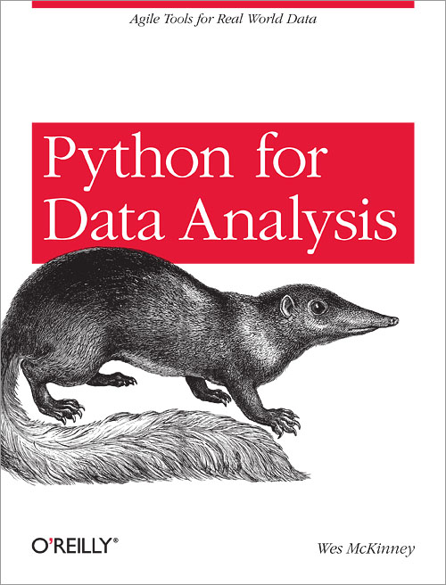
Resources
Wes Anderson, the creator of the Pandas library, has written a book that is a good reference guide.

Slide 19

Resources
General Assembly offers a class on Data Science that covers the following topics:
Predictive Modeling
Clustering and Dimension Reduction
Natural Language Processing
Databases
Web Scraping & APIs

