Slide 1

Python for Data Analysis

Slide 2
Introduction
Learned MATLAB in college
Started out as a business analyst
Learned R to apply random forests
Listened to a lecture by Hadley Wickham
…
Invited conference speaker
Working as a data scientist at Slalom

Slide 3
Agenda
What is data analysis?
Why learn to program?
Why learn to program in python?
Code Walkthrough & Exercise
Resources

Slide 4
What is
data analysis?

Slide 5

Data analysis is the process by which data becomes understanding, knowledge and insight.
Hadley Wickham
Define
Collect
Transform
Explore
Model
Communicate

Slide 6
Why learn to program?

Slide 7
#1
Provides liberation to analyze data on your own terms

Slide 8
#2
Provokes knowledge sharing and reproducibility

Slide 9
#3
Promotes continuous improvement through automation

Slide 10
Why program in Python?

Slide 11
#1
Python is free

Slide 12
#2
Python is a general purpose language

Slide 13
#3
Python is designed for ease of use

Slide 14
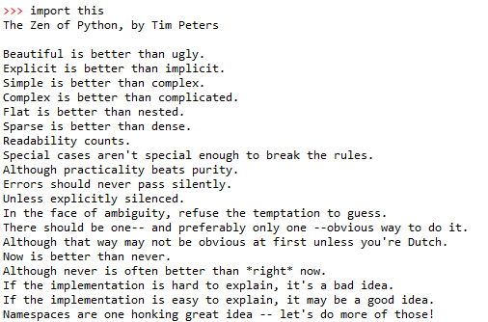

Slide 15
#4
Python has an organized development community

Slide 16
Python has a rich and cohesive package ecosystem for conducting data science
Analysis
Extraction
Modeling
NumPy
[Arrays]
Beautiful Soup
[Web-Scraping]
Scikit-learn
[Machine Learning]
Pandas
[Data Frames]
NLTK
[NLP]
StatsModels
[Statistics]

Slide 17
Code Walkthrough & Exercises

Slide 18
Stay in touch
Twitter: @josiahjdavis
E-mail: josiah.j.davis@gmail.com
Website: www.josiahjdavis.com

