Slide 1

Taste Intelligence
From product evidence
to a defensible decision.
A connected sensory and consumer science workspace for food development teams.
Built by New Food Innovation
tasteintelligence.co.uk
Notes:
Open with the business outcome: better food-development decisions backed by connected evidence. Avoid beginning with a feature tour.
[Sources]
- Internal product positioning and implemented Sensory Platform workflow.
- Hero image generated for this deck on 2026-08-19.
[/Sources]

Slide 2
THE PROBLEM
Good evidence loses value when the workflow is fragmented
A product decision may depend on four different evidence streams—yet they are often reviewed in separate files, systems and meetings.
Technical
Instrumental, composition and formulation data
Sensory
Attributes, intensity, liking and open response
The consequence is not simply administration. Teams can lose sample lineage, repeat work, overstate weak findings, or struggle to explain why a product advanced.
Consumer
Concept, usage, price and purchase feedback
Commercial
GO, TWEAK or STOP—and the evidence behind it
Taste Intelligence keeps the evidence, the decision and the next action connected.
Taste Intelligence · NFI sensory and consumer science hub
2
Notes:
Use examples the audience recognizes: lab files, survey tools, analysis spreadsheets and separate presentation decks. This is a workflow diagnosis, not a claim that every customer has identical problems.
[Sources]
- Internal workflow analysis; no external market statistic is asserted.
[/Sources]

Slide 3
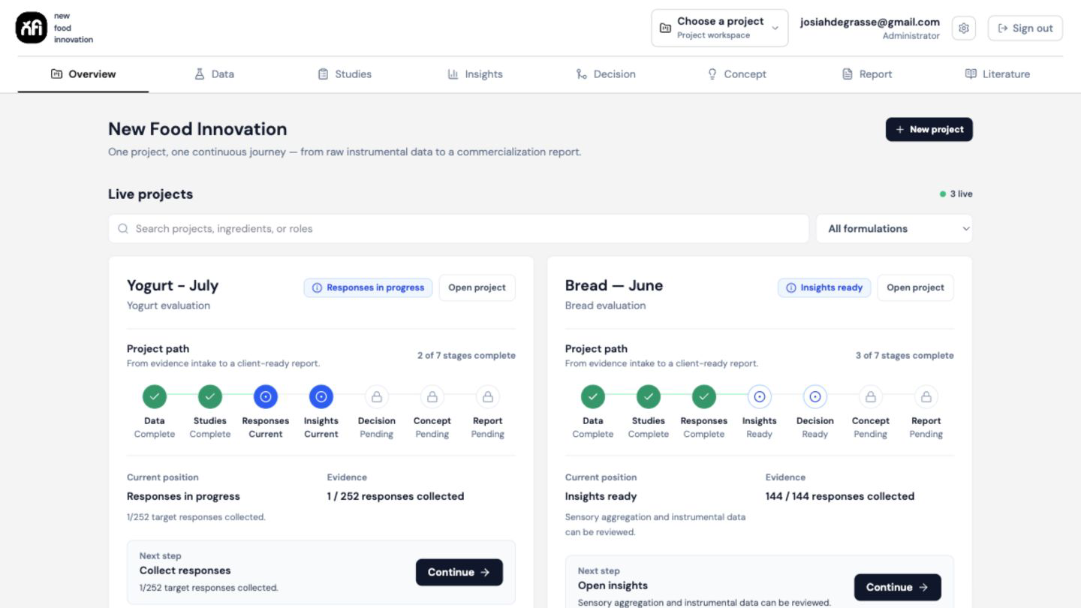
THE PLATFORM
One workspace shows where the project is—and what happens next
Project continuity
A visible path from Data to Report
Current status and evidence gaps
A specific next action for the team
Project context retained across stages
The interface is designed to support the working process—not create another disconnected output.
REPRESENTATIVE INTERFACE · ILLUSTRATIVE PROJECT DATA
Taste Intelligence · NFI sensory and consumer science hub
3
Notes:
This is genuine product proof. Explain that the Overview is the operating layer: it shows the active project, its stage, evidence status and next recommended action.
[Sources]
- Internal product screenshot captured from the implemented Sensory Platform, 2026-08-19.
[/Sources]

Slide 4
HOW IT WORKS
A connected journey from sample to commercial recommendation
Data
Studies
Insights
Decision
Concept
Report
Sample, formulation and instrumental evidence
Sensory, discrimination and concept tests
Patterns, comparisons and evidence limits
GO, TWEAK or STOP with rationale
Validated direction becomes a stimulus
Versioned, reviewable commercial output
Human review remains the gate at every consequential step.
The platform makes the evidence chain visible; it does not substitute software output for scientific judgment.
Taste Intelligence · NFI sensory and consumer science hub
4
Notes:
Walk left to right. The critical distinction is continuity: later outputs inherit the approved evidence and decision record instead of starting from a blank page.
[Sources]
- Implemented Sensory Platform workflow and internal product documentation.
[/Sources]

Slide 5
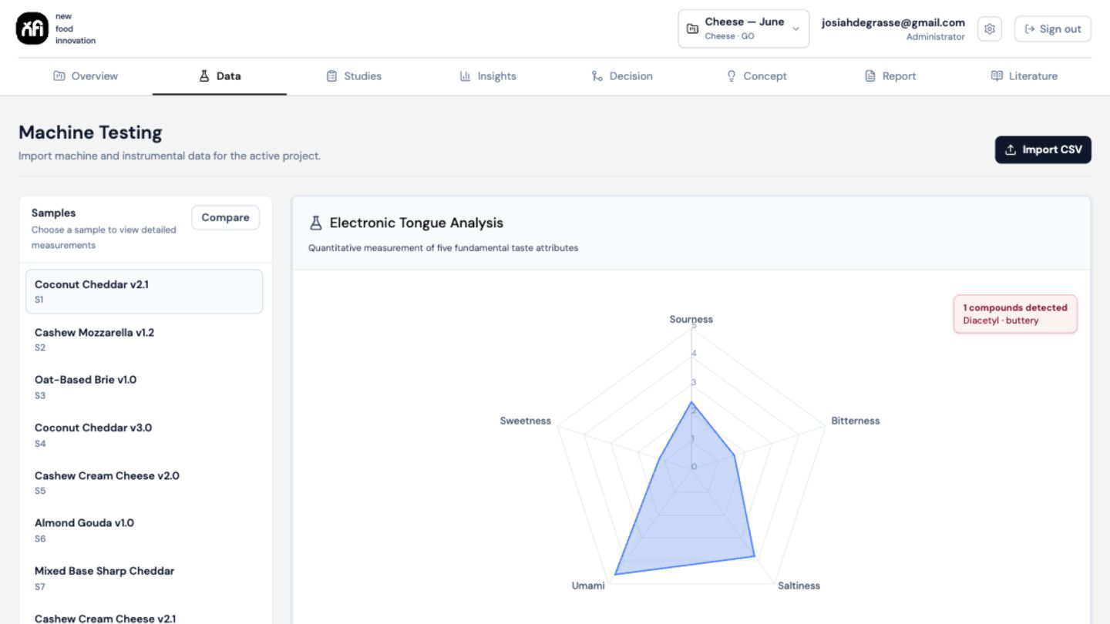
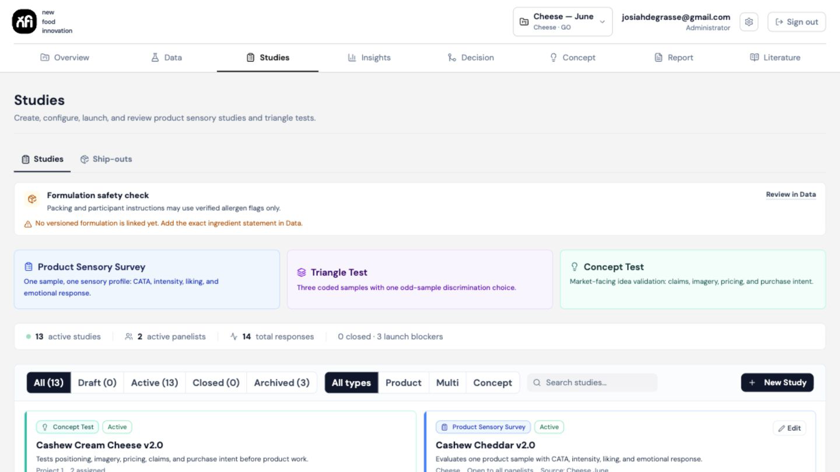
BUILD THE EVIDENCE
Keep the sample identity intact from measurement to study
1 · Organise evidence by project and sample
2 · Configure the right study and eligible panel
Import technical data, retain version context and compare the correct prototypes.
Use sensory, triangle or concept studies with formulation and allergen-safety checks.
REPRESENTATIVE INTERFACE · ILLUSTRATIVE PROJECT DATA
Taste Intelligence · NFI sensory and consumer science hub
5
Notes:
For ingredient and food-development companies, emphasize sample lineage, formulation context, comparison and panelist eligibility. Avoid implying that software replaces the formal safety review.
[Sources]
- Internal product screenshots captured from the implemented Sensory Platform, 2026-08-19.
[/Sources]

Slide 6
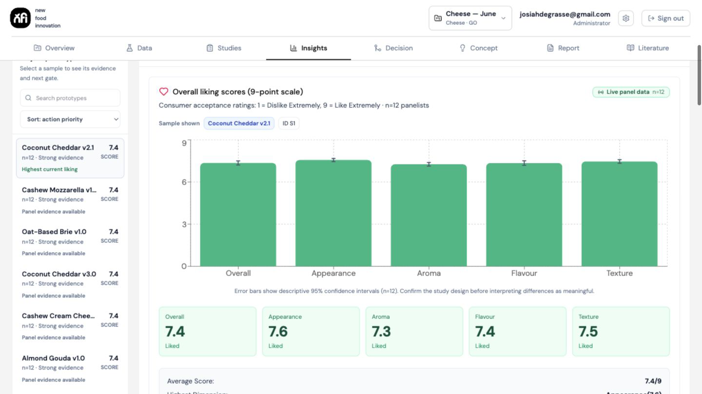
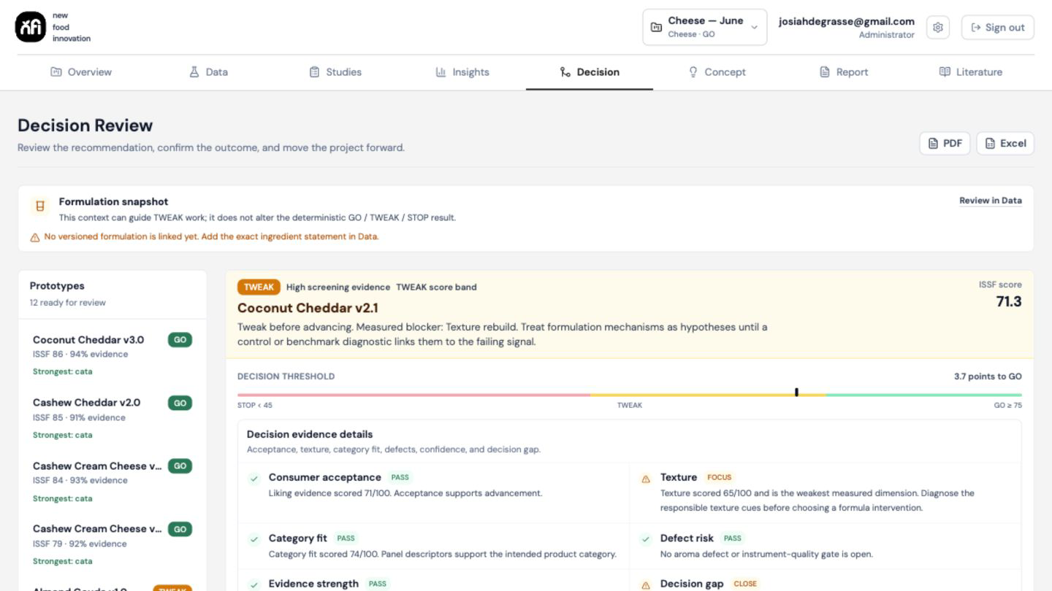
INTERPRET AND DECIDE
A recommendation that shows the evidence—and the gap
Understand what changed
Make the action explicit
Compare prototypes, inspect dimensions and keep uncertainty visible.
Record GO, TWEAK or STOP with method, confidence, evidence status and rationale.
REPRESENTATIVE INTERFACE · ILLUSTRATIVE PROJECT DATA
Taste Intelligence · NFI sensory and consumer science hub
6
Notes:
The score is not a black box. The decision view is intended to show the threshold, evidence strength and what remains incomplete before a reviewer confirms the decision.
[Sources]
- Internal product screenshots captured from the implemented Sensory Platform, 2026-08-19.
[/Sources]

Slide 7
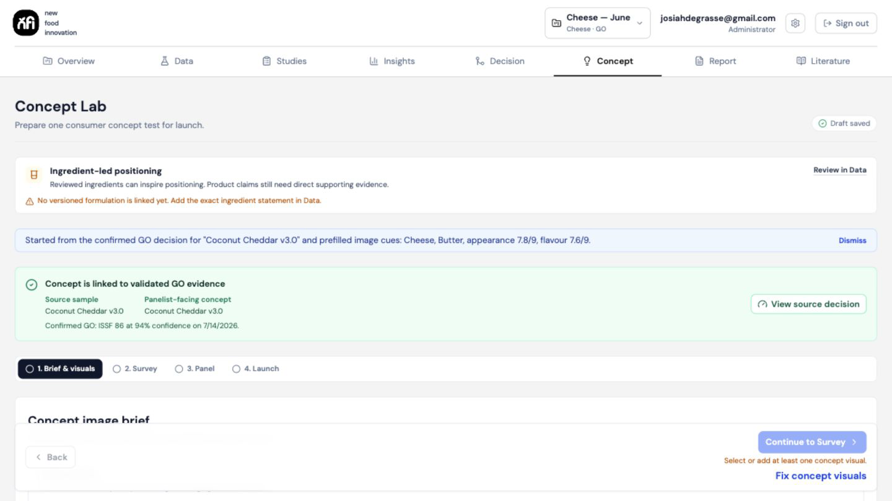
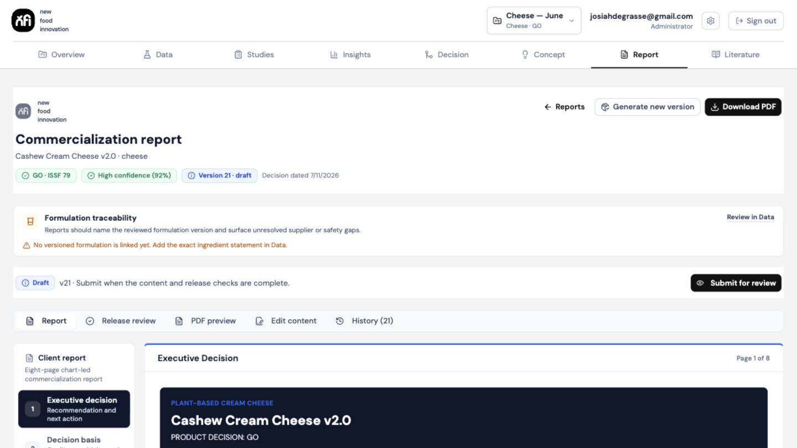
ACTIVATE THE DECISION
Move into concepts and reports without losing provenance
Concept work starts from an approved direction
Reports remain reviewable before release
Brief, stimulus, survey and panel remain linked to the confirmed product evidence.
Draft history, checks and PDF preview support a controlled hand-off to clients or decision-makers.
REPRESENTATIVE INTERFACE · ILLUSTRATIVE PROJECT DATA
Taste Intelligence · NFI sensory and consumer science hub
7
Notes:
Concept and report stages are gated by the confirmed decision. This prevents an attractive output from quietly outrunning the underlying evidence.
[Sources]
- Internal product screenshots captured from the implemented Sensory Platform, 2026-08-19.
[/Sources]

Slide 8
ILLUSTRATIVE BAKERY WORKFLOW
Turn an ingredient change into a customer-ready evidence story
Example question
01
Compare
Does the new ingredient system improve finished-product performance without compromising consumer acceptance?
Control vs new ingredient system
02
Diagnose
Identify drivers, penalties and evidence gaps
A practical study could connect formulation and instrumental evidence to blinded sensory comparison, liking, diagnostic attributes and an explicit advancement decision.
03
Decide
Advance, refine or stop with rationale
04
Communicate
Create a traceable customer-facing report
Outcome: a clearer next experiment and a more defensible technical-commercial conversation.
Taste Intelligence · NFI sensory and consumer science hub
8
Notes:
This is deliberately illustrative, not a claim about Cain Food Industries or any completed study. Tailor the product format and decision question during the first working session.
[Sources]
- Illustrative workflow derived from the platform capabilities and the user-supplied bakery-ingredient audience context.
[/Sources]

Slide 9
BUSINESS VALUE
One evidence base. Different value for each role.
FOOD & INGREDIENT COMPANY
INNOVATION ADVISER OR COMMERCIAL PARTNER
Strengthen the decision behind the product
Make the recommendation easier to act on
Compare prototypes and reformulations against a defined control
Structure discovery around the decision that must be made
Connect ingredient performance to the finished product experience
Connect technical performance with sensory and consumer relevance
Give internal teams and customers a traceable evidence story
Keep stakeholder conversations anchored to the evidence
Focus the next experiment on the most important uncertainty
Translate findings into practical product and market next steps
Taste Intelligence · NFI sensory and consumer science hub
9
Notes:
For Alessandro, lead with ingredient performance, finished-product evidence and customer conversations. For Mike, lead with structured discovery and actionable innovation recommendations.
[Sources]
- Audience roles supplied by the user; value framing derived from implemented platform capabilities.
[/Sources]

Slide 10
WHY TASTE INTELLIGENCE
More than a survey tool, dashboard or report generator
Not just data capture
Project, sample and formulation lineage stays attached to the evidence.
Designed for governed work
Not just a score
Thresholds, confidence, limitations and the human confirmation are visible.
Tenant and project separation
Not just AI output
Draft assistance remains grounded in approved evidence and controlled by review gates.
Sample and formulation provenance
Panelist allergen eligibility controls
Not just a final report
The report inherits the decision history, version context and source trail.
Decision and report audit trail
Review before concept or release
Taste Intelligence · NFI sensory and consumer science hub
10
Notes:
This is the differentiation slide. Do not position the product as replacing a sensory scientist or consultant. Position it as the operating and governance layer that makes expert work more consistent and traceable.
[Sources]
- Internal product architecture, safety controls and workflow gates.
[/Sources]

Slide 11
A PRACTICAL FIRST ENGAGEMENT
Start with one live product question—not a platform rollout
YOU BRING
NFI CONFIGURES
TOGETHER YOU LEAVE WITH
A current product or ingredient question
A focused evidence workflow
A usable decision package
Samples or formulations
Project and sample structure
Evidence summary
Existing technical evidence
Appropriate study and panel
Prioritised next action
The decision and audience
Review points and decision gate
Client-ready, reviewable report
The pilot scope, study design, timing and commercial terms are agreed around the real decision.
Taste Intelligence · NFI sensory and consumer science hub
11
Notes:
Invite the prospect to bring one current problem for a private working session. Do not promise a fixed timeline until the samples, study method, panel and evidence requirements are understood.
[Sources]
- Proposed pilot engagement model; timing and commercial terms intentionally left to scoping.
[/Sources]

Slide 12
Taste Intelligence
Bring one product question.
Build the evidence around the decision.
Next step: a private demonstration using a representative development question.
tasteintelligence.co.uk
tasteintelligences.com
Taste Intelligence · NFI sensory and consumer science hub
12
Notes:
Close on a specific ask: select one representative product-development question for a private demonstration or scoped pilot. The singular domain should be the primary public address; the plural domain can redirect.
[Sources]
- Domain ownership and audience context supplied by the user.
[/Sources]

