Slide 1

Taste Intelligence
Clearer evidence.
Stronger food decisions.
Connect technical, sensory and consumer evidence across one product-development journey.
An NFI sensory and consumer science hub
tasteintelligence.co.uk
Notes:
Open with the decision problem, not the software. Taste Intelligence is the working public name; the hub is backed by New Food Innovation.
[Sources]
- Internal product positioning: PRODUCT.md and the implemented Sensory Platform workflow.
- Hero image: AI-generated for this deck on 2026-08-19.
[/Sources]

Slide 2
Product-development evidence is often fragmented
Instrumental data, sensory results, consumer feedback and concept work are often reviewed in separate places.
Technical data
Instrument, composition and formulation evidence
Sensory studies
Attributes, liking, intensity and comments
That makes it harder to see why a product advanced, what changed between versions, and which question should be answered next.
Consumer learning
Concept, usage, price and purchase feedback
Commercial decisions
GO, TWEAK or STOP — and the rationale
When the evidence is disconnected, the decision becomes harder to explain, repeat and defend.
Taste Intelligence · An NFI sensory and consumer science hub
2
Notes:
Use examples the audience recognizes: spreadsheets, survey exports, lab reports and separate concept decks. Do not imply that every company has the same systems problem.
[Sources]
- Internal workflow analysis based on PRODUCT.md and DESIGN.md; no external market claim.
[/Sources]

Slide 3
One journey keeps every decision in context
Data
Studies
Insights
Decision
Concept
Report
Bring in sample and technical evidence.
Choose the questions and safe panel.
See what the responses support.
Record GO, TWEAK or STOP.
Translate validated direction.
Create a traceable client output.
Each stage inherits the evidence that came before it.
The result is a clearer line from sample to commercial recommendation.
Taste Intelligence · An NFI sensory and consumer science hub
3
Notes:
Walk left to right. Emphasize that the workflow is connected but still human-reviewed: the platform organizes evidence and preserves decisions; it does not replace scientific judgment.
[Sources]
- Internal product workflow: PRODUCT.md and DESIGN.md.
[/Sources]

Slide 4
Evidence stays attached to every recommendation
Technical evidence
Sensory and consumer studies
Import instrumental, composition and formulation information against the correct sample and project.
Configure the right questions, select safe eligible panelists, and monitor responses without losing sample identity.
Decision discipline
Commercial output
Make the GO, TWEAK or STOP rationale explicit, with method, confidence and evidence limitations visible.
Carry validated product direction into concepts, consumer testing and client-ready commercialization reports.
Taste Intelligence · An NFI sensory and consumer science hub
4
Notes:
This is the capability slide. Keep it outcome-led: the benefit is evidence continuity, not simply having four software modules.
[Sources]
- Internal capability summary derived from implemented Sensory Platform features.
[/Sources]

Slide 5
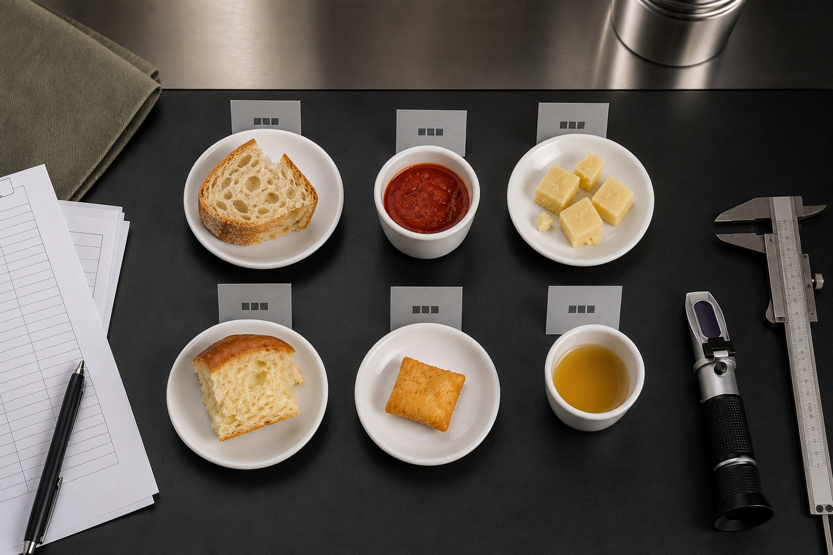
Built around the questions food developers need to answer
Did the reformulation improve the product?
Which attributes are driving liking or rejection?
Is the evidence strong enough to advance?
What should we test or change next?
Taste Intelligence · An NFI sensory and consumer science hub
5
Notes:
For Alessandro, connect this slide to ingredient performance in the finished bakery system: compare versions, understand the sensory effect and create evidence that supports customer conversations.
[Sources]
- Questions reflect the implemented decision and study workflow; no outcome claim.
- Supporting image: AI-generated for this deck on 2026-08-19.
[/Sources]

Slide 6
Useful from ingredient development to market innovation
For food and ingredient companies
For innovation advisers and commercial partners
Compare prototypes and reformulations against a clear control.
Structure product and market discovery around a decision.
Show how an ingredient changes the finished product experience.
Connect technical evidence to consumer relevance.
Coordinate technical, sensory and consumer evidence.
Focus stakeholder conversations on what the evidence supports.
Build a stronger evidence story for internal and customer decisions.
Develop practical next steps without losing the original context.
One evidence base. Different decisions for each stakeholder.
Taste Intelligence · An NFI sensory and consumer science hub
6
Notes:
For Mike, focus on how a structured evidence journey improves market-innovation discussions across his network. The hub can support advisory work without presenting the technology as the adviser.
[Sources]
- Audience framing supplied by the user; product value derived from internal capabilities.
[/Sources]

Slide 7
Start a focused pilot with one live question
Define
Test
Decide
Choose the product, the decision to make and the evidence already available.
Connect the data, design the study and gather the right sensory or consumer response.
Interpret the evidence, record the action and create a report that preserves the rationale.
Narrow enough to learn quickly. Real enough to matter.
Taste Intelligence · An NFI sensory and consumer science hub
7
Notes:
Invite the prospect to bring one current project rather than asking them to adopt an entire platform at once. Scope, timing and commercial terms should be agreed separately.
[Sources]
- Pilot structure is a proposed engagement model, not a performance promise.
[/Sources]

Slide 8
Taste Intelligence
Bring one product question.
Leave with a clearer decision.
Discuss a focused pilot or private demonstration.
tasteintelligence.co.uk
Taste Intelligence · An NFI sensory and consumer science hub
8
Notes:
Close on a specific next step: choose one product-development question for a private working session. The public address is tasteintelligence.co.uk; tasteintelligences.com can redirect to it.
[Sources]
- Domain ownership and hosting context supplied by the user.
[/Sources]

