Slide 1
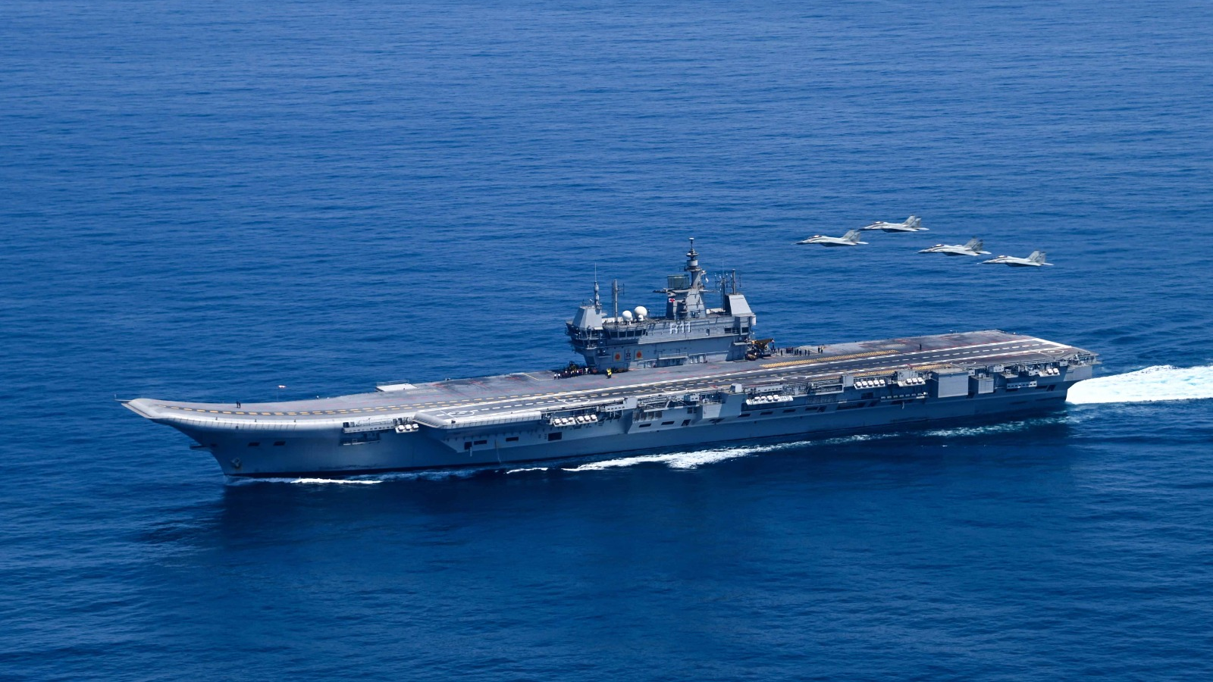
The Indian Navy:
Multi-Alignment or Shifting Alignments?
Josiah Gottfried

Slide 2
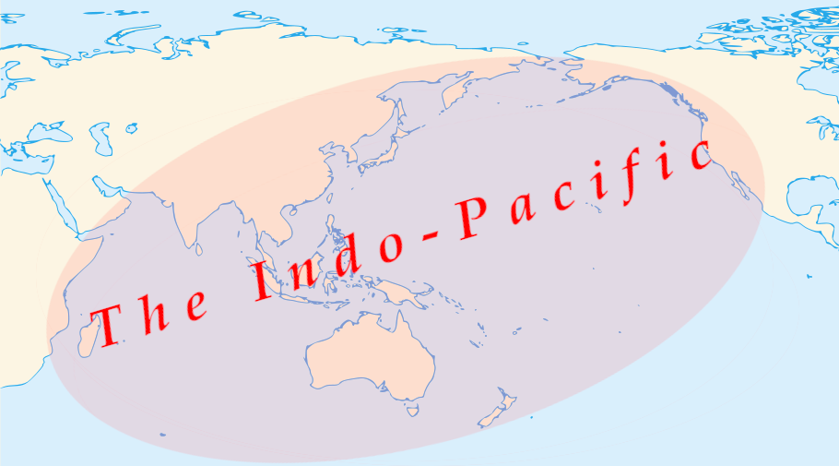

Slide 3
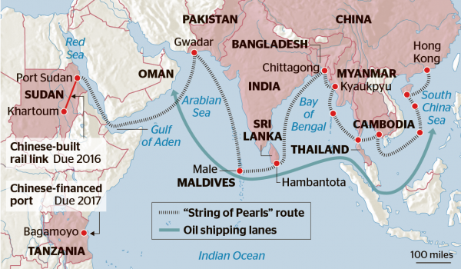
“String of Pearls” route
Oil shipping lanes
Image source: Khmer Times

Slide 4
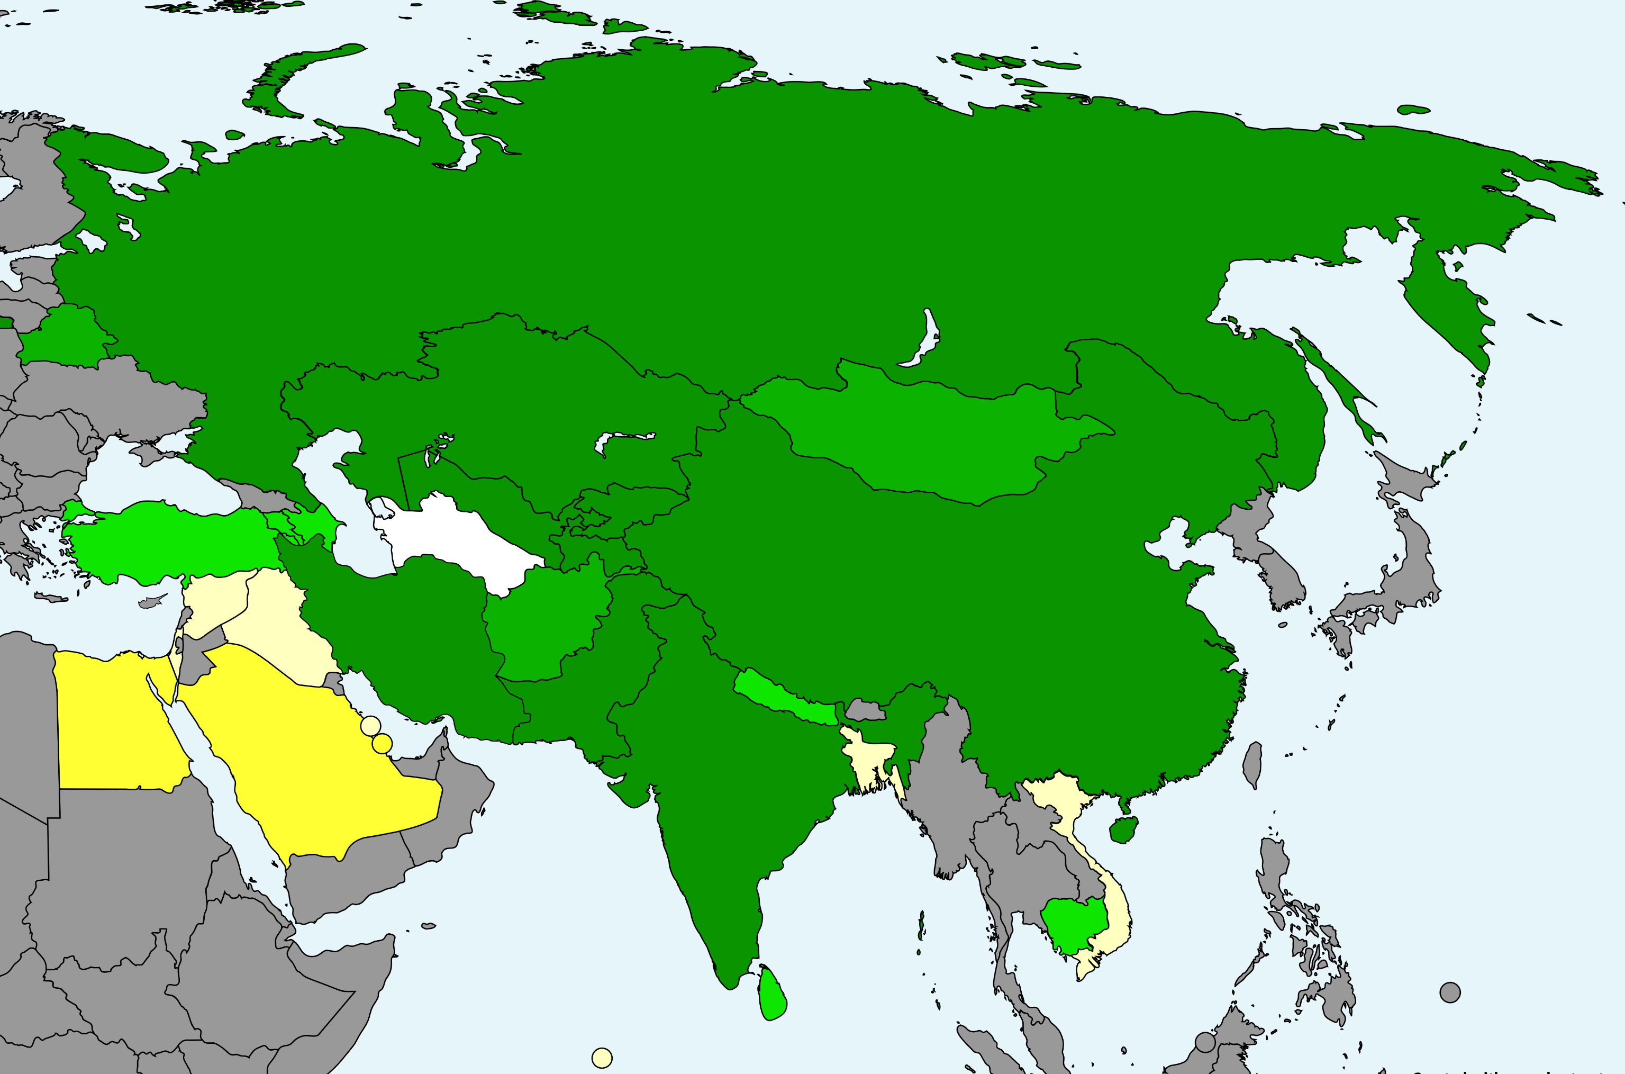
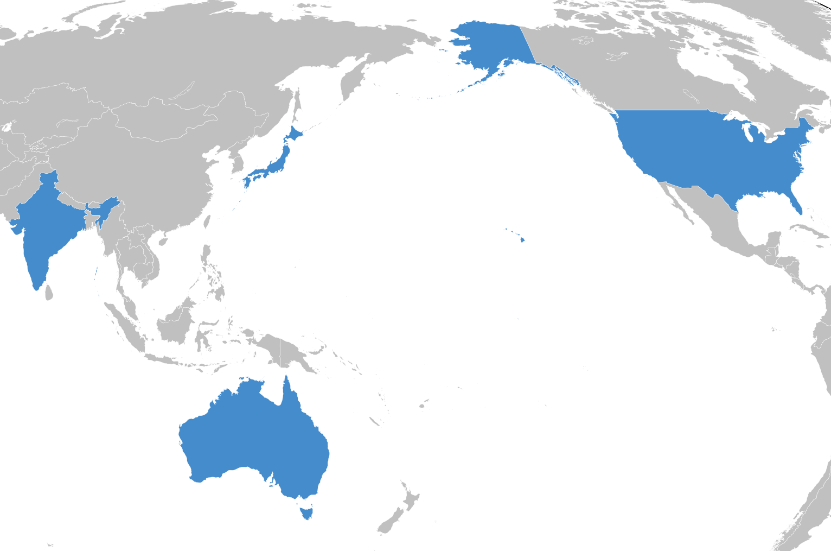
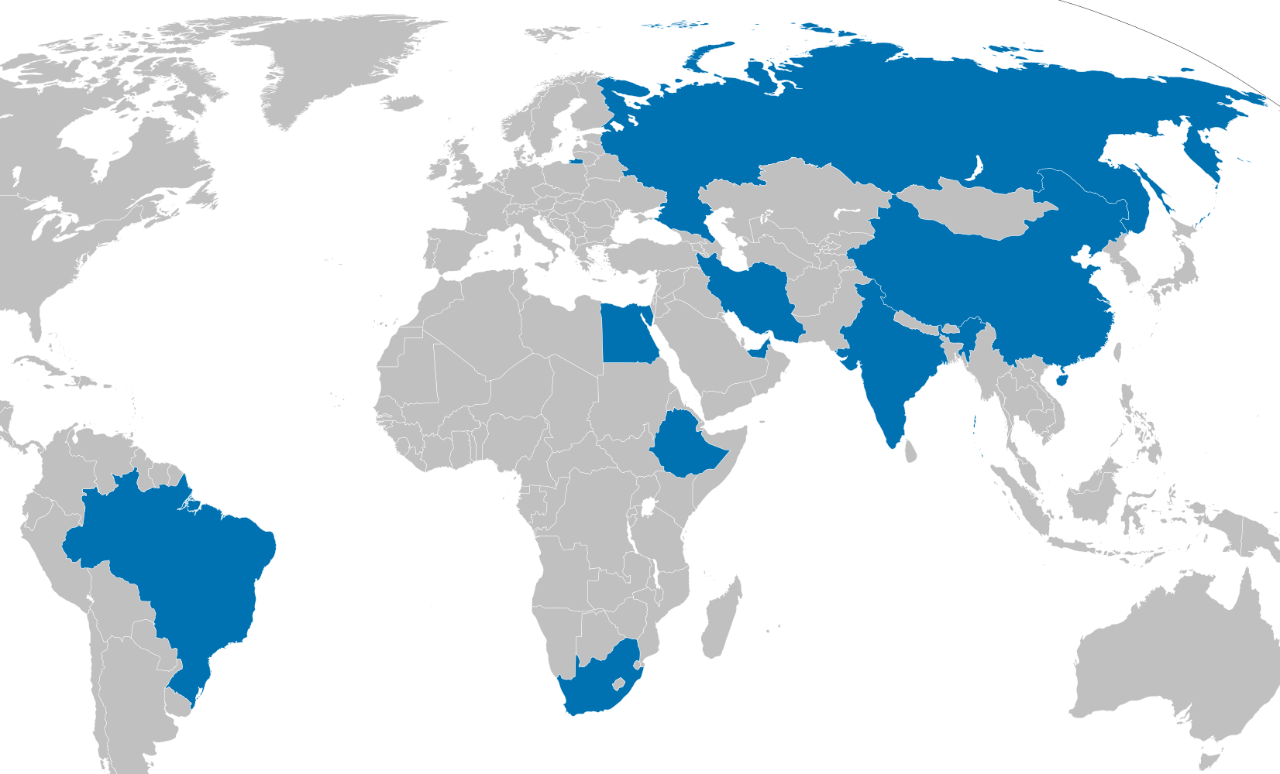
Multi-Alignment
SCO
A few international groupings that India participates in
Quad
BRICS
Image source: Wikimedia Commons

Slide 5
Research Questions
Is naval cooperation between India and members of the Quad increasing?
Is naval cooperation between India and Russia decreasing?
Is there a negative correlation between Indian naval cooperation with the Quad and Indian naval cooperation with Russia?

Slide 6
Data Sources
Naval arms purchases
  Data from Stockholm International Peace Research Institute
  Manually filtered for naval equipment
International joint naval exercises
  Data collected from press releases, news articles, official social media
  Institutionalized exercises, occasional exercises, passage exercises

Slide 7
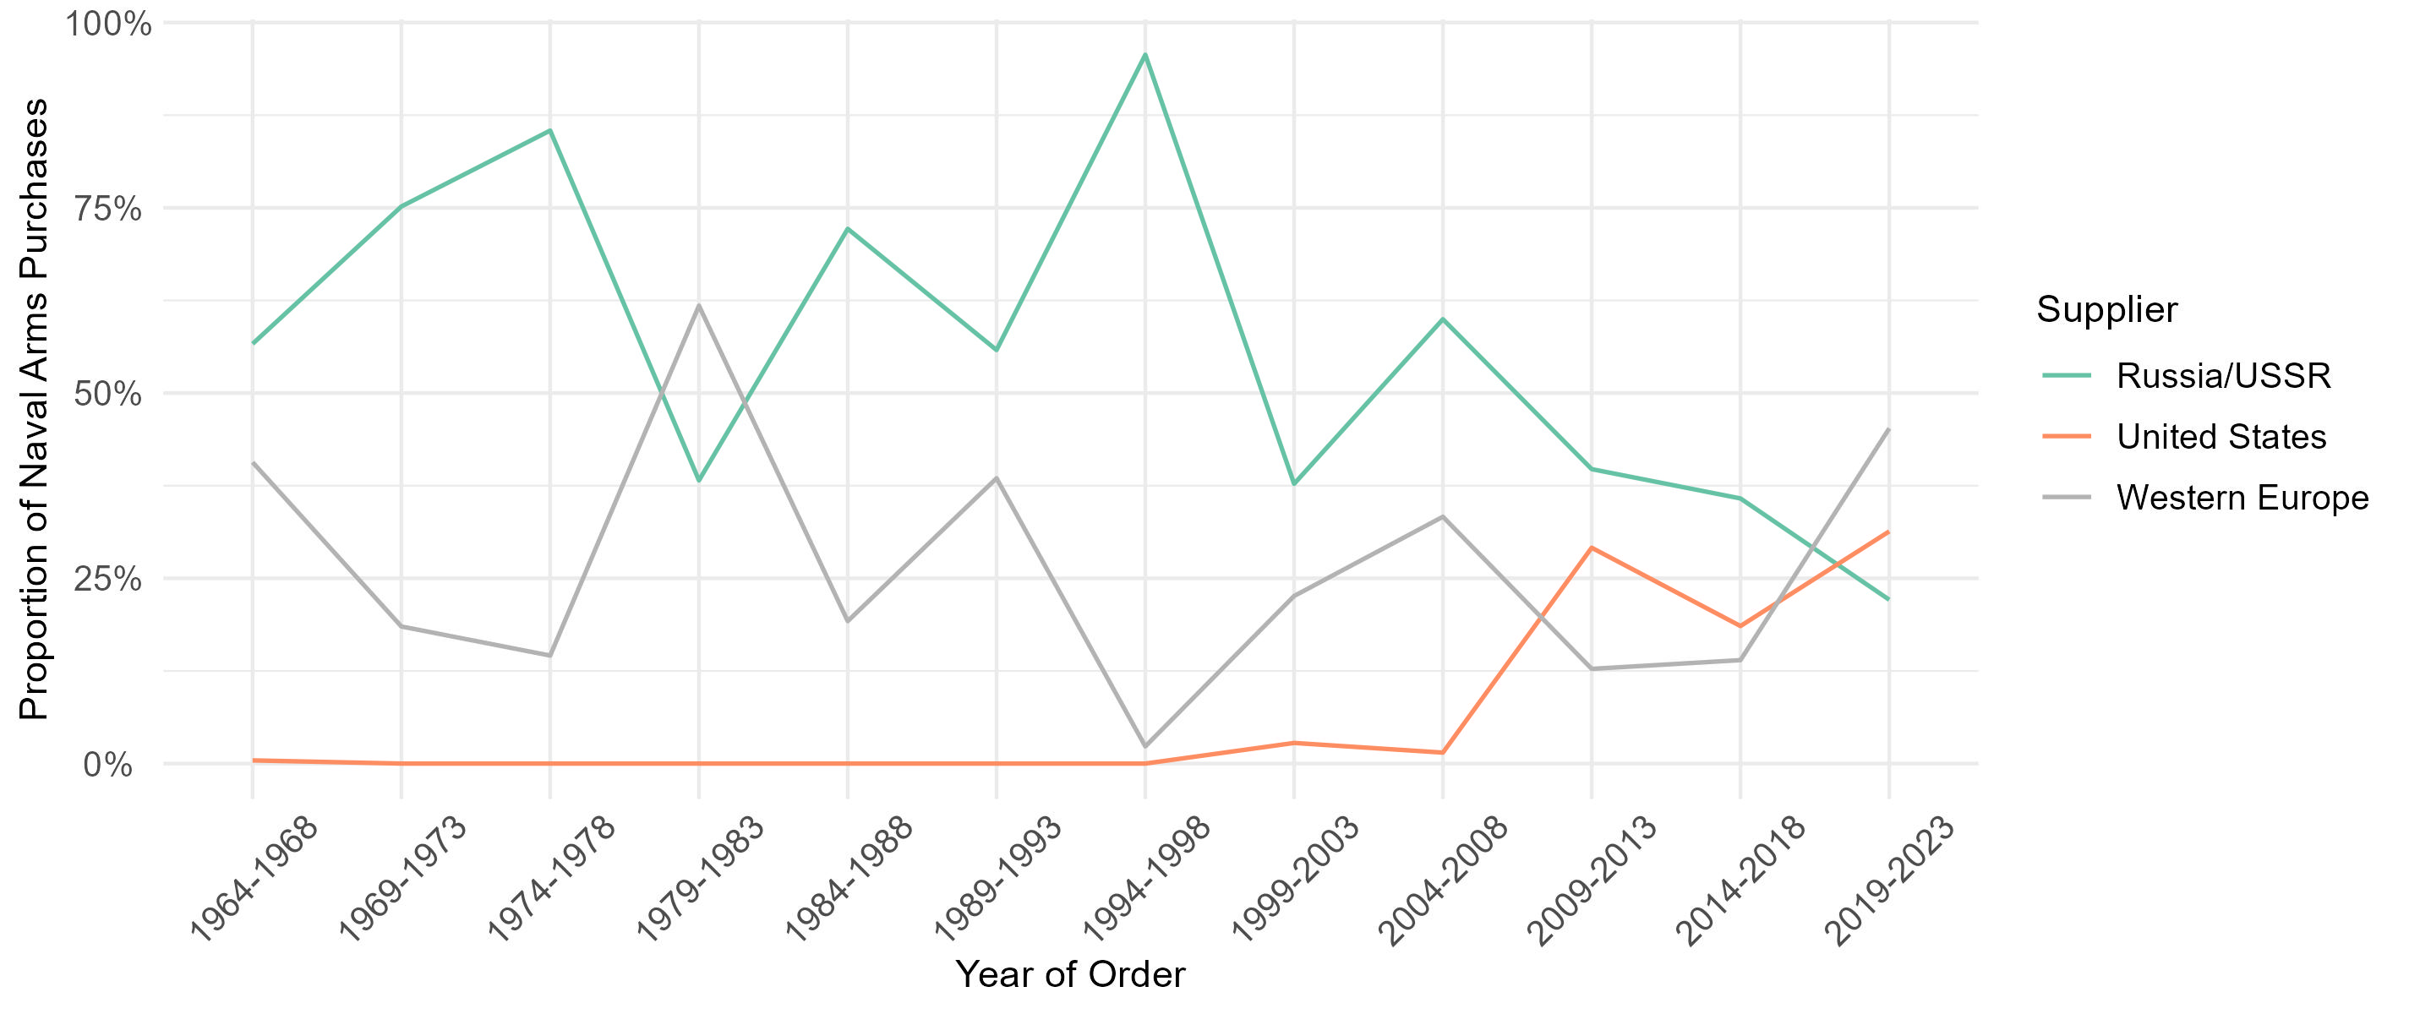
The Indian Navy’s Diversifying Suppliers (1964-2023)
Source: SIPRI. Arms Transfers Database, 11 March 2024. https://armstransfers.sipri.org/ArmsTransfer/

Slide 8
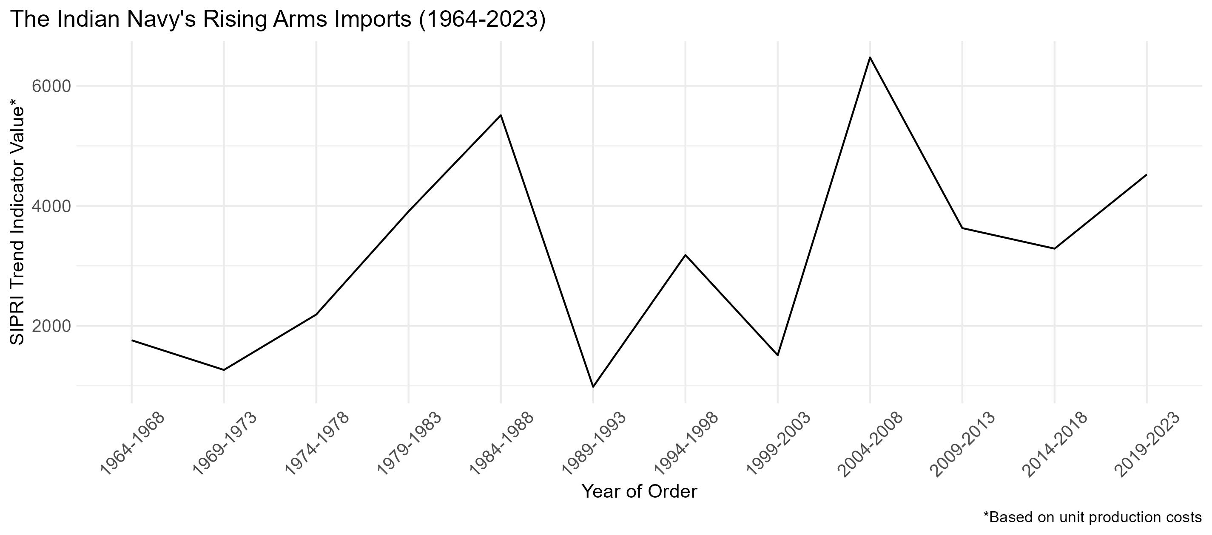
Naval Imports Have Not Declined Yet
Source: SIPRI. Arms Transfers Database, 11 March 2024. https://armstransfers.sipri.org/ArmsTransfer/

Slide 9
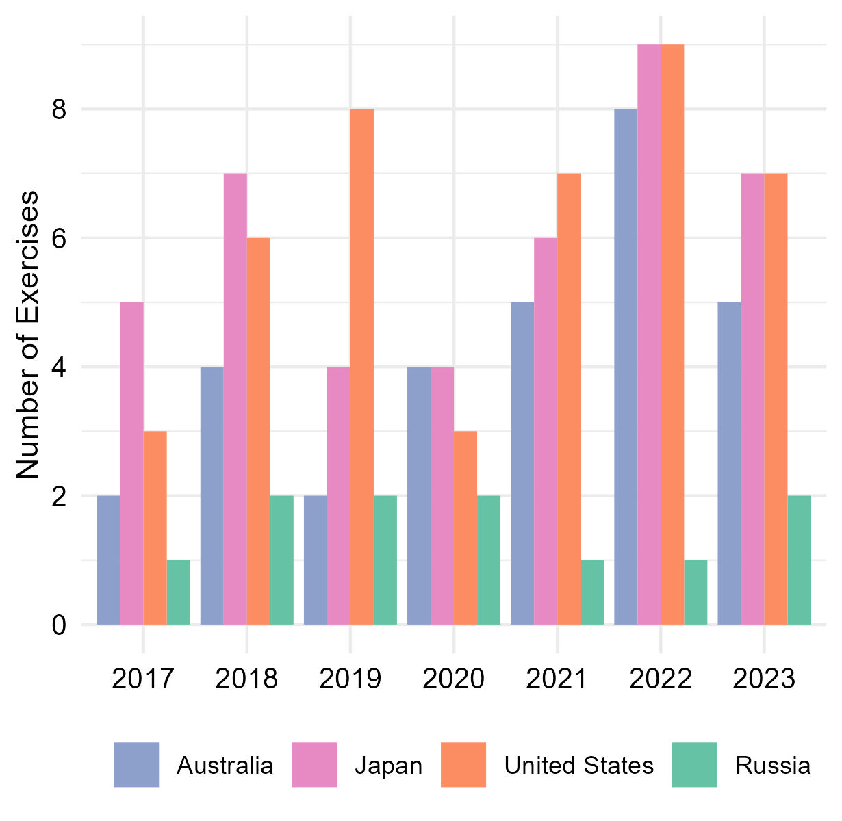
Exercises with Quad Up; Exercises with Russia Down
Exercise Malabar includes all four Quad partners since 2020
Regular bilateral exercises with each Quad partner
Increasing participation in “Quad+” exercises
Annual exercise INDRA with Russia not held since 2021
Indian Navy declined to participate in exercise Vostok 2022 with Russia
Source: Author’s count based on press releases, news articles, and official social media

Slide 10
Discussion
Cooperation with Russia down since Ukraine War
Cooperation with Quad partners increasing in quantity and dimensionality
Inverse correlation since Ukraine War
Factors inhibiting cooperation with Russia:
  Russia tied up with war
  Growing Russia-China alignment

Slide 11
Recommendations for India and the U.S.
Cooperate on indigenization
  U.S. should fast track export controls
  India should reduce restrictions on foreign defense investment
Establish a new bilateral exercise
  Multilateralization of Malabar reduces scope for bilateral cooperation
  Full-scope exercise would signal Quad strength and enable deeper cooperation
Continue to respect differing maritime alignments

