Slide 1
Object Oriented Programming Using C++
By: Apurva Kumar Singh

Slide 2
Contents
OOPS Concepts
- Class and Objects
- Encapsulation
- Abstraction
- Inheritance
- Polymorphism

Slide 3
Object Oriented Paradigm
Paradigm describes a system as it exists in real life based on interactions among real objects.
Application is modeled as collection of related objects that interact and do your work(task).

Slide 4
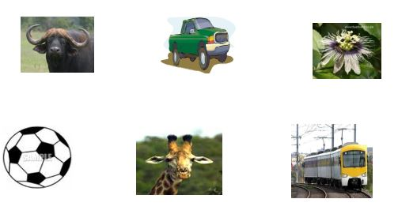
Classes And Objects
Object: Any Entity which possess attribute and behavior.
Example: Fan, Dog, Flower etc.

Slide 5
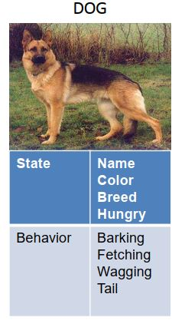
Cont…

Slide 6
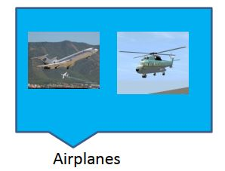
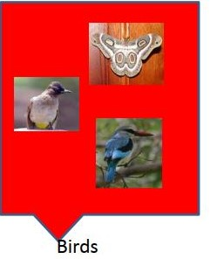
Classes
Collection of objects that share common attribute and behavior (functions).

Slide 7
Cont…
Classes are user defined data type based on which objects are created.
Class in C++ :
class person
{
char name[20];
int id;
public:
void getdetails(){}
};
int main()
{
person p1; // p1 is a object
}

Slide 8
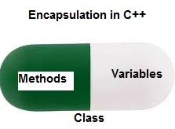
Data Encapsulation
In object oriented programming, Encapsulation is
Defined as binding together the data and the function
that Manipulates them.
Prevent access of private data members from outside the class.
Notes:
It is applicable in home offices or small offices.

Slide 9
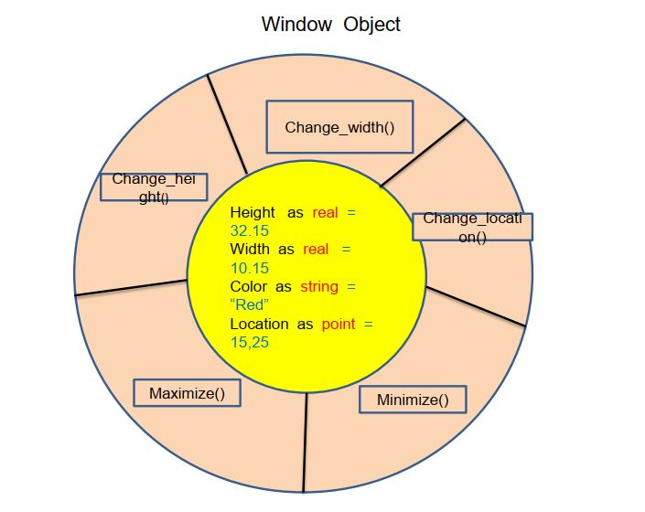
Cont…
Notes:
It is being used in large enterprises as one node dysfunction doesn’t hamper other’s work.

Slide 10
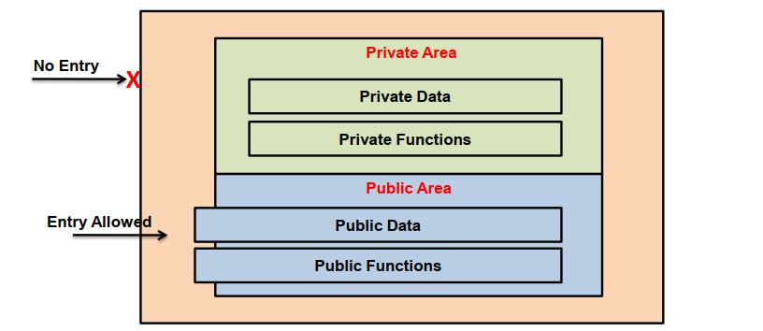
Cont…
Notes:
Most common example is IBM token Ring , which uses token to give privilege to the node for sending the data.

Slide 11
Cont…
#include<iostream>
using namespace std;
class Encapsulation
{
private:
int x;
public:
void set(int a)
{
x =a;
}
int get()
{
return x;
}
};
int main()
{
Encapsulation obj;
obj.set(5);
cout<<obj.get();
return 0;
}
Notes:
It is being used mainly as it provides redundancy as well as load balancing.

Slide 12
Data Abstraction
Hiding the complex detail.
Reveal only relevant to the context.
Implemented using Access Specifiers
private
Scope :- class boundary
protected
Scope :- class boundary + Inheritance
public
Scope :- class boundary + Inheritance + Object

Slide 13
Inheritance
an object of class acquires the properties of another class.
Parent / Super class - whose properties can be inherited.
Child / Sub class - who inherits the properties of class.
Types of Inheritance
Single
Multiple
Multilevel
achieves reusability
implemented using operator ':' with access modifiers [private , protected, public].

Slide 14
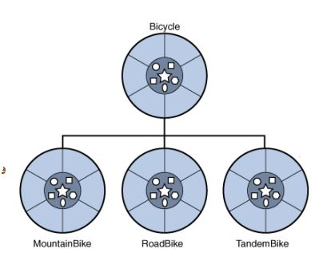
Cont…

Slide 15
Single Level Inheritance
Single inheritance is the one where you have a single base class and a single derived class.
Class Employee
It is a Base class (super)
Class Manager
it is a sub class (derived)

Slide 16
Multilevel Inheritance
Class A
it is a Base class (super) of B
Class B
it is a sub class (derived) of A
and base class of class C
Class C
derived class(sub) of class B

Slide 17
Example
class Person {
private int aadharNo;
protected char[] name;
protected char[] address;
public void showID()
}
class Teacher : public Person {
private int employeeNo ;
private char[] subjectsTaken;
private int experience;
public int getexpertiseSubject();
}
class Student : public Person {
private int rollNo ;
private char [] marks;
private float height;
private Attendences attendences;
public float calculatePercentage()
public int getAttendOfMonth(Month)
}

Slide 18
Multiple Inheritance
In Multiple inheritances, a derived class inherits from multiple base classes. It has properties of both the base classes.
Class A
Class B
Base class
Class C
Derived class

Slide 19
Hierarchical Inheritance
In hierarchical Inheritance, it's like an inverted tree. So multiple classes inherit from a single base class. It's quite analogous to the File system in a unix based system.
Class A
Class B
Class D
Class C

Slide 20
Cont…
Following are the things which a derived class inherits from its parent -
Every data member defined in the parent class (although such members may not always be accessible in the derived class!)
Every ordinary member function of the parent class (although such members may not always be accessible in the derived class!)
The same initial data layout as the base class.
Following are the things which a derived class doesn’t inherits from its parent :
- The base class’s constructors and destructor.
- The base class’s friends

Slide 21
Polymorphism
Polymorphism (from Greek, meaning ‘many forms’) is a feature that allows same interface (method name) to be used for a multiple class of actions depending on context.
Function overloading and Operator overloading.
Function overloading : more than one function with same name but implements different action by varying parameters or type in function.
Operator overloading : same operator perform different functionality by differentiate the type of arguments.
Types of Polymorphism :
Compile time : - Function or Operator overloading.
Runtime :- Function overriding

Slide 22
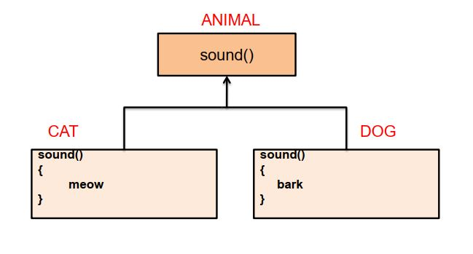
Cont…

Slide 23
Example
class MultiBehaviour
{
// function with 1 int parameter
public void func(int x)
{
cout << "value of x is " << x << endl;
}
// function with same name but 1 double parameter
void func(double x)
{
cout << "value of x is " << x << endl;
}
// function with same name and 2 int parameters
void func(int x, int y)
{
cout << "value of x&y is " <<x<<","<<y<< endl;
}
}

Slide 24
Cont…
int main() {
MultiBehaviour obj1 = new MultiBehaviour() ;
// Which function is called will depend on the parameters passed
// The first 'func' is called
obj1.func(7);
// The second 'func' is called
obj1.func(9.132);
// The third 'func' is called
obj1.func(85,64);
return 0;
}

Slide 25
Function Overriding
It is the redefinition of base class function in its derived class with same signature i.e. return type and parameters.
It can only be done in derived class.

Slide 26
