Slide 1
OPUS
Offline Patient Uploading Software

Slide 2
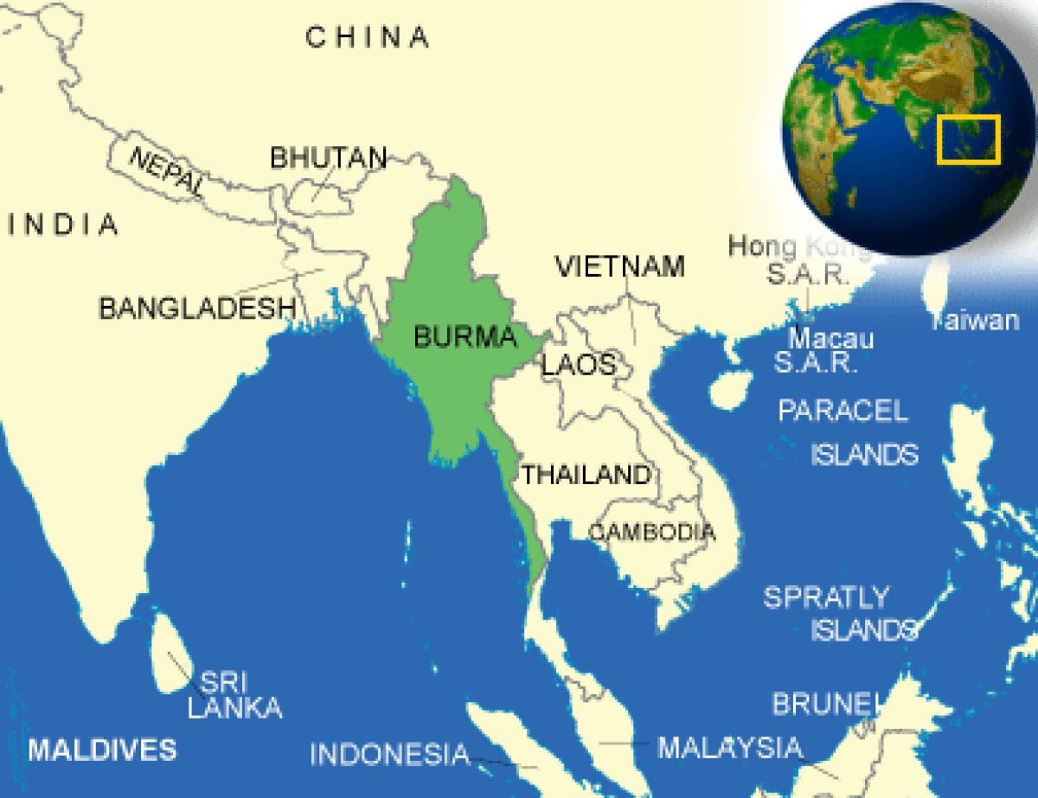

Slide 3
Vision
-Remote Doctors
-Medical Information Tracking
-Offline Use

Slide 4
User Stories
Add and Store new Patient
Add a Visit Form for Patient
View Existing Patients and Forms
Upload/Download Patient Information

Slide 5
Demo

Slide 6
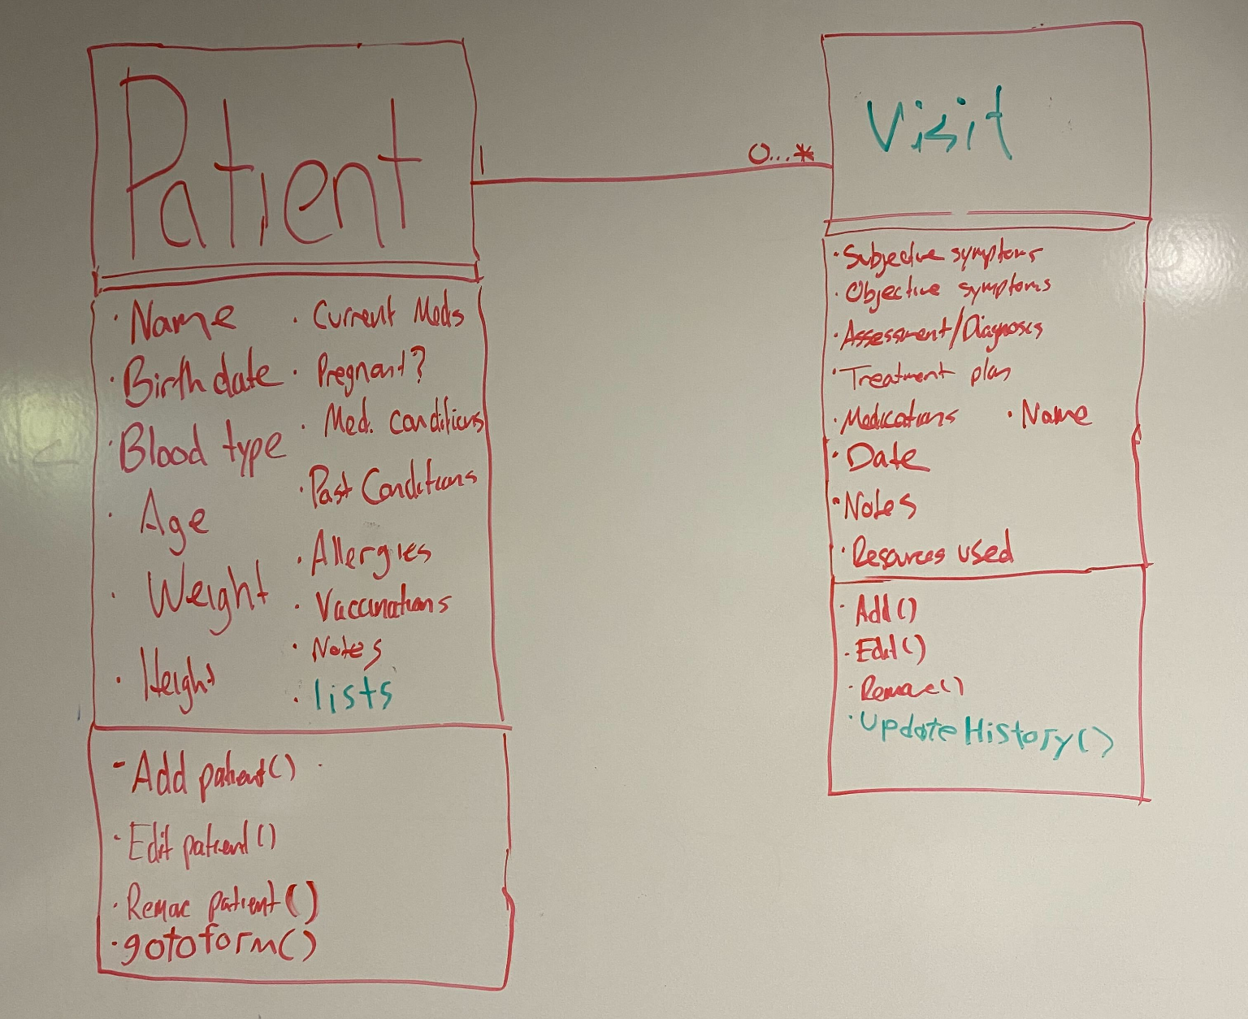
Domain Model

Slide 7
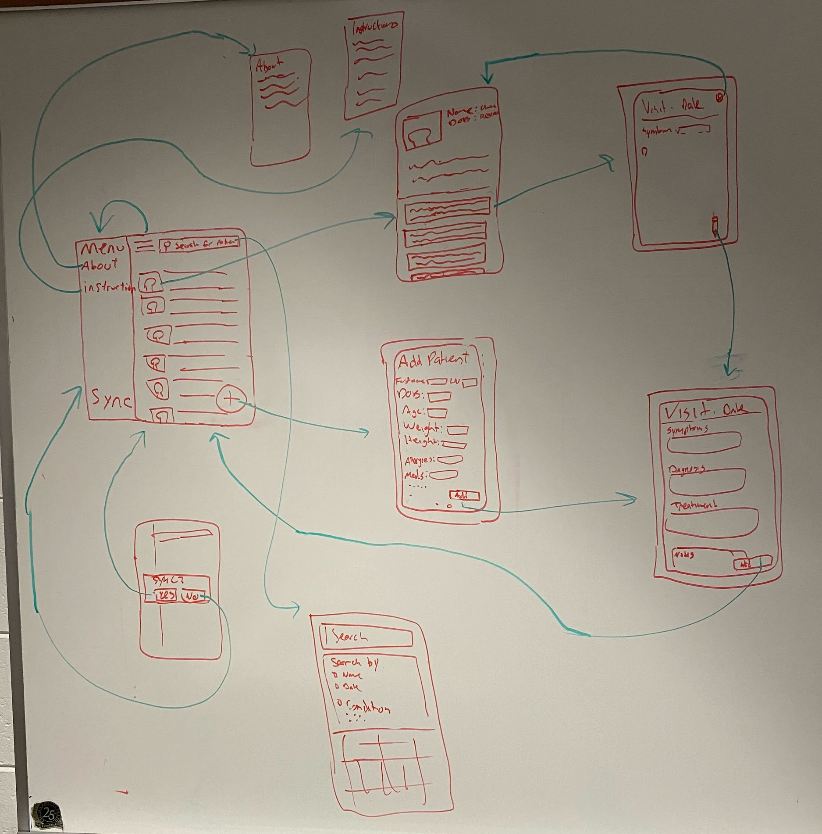
UI Model

Slide 8
Information Systems Design
Patient
Registration Number
Name
Sex
Date of Birth
City
Region
Ethnicity
Language
Visit
ID
Visit Date
Patient
Doctor
Student
Primary Diseases
Secondary Diseases
Discharge Date
Notes

Slide 9
Coming Soon...
-Upload/Download (Requires Database)
-Search Patient Feature
-Edit patient/visit

Slide 10
Questions?

