Slide 1
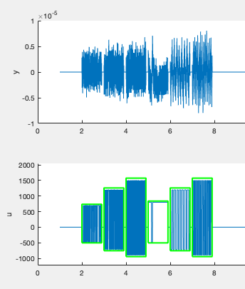
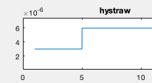
6 different sections of data
1 has bad data (section 4)

Slide 2
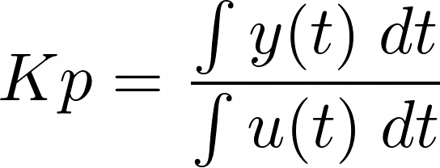
Standard method to estimate Kp with biased relay:
Sensitive to integration windows
Sensitive to sensor bias in y(t)
In PCS, y(t) periodically reset to account for sensor drift ==> erases the steady state response!
Result: Kp variation factor of 10-100, positive and negative

Slide 3

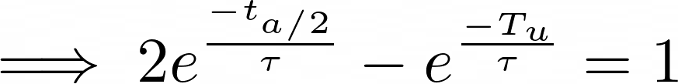
0
For D << tau, D is measurable directly from time series.
Kp and tau unknown
Not sensitive to systemic bias in the measurement of y(t)

Slide 4
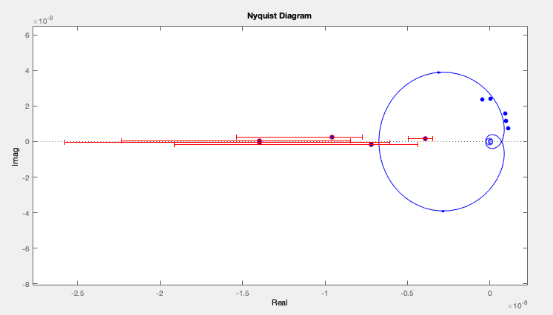
Zero midpoint
Growth rate = 1/tau
Fitted: 41 Hz Range: 24 – 43 Hz
Wang (NF), d3d: 13 – 44 Hz
Kp: -6.7313e-09
tau: 0.024016
D: 0.0042434
Gains at the ultimate frequency for the (5) mini-xp time windows
Estimated steady state gains

Slide 5
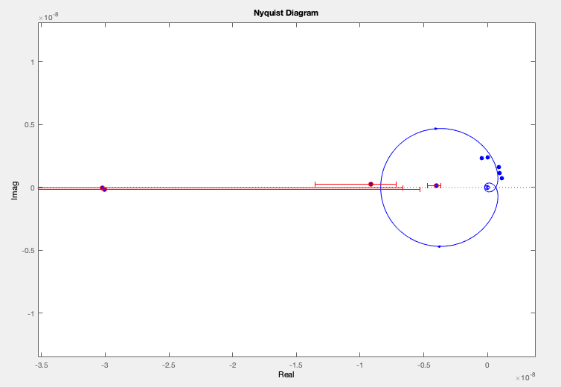
Floating midpoint
Growth rate = 1/tau
Fitted: 31 Hz
Kp: -8.0644e-09
tau: 0.03195
D: 0.0038374

Slide 6
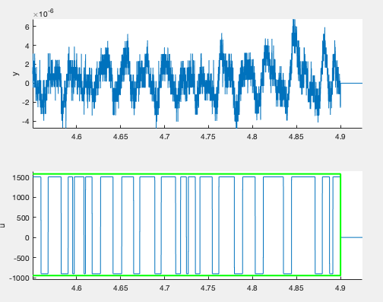
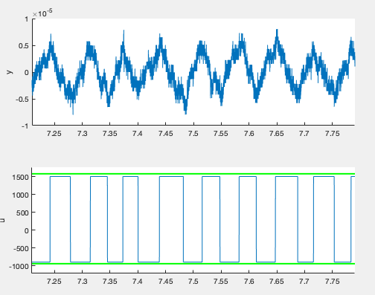
Noise in Kp estimates associated with noisy relay switching (relay hysteresis too low)

Slide 7
Tau is sensitive to measurements of t_(a/2)
However, t_(a/2) is measured every relay feedback cycle.
Can find confidence intervals, mini-xp window length to achieve specified accuracy

Slide 8
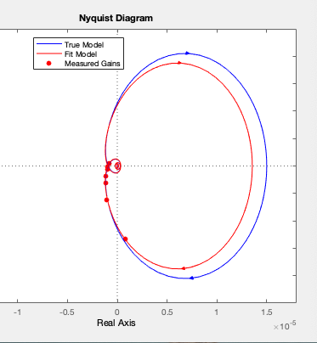
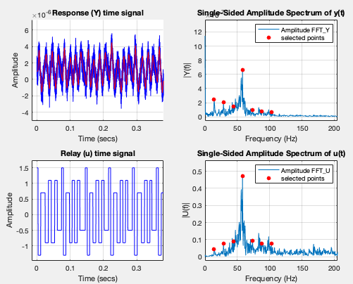
Fit will improve with parasitic relays
2 parasites with toy model, similar parameters to plasma
Excites low frequencies, can possibly use in place of measuring Kp

