Slide 1
Nominal Model
Kp = 1e-4
Tau = 0.003 – 0.1
D = 0.003
From Z. Wang, instabilities at 13Hz, R. Shousha 300 Hz (prelim analysis) ➔ tau = .003 to .077

Slide 2
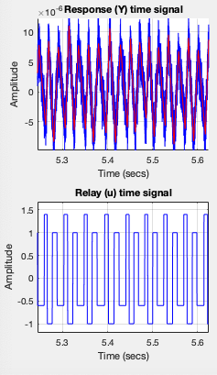
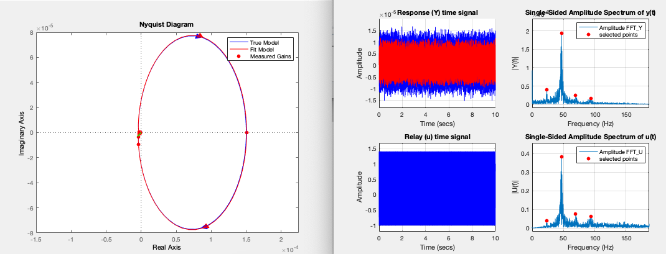
Nominal Model, Noise Ratio = 0.41
Kp = 1.5e-4
Tau = 0.1
D = 0.003
Fit Parameters (nonlinear wt least-squares to fopdt), Initial starting guess from DF theory
Kp = 1.50569e-4
Tau = 0.09997
D = 0.003066

Slide 3
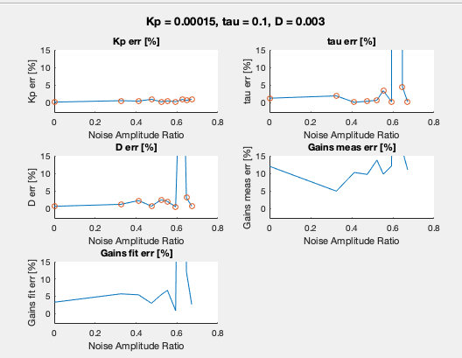
Noise Scan
Hysteresis = 4*mean( abs( noise)) to avoid false switching
Fits the model well with ~ 5% error – until it doesn’t! (n2 = 0.6).
Later sims have false switching (could explain improvement with noise)

Slide 4
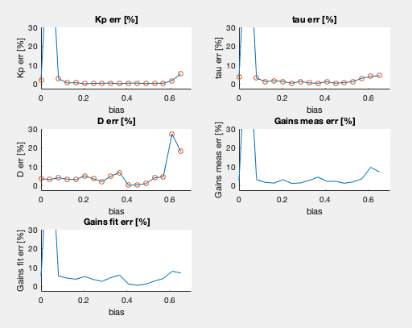
Bias Scan
Nominal Parameters:
Kp = 1.5e-5, tau = 0.03, D = .003, hyst = 1.7e-6 (30deg), noise_ratio = 0.3
Fails dramatically for bias > 0.65 (i.e. finding the wrong frequencies to fit transfer function)

Slide 5
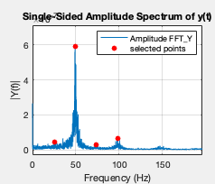
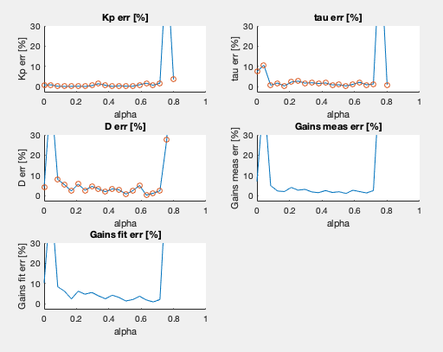
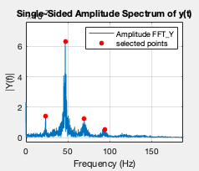
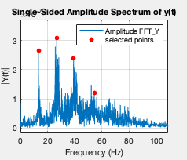
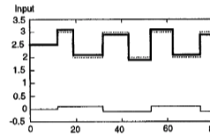
Alpha Scan
alpha = 0.05
alpha = 0.3
alpha = 0.7
Alpha := magnitude of parasite relay / magnitude base relay

Slide 6
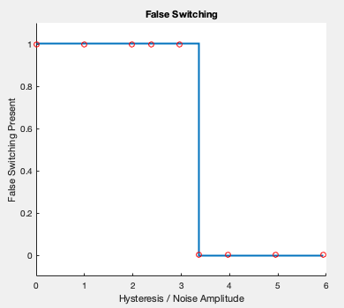
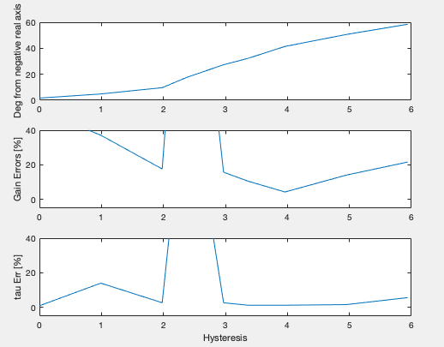
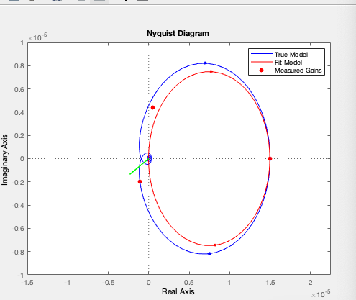
Hysteresis Scan
noise_power = 2e-17;
Kp = 1.5e-5;
tau = 0.03;
D = .003;
h = 1;
alpha = 0.25;
bias = 0.25;
hysteresis/noise = 6 (significant gain errors)

Slide 7
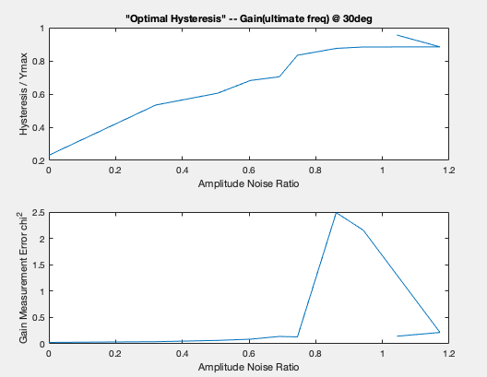
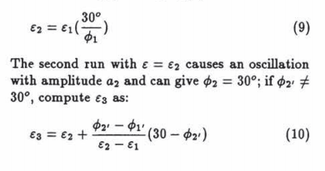
Finding “optimal” values of hysteresis
following (need D > 0.003) “Scali and Cosaggiu, Relay with hysteresis”
Linear dependence of optimal hysteresis vs amplitude noise ratio := N2
Kp = 1.5e-4, tau = 0.1, D = .01

Slide 8
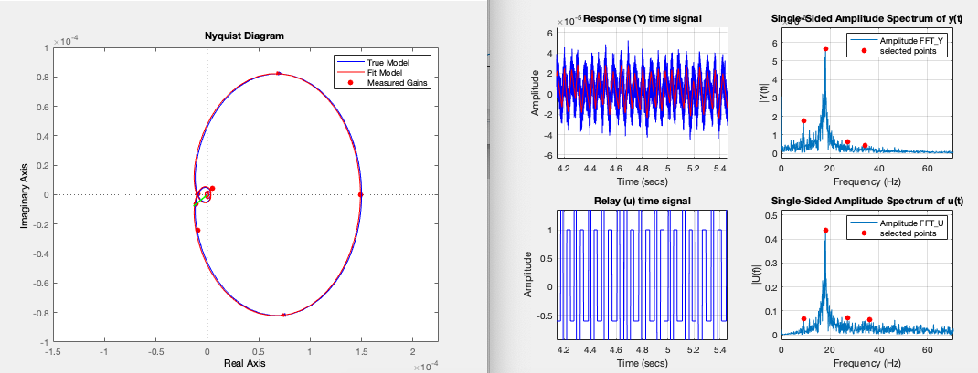
Kp = 1.5e-4, tau = 0.1, D = .01
Noise Amplitude Ratio = 0.6
Reliably find ultimate frequency fu, and 0.5*fu, often 1.5*fu depending on noise

Slide 10
SENSOR BIAS ISSUES
Kp estimate sensitive to sensor bias
Kp = int(ydt) / int(udt)

