Slide 1
Millimeter-Wave Near-Field
SAR Imaging
3D MIMO-SAR Imaging
3D Simulation Toolset
Muhammet Emin Yanik and Murat Torlak
Department of Electrical & Computer Engineering
The University of Texas at Dallas
(muhammet.yanik@utdallas.edu)

Slide 2
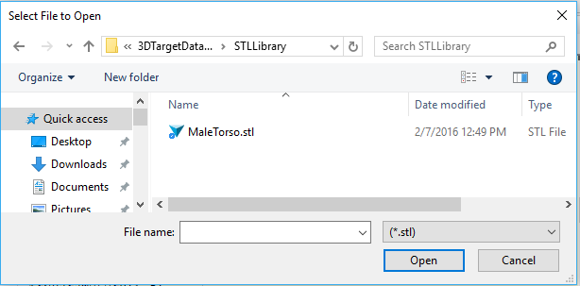
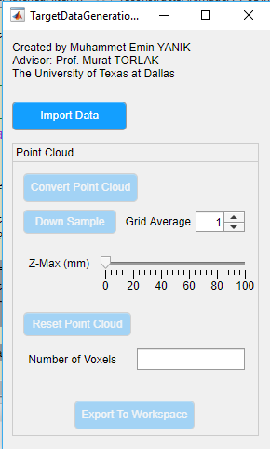
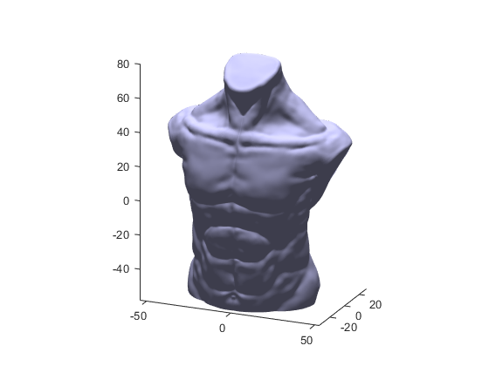
3-D SAR Simulation GUI
STL object to SAR simulation tool
Import STL object to MATLAB

Slide 3
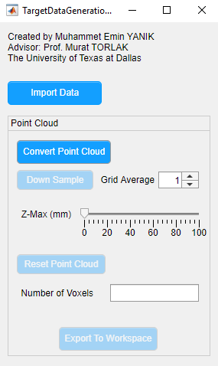
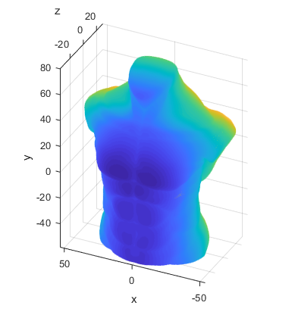
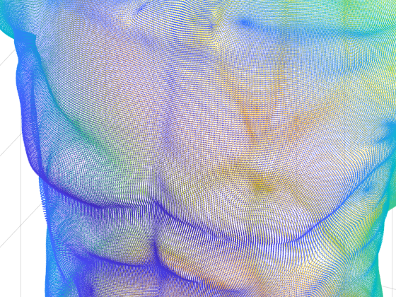
3-D SAR Simulation GUI
STL object to SAR simulation tool
Convert to point cloud
Get voxel data

Slide 4
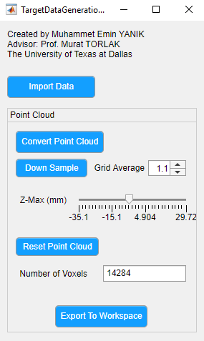
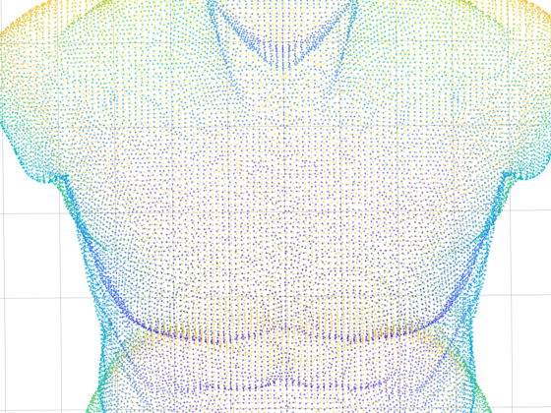
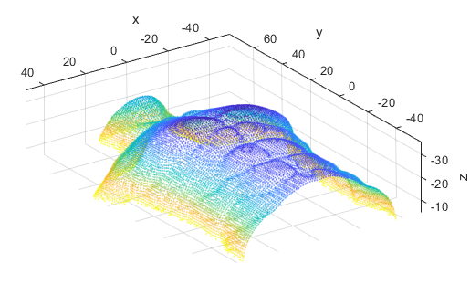
3-D SAR Simulation GUI
STL object to SAR simulation tool
Downsample
Define Range of Interest (crop z-axis)
Reduce number of voxels

Slide 5
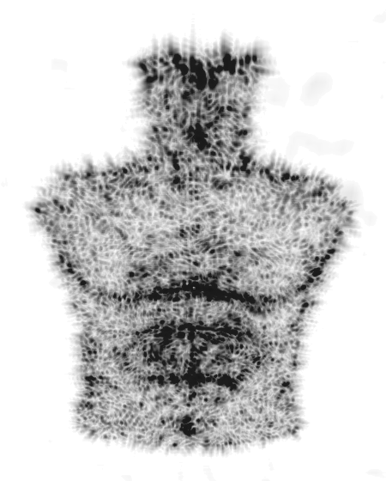
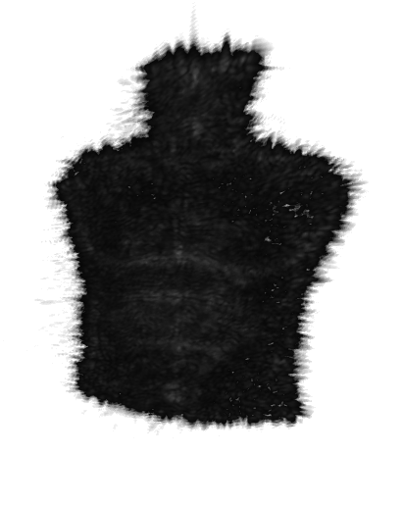
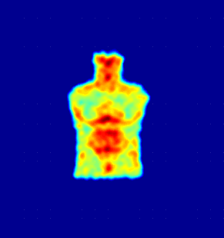
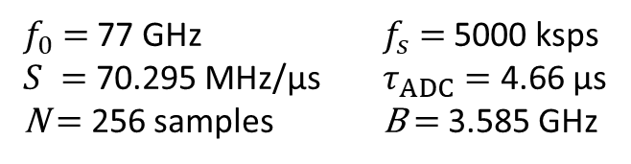
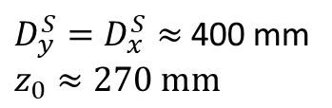
3D MIMO-SAR Simulations
Array configuration: IWR1443-Boost, 2Tx, 4Rx
$f_{0}$ $=$ 77 GHz $f_{s}$ $=$ 5000 ksps
$S =$ 70.295 MHz/µs $τ_{ADC}=$ 4.66 µs
N $=$ 256 samples B $=$ 3.585 GHz
${D_{y}^{S}=D}_{x}^{S}≈$ 400 mm
$$z_{0}≈270 mm$$
MIP
Volume rendering
MIP (Jet)

Slide 6
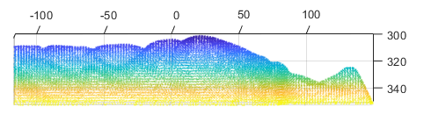
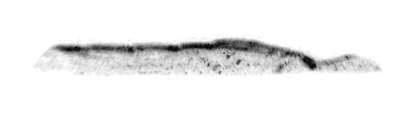
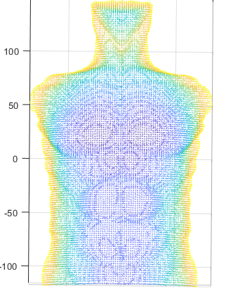
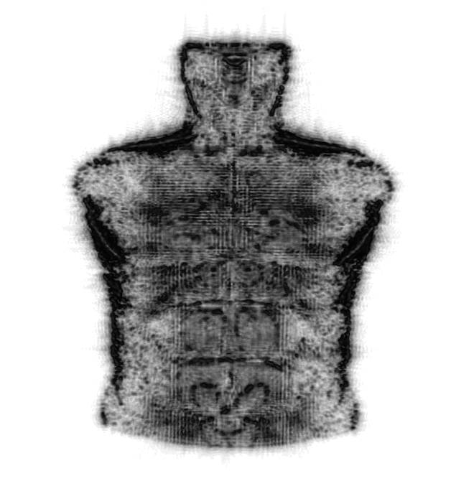
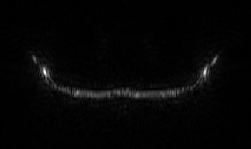
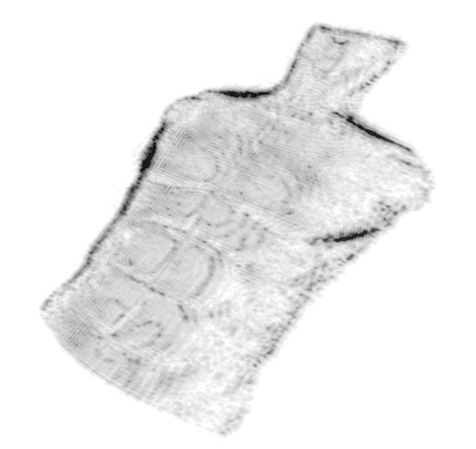
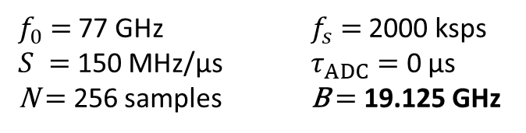
Effect of Bandwidth
Same SAR parameters, larger bandwidth:
$f_{0}$ $=$ 77 GHz $f_{s}$ $=$ 2000 ksps
$S =$ 150 MHz/µs $τ_{ADC}=$ 0 µs
N $=$ 256 samples B $=$ 19.125 GHz
Point cloud
y-z view
3-D Volume Image
x-z slice
MIP

Slide 7
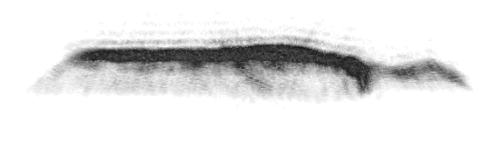
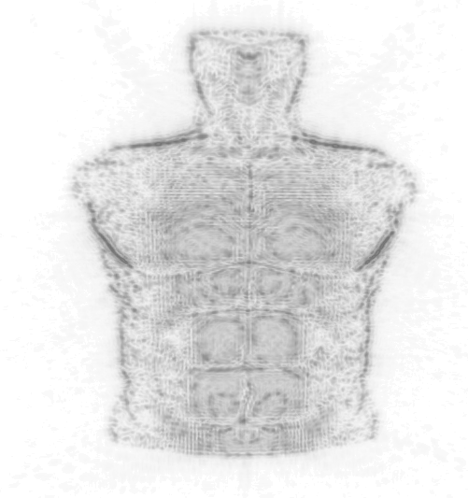
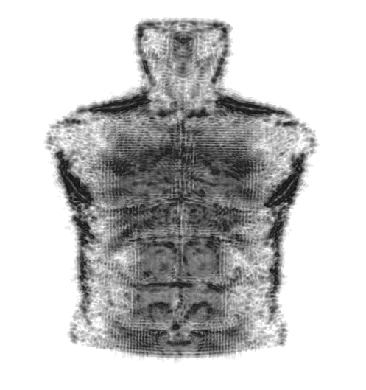
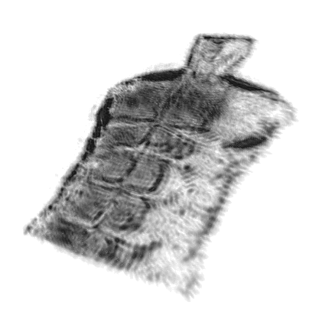
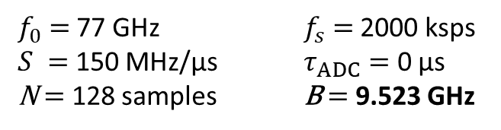
Effect of Bandwidth
Same SAR parameters, same target, lower bandwidth:
$f_{0}$ $=$ 77 GHz $f_{s}$ $=$ 2000 ksps
$S =$ 150 MHz/µs $τ_{ADC}=$ 0 µs
N $=$ 128 samples B $=$ 9.523 GHz
MIP
y-z view
3-D Volume Image

