Slide 1
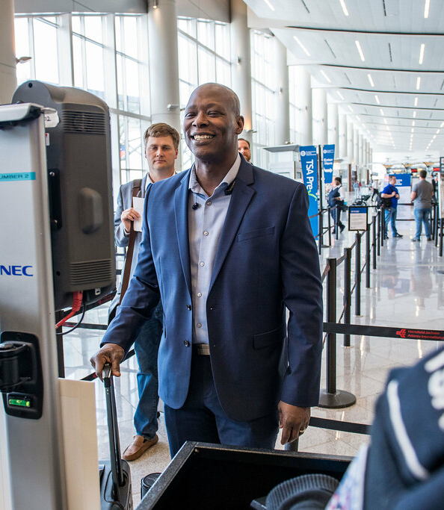
TSA Complaint Analysis: A Review of National Complaint Patterns Across U.S. Airports
By: Joanna Sierra-Mendoza
This Photo by Unknown Author is licensed under CC BY

Slide 2
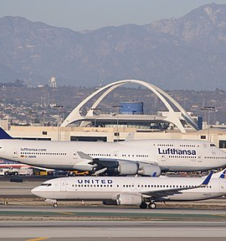
What This Analysis Reveals
This analysis looks beyond complaint numbers to show how traveler experience has changed over time and where TSA operations feel the most strain.
We explore how complaint patterns reflect shifts in passenger volume, public expectations, staffing capacity, and post-pandemic recovery.
By reviewing complaints by airport, category, and geography, we uncover the deeper story behind where problems emerge and why.
The findings highlight specific airports that contribute disproportionally to the national complaint burden.
Ultimately, this analysis provides a clear path for where targeted improvements can make the biggest impact.
This Photo by Unknown Author is licensed under CC BY-SA

Slide 3
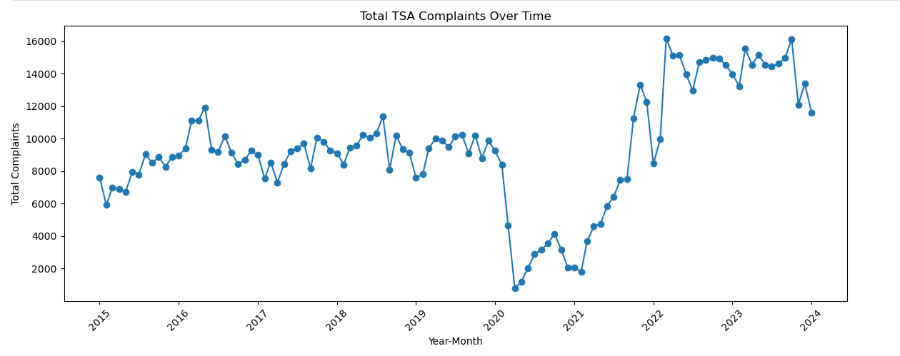
TSA Complaints Over Time
Complaint trends show how tightly TSA operations are tied to national travel patterns. Before 2020, complaints had risen steadily.
In early 2020, complaints abruptly collapsed, a direct reflection of pandemic-related shutdowns.
As travel surged back in 2021 and 2022, complaints rose even faster, signaling major operational strain during the recovery period.
Since 2022, complaints have consistently remained high, revealing ongoing gaps in staffing, lane availability, consistency, and communication at many airports.
This long-term curve sets the stage for identifying which airports and processes are driving current complaint levels.

Slide 4
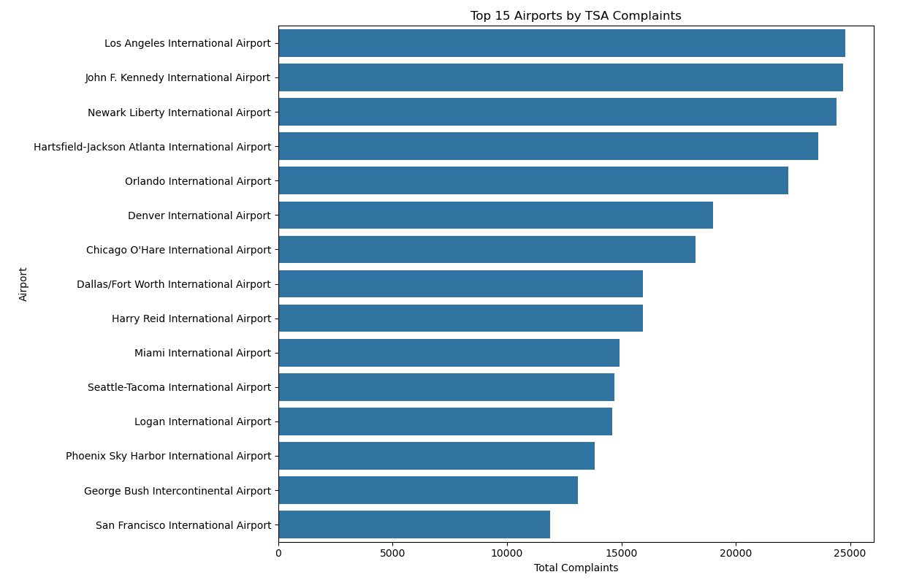
Identifying Pressure Points: Airports with the Highest Complaints
When we look at the airports with the most TSA complaints, it becomes clear that a handful of locations carry a disproportionate share of the national workload. These are airports that millions of travelers pass through every month, and their screening operations face constant pressure.
LAX, JFK, and Newark consistently appear at the top of the list. These airports combine international traffic, high passenger density, and complicated terminal layouts; factors that can intensify wait times and amplify any breakdowns in the screening process.
Major connecting hubs like ATL, DFW, DEN, and ORD also show high complaint levels tied to sheer passenger volume.
These airports represent important opportunities. Addressing issues at even a few of these high-volume hubs has the potential to make a meaningful decrease in TSA’s overall national complaint numbers.

Slide 5
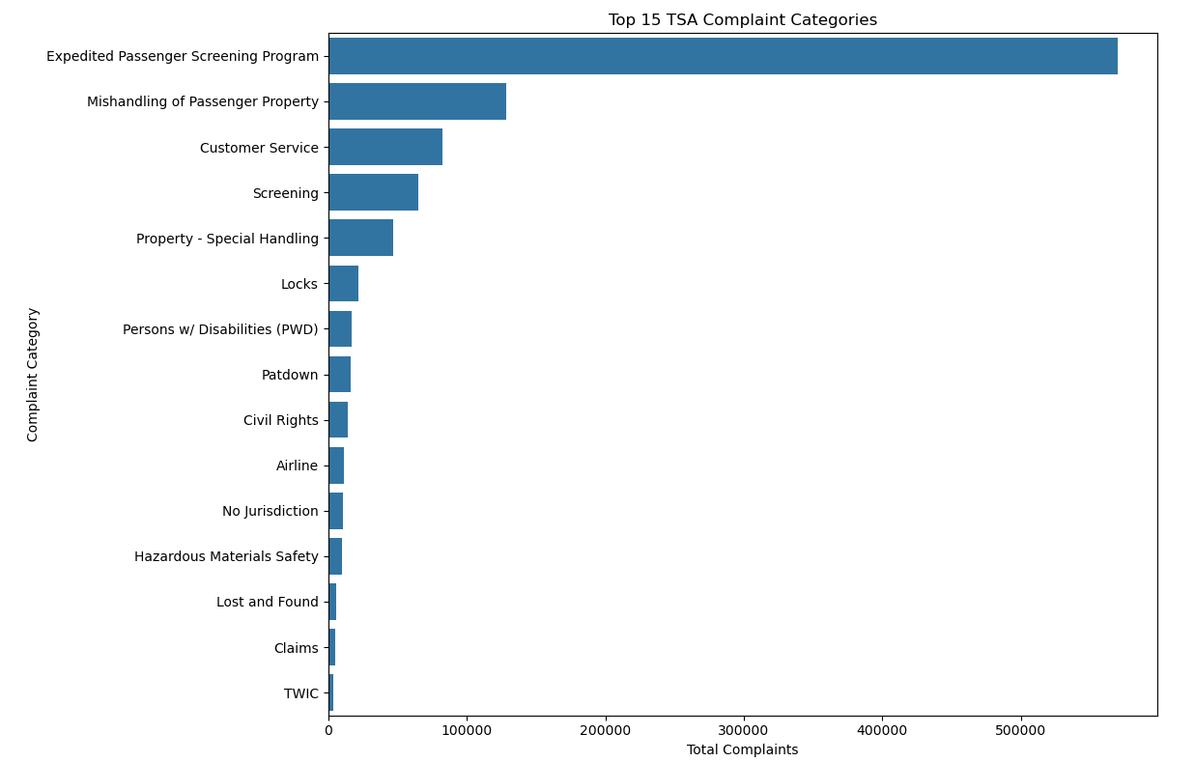
What Travelers Are Struggling With Most
When we break down the types of complaints passengers file, one category stands out immediately: the Expedited Passenger Screening Program. It’s not just the biggest category; it’s bigger than everything else combined.
This tells us that most frustration isn’t coming from traditional screening lanes or baggage issues. Instead, it’s concentrated in a program designed to make screening faster and easier. That contrast alone suggests a mismatch between traveler expectations and what they experience.
Other categories like Mishandling of Property, Customer Service, and Screening show up, but at a much smaller scale.
The sheer dominance of EPSP complaints makes it clear that any meaningful reduction in total complaints has to start here.
Presentation Title

Slide 6
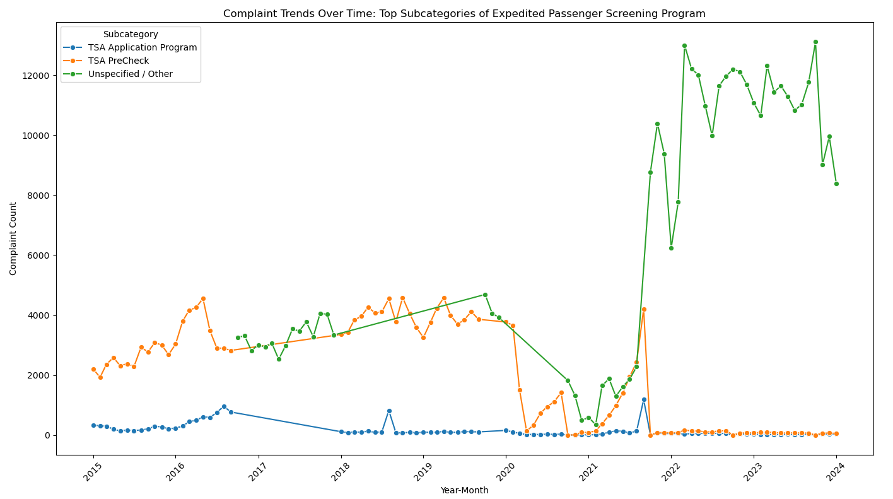
Digging Into EPSP: What’s Driving the Complaints?
When we look at EPSP’s subcategories, one of the first things that jumps out is how many complaints fall under “Other”. This is a sign that many complaints aren’t being categorized properly, which makes it harder to pinpoint exact issues happening in the checkpoint.
TSA PreCheck-related complaints have been consistently visible across the years. They tend to spike during busy travel seasons when lane availability, staffing, and passenger expectations are all stretched thin.
The surge in EPSP complaints around 2021-2022 lines up with the rapid return of travel. That period was marked by high passenger volume but slower operational recovery, which likely contributed to passenger frustration.
These patterns point to a combination of inconsistent implementation, communication challenges, and lingering recovery-period stress.

Slide 7
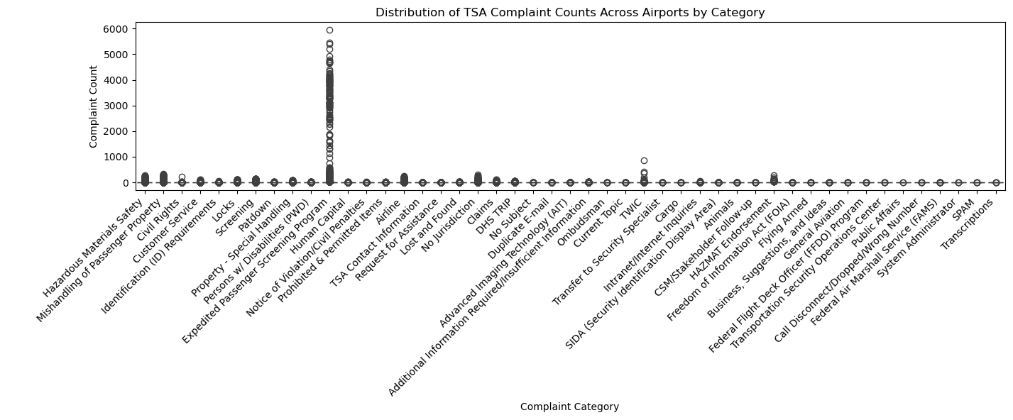
How Consistent are Airports? Variability Across Categories
When we compare complaint volumes across all airports for each category, most categories show very little movement. In many cases, airports report almost no complaints at all.
EPSP, however, shows a completely different pattern. Some airports have extremely high counts, while others have very few, indicating uneven implementation across the system.
Overall, this chart reinforces the idea that improving EPSP consistency could significantly improve the traveler experience nationwide.

Slide 8
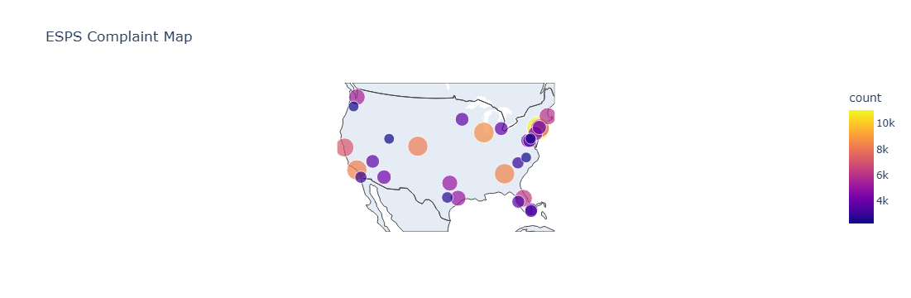
Mapping the Issue: Where EPSP Complaints are Concentrated
When we map EPSP complaints across the country, we can see that this isn’t a regional issue.
The biggest concentrations appear at major hubs. Airports like LAX, JFK, ATL, DEN, and MIA consistently stand out. These locations handle big passenger volumes, including a high number of PreCheck travelers.
What this suggests is that targeted improvements at these specific hubs could have an outsized effect on reducing EPSP complaints nationwide.
This also aligns with the earlier charts: a small number of key airports are carrying much of the pressure.

Slide 9
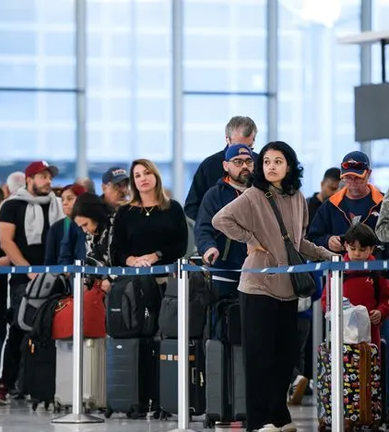
The Big Picture: What the Data Tells Us & Where TSA Should Go Next
Across all the charts, one message keeps coming forward: The EPSP is the primary driver of TSA complaints nationwide. It shows the highest volumes, the widest variability across airports, and the largest number of uncategorized submissions, making it the clearest area for improvement.
A small number of airports, major hubs with the highest traffic, consistently generate a disproportionate share of complaints. This means that targeted improvements in these key locations could significantly reduce complaints nationwide.
Data quality is also playing a role. The high number of “Other” EPSP complaints makes it harder to pinpoint the root cause of traveler frustration. Improving how complaints are categorized can enable the TSA to better understand and respond to operational gaps.
To improve, TSA should strengthen communication around PreCheck and EPSP; including eligibility, lane availability, and wait-time expectations to reduce traveler uncertainty.
By focusing on EPSP performance and standardizing processes at key locations, TSA can reduce nationwide complaint volume, restore consistency, and deliver a smoother, more predictable screening experience for millions of travelers.

Slide 10
Sources
https://github.com/data-liberation-project/tsa-complaint-counts/tree/main
https://github.com/ip2location/ip2location-iata-icao
https://www.tsa.gov/news/press/factsheets/tsa-glance-factsheet

