Slide 1

The Growing Threat of Financial Fraud
Global banks are experiencing a sharp rise in unauthorized credit card transactions and suspicious account activity
Millions of daily transactions make manual fraud detection impossible at scale
Traditional systems are too slow to catch fraud as it happens in real-time
Money laundering activity is becoming harder to detect and trace
The bank lacks automated tools to block high-risk transactions instantly
Non-compliance with global AML regulations risks heavy financial penalties
Customer trust and the bank’s reputation are at serious risk without a modern solution

Slide 2
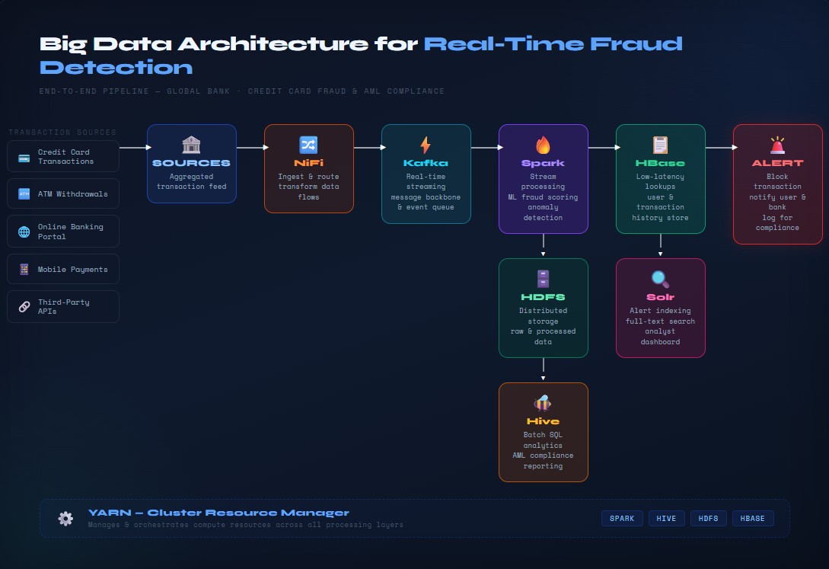

Slide 3

A Scalable, Real-Time Defense
BENEFITS
Real-time fraud detection prevents financial losses before they occur
Automated transaction blocking reduces risk without human intervention
Behavioral analysis identifies suspicious patterns across millions of accounts simultaneously
Fully scalable architecture grows with the bank’s transaction volume
Centralized data storage in HDFS ensures no transaction data is ever lost
Anti-money laundering compliance reporting is automated, reducing regulatory risk and manual work
Fraud analysts get instant visibility into alerts through Solr’s search dashboard
Customers receive real-time security notifications, strengthening trust in the bank
CONCLUSION
This architecture transforms fraud detection from a reactive process into a proactive, automated defense
The bank gains a competitive edge through cutting-edge big data technology
It protects customers, assets, and the bank’s long-term reputation

