Slide 1
IMAGE CAPTION GENERATION
Comparative Analysis of Deep Learning Architectures
MobileNetV2 + LSTM vs. VGG16 + LSTM, with a final pretrained ViT-GPT2 comparison
BY: Joanna Sierra-Mendoza
DSC 680: Applied Data Science | May 2026
Notes:
Open with the project goal: compare two trained CNN + LSTM captioning models, then use the transformer model as a final contrast.

Slide 2
PROBLEM
Image captioning makes large image collections easier to search and use.
Many organizations store large numbers of images. Without captions, those images are harder to search, organize, and understand at scale.
Common uses
1
Accessibility
Describe images for users who cannot easily view them
The goal is not just to name objects, but to turn visual content into useful language.
2
Search
Help people find images or products using text
3
Organization
Tag and manage large image libraries
4
Automation
Support AI workflows that need scene understanding

Slide 3
STUDY DESIGN
The experiment tested whether a larger dataset and deeper CNN improved caption quality.
Model 1
Model 2
MobileNetV2 + LSTM
VGG16 + LSTM
Dataset
Flickr8k
Dataset
Flickr30k
Scale
~8K images / ~40K captions
Scale
~30K images / ~150K captions
Training goal
Predict next caption word
Training goal
Predict next caption word
Evaluation
Loss, accuracy, BLEU, examples
Evaluation
Loss, accuracy, BLEU, examples
Model components
Model components
- CNN: extracts visual patterns from the image
- MobileNetV2: lightweight pretrained CNN used for faster feature extraction
- LSTM: sequence model that predicts the caption one word at a time
- VGG16: deeper pretrained CNN tested for richer image features
- Flickr30k: larger dataset used to test whether scale improved generalization
- Same LSTM decoder: kept the caption generator structure comparable
Hypothesis: more data plus VGG16 would improve generalization. Result: gains were modest.

Slide 4
DATA PIPELINE
The data pipeline protected evaluation by splitting images, not captions.
1
Collect
Kaggle Flickr8k and Flickr30k image-caption datasets
Dataset size
2
Clean text
Lowercase, remove punctuation, normalize whitespace
8K
30K
3
Mark sequences
Add startseq and endseq tokens to every caption
Flickr8k images
Flickr30k images
4
Tokenize
Build vocabulary and convert words to integer IDs
5
human captions per image
5
Split images
Train / validation / test split by image to prevent leakage
Splitting by image prevents captions from the same photo appearing in both training and validation.
4

Slide 5
ARCHITECTURE
Both trained systems used the same encoder-decoder captioning pattern.
1
Input image
2
CNN features
3
LSTM decoder
4
Next word
5
Caption
Resize photo to 224x224
MobileNetV2 or VGG16
Learns caption sequence
Predicts vocabulary output
Words until endseq
• The CNN reads the image and turns it into features; the LSTM uses those features and previous words to predict the next word in the caption.
• Main limitation: the decoder can still fall back to common caption phrases when the image contains a less common object or scene.
5

Slide 6
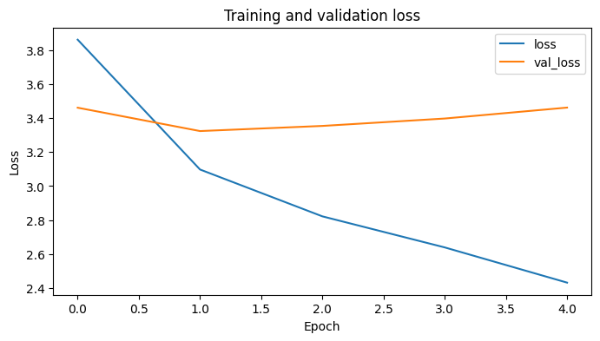
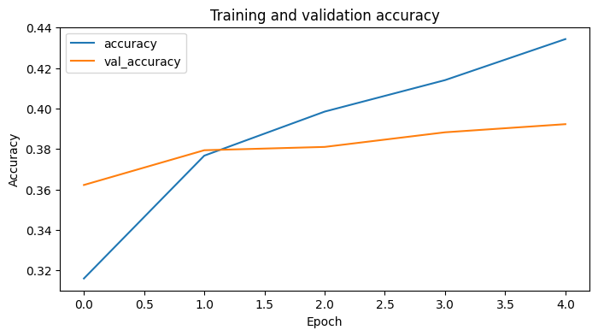
MODEL 1: FLICKR8K + MOBILENETV2
Model 1 learned quickly, but validation loss showed early overfitting.
~43.4%
~39.3%
Validation loss improved at first, from ~3.46 to ~3.33, then rose back to ~3.46.
final training accuracy
final validation accuracy
Interpretation: the model learned the training captions, but validation loss increased after the early low point, suggesting overfitting.

Slide 7
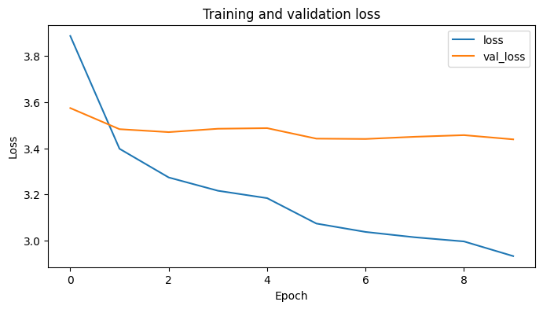
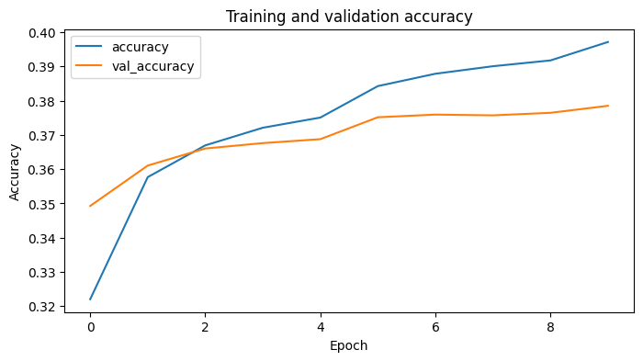
MODEL 2: FLICKR30K + VGG16
Model 2 had more data and a deeper CNN, but validation gains were modest.
~39.8%
~37.9%
Validation loss improved only slightly, from ~3.58 to ~3.44, before leveling off.
final training accuracy
final validation accuracy
Interpretation: scaling from Flickr8k to Flickr30k and replacing MobileNetV2 with VGG16 did not dramatically improve generalization.

Slide 8
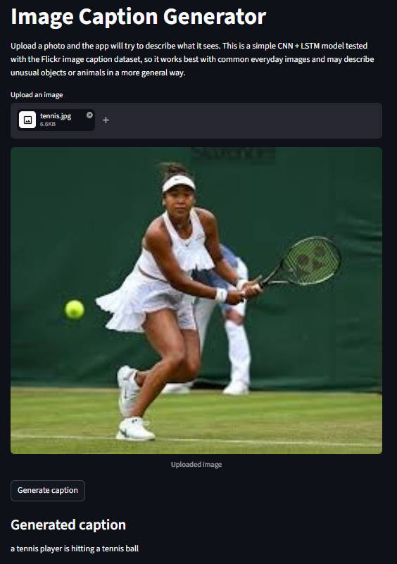
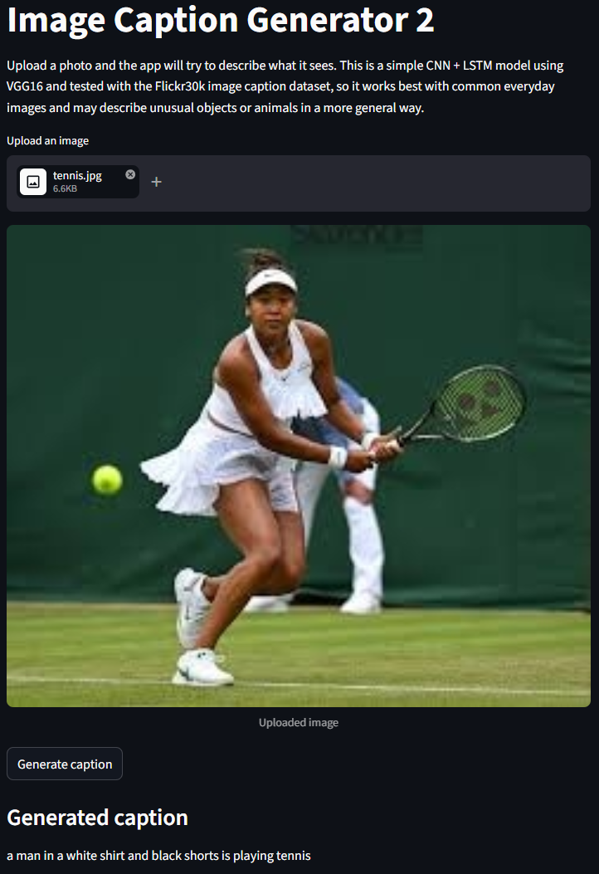
GENERATED OUTPUTS
Both trained models produced useful tennis captions, with different strengths.
What this shows
Model 1 was more concise and directly captured the key action: the player hitting the tennis ball.
Model 2 attempted a richer description of the scene, including clothing and the sport, but added more detail that could be less reliable.
Positive takeaway: both models understood the broad tennis context.
Model 1: concise and accurate
Model 2: more descriptive
Image Caption Generation | DSC 680
8

Slide 9
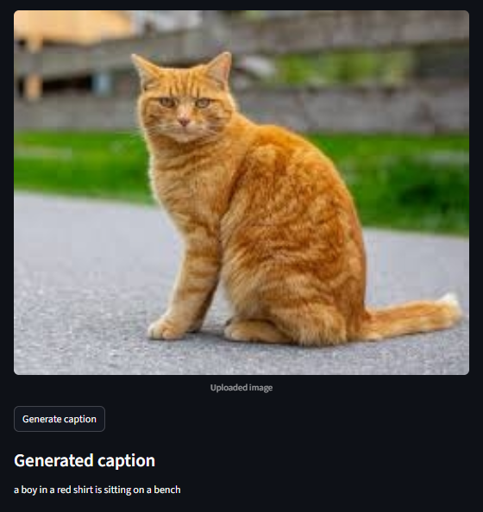
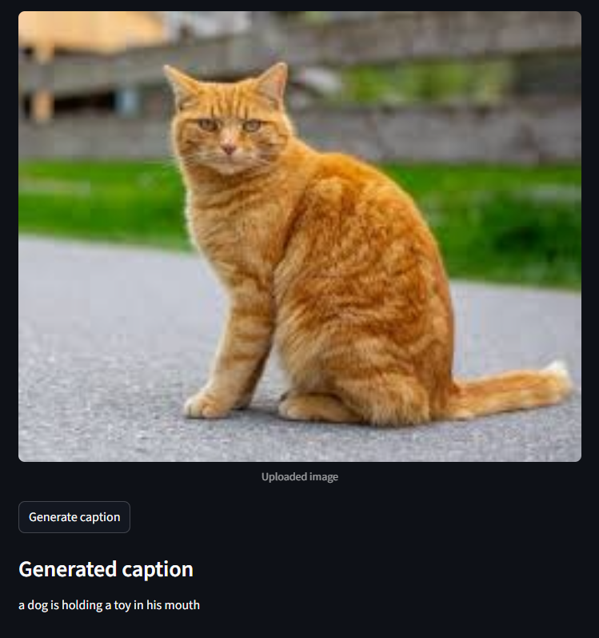
GENERATED OUTPUTS
Qualitative testing showed both trained models still struggled with object-specific accuracy.
MODEL 1 | MOBILENETV2 + LSTM
MODEL 2 | VGG16 + LSTM
Both systems generated readable captions, but they sometimes relied on common dataset patterns instead of accurately identifying the main object.

Slide 10
FINDINGS
The main finding: more data and VGG16 did not solve the CNN-LSTM bottleneck.
1
Scale helped less than expected
2
Architecture mattered more
Flickr30k added far more examples, but validation accuracy remained below 40%.
The LSTM decoder still leaned on frequent caption patterns.
3
Qualitative results exposed gaps
4
BLEU is useful but incomplete
Simple scenes worked best; unusual animals and complex interactions were harder.
Word overlap does not fully capture whether a caption feels correct to a human.
Future gains likely require attention or transformer-based vision-language models, not only a larger CNN or dataset.
10

Slide 11
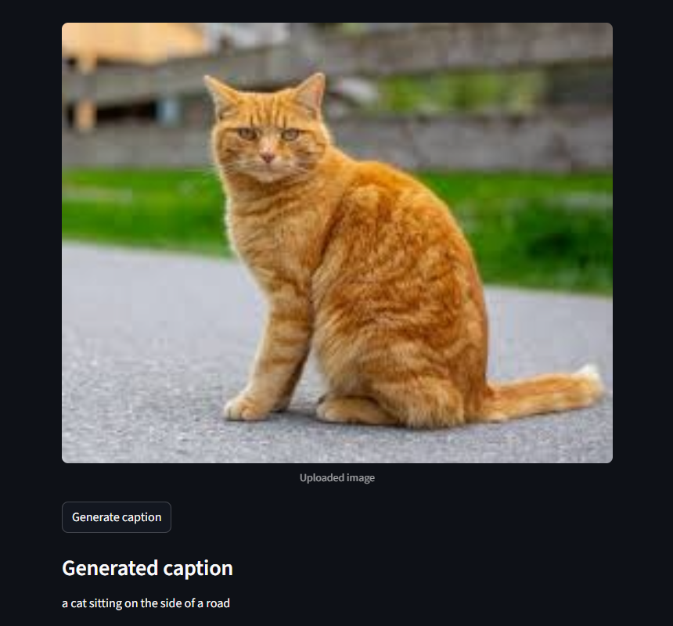
ViT COMPARISON
Bonus comparison: a pretrained ViT-GPT2 model produced more natural captions.
What changed?
- ViT is a Vision Transformer that reads image patches with attention.
- GPT-2 is the language decoder that writes the caption word by word.
- The model was pretrained, so it was not counted as one of the two trained project models.
- It shows why transformer vision-language models can outperform CNN + LSTM captioning.
*The first two models are the trained project; ViT-GPT2 is a bonus benchmark for modern pretrained models.

Slide 12
ETHICS
Responsible image captioning requires accuracy, fairness, and transparency.
Main risks
Responsible use
Bias in training data can affect captions
Incorrect captions can mislead users
Privacy matters when images include people
Use captions as assistance, not proof
Warn users that captions may be wrong
Review high-impact or sensitive outputs
Ethics takeaway
An image captioning system should be useful, but it should also be honest about uncertainty and tested for harm before people rely on it.

Slide 13
Q&A
Q&A: Dataset and model behavior
1. Why did you choose the Flickr8k dataset?
2. Why do you think the model struggled with some images?
3. How did you prevent overfitting?
- Common benchmark
- Small enough to train locally
- Created the first baseline
- Learned common caption patterns
- Best on simple scenes
- Harder with unusual objects
- Split data by image
- Used dropout
- Watched validation results
13

Slide 14
Q&A
Q&A: Evaluation and next steps
4. What improvements would you make if you had more time?
5. How would you measure success beyond BLEU scores?
6. If you were building this for a company, what would be your next step?
- Add attention
- Tune hyperparameters
- Try transformer models
- Human review
- Object accuracy
- Real upload testing
- Define the use case
- Collect domain images
- Add human review
14

Slide 15
Q&A
Q&A: Ethics, risk, and bias
7. Who is responsible when an AI-generated caption is wrong?
8. Could the model exhibit bias when generating captions?
- The organization using it
- Developers must test limits
- Captions are assistive
- Yes, from training data
- Some patterns may be overlearned
- Some scenes may be misread
9. What are the risks if the model generates inaccurate captions?
10. How can bias be reduced in image captioning systems?
- Users may be misled
- Accessibility trust can be harmed
- Fairness concerns can increase
- Use more diverse data
- Audit errors regularly
- Add review and warnings
15

Slide 16
RESOURCES
References
• Flickr8k dataset: https://www.kaggle.com/datasets/adityajn105/flickr8k/data
• Flickr30k dataset: https://www.kaggle.com/datasets/eeshawn/flickr30k
• Hugging Face ViT-GPT2 pretrained model: https://huggingface.co/nlpconnect/vit-gpt2-image-captioning
• CNN + LSTM image caption generator reference: https://data-flair.training/blogs/python-based-project-image-caption-generator-cnn/
• TensorFlow image captioning guide: https://medium.com/@khaledeemam/a-step-by-step-guide-to-building-an-image-caption-generator-using-tensorflow-a9e0a87cc0cb
• VGG16 implementation reference: https://builtin.com/machine-learning/vgg16
Image Caption Generation | DSC 680
16

