Slide 1
Becoming a Docker Ninja
…a friendly introduction to Docker and docker commands

Slide 2
Meet your instructor
Dr. Joseph Ayeni
Experience:
IT enthusiast with over 15 years cumulative experience
Terraform Certified Cloud Engineer
Project Management Professional (PMP)
Risk Management Professional (RMP)
Background:
PhD (UofA, Canada)
MPA (Uvic, Canada)
MPH (UofS, Canada)
LLB (UofL, UK)
BSc. (OAU, Nigeria)

Slide 3
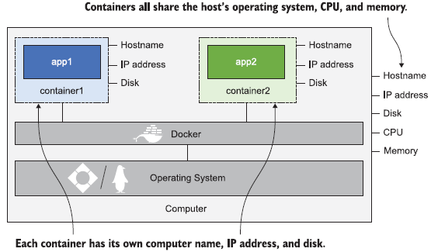
Docker’s Take Away:

Slide 4
Objectives
Understanding concepts of virtualization, containerization and orchestration
Develop basic-to-intermediate understanding of Docker platform
Develop basic-to-intermediate understanding of docker commands
Develop an intermediate skills to develop your own docker images
Explore how to use docker for orchestrating/managing multiple containers in development
Acquire basic skills require to explore advanced Docker topics and concepts

Slide 5
What is Docker?
A containerization tool (Became open source in 2013)
Helps with application deployment using software container
Enables isolation of application from its host system
Allow the build once and deploy everywhere philosophy.

Slide 6
Virtualization versus Containerization
Challenge:-
It is year 2000 and cloud adoption is at its infancy. You are asked to deploy multiple applications onto a single machine, or collection of machines.
What are your choices?

Slide 7
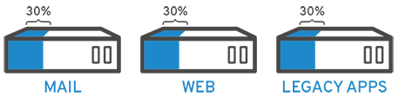
Solution 1: Traditional Approach
Installed each on different host, and serve each on a separate port
Challenges:
Expensive in terms of physical space, hardware-availability, cooling and power
Difficulty sharing resources (like CPU, memory and available ports)
Cannot be scaled (scalability problem)
High cost of operation
Problems: Isolation; Density; Efficiency

Slide 8
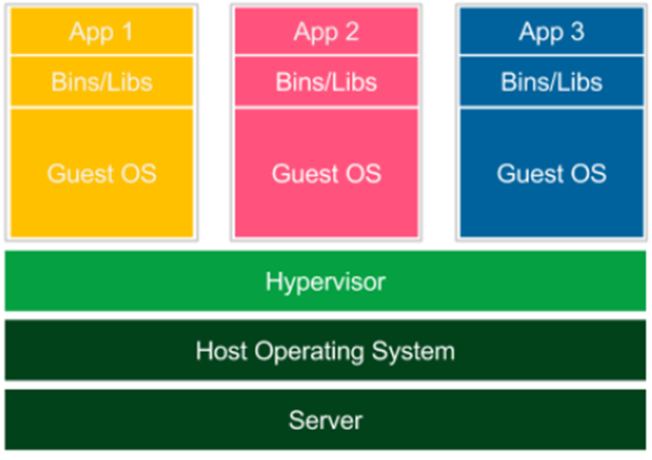
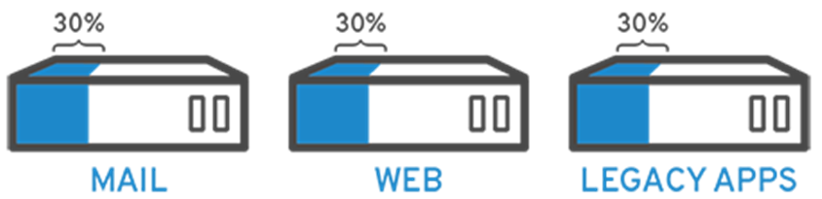
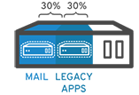
Solution 2: Virtualization (i.e., OS Level)
Package each application into a virtual machine of its own
Each application has its own machine so dependencies

Slide 9
Advantage of Virtualization
Can be isolated, and resources divided up and allocated
Each VM maintains operating system and all packages for each application
Consolidation; complete isolation; resource optimization
Downside:
Efficiency:
# Resource-intensive
# Look, act, and feel like real bare metal hardware
Density
Notes:
Moving VMs between an on-premises hypervisor and the cloud could potentially mean moving hundreds of gigabytes worth of data per VM

Slide 10
Examples of Hypervisor
Type 1 Hypervisor
VMware hypervisors like vSphere, ESXi and ESX
Microsoft Hyper-V
Oracle VM Server
Citrix Hypervisor
Type 2 Hypervisor
VMware Workstation
VMware Fusion
Oracle VirtualBox
Oracle Solaris Zones
Oracle VM Server for x86

Slide 11
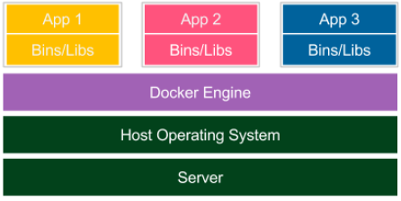
Solution 3: Containerization
Package up your application and it’s required dependencies in a container
Hosting in an isolated environment much like a virtual machine
No need to install and manage a separate OS for each container

Slide 12
Advantage of Containerization
Docker allows you to treat your servers like cattle, not pets (kittens vs cattle).
Container achieves:
Isolation
Density
Efficiency
Portability
Reproducibility
Cloud native deployment (i.e., Microservices deployment)

Slide 13
Docker Alternatives
CRI-O (Container Runtime Interface – Open Container Initiative)
Containerd
Podman
Crane
Linux Containers (LXC)
Windows Server containers
OpenVZ
Linux Server

Slide 14

Docker Installation

Slide 15
System Requirements
macOS:
- macOS 10.15 or newer
- At least 4 GB of RAM
- No VirtualBox prior to version 4.3.30 installed
Windows:
- 64-bit Windows 10/11
- WSL2 backend or Hyper-V must be enabled
- At least 4 GB of RAM

Slide 16
Install Docker Engine
Website:
https://docs.docker.com/engine/install/
Desktop
Easiest way to install Docker Engine on a local machine
https://docs.docker.com/get-docker/
Server
Either manually install Docker; or
Take advantage of platform providers

Slide 17
bcdedit /set hypervisorlaunchtype auto

Slide 18
Exercise 1: Install Docker
Install Docker Desktop
Confirm installation:
docker version
docker --version
docker --help

Slide 19

Introduction to Docker commands

Slide 20
Run and Manage Docker Containers
Learn basic docker commands:
docker container run
docker ps
docker images
Managing Docker Containers
Pulling, starting, stopping, and removing containers from our local environment quite frequently
Run container locally to understand how it functions and what normal behavior looks like prior to deploying a container in a production environment

Slide 21
Exercise 1: Running the hello-world Container
Run the following commands:
docker container run hello-world
docker ps
docker ps -a
docker images

Slide 22
Docker Architecture

Slide 23
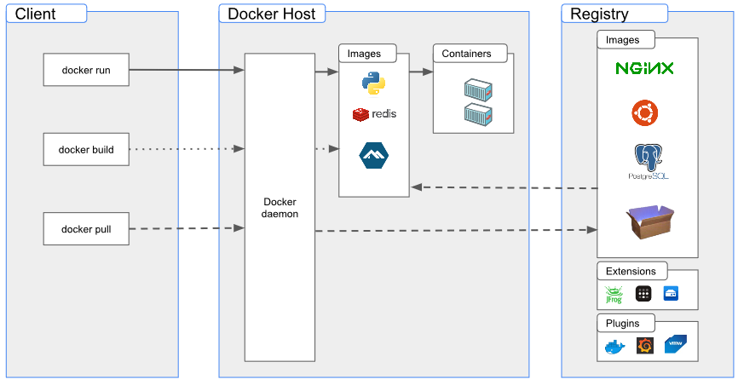
Docker Engine

Slide 24
Docker Images
Think of a Docker image as a collection of all the files necessary to run your application, together with the recipe on how to run it
An image contains the application code, run time and libraries require to run an application
A Docker image is a read-only instance of the application that just needs to be started
Docker images are typically shared through registries (public and private)
Open Container Initiative (OCI) has standardized the Docker image format

Slide 25
Docker Containers
A container is a running instances of an image
A container is an instance that is executed from a Docker image
External libraries such as libc are typically provided by the host operating system, but in a container it is include in the images
While starting a container, it adds a writable layer on top to store any changes that are made while working with the container

Slide 26
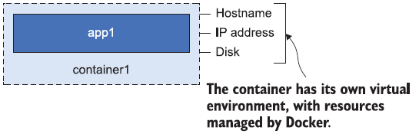
Properties of containers
Application inside a container cannot see anything outside the container
A container is running on a computer, and that computer can also be running lots of containers
Containers share the resources of the host computer i.e., CPU, memory & OS

Slide 27
Types of Containers
System containers
Provide a base operating system that can be used as the foundation to build your own container images
Application containers:
used to start just one application.
Application containers have become the default

Slide 28
Exercise 2: System vs Application Containers
(2) docker container run Ubuntu
docker ps
docker ps –a
(3) docker container run nginx
docker container run httpd
(4)
docker container run -it ubuntu sh
docker container run -it ubuntu /bin/bash

Slide 29

Labs
Getting your feet wet with Docker commands

Slide 30
Lab: Docker Commands
Complete Lab 1 - 6

Slide 31
Publishing Container Ports
Port Mapping in Docker

Slide 32
Port mapping example
Run a Tomcat server in a container
docker run -d tomcat
Check if Tomcat server can be assessed on port 8080
http://localhost:8080
Troubleshoot:
docker ps
docker logs <container ID>
Now, specify the port mapping using -p (--publish) flag
-p <host_port>:<container_port>
-p 80:80
-p 7779:80
--publish <host_port>:<container_port>

Slide 33
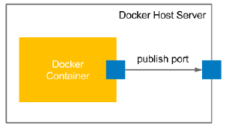
Container Port Mapping

Slide 34
In Class Lab: Using Containers
Using a combination of ‘docker search’ and ‘docker container run’ commands, run a busybox container.
By executing shell commands in the container, determine the:
Hostname
Present working directory
List of directories in the container file system
Create two files (filename1.txt and filename2.txt)
Merge contents of filename1.txt and filename2.txt into a new filename3.txt
Make filename3.txt only executable
Remove filename1, filename2, filename3
Confirm that the three files have been removed
Report the system’s disk space usage for lib directory on your container
Exit the container
Check the current state of the container

Slide 35
Lab Solution: Using Containers
Step 1:
docker search busybox
docker container run -it busybox
Questions | Commands
i. Hostname | hostname
ii. Present working directory | pwd
iii. List of directories in the container file system with sizes in readable format | ls -lh
iv. Create two files (filename1.txt and filename2.txt) | touch filename1.txt touch filename2.txt
v. Merge contents of filename1.txt and filename2.txt into a new filename3.txt | cat filename1.txt filename2.txt > filename3.txt
vi. Make filename3.txt only executable | chmod 111 filename3.txt
vii. Remove filename1, filename2, filename3 | rm filename1.txt filename2.txt filename3.txt rm *.txt
viii. Confirm that the three files | ls -lh
ix. Report the system’s disk space usage of lib directory on your container | du /lib
x. Exit the container | exit
xi. Check the current state of the container | docker ps docker ps -a

Slide 36

End of Module 1: Introduction to Docker
TO DO:
Assign Labs
Questions??

Slide 37
Building Your Own Docker Images
Module 2

Slide 38
Docker Workflow
Build Image
Share Image
Run Container

Slide 39
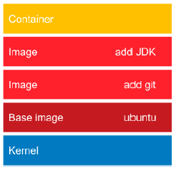
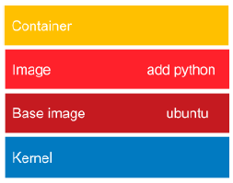
Concept of Image Layered Structure
Docker images consist of multiple layers that are built on top of each other
Layering is a very smart mechanism to save bandwidth and storage.
Application 2 reusing layers of Docker images
Application 1 with layered structure of Docker images

Slide 40
Building Docker Images
Two different method:
Using docker commit command
Using a Dockerfile automated build

Slide 41
Lab 1: Using docker commit command
You have been asked to prepare an image with the Git and JDK toolkits using the Ubuntu 20.04 image available on Docker Hub registry as a base image.
Run a container from ubuntu:20.04 and connect it to its command line
docker run -i -t ubuntu:20.04 /bin/bash
2. Install the Git toolkit
apt-get update
apt-get install -y git
3. Check whether the Git toolkit is installed
which git
4. Exit the container
exit
5. Run docker commit
docker commit <container ID> <Name of Your Image>

Slide 42
Using docker commit command
Run a container from ubuntu:20.04 and connect it to its command line
docker run -i -t ubuntu:20.04 /bin/bash
2. Install the Git toolkit
apt-get update
apt-get install -y git
3. Check whether the Git toolkit is installed
which git
4. Exit the container
exit
5. Check what has changed (compare container’s unique ID to the Ubuntu image
docker diff <container ID>
6. Commit container to the image
docker commit <container ID> ubuntu_with_git
7. Confirm that Git is installed by running a container with the new image

Slide 43
Sharing and Distribution Container Images
Remote public registries
DockerHub registry is the standard
https://hub.docker.com
Local private registries
Remote private registries
ECR => AWS Elastic Container Registry
ACR => Azure Container Registry
GCR => Google Container Registry

Slide 44
Containers and microservices
Microservices focuses on developing minimal pieces of code and joining them
Containers focuses on packaging minimal running application components
Both have the same objectives in mind
The only requirement is a layer that connects containers together
This is where the container orchestration layer comes in.

Slide 45
Multi-Stage Build
Compiling Codes

Slide 46
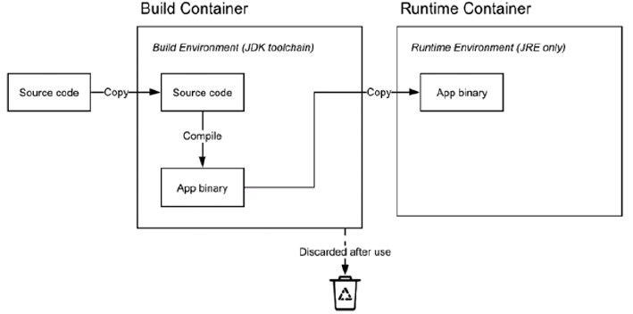
Compiling Code with a Multi-stage Build

Slide 47
LABS:
Hands on experience with multi-stage build
Compare normal build to a multi-stage build

Slide 48
Lab 1:
Create a directory and change into the directory
Create a Dockerfile file in your new directory and enter the following code
FROM diamol/base AS build-stage
RUN > echo 'Building...' /build.txt
FROM diamol/base AS test-stage
COPY --from=build-stage /build.txt /build.txt
RUN echo 'Testing...' >> /build.txt
FROM diamol/base
COPY --from=test-stage /build.txt /build.txt
CMD cat /build.txt
3. Build an image with your Dockerfile
4. Start a container with your newly created image

Slide 49
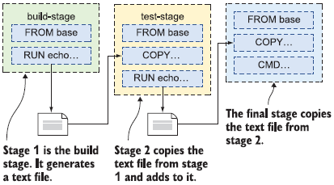
Behind the scene when we build the Multi-Stage Dockerfile

Slide 50
Persistent Storage

Slide 51
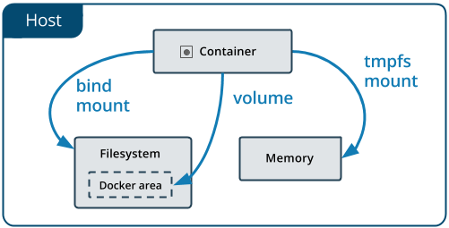
Storage Options in Docker

Slide 52
LABS
Docker Compose
Demo of Docker Compose
Jenkins = Automate

Slide 53
Networking in Docker

