Slide 1


Real-time activity tracking for Peace Corps Volunteers

Slide 2
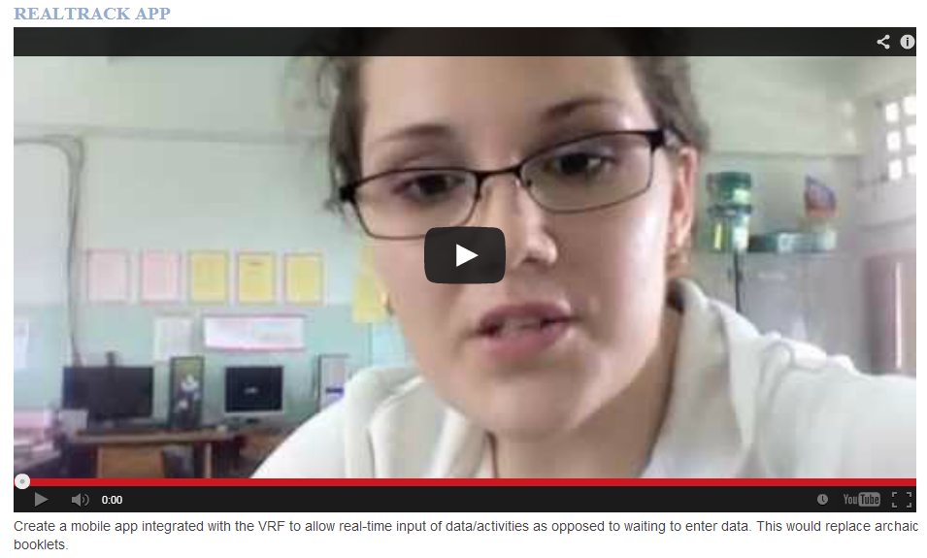
The Challenge

Slide 3

Volunteers can track their activities real-time, and share their activities with others

Slide 4



Resources

Slide 5
RealTrack Demo

Slide 6

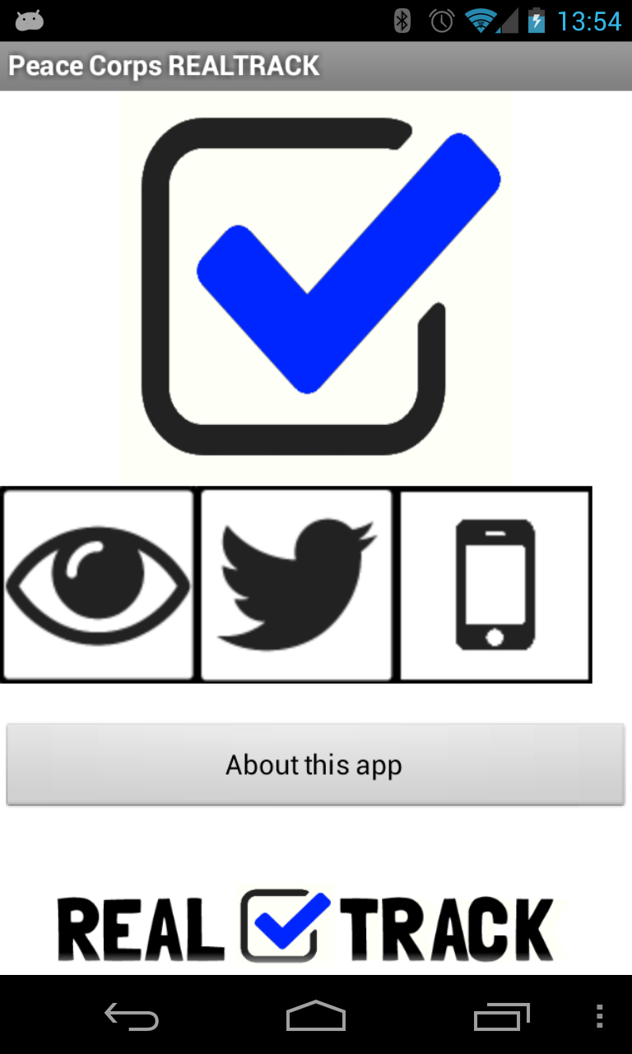
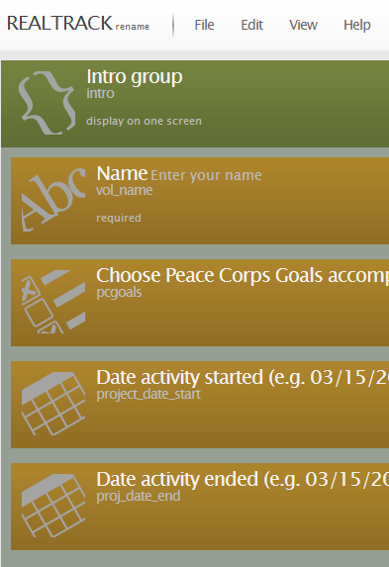
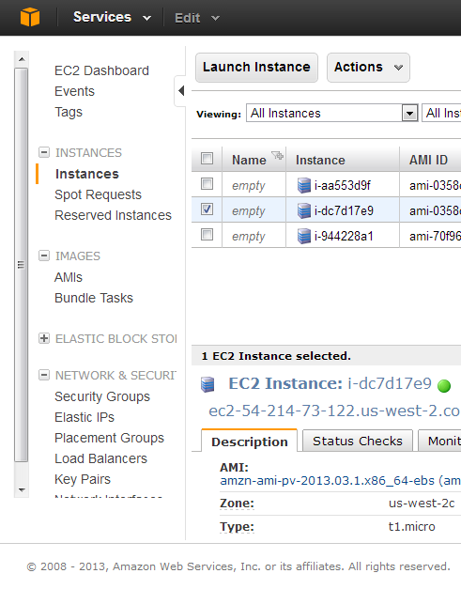
API

