Slide 1
Generating Upvoted Reddit Comments
By Joshua Frederick

Slide 2
The Goal -> Reality
Predict the upvotes of a comment from the sequence of comments prior to a comment and the comment itself.
Use this model to generate comments.
Unsatisfying upvote model results

Slide 3
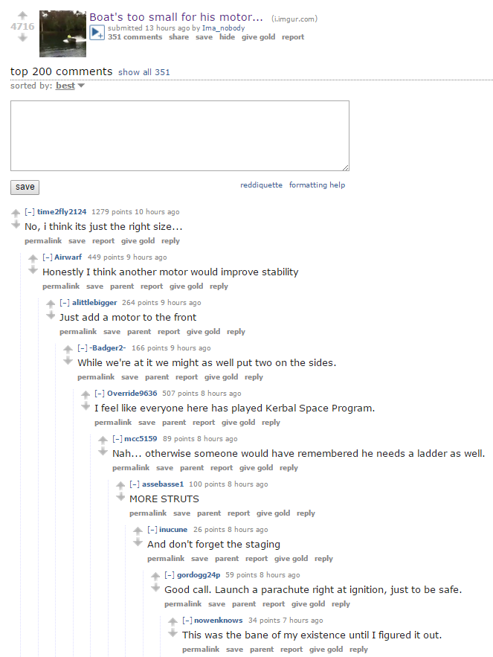
“No, I think its just the right size… <T> Honestly I think another motor would improve stability <T> Just add a motor to the front <T>”
Metadata
264

Slide 4
Generating a Comment
Generate the first word of the next comment (now termed ‘seed’)
Generate some n words as candidates for the next word in the comment.
For each of these n choices, use some evaluation metric to determine the best choice.
Extend the comment with this choice and repeat 2-4 until a terminating token is selected

Slide 5
The
rat
cat
bat
gnat
sat
likes
meows
licks
in
by
near
on
the
what
my
any
<T>
mat
thing
rat
“The cat sat on what”

Slide 6
The Models
The Upvotes Predicting Model
The First Word Predicting Model
The Bigram Markov Model
The K-Means Model
The Cluster Markov Model

Slide 7
Implementation
Generate a probability distribution for the seed using a LSTM and weightedly choose a word from the distribution.
Generate a probability distribution from the previous two terms and weigh it by the probability distribution for the parent’s cluster.
Weightedly choose n choice of words from this distribution and use the upvote model to select the word that maximizes predicted upvotes
Extend the comment with this choice and repeat the process until a terminating token is selected

Slide 8
Consider the case where we have the vocab (A, B, C, D). Suppose the parent comment is in a cluster with distribution [0.25, 0.25, 0.5, 0]. Suppose further that the generated seed was A, and that n=3 Then our model works as follows:
0
0.25
0.5
0.25
0.25
0.25
0.5
0
0
0.125
0.25
0
0
0.333
0.667
0
C
B
C
(<S> , A)
=
⊙
<S>AC
<S>AB
17.2
6.5
Predict Upvotes:
Repeat with (A, C)

Slide 9
Evaluation
Upvote Model: Validation MSE of 2500
Comment: Gitlab’s github importer can automatically import them.
Reply: No you educate me. I do acknowledge the change in society and culture and not backed up github. Hard to integrate github into their own interface, so it's a valid answer and so on.
Comment: Welcome to r/programmerhumor. Reply: A communications company in my frontpage to find that suspect they will.
Comment: Microsoft's enterprise account system
Reply: Can't kick you for pulling through. Don't let me just clone myself a tinfoil hat real quick and say excuse me your python is showing.
Comment: I imagine you found this funny.
Reply: I'm a bot.

Slide 10
Embedding and Topic Modeling
Extend the project with topic modeling

Slide 11
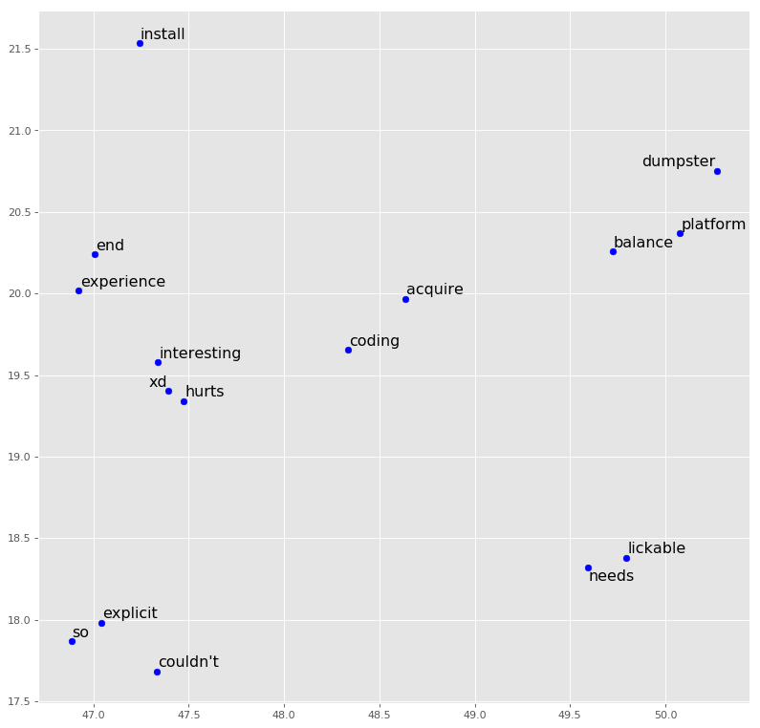
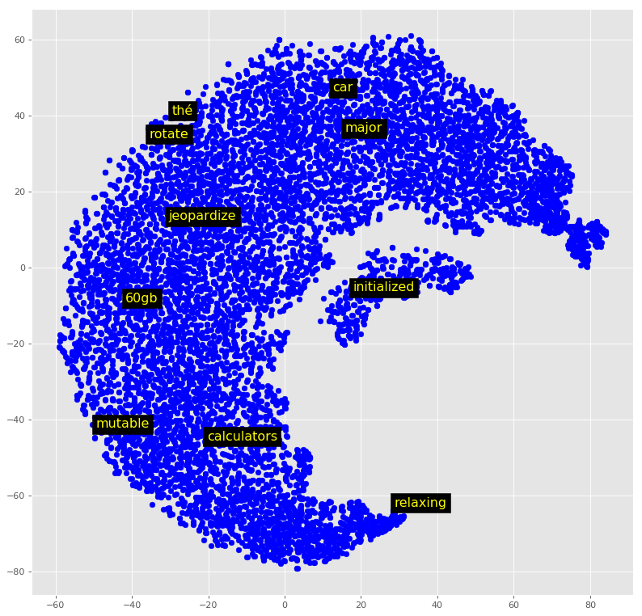
15 nearest words to coding
10 random words location

