Slide 1

UNIT
10
강화 학습

Slide 2
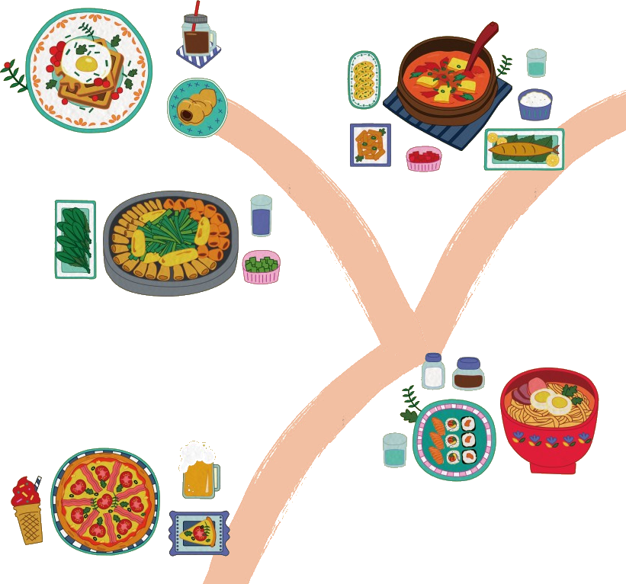





강화 학습

Slide 3
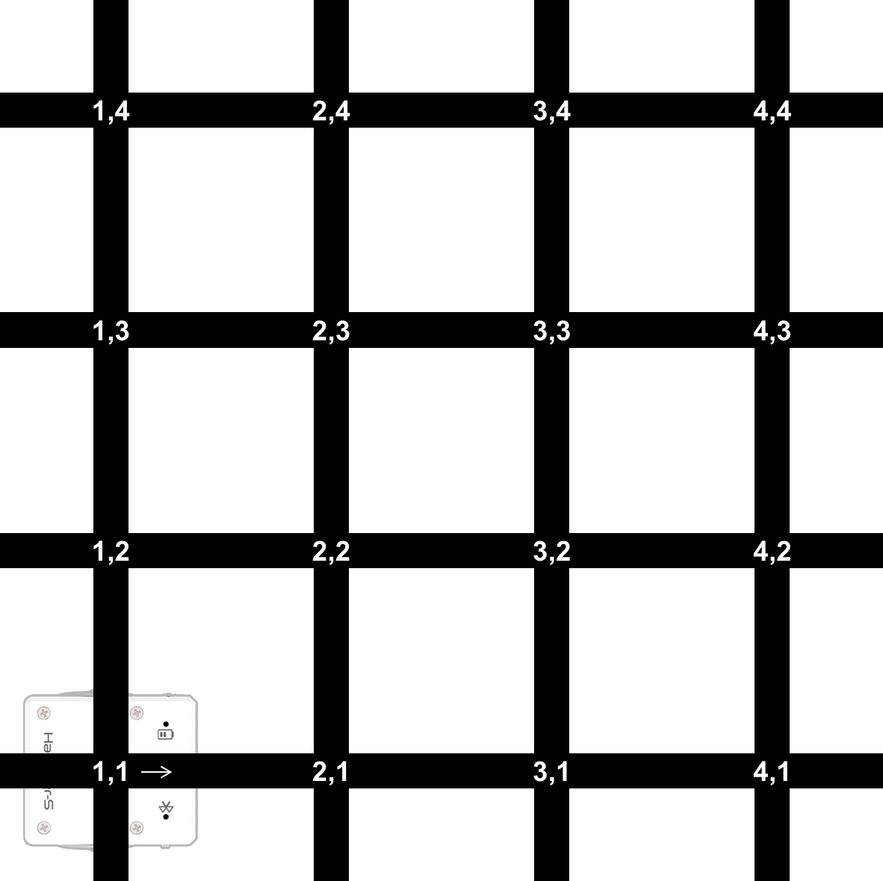
길 찾기 문제

Slide 4


강화 학습
에이전트 (agent)
환경 (environment)
환경을 인지하고 그에 대응하는 행동을 하는
컴퓨터 프로그램
인터넷 봇 (웹 크롤러)
게임 봇 (인공지능 플레이어)
챗봇

Slide 5
강화 학습
에이전트 (agent)
환경 (environment)
행동 (action)
상태 (state)
보상 (reward)
환경을 인지하고 그에 대응하는 행동을 하는
컴퓨터 프로그램
인터넷 봇 (웹 크롤러)
게임 봇 (인공지능 플레이어)
챗봇

Slide 6
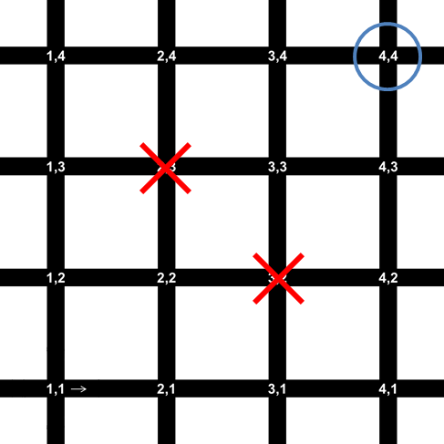
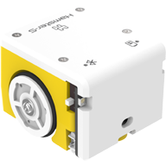
강화 학습
왼쪽으로 이동, 오른쪽으로 이동
위로 이동, 아래로 이동
에이전트 (agent)
환경 (environment)
행동 (action)
상태 (state)
보상 (reward)
로봇의 위치(x, y)
o → +1
x → -1
내버려 두기 → 0

Slide 7
강화 학습
에이전트 (agent)
환경 (environment)
행동 (action)
상태 (state)
보상 (reward)
목적 : 현재부터 미래까지의 모든 보상의 합을 최대화
학습의 결과 : 각 상태에서 취해야 할 행동 → 정책 (policy)
로봇의 위치
왼쪽으로, 오른쪽으로
위로, 아래로

Slide 8
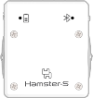
강화 학습
현재: $t$
다음: $t+1$
에이전트 (agent)
환경 (environment)
$$a_{t}$$
$$a_{t+1}$$
행동 (action)
$$s_{t}$$
$$s_{t+1}$$
상태 (state)
보상 (reward)
$$r_{t}$$
$$r_{t+1}$$
$$r_{t}+r_{t+1}+r_{t+2}+⋯$$
목적 : 현재부터 미래까지의 모든 보상의 합을 최대화
학습의 결과 : 각 상태에서 취해야 할 행동 → 정책 (policy)
로봇의 위치
왼쪽으로, 오른쪽으로
위로, 아래로

Slide 9

각 상태에서의 행동에 대한 보상
상태 (state) : 로봇의 위치 → 회색 테두리의 사각형 칸
행동 (action) : 연두색 화살표
보상 (reward) : 화살표 옆의 숫자 (0 또는 1)
$$0$$
$$1$$
$$0$$
$$0$$
$$0$$
$$0$$
$$0$$
$$0$$
$$1$$
$$0$$
$$0$$
$$0$$
$$0$$

Slide 10
누적 보상
현재부터 미래까지의 모든 보상의 합
$$r_{t}+r_{t+1}+r_{t+2}+⋯$$
누적 보상 : $0+0+1=1$
$$0$$
$$1$$
$$0$$
$$0$$

Slide 11
누적 보상
현재부터 미래까지의 모든 보상의 합
$$r_{t}+r_{t+1}+r_{t+2}+⋯$$
누적 보상 : $0+0+0+0+1=1$
$$0$$
$$0$$
$$0$$
$$0$$
$$1$$
$$0$$

Slide 12
누적 보상
$$r_{t}+r_{t+1}+r_{t+2}+⋯$$
$$r_{t}+{\left(0.9\right)r}_{t+1}+{{\left(0.9\right)}^{2}r}_{t+2}+{{\left(0.9\right)}^{3}r}_{t+3}+⋯$$

Slide 13
누적 보상
현재부터 미래까지의 모든 보상의 합
$$r_{t}+{\left(0.9\right)r}_{t+1}+{{\left(0.9\right)}^{2}r}_{t+2}+{{\left(0.9\right)}^{3}r}_{t+3}+⋯$$
누적 보상 : $0+\left(0.9\right)×0+{\left(0.9\right)}^{2}×1=0.81$
$$0$$
$$1$$
$$0$$
$$0$$

Slide 14
누적 보상
현재부터 미래까지의 모든 보상의 합
$$r_{t}+{\left(0.9\right)r}_{t+1}+{{\left(0.9\right)}^{2}r}_{t+2}+{{\left(0.9\right)}^{3}r}_{t+3}+⋯$$
누적 보상 : $0+\left(0.9\right)×0+{\left(0.9\right)}^{2}×0+{\left(0.9\right)}^{3}×0+{\left(0.9\right)}^{4}×1=0.6561$
$$0$$
$$0$$
$$0$$
$$0$$
$$1$$
$$0$$

Slide 15
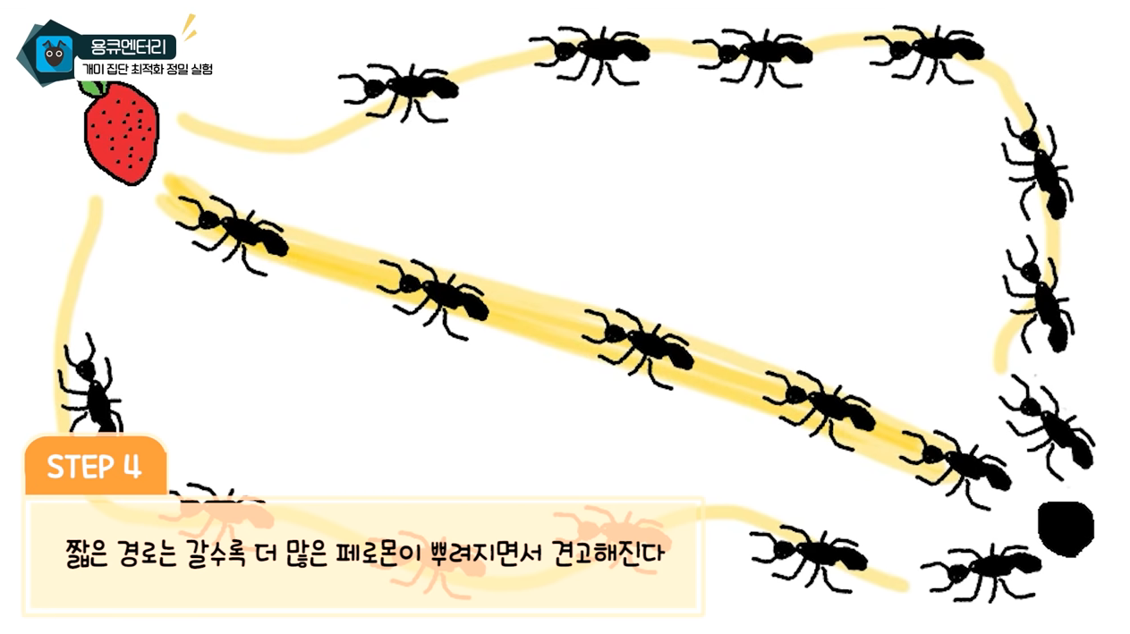
개미는 정말 짧은 길을 알아낼 수 있을까?
https://youtu.be/5E32W45TuMk

Slide 16
누적 보상
$$r_{t}+r_{t+1}+r_{t+2}+⋯$$
$$r_{t}+{\left(0.9\right)r}_{t+1}+{{\left(0.9\right)}^{2}r}_{t+2}+{{\left(0.9\right)}^{3}r}_{t+3}+⋯$$
$γ$ : 할인율(discount factor), $0≤γ<1$

Slide 17

누적 보상
각 상태에서 취해야 할 행동
누적 보상이 최대가 되도록 하는 정책을 구하라?
→ 미래의 상태 변화, 보상을 모두 알고 있어야 함
$$0$$
$$1$$
$$0$$
$$0$$
$$0$$
$$0$$
$$0$$
$$0$$
$$1$$
$$0$$
$$0$$
$$0$$
$$0$$

Slide 18
Q-러닝
$$\hat{Q}\left(s,a\right)←r+γ\max_{a^{′}}{\hat{Q}\left(s^{′},a^{′}\right)}$$
모든 상태에서의 모든 행동을 계속 경험하면
$\hat{Q}\left(s,a\right)→Q\left(s,a\right)$로 수렴
$$0.9$$
$$π^{∗}\left(s\right)=\underset{a}{argmax}{Q\left(s,a\right)}$$
각 상태에서 $Q\left(s,a\right)$가 최대인 행동($a$)을 취하면 됨

Slide 19
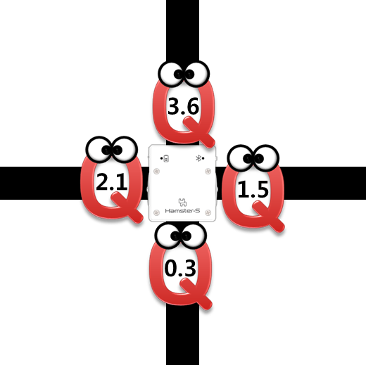
Q친구들
로봇이 이동하는 규칙:
어느 방향으로 가면 좋을지 네 명의 Q친구들에게 물어 봅니다.
가장 큰 숫자를 얘기하는 방향으로 로봇이 이동하면 됩니다.

Slide 20
보상 (점수)
Q 친구를 지나갈 때 각 행동에 대한 점수(보상)

Slide 21
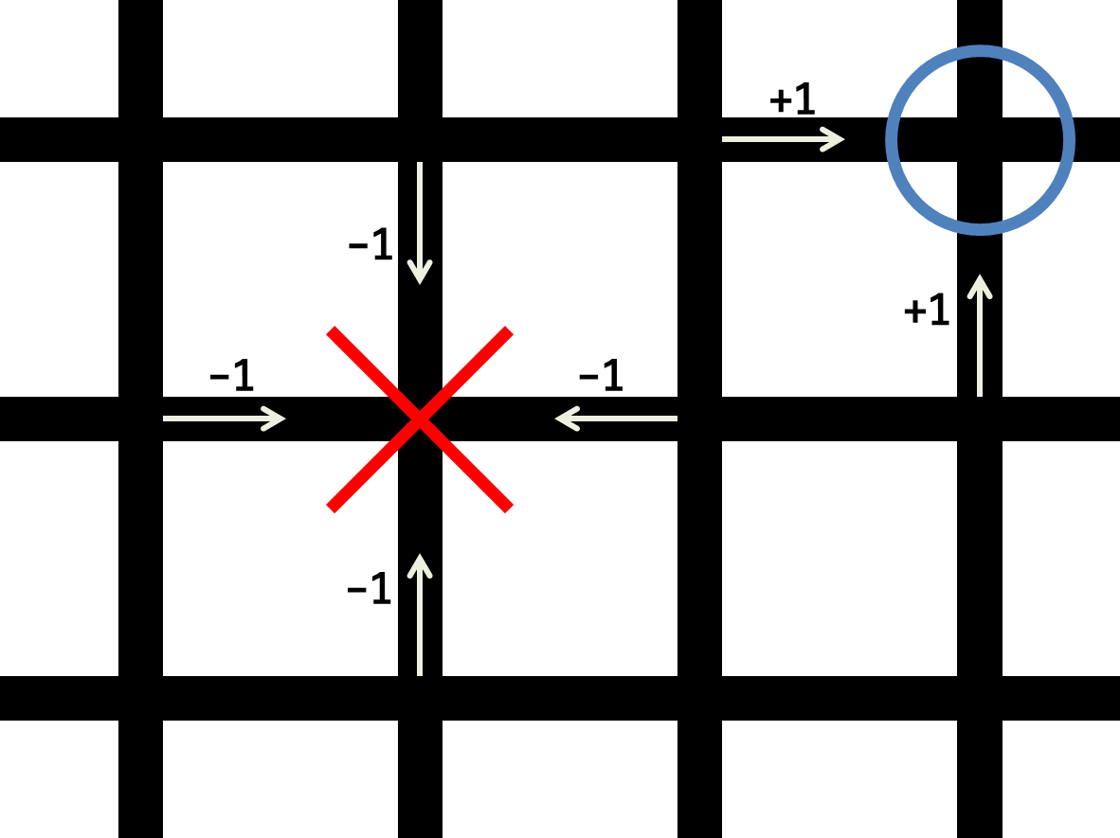

보상 (점수)
각 교차로에서 표시되지 않은 행동(화살표)는 점수가 모두 0이며 표시를 생략한 것임
Q 친구를 지나갈 때 각 행동에 대한 점수(보상)

Slide 22
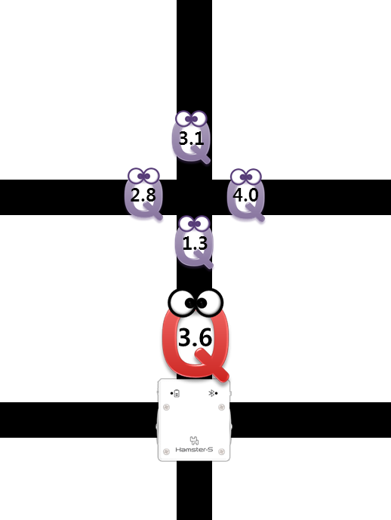
Q 친구들이 말하는 숫자
Q값을 계산하는 규칙:
다음 교차로의 Q친구들에게 물어 보고 가장 큰 숫자
ⅹ 0.9
+ 자기 점수
0

Slide 23
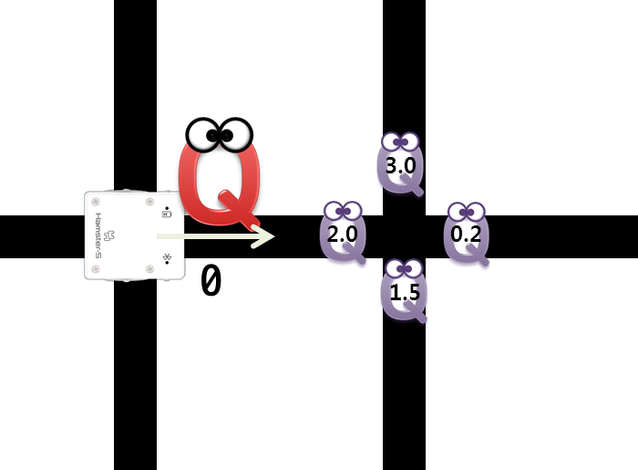
Q값 계산해 보기
[현재 교차로에서 Qa 값] ← [점수 r] + 0.9 ⅹ [다음 교차로에서 Qa 값들 중 최댓값]
점수 r | 다음 교차로의 보라색 Q값 |  |  |  |  | 현재 교차로의 오른쪽 방향 빨간색 Q값
0 | 왼쪽 | 오른쪽 | 위쪽 | 아래쪽 | 최댓값
2.7
2.0
0.2
3.0
1.5
3.0

Slide 24
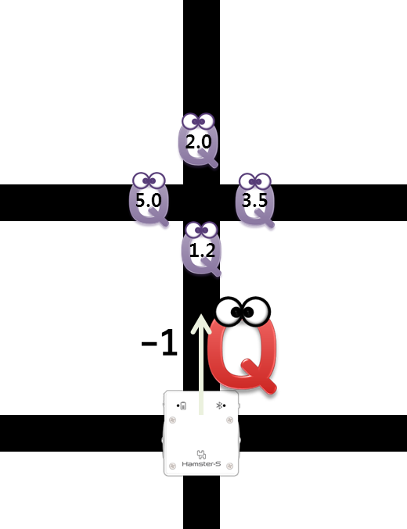
Q값 계산해 보기
[현재 교차로에서 Qa 값] ← [점수 r] + 0.9 ⅹ [다음 교차로에서 Qa 값들 중 최댓값]
점수 r | 다음 교차로의 보라색 Q값 |  |  |  |  | 현재 교차로의 오른쪽 방향 빨간색 Q값
-1 | 왼쪽 | 오른쪽 | 위쪽 | 아래쪽 | 최댓값
3.5
5.0
3.5
2.0
1.2
5.0

Slide 25
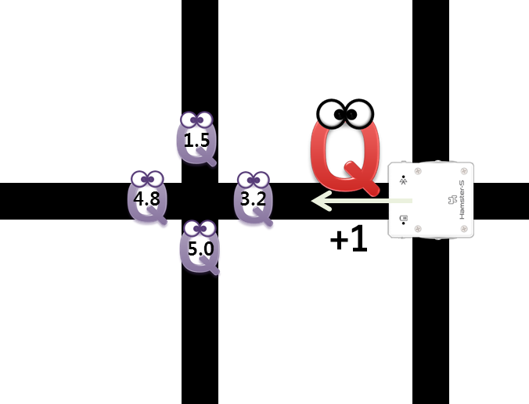
Q값 계산해 보기
[현재 교차로에서 Qa 값] ← [점수 r] + 0.9 ⅹ [다음 교차로에서 Qa 값들 중 최댓값]
점수 r | 다음 교차로의 보라색 Q값 |  |  |  |  | 현재 교차로의 오른쪽 방향 빨간색 Q값
1 | 왼쪽 | 오른쪽 | 위쪽 | 아래쪽 | 최댓값
5.5
4.8
3.2
1.5
5.0
5.0

Slide 26
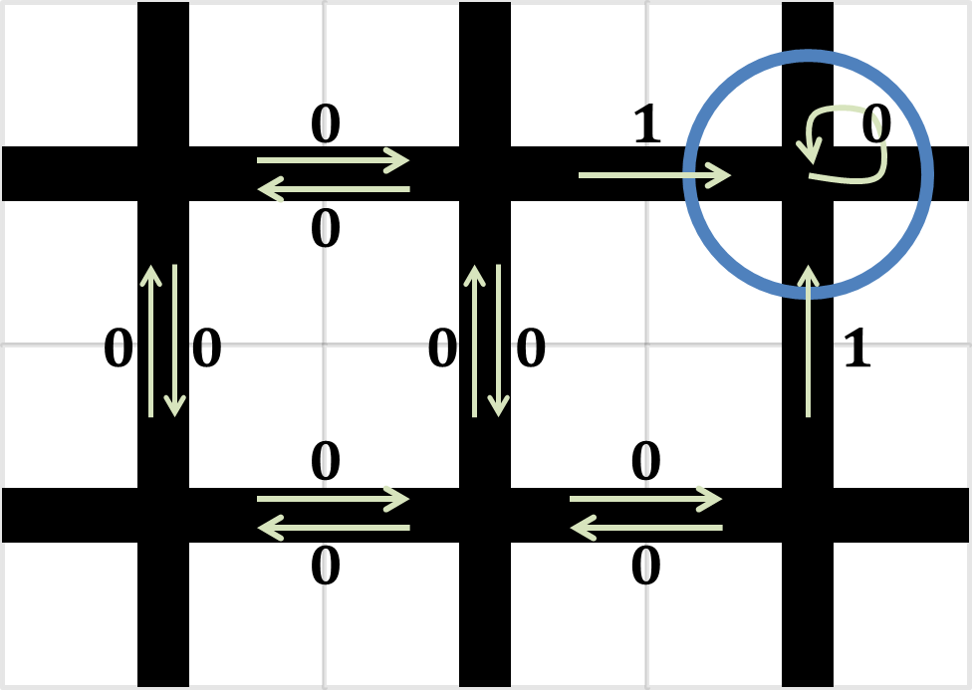
Q-러닝
$$\hat{Q}\left(s,a\right)←r+0.9×\max_{a^{′}}{\hat{Q}\left(s^{′},a^{′}\right)}$$
$\hat{Q}$ 초기 값 : 모두 0
$$0$$
$$0$$
$$0$$
$$0$$
$$0$$
$$0$$
$$0$$
$$0$$
$$0$$
$$0$$
$$0$$
$$0$$
$$0$$

Slide 27
Q-러닝
$$\hat{Q}\left(s,a\right)←r+0.9×\max_{a^{′}}{\hat{Q}\left(s^{′},a^{′}\right)}$$
$$0$$
$$0$$
$$0$$
$$0$$
$$0$$
$$s$$
$$s′$$
$$0$$
$$0$$
$$0$$
$$0$$
$$0$$
$$0$$
$$0$$
$$0$$
$$0$$
$$0$$

Slide 28
Q-러닝
$$\hat{Q}\left(s,a\right)←r+0.9×\max_{a^{′}}{\hat{Q}\left(s^{′},a^{′}\right)}$$
$$0$$
$$0$$
$$0$$
$$0$$
$$0$$
$$s$$
$$0$$
$$0$$
$$0$$
$$0$$
$$0$$
$$0$$
$$0$$
$$0$$
$$s′$$
$$0$$
$$0$$

Slide 29
Q-러닝
$$\hat{Q}\left(s,a\right)←r+0.9×\max_{a^{′}}{\hat{Q}\left(s^{′},a^{′}\right)}$$
$$1$$
$$0$$
$$1$$
$$0$$
$$0$$
$$0$$
$$s$$
$$s′$$
$$0$$
$$0$$
$$0$$
$$0$$
$$0$$
$$0$$
$$0$$
$$0$$
$$0$$
$$0$$

Slide 30
Q-러닝
$$\hat{Q}\left(s,a\right)←r+0.9×\max_{a^{′}}{\hat{Q}\left(s^{′},a^{′}\right)}$$
$$0$$
$$0$$
$$0$$
$$0$$
$$1$$
$$s$$
$$0$$
$$0$$
$$0$$
$$0$$
$$0$$
$$0$$
$$0$$
$$0$$
$$s′$$
$$0$$
$$0$$

Slide 31
Q-러닝
$$\hat{Q}\left(s,a\right)←r+0.9×\max_{a^{′}}{\hat{Q}\left(s^{′},a^{′}\right)}$$
$$0$$
$$0$$
$$0$$
$$0$$
$$1$$
$$s′$$
$$s$$
$$0$$
$$0$$
$$0$$
$$0$$
$$0$$
$$0$$
$$0$$
$$0$$
$$0$$
$$0$$

Slide 32
Q-러닝
$$\hat{Q}\left(s,a\right)←r+0.9×\max_{a^{′}}{\hat{Q}\left(s^{′},a^{′}\right)}$$
$$0$$
$$0$$
$$0$$
$$0$$
$$1$$
$$0$$
$$0$$
$$0$$
$$0$$
$$0$$
$$0$$
$$0$$
$$0$$
$$s$$
$$s′$$
$$0$$
$$0$$

Slide 33
Q-러닝
$$\hat{Q}\left(s,a\right)←r+0.9×\max_{a^{′}}{\hat{Q}\left(s^{′},a^{′}\right)}$$
$$0$$
$$0$$
$$0$$
$$0$$
$$1$$
$$s′$$
$$0$$
$$0$$
$$0$$
$$0$$
$$0$$
$$0$$
$$0$$
$$0$$
$$s$$
$$0$$
$$0$$

Slide 34
Q-러닝
$$\hat{Q}\left(s,a\right)←r+0.9×\max_{a^{′}}{\hat{Q}\left(s^{′},a^{′}\right)}$$
$$0$$
$$0$$
$$0$$
$$0$$
$$1$$
$$0$$
$$0$$
$$0$$
$$0$$
$$0$$
$$0$$
$$0$$
$$0$$
$$s$$
$$s′$$
$$0$$
$$0$$

Slide 35
Q-러닝
$$\hat{Q}\left(s,a\right)←r+0.9×\max_{a^{′}}{\hat{Q}\left(s^{′},a^{′}\right)}$$
$$0$$
$$1$$
$$0$$
$$0$$
$$1$$
$$s′$$
$$0$$
$$0$$
$$0$$
$$0.9$$
$$0$$
$$0$$
$$0$$
$$0$$
$$0$$
$$s$$
$$0$$
$$0$$

Slide 36
Q-러닝
$$\hat{Q}\left(s,a\right)←r+0.9×\max_{a^{′}}{\hat{Q}\left(s^{′},a^{′}\right)}$$
$$0$$
$$0$$
$$0$$
$$0$$
$$1$$
$$0$$
$$0$$
$$0$$
$$0.9$$
$$0$$
$$0$$
$$0$$
$$0$$
$$s′$$
$$s$$
$$0$$
$$0$$

Slide 37
Q-러닝
$$\hat{Q}\left(s,a\right)←r+0.9×\max_{a^{′}}{\hat{Q}\left(s^{′},a^{′}\right)}$$
$$1$$
$$0$$
$$0$$
$$0$$
$$1$$
$$s′$$
$$0$$
$$0$$
$$0$$
$$0.9$$
$$0$$
$$0$$
$$1$$
$$0$$
$$0$$
$$s$$
$$0$$
$$0$$

Slide 38


Q-러닝
$$\hat{Q}\left(s,a\right)←r+0.9×\max_{a^{′}}{\hat{Q}\left(s^{′},a^{′}\right)}$$
$$0$$
$$0.9$$
$$0$$
$$0$$
$$1$$
$$0$$
$$0$$
$$0$$
$$0.9$$
$$0$$
$$1$$
$$0$$
$$0$$
$$s′$$
$$s$$
$$0$$
$$0$$
$$0.81$$

Slide 39
Q-러닝
$$\hat{Q}\left(s,a\right)←r+0.9×\max_{a^{′}}{\hat{Q}\left(s^{′},a^{′}\right)}$$
$$0$$
$$1$$
$$0.9$$
$$0$$
$$0$$
$$1$$
$$s$$
$$s′$$
$$0$$
$$0$$
$$0$$
$$0.9$$
$$0$$
$$1$$
$$0$$
$$0$$
$$0$$
$$0.81$$

Slide 40
Q-러닝
$$\hat{Q}\left(s,a\right)←r+0.9×\max_{a^{′}}{\hat{Q}\left(s^{′},a^{′}\right)}$$
$$0$$
$$0$$
$$0$$
$$0.9$$
$$1$$
$$s$$
$$0$$
$$0$$
$$0$$
$$0.9$$
$$0$$
$$1$$
$$0$$
$$0$$
$$s′$$
$$0$$
$$0.81$$

Slide 41

Q-러닝
$$\hat{Q}\left(s,a\right)←r+0.9×\max_{a^{′}}{\hat{Q}\left(s^{′},a^{′}\right)}$$
$$1$$
$$0$$
$$0$$
$$0.9$$
$$1$$
$$s$$
$$s′$$
$$0$$
$$0$$
$$0$$
$$0.9$$
$$0$$
$$1$$
$$0$$
$$0$$
$$0$$
$$0.81$$

Slide 42
Q-러닝
$$\hat{Q}\left(s,a\right)←r+0.9×\max_{a^{′}}{\hat{Q}\left(s^{′},a^{′}\right)}$$
$$0$$
$$0.9$$
$$0$$
$$0.9$$
$$1$$
$$s$$
$$0$$
$$0$$
$$0$$
$$0.9$$
$$0$$
$$1$$
$$0.81$$
$$0$$
$$0$$
$$s′$$
$$0$$
$$0.81$$

Slide 43
Q-러닝
$$\hat{Q}\left(s,a\right)←r+0.9×\max_{a^{′}}{\hat{Q}\left(s^{′},a^{′}\right)}$$
$$0$$
$$0.9$$
$$0$$
$$0.9$$
$$1$$
$$s′$$
$$s$$
$$0$$
$$0.81$$
$$0$$
$$0$$
$$0.9$$
$$0.81$$
$$1$$
$$0$$
$$0$$
$$0$$
$$0.81$$

Slide 44
Q-러닝
$$\hat{Q}\left(s,a\right)←r+0.9×\max_{a^{′}}{\hat{Q}\left(s^{′},a^{′}\right)}$$
$$0$$
$$0.9$$
$$0$$
$$0.9$$
$$1$$
$$0.81$$
$$0$$
$$0$$
$$0.9$$
$$0.81$$
$$1$$
$$0.81$$
$$0$$
$$0$$
$$s$$
$$s′$$
$$0$$
$$0.81$$

Slide 45
Q-러닝
$$\hat{Q}\left(s,a\right)←r+0.9×\max_{a^{′}}{\hat{Q}\left(s^{′},a^{′}\right)}$$
$$0$$
$$0.9$$
$$0$$
$$0.9$$
$$1$$
$$s′$$
$$0.81$$
$$0$$
$$0$$
$$0.9$$
$$0.81$$
$$1$$
$$0.81$$
$$0.81$$
$$0$$
$$s$$
$$0$$
$$0.81$$

Slide 46
Q-러닝
$$\hat{Q}\left(s,a\right)←r+0.9×\max_{a^{′}}{\hat{Q}\left(s^{′},a^{′}\right)}$$
$$0$$
$$1$$
$$0$$
$$0.9$$
$$1$$
$$0.81$$
$$0.81$$
$$0$$
$$0.9$$
$$0.81$$
$$1$$
$$0.9$$
$$0.81$$
$$0$$
$$s$$
$$s′$$
$$0$$
$$0.81$$

Slide 47
Q-러닝
$$\hat{Q}\left(s,a\right)←r+0.9×\max_{a^{′}}{\hat{Q}\left(s^{′},a^{′}\right)}$$
$$0$$
$$1$$
$$0$$
$$0.9$$
$$1$$
$$s′$$
$$0.81$$
$$0.81$$
$$0$$
$$0.9$$
$$0.81$$
$$1$$
$$0.81$$
$$0.9$$
$$s$$
$$0$$
$$0.81$$

Slide 48
Q-러닝
$$\hat{Q}\left(s,a\right)←r+0.9×\max_{a^{′}}{\hat{Q}\left(s^{′},a^{′}\right)}$$
$$0$$
$$0.81$$
$$0$$
$$0.9$$
$$1$$
$$0.81$$
$$0.81$$
$$0$$
$$0.9$$
$$0.81$$
$$1$$
$$0.81$$
$$0.9$$
$$s′$$
$$s$$
$$0$$
$$0.81$$
$0.7$29

Slide 49
Q-러닝
$$\hat{Q}\left(s,a\right)←r+0.9×\max_{a^{′}}{\hat{Q}\left(s^{′},a^{′}\right)}$$
$$1$$
$$0$$
$$0$$
$$0.9$$
$$1$$
$$s′$$
$$0.81$$
$$0.81$$
$$0$$
$$0.9$$
$$0.81$$
$$1$$
$$0.81$$
$$0.9$$
$$s$$
$$0.729$$
$$0.81$$

Slide 50
Q-러닝
$$\hat{Q}\left(s,a\right)←r+0.9×\max_{a^{′}}{\hat{Q}\left(s^{′},a^{′}\right)}$$
$$0$$
$$0.9$$
$$0$$
$$0.9$$
$$1$$
$$0.81$$
$$0.81$$
$$0$$
$$0.9$$
$$0.81$$
$$1$$
$$0.81$$
$$0.9$$
$$s′$$
$$s$$
$$0.729$$
$$0.81$$

Slide 51
Q-러닝
$$\hat{Q}\left(s,a\right)←r+0.9×\max_{a^{′}}{\hat{Q}\left(s^{′},a^{′}\right)}$$
$$0$$
$$1$$
$$0$$
$$0.9$$
$$1$$
$$s$$
$$s′$$
$$0.81$$
$$0.81$$
$$0$$
$$0.9$$
$$0.81$$
$$1$$
$$0.81$$
$$0.9$$
$$0.729$$
$$0.81$$

Slide 52
Q-러닝
$$\hat{Q}\left(s,a\right)←r+0.9×\max_{a^{′}}{\hat{Q}\left(s^{′},a^{′}\right)}$$
$$0$$
$$0.81$$
$$0$$
$$0.9$$
$$1$$
$$s$$
$$0.81$$
$$0.729$$
$$0.81$$
$$0$$
$$0.9$$
$$0.81$$
$$1$$
$$0.81$$
$$0.9$$
$$s′$$
$$0.729$$
$$0.81$$

Slide 53
Q-러닝
$$\hat{Q}\left(s,a\right)←r+0.9×\max_{a^{′}}{\hat{Q}\left(s^{′},a^{′}\right)}$$
$$1$$
$$0$$
$$0$$
$$0.9$$
$$1$$
$$s$$
$$s′$$
$$0.81$$
$$0.81$$
$$0.729$$
$$0.9$$
$$0.81$$
$$1$$
$$0.81$$
$$0.9$$
$$0.729$$
$$0.81$$

Slide 54
Q-러닝
$$\hat{Q}\left(s,a\right)←r+0.9×\max_{a^{′}}{\hat{Q}\left(s^{′},a^{′}\right)}$$
$$0$$
$$0.9$$
$$0$$
$$0.9$$
$$1$$
$$s$$
$$0.81$$
$$0.81$$
$$0.729$$
$$0.9$$
$$0.81$$
$$1$$
$$0.81$$
$$0.9$$
$$s′$$
$$0.729$$
$$0.81$$

Slide 55
Q-러닝
$$\hat{Q}\left(s,a\right)←r+0.9×\max_{a^{′}}{\hat{Q}\left(s^{′},a^{′}\right)}$$
$$0$$
$$0.9$$
$$0$$
$$0.9$$
$$1$$
$$s′$$
$$s$$
$$0.81$$
$$0.81$$
$$0.729$$
$$0.9$$
$$0.81$$
$$1$$
$$0.81$$
$$0.9$$
$$0.729$$
$$0.81$$

Slide 56
Q-러닝
$$\hat{Q}\left(s,a\right)←r+0.9×\max_{a^{′}}{\hat{Q}\left(s^{′},a^{′}\right)}$$
$$0$$
$$0.9$$
$$0$$
$$0.9$$
$$1$$
$$0.81$$
$$0.81$$
$$0.729$$
$$0.9$$
$$0.81$$
$$1$$
$$0.81$$
$$0.9$$
$$s$$
$$s′$$
$$0.729$$
$$0.81$$

Slide 57
Q-러닝
$$\hat{Q}\left(s,a\right)←r+0.9×\max_{a^{′}}{\hat{Q}\left(s^{′},a^{′}\right)}$$
$$0$$
$$0.9$$
$$0$$
$$0.9$$
$$1$$
$$s′$$
$$0.81$$
$$0.81$$
$$0.729$$
$$0.9$$
$$0.81$$
$$1$$
$$0.81$$
$$0.9$$
$$s$$
$$0.729$$
$$0.81$$

Slide 58
Q-러닝
$$\hat{Q}\left(s,a\right)←r+0.9×\max_{a^{′}}{\hat{Q}\left(s^{′},a^{′}\right)}$$
$$0$$
$$1$$
$$0$$
$$0.9$$
$$1$$
$$0.81$$
$$0.81$$
$$0.729$$
$$0.9$$
$$0.81$$
$$1$$
$$0.81$$
$$0.9$$
$$s$$
$$s′$$
$$0.729$$
$$0.81$$

Slide 59
Q-러닝
$$\hat{Q}\left(s,a\right)←r+0.9×\max_{a^{′}}{\hat{Q}\left(s^{′},a^{′}\right)}$$
$$0$$
$$1$$
$$0$$
$$0.9$$
$$1$$
$$s′$$
$$0.81$$
$$0.81$$
$$0.729$$
$$0.9$$
$$0.81$$
$$1$$
$$0.81$$
$$0.9$$
$$s$$
$$0.729$$
$$0.81$$

Slide 60
Q-러닝
$$\hat{Q}\left(s,a\right)←r+0.9×\max_{a^{′}}{\hat{Q}\left(s^{′},a^{′}\right)}$$
$$0$$
$$0.81$$
$$0$$
$$0.9$$
$$1$$
$$0.81$$
$$0.81$$
$$0.729$$
$$0.9$$
$$0.81$$
$$1$$
$$0.81$$
$$0.9$$
$$s′$$
$$s$$
$$0.729$$
$$0.81$$

Slide 61
Q-러닝
$$\hat{Q}\left(s,a\right)←r+0.9×\max_{a^{′}}{\hat{Q}\left(s^{′},a^{′}\right)}$$
$$1$$
$$0$$
$$0$$
$$0.9$$
$$1$$
$$s′$$
$$0.81$$
$$0.81$$
$$0.729$$
$$0.9$$
$$0.81$$
$$1$$
$$0.81$$
$$0.9$$
$$s$$
$$0.729$$
$$0.81$$

Slide 62
Q-러닝
$$\hat{Q}\left(s,a\right)←r+0.9×\max_{a^{′}}{\hat{Q}\left(s^{′},a^{′}\right)}$$
$$0$$
$$0.9$$
$$0$$
$$0.9$$
$$1$$
$$0.81$$
$$0.81$$
$$0.729$$
$$0.9$$
$$0.81$$
$$1$$
$$0.81$$
$$0.9$$
$$s′$$
$$s$$
$$0.729$$
$$0.81$$

Slide 63
Q-러닝
변화가 없을 때까지 계속 반복
$$0$$
$$0.9$$
$$1$$
$$0.81$$
$$0.81$$
$$0.729$$
$$0.9$$
$$0.81$$
$$1$$
$$0.81$$
$$0.9$$
$$0.729$$
$$0.81$$

Slide 64
Q-러닝
$$π^{∗}\left(s\right)=\underset{a}{argmax}{Q\left(s,a\right)}$$
최적의 정책(policy)
$$π^{∗}\left(s\right)$$
각 상태에서 Q값이 가장 큰 행동
$$0$$
$$0.9$$
$$1$$
$$0.81$$
$$0.81$$
$$0.729$$
$$0.9$$
$$0.81$$
$$1$$
$$0.81$$
$$0.9$$
$$0.729$$
$$0.81$$

Slide 65
Q-러닝
$$π^{∗}\left(s\right)=\underset{a}{argmax}{Q\left(s,a\right)}$$
최적의 정책(policy)
$$π^{∗}\left(s\right)$$
각 상태에서 Q값이 가장 큰 행동

Slide 66
Q-러닝
실제 상황에서는 학습을 완료한 후
행동하는 것이 아닐 수 있다.
$Q\left(s,a\right)$가 아니라 $\hat{Q}\left(s,a\right)$가 최대인 행동 선택
$$\hat{Q}\left(s,a\right)←r+γ\max_{a^{′}}{\hat{Q}\left(s^{′},a^{′}\right)}$$
모든 상태에서의 모든 행동을 계속 경험하면
$\hat{Q}\left(s,a\right)→Q\left(s,a\right)$로 수렴
$$0.9$$
$$π^{∗}\left(s\right)=\underset{a}{argmax}{Q\left(s,a\right)}$$
각 상태에서 $Q\left(s,a\right)$가 최대인 행동($a$)을 취하면 됨

Slide 67
Q-러닝
$$\hat{Q}\left(s,a\right)←r+0.9×\max_{a^{′}}{\hat{Q}\left(s^{′},a^{′}\right)}$$
$\hat{Q}$ 초기 값 : 모두 0
$$0$$
$$0$$
$$0$$
$$0$$
$$0$$
$$0$$
$$0$$
$$0$$
$$0$$
$$0$$
$$0$$
$$0$$
$$0$$

Slide 68
Q-러닝
$$\hat{Q}\left(s,a\right)←r+0.9×\max_{a^{′}}{\hat{Q}\left(s^{′},a^{′}\right)}$$
출발 위치: 왼쪽 아래
$$0$$
$$0$$
$$s$$
$\hat{Q}$가 같으면 랜덤으로 행동 선택

Slide 69
Q-러닝
$$\hat{Q}\left(s,a\right)←r+0.9×\max_{a^{′}}{\hat{Q}\left(s^{′},a^{′}\right)}$$
$$0$$
$$0$$
$$0$$
$$s′$$
$$0$$
$$0$$
$$s$$

Slide 70
Q-러닝
$$\hat{Q}\left(s,a\right)←r+0.9×\max_{a^{′}}{\hat{Q}\left(s^{′},a^{′}\right)}$$
$$0$$
$$s$$
$$0$$
$\hat{Q}$가 같으면 랜덤으로 행동 선택

Slide 71
Q-러닝
$$\hat{Q}\left(s,a\right)←r+0.9×\max_{a^{′}}{\hat{Q}\left(s^{′},a^{′}\right)}$$
$$0$$
$$0$$
$$0$$
$$0$$
$$s$$
$$s′$$
$$0$$
$$0$$

Slide 72
Q-러닝
$$\hat{Q}\left(s,a\right)←r+0.9×\max_{a^{′}}{\hat{Q}\left(s^{′},a^{′}\right)}$$
$$0$$
$$s$$
$$0$$
$$0$$
$\hat{Q}$가 같으면 랜덤으로 행동 선택

Slide 73
Q-러닝
$$\hat{Q}\left(s,a\right)←r+0.9×\max_{a^{′}}{\hat{Q}\left(s^{′},a^{′}\right)}$$
$$0$$
$$0$$
$$s$$
$$0$$
$$0$$
$$0$$
$$s′$$
$$0$$

Slide 74
Q-러닝
$$\hat{Q}\left(s,a\right)←r+0.9×\max_{a^{′}}{\hat{Q}\left(s^{′},a^{′}\right)}$$
$$0$$
$$0$$
$$s$$
$$0$$
$\hat{Q}$가 같으면 랜덤으로 행동 선택

Slide 75
Q-러닝
$$\hat{Q}\left(s,a\right)←r+0.9×\max_{a^{′}}{\hat{Q}\left(s^{′},a^{′}\right)}$$
$$0$$
$$0$$
$$0$$
$$0$$
$$s$$
$$s′$$
$$0$$

Slide 76
Q-러닝
$$\hat{Q}\left(s,a\right)←r+0.9×\max_{a^{′}}{\hat{Q}\left(s^{′},a^{′}\right)}$$
$$0$$
$$s$$
$$0$$
$\hat{Q}$가 같으면 랜덤으로 행동 선택

Slide 77
Q-러닝
$$\hat{Q}\left(s,a\right)←r+0.9×\max_{a^{′}}{\hat{Q}\left(s^{′},a^{′}\right)}$$
$$1$$
$$0$$
$$0$$
$$s′$$
$$0$$
$$1$$
$$s$$

Slide 78
Q-러닝
$$\hat{Q}\left(s,a\right)←r+0.9×\max_{a^{′}}{\hat{Q}\left(s^{′},a^{′}\right)}$$
$$0$$
$$0$$
$$s$$
$\hat{Q}$가 같으면 랜덤으로 행동 선택

Slide 79
Q-러닝
$$\hat{Q}\left(s,a\right)←r+0.9×\max_{a^{′}}{\hat{Q}\left(s^{′},a^{′}\right)}$$
$$0$$
$$0$$
$$0$$
$$s′$$
$$0$$
$$0$$
$$s$$

Slide 80
Q-러닝
$$\hat{Q}\left(s,a\right)←r+0.9×\max_{a^{′}}{\hat{Q}\left(s^{′},a^{′}\right)}$$
$$0$$
$$s$$
$$0$$
$\hat{Q}$가 같으면 랜덤으로 행동 선택

Slide 81
Q-러닝
$$\hat{Q}\left(s,a\right)←r+0.9×\max_{a^{′}}{\hat{Q}\left(s^{′},a^{′}\right)}$$
$$0$$
$$0$$
$$0$$
$$0$$
$$s$$
$$s′$$
$$0$$
$$0$$

Slide 82
Q-러닝
$$\hat{Q}\left(s,a\right)←r+0.9×\max_{a^{′}}{\hat{Q}\left(s^{′},a^{′}\right)}$$
$$0$$
$$s$$
$$0$$
$$0$$
$\hat{Q}$가 같으면 랜덤으로 행동 선택

Slide 83
Q-러닝
$$\hat{Q}\left(s,a\right)←r+0.9×\max_{a^{′}}{\hat{Q}\left(s^{′},a^{′}\right)}$$
$$0$$
$$0$$
$$s$$
$$0$$
$$0$$
$$0$$
$$s′$$
$$0$$

Slide 84
Q-러닝
$$\hat{Q}\left(s,a\right)←r+0.9×\max_{a^{′}}{\hat{Q}\left(s^{′},a^{′}\right)}$$
$$0$$
$$0$$
$$s$$
$$0$$
$\hat{Q}$가 같으면 랜덤으로 행동 선택

Slide 85
Q-러닝
$$\hat{Q}\left(s,a\right)←r+0.9×\max_{a^{′}}{\hat{Q}\left(s^{′},a^{′}\right)}$$
$$0$$
$$1$$
$$1$$
$$0.9$$
$$0$$
$$s$$
$$s′$$
$$0$$

Slide 86
Q-러닝
$$\hat{Q}\left(s,a\right)←r+0.9×\max_{a^{′}}{\hat{Q}\left(s^{′},a^{′}\right)}$$
$$1$$
$$s$$
$$0$$

Slide 87
Q-러닝
$$\hat{Q}\left(s,a\right)←r+0.9×\max_{a^{′}}{\hat{Q}\left(s^{′},a^{′}\right)}$$
$$1$$
$$0$$
$$0$$
$$s′$$
$$1$$
$$s$$

Slide 88
Q-러닝
$$\hat{Q}\left(s,a\right)←r+0.9×\max_{a^{′}}{\hat{Q}\left(s^{′},a^{′}\right)}$$
$$0$$
$$0$$
$$s$$
$\hat{Q}$가 같으면 랜덤으로 행동 선택

Slide 89
Q-러닝
$$\hat{Q}\left(s,a\right)←r+0.9×\max_{a^{′}}{\hat{Q}\left(s^{′},a^{′}\right)}$$
$$0$$
$$0$$
$$0$$
$$s′$$
$$0$$
$$0$$
$$s$$

Slide 90
Q-러닝
$$\hat{Q}\left(s,a\right)←r+0.9×\max_{a^{′}}{\hat{Q}\left(s^{′},a^{′}\right)}$$
$$0$$
$$s$$
$$0$$
$\hat{Q}$가 같으면 랜덤으로 행동 선택

Slide 91
Q-러닝
$$\hat{Q}\left(s,a\right)←r+0.9×\max_{a^{′}}{\hat{Q}\left(s^{′},a^{′}\right)}$$
$$0$$
$$0$$
$$0$$
$$0$$
$$s$$
$$s′$$
$$0$$
$$0$$

Slide 92
Q-러닝
$$\hat{Q}\left(s,a\right)←r+0.9×\max_{a^{′}}{\hat{Q}\left(s^{′},a^{′}\right)}$$
$$0$$
$$s$$
$$0$$
$$0$$
$\hat{Q}$가 같으면 랜덤으로 행동 선택

Slide 93
Q-러닝
$$\hat{Q}\left(s,a\right)←r+0.9×\max_{a^{′}}{\hat{Q}\left(s^{′},a^{′}\right)}$$
$$0$$
$$0.9$$
$$s$$
$$0$$
$$0$$
$$0.81$$
$$0.9$$
$$s′$$
$$0$$

Slide 94
Q-러닝
$$\hat{Q}\left(s,a\right)←r+0.9×\max_{a^{′}}{\hat{Q}\left(s^{′},a^{′}\right)}$$
$$0$$
$$0.9$$
$$s$$
$$0$$

Slide 95
Q-러닝
$$\hat{Q}\left(s,a\right)←r+0.9×\max_{a^{′}}{\hat{Q}\left(s^{′},a^{′}\right)}$$
$$0$$
$$1$$
$$1$$
$$0.9$$
$$s$$
$$s′$$
$$0$$

Slide 96
Q-러닝
$$\hat{Q}\left(s,a\right)←r+0.9×\max_{a^{′}}{\hat{Q}\left(s^{′},a^{′}\right)}$$
$$1$$
$$s$$
$$0$$

Slide 97
Q-러닝
$$\hat{Q}\left(s,a\right)←r+0.9×\max_{a^{′}}{\hat{Q}\left(s^{′},a^{′}\right)}$$
$$1$$
$$0$$
$$0$$
$$s′$$
$$1$$
$$s$$

Slide 98
Q-러닝
$$\hat{Q}\left(s,a\right)←r+0.9×\max_{a^{′}}{\hat{Q}\left(s^{′},a^{′}\right)}$$
$$0$$
$$0$$
$$s$$
$\hat{Q}$가 같으면 랜덤으로 행동 선택

Slide 99
Q-러닝
$$\hat{Q}\left(s,a\right)←r+0.9×\max_{a^{′}}{\hat{Q}\left(s^{′},a^{′}\right)}$$
$$0$$
$$0$$
$$0$$
$$s′$$
$$0$$
$$0$$
$$s$$

Slide 100
Q-러닝
$$\hat{Q}\left(s,a\right)←r+0.9×\max_{a^{′}}{\hat{Q}\left(s^{′},a^{′}\right)}$$
$$0$$
$$s$$
$$0$$
$\hat{Q}$가 같으면 랜덤으로 행동 선택

Slide 101
Q-러닝
$$\hat{Q}\left(s,a\right)←r+0.9×\max_{a^{′}}{\hat{Q}\left(s^{′},a^{′}\right)}$$
$$0$$
$$0.81$$
$0.72$9
$$0$$
$$0$$
$$s$$
$$s′$$
$$0$$
$$0.81$$

Slide 102
Q-러닝
$$\hat{Q}\left(s,a\right)←r+0.9×\max_{a^{′}}{\hat{Q}\left(s^{′},a^{′}\right)}$$
$$0$$
$$s$$
$$0$$
$$0.81$$

Slide 103
Q-러닝
$$\hat{Q}\left(s,a\right)←r+0.9×\max_{a^{′}}{\hat{Q}\left(s^{′},a^{′}\right)}$$
$$0$$
$$0.9$$
$$s$$
$$0$$
$$0.81$$
$$0.9$$
$$s′$$
$$0$$

Slide 104
Q-러닝
$$\hat{Q}\left(s,a\right)←r+0.9×\max_{a^{′}}{\hat{Q}\left(s^{′},a^{′}\right)}$$
$$0$$
$$0.9$$
$$s$$
$$0$$

Slide 105
Q-러닝
Q-러닝
$$\hat{Q}\left(s,a\right)←r+0.9×\max_{a^{′}}{\hat{Q}\left(s^{′},a^{′}\right)}$$
$$0$$
$$1$$
$$1$$
$$0.9$$
$$s$$
$$s′$$
$$0$$

Slide 106
Q-러닝
Q-러닝
$$\hat{Q}\left(s,a\right)←r+0.9×\max_{a^{′}}{\hat{Q}\left(s^{′},a^{′}\right)}$$
$$1$$
$$s$$
$$0$$

Slide 107
Q-러닝
Q-러닝
$$\hat{Q}\left(s,a\right)←r+0.9×\max_{a^{′}}{\hat{Q}\left(s^{′},a^{′}\right)}$$
$$1$$
$$0$$
$$0$$
$$s′$$
$$1$$
$$s$$

Slide 108
Q-러닝
Q-러닝
$$\hat{Q}\left(s,a\right)←r+0.9×\max_{a^{′}}{\hat{Q}\left(s^{′},a^{′}\right)}$$
$$0$$
$$0$$
$$s$$
$\hat{Q}$가 같으면 랜덤으로 행동 선택

Slide 109
Q-러닝
Q-러닝
$$\hat{Q}\left(s,a\right)←r+0.9×\max_{a^{′}}{\hat{Q}\left(s^{′},a^{′}\right)}$$
$$0$$
$$0.729$$
$$0.729$$
$$s′$$
$$0$$
$$0$$
$$0.6561$$
$$s$$

Slide 110
Q-러닝
Q-러닝
$$\hat{Q}\left(s,a\right)←r+0.9×\max_{a^{′}}{\hat{Q}\left(s^{′},a^{′}\right)}$$
$$0.729$$
$$s$$
$$0$$

Slide 111
Q-러닝
Q-러닝
$$\hat{Q}\left(s,a\right)←r+0.9×\max_{a^{′}}{\hat{Q}\left(s^{′},a^{′}\right)}$$
$$0$$
$$0.81$$
$$0.729$$
$$0$$
$$s$$
$$s′$$
$$0$$
$$0.81$$

Slide 112
Q-러닝
Q-러닝
$$\hat{Q}\left(s,a\right)←r+0.9×\max_{a^{′}}{\hat{Q}\left(s^{′},a^{′}\right)}$$
$$0$$
$$s$$
$$0$$
$$0.81$$

Slide 113
Q-러닝
Q-러닝
$$\hat{Q}\left(s,a\right)←r+0.9×\max_{a^{′}}{\hat{Q}\left(s^{′},a^{′}\right)}$$
$$0$$
$$0.9$$
$$s$$
$$0$$
$$0.81$$
$$0.9$$
$$s′$$
$$0$$

Slide 114
Q-러닝
Q-러닝
$$\hat{Q}\left(s,a\right)←r+0.9×\max_{a^{′}}{\hat{Q}\left(s^{′},a^{′}\right)}$$
$$0$$
$$0.9$$
$$s$$
$$0$$

Slide 115
Q-러닝
Q-러닝
$$\hat{Q}\left(s,a\right)←r+0.9×\max_{a^{′}}{\hat{Q}\left(s^{′},a^{′}\right)}$$
$$0$$
$$1$$
$$1$$
$$0.9$$
$$s$$
$$s′$$
$$0$$

Slide 116
Q-러닝
Q-러닝
$$\hat{Q}\left(s,a\right)←r+0.9×\max_{a^{′}}{\hat{Q}\left(s^{′},a^{′}\right)}$$
$$1$$
$$s$$
$$0$$

Slide 117
Q-러닝
Q-러닝
$$\hat{Q}\left(s,a\right)←r+0.9×\max_{a^{′}}{\hat{Q}\left(s^{′},a^{′}\right)}$$
$$1$$
$$0$$
$$0$$
$$s′$$
$$1$$
$$s$$

Slide 118
Q-러닝
변화가 없을 때까지 계속 반복
$$0$$
$$0.729$$
$$0$$
$$0$$
$$0.6561$$
$$0$$
$$0$$
$$0.81$$
$$1$$
$$0$$
$$0.9$$
$$0$$
$$0$$

Slide 119
Q-러닝
$$π^{∗}\left(s\right)=\underset{a}{argmax}{Q\left(s,a\right)}$$
최적의 정책(policy)
$$π^{∗}\left(s\right)$$
각 상태에서 Q값이 가장 큰 행동
$$0$$
$$0.729$$
$$0$$
$$0$$
$$0.6561$$
$$0$$
$$0$$
$$0.81$$
$$1$$
$$0$$
$$0.9$$
$$0$$
$$0$$

Slide 120
Q-러닝
$$π^{∗}\left(s\right)=\underset{a}{argmax}{Q\left(s,a\right)}$$
최적의 정책(policy)
$$π^{∗}\left(s\right)$$
각 상태에서 Q값이 가장 큰 행동

Slide 121
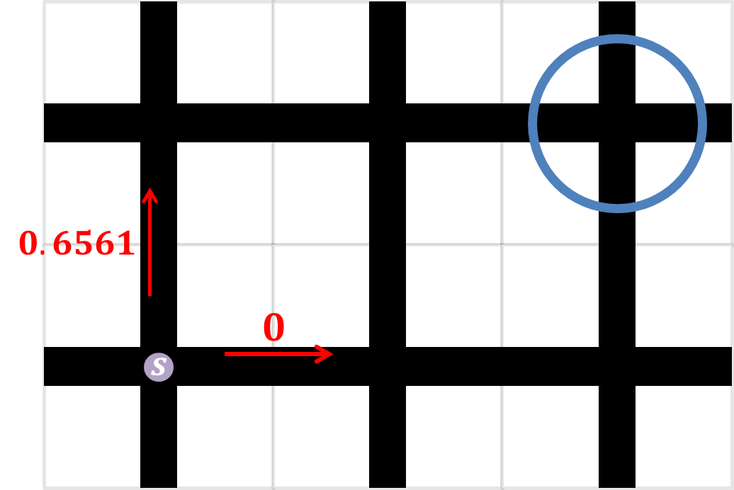
탐험(exploration)과 착취(exploitation)
$$p\left(a_{i}\left|s\right.\right)=\frac{κ^{\hat{Q}\left(s,a_{i}\right)}}{\sum_{j}{κ^{\hat{Q}\left(s,a_{j}\right)}}}$$
$$κ>0$$
$$κ^{\hat{Q}\left(s,a_{up}\right)}={0.1}^{0.6561}=0.22$$
$$p\left(a_{up}\left|s\right.\right)=\frac{0.22}{0.22+1}=0.18$$
$$κ=0.1$$
$$κ^{\hat{Q}\left(s,a_{right}\right)}={0.1}^{0}=1$$
$$p\left(a_{right}\left|s\right.\right)=\frac{1}{0.22+1}=0.82$$
$κ^{\hat{Q}\left(s,a_{up}\right)}={10}^{0.6561}=4.5$3
$$p\left(a_{up}\left|s\right.\right)=\frac{4.53}{4.53+1}=0.82$$
$$κ=10$$
$$κ^{\hat{Q}\left(s,a_{right}\right)}={10}^{0}=1$$
$$p\left(a_{right}\left|s\right.\right)=\frac{1}{4.53+1}=0.18$$

Slide 122
탐험(exploration)과 착취(exploitation)
랜덤 노이즈: $\hat{Q}\left(s,a\right)$+노이즈
$ε$-그리디(greedy):
$ε$ 확률로 탐험
$\left(1−ε\right)$ 확률로 착취(Q값에 따라 행동)
감소하는 $ε$-그리디(decaying $ε$-greedy):
$ε$ 값을 점점 줄여 가며 $ε$-그리디

Slide 123
함정 추가
$$−1$$
$$1$$
$$0$$
$$0$$
$$0$$
$$0$$
-1
$$0$$
$$1$$
$$0$$
$$0$$
$$0$$
$$0$$

Slide 124
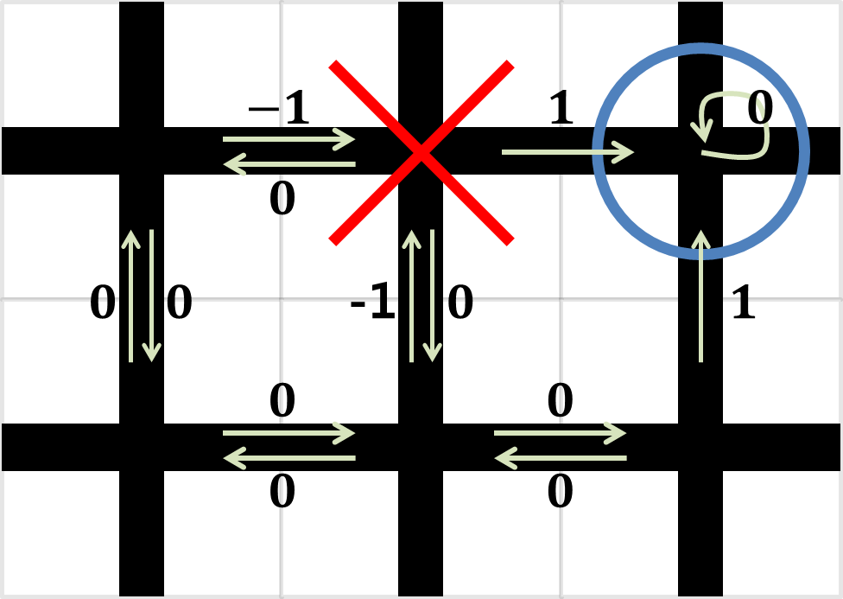
함정 추가
$$\hat{Q}\left(s,a\right)←r+γ\max_{a^{′}}{\hat{Q}\left(s^{′},a^{′}\right)}$$
$$0$$
$−0.$1
$$1$$
$0.$63
$$0.63$$
$$0.72$$
$−0.$1
$$0.81$$
$$1$$
$$0.81$$
$$0.9$$
$$0.72$$
$$0.81$$

Slide 125
함정 추가
$$π^{∗}\left(s\right)=\underset{a}{argmax}{Q\left(s,a\right)}$$
최적의 정책(policy)
$$π^{∗}\left(s\right)$$
각 상태에서 Q값이 가장 큰 행동
$$0$$
$−0.$1
$$1$$
$0.$63
$$0.63$$
$$0.72$$
$−0.$1
$$0.81$$
$$1$$
$$0.81$$
$$0.9$$
$$0.72$$
$$0.81$$

Slide 126
함정 추가
$$π^{∗}\left(s\right)=\underset{a}{argmax}{Q\left(s,a\right)}$$
최적의 정책(policy)
$$π^{∗}\left(s\right)$$
각 상태에서 Q값이 가장 큰 행동

Slide 127
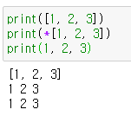
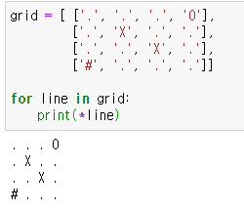
파이썬 코드

Slide 128
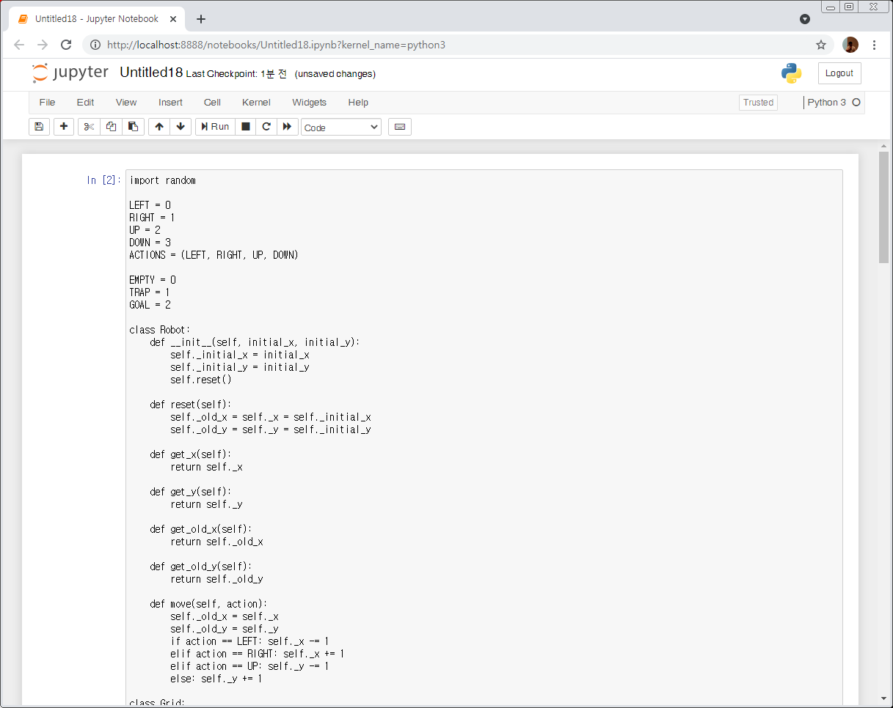
파이썬 코드
0,0 | 1,0 | 2,0 | 3,0
0,1 | 1,1 | 2,1 | 3,1
0,2 | 1,2 | 2,2 | 3,2
0,3 | 1,3 | 2,3 | 3,3

Slide 129
파이썬 코드
0,0 | 1,0 | 2,0 | 3,0
0,1 | 1,1 | 2,1 | 3,1
0,2 | 1,2 | 2,2 | 3,2
0,3 | 1,3 | 2,3 | 3,3

Slide 130
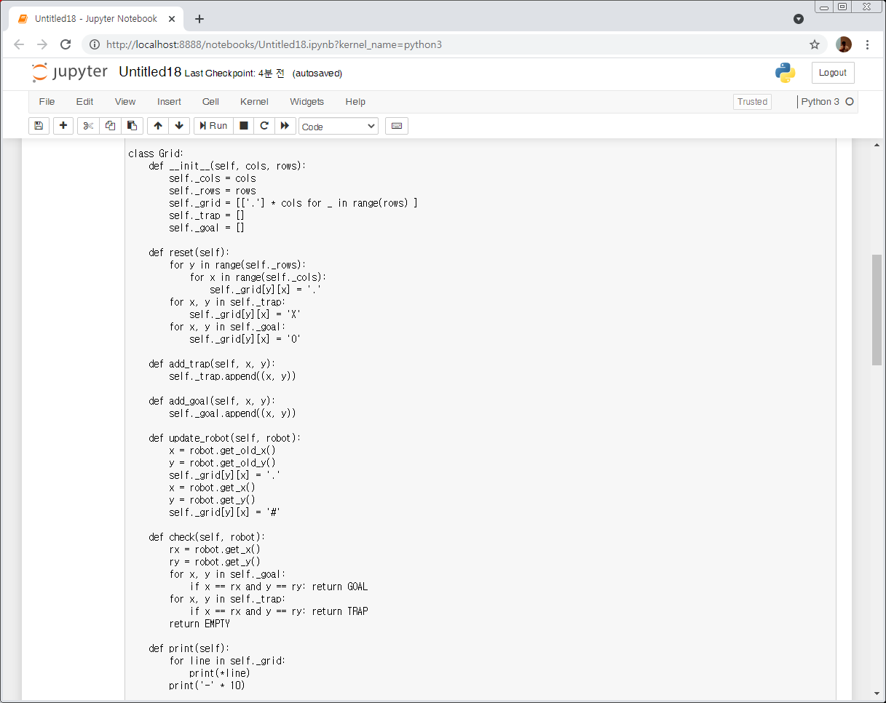
파이썬 코드
0,0 | 1,0 | 2,0 | 3,0
0,1 | 1,1 | 2,1 | 3,1
0,2 | 1,2 | 2,2 | 3,2
0,3 | 1,3 | 2,3 | 3,3

Slide 131
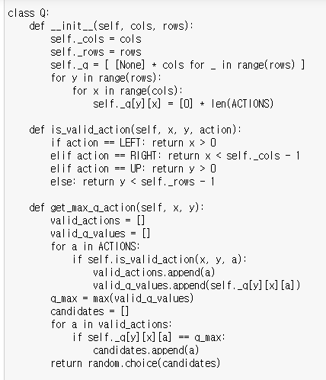
파이썬 코드
0,0 | 1,0 | 2,0 | 3,0
0,1 | 1,1 | 2,1 | 3,1
0,2 | 1,2 | 2,2 | 3,2
0,3 | 1,3 | 2,3 | 3,3

Slide 132
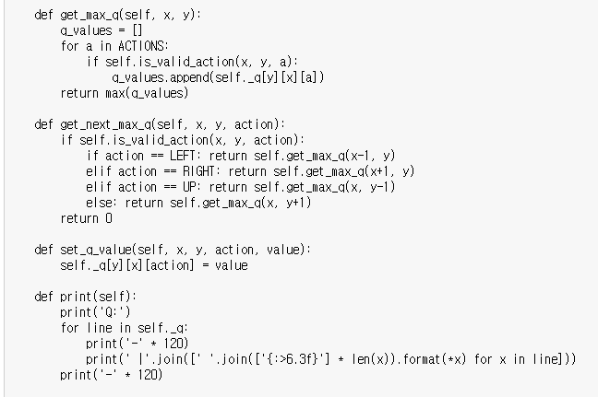
파이썬 코드
0,0 | 1,0 | 2,0 | 3,0
0,1 | 1,1 | 2,1 | 3,1
0,2 | 1,2 | 2,2 | 3,2
0,3 | 1,3 | 2,3 | 3,3

Slide 133
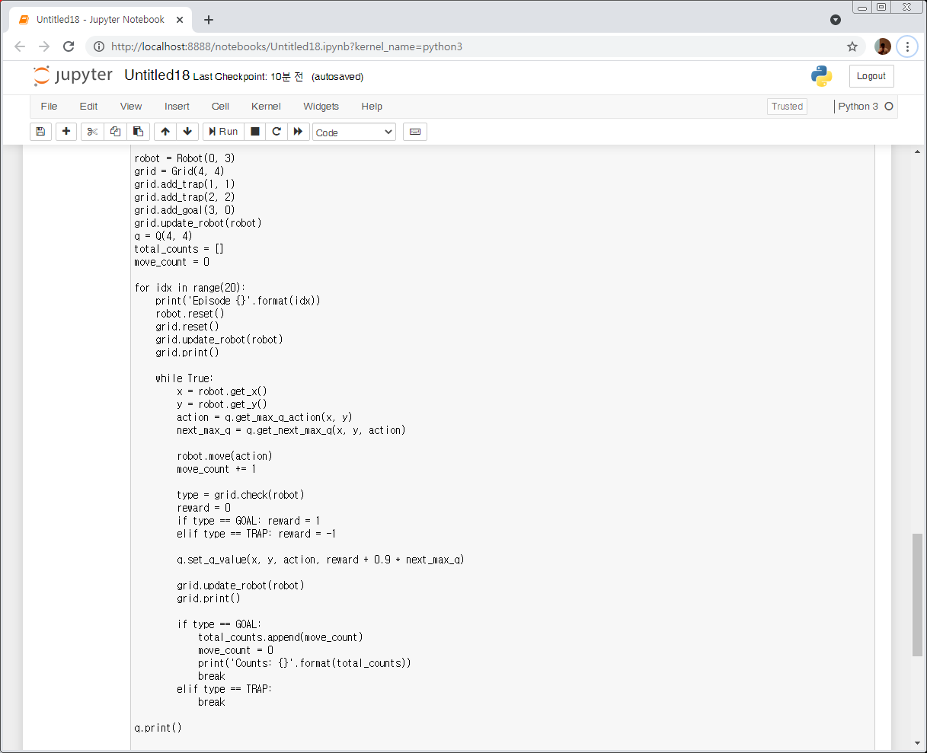
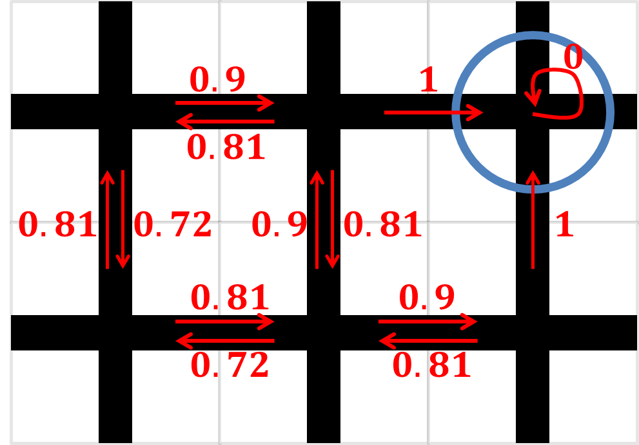
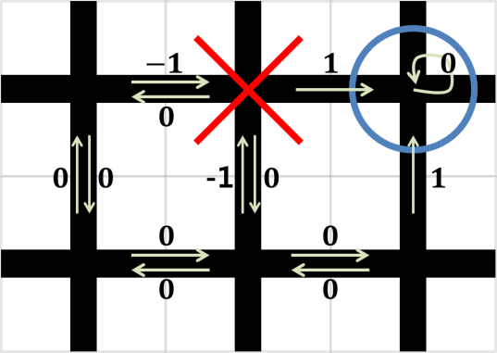


파이썬 코드
$$\hat{Q}\left(s,a\right)$$
0,0 | 1,0 | 2,0 | 3,0
0,1 | 1,1 | 2,1 | 3,1
0,2 | 1,2 | 2,2 | 3,2
0,3 | 1,3 | 2,3 | 3,3
보상
$$r$$

Slide 134
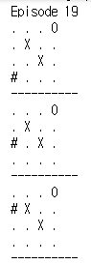
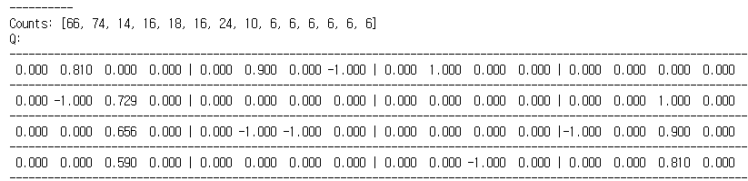
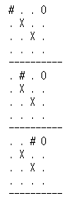
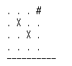
파이썬 코드
0,0 | 1,0 | 2,0 | 3,0
0,1 | 1,1 | 2,1 | 3,1
0,2 | 1,2 | 2,2 | 3,2
0,3 | 1,3 | 2,3 | 3,3

Slide 135
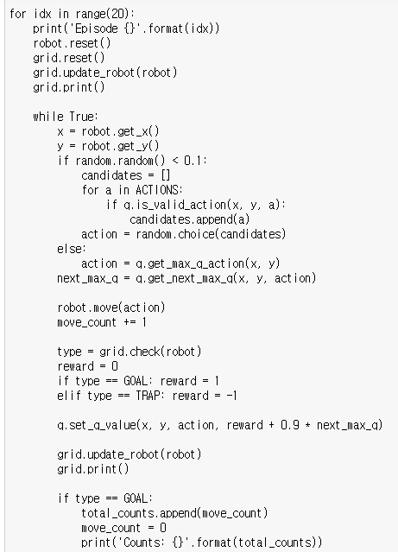

$ε$-그리디(greedy)

Slide 136
상태
에이전트 (agent)
환경 (environment)
행동 (action)
상태 (state)
보상 (reward)

Slide 137
상태
상태 : 로봇의 위치(x, y)
Q(x, y, a)
상태 : 로봇의 위치(x, y)와 방향

Slide 138
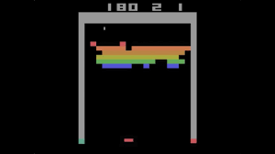
상태
아타리 벽돌 게임 (DeepMind)
https://youtu.be/V1eYniJ0Rnk

