Slide 1

Redskies Online
Effortless Shopping. Powerful Platform.
Presented by: Josphat Ndungu, Founder & CEO

Slide 2
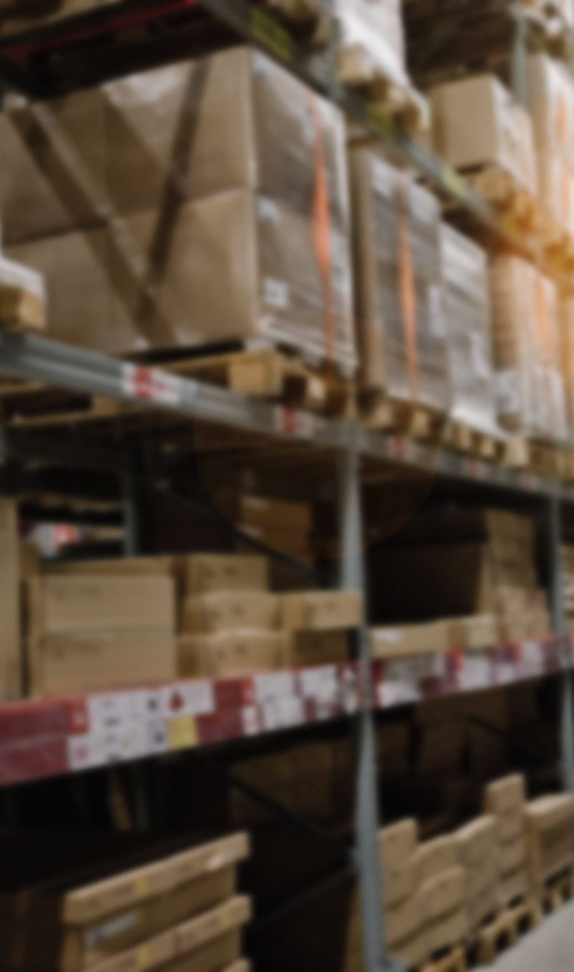
Problem or Idea
Problem:
- Many small businesses struggle to sell online due to lack of technical skills and logistics challenges.
- Customers often face poor service, limited selection, and slow delivery.
Idea:
- Redskies Online solves these issues by building online stores, managing logistics, handling inventory, providing customer service, and implementing marketing strategies.

Slide 3
Solution
- All-in-one platform for online store creation
- Integrated logistics and inventory management
- Secure and fast checkout process
- Excellent customer support
- Effective marketing tools for seller growth

Slide 4
Product
Redskies Online Platform
Discover, shop, and save like never before with Redskies Online — the ultimate eCommerce solution for modern shoppers.
Browse fashion, electronics, groceries, and more. Enjoy seamless shopping with secure payments and lightning-fast delivery.

Slide 5
Key Statistics
2 out of 5 – eCommerce users churn due to poor service
95% – Of online shoppers prioritize platforms with faster delivery and better UX
123 million – Active monthly online shoppers across our regions

Slide 6
Target Market
Item 1: Age 18–45 (20%)
Item 2: Both genders (20%)
Item 3: Middle to high income (20%)
Item 4: Urban tech-savvy individuals (20%)
Item 5: Frequent online buyers (20%)

Slide 7
Market Size
Global Market: $6.3 trillion eCommerce revenue by 2024
Africa: $75B eCommerce opportunity by 2025
Kenya: Rapid smartphone & internet penetration, rising demand for localized solutions

Slide 8
Competitors
Direct Competitors:
- Amazon, Shopify, eBay, Walmart.com, Temu
Why We're Different:
- Africa-first focus
- Affordable, localized logistics
- Vendor growth tools built in
- Real-time customer service

Slide 9

Competitive Advantage
- End-to-end support for sellers
- Custom storefronts with ease
- Fast delivery using local logistics
- Data-driven marketing and analytics
- Scalable architecture for multi-region expansion

Slide 10
Project Traction
Month 1–2: MVP development and pilot onboarding
Month 3: Launch with 50+ merchants
Month 4: Begin regional marketing campaigns
Month 5: Reach 10,000+ customers
Month 6: Expand to neighboring countries

Slide 11
Business Model
Revenue Streams:
- Product Sales Commission
- Subscription-Based Vendor Plans
- Sponsored Listings & Ads
Margins: High scalability with 60–70% gross margin potential on platform services

Slide 12

Go-To-Market Strategy
Target Market: East Africa, starting in Kenya
Positioning: Affordable, mobile-first eCommerce platform for underserved regions
Marketing Channels:
- Social media & influencer marketing
- SEO and content marketing
- Vendor referrals and promotions

Slide 13

Social Impact
- SDG 8: Creating jobs and empowering SMEs
- SDG 12: Promoting responsible consumption and local products
- SDG 13: Eco-friendly logistics and packaging initiatives

Slide 14
Our Ask
Funding Request: $250,000
Use of Funds:
- 40% – Platform Development
- 35% – Marketing & User Growth
- 15% – Logistics & Operations
- 10% – Hiring and Admin Costs

Slide 15
Team Members
- Josphat Ndungu – Founder & CEO
- Wanganga – Chief Technology Officer (CTO)
- Omondi K. – Chief Marketing Officer (CMO)
- Jane Kimani – Chief Financial Officer (CFO)

Slide 16
Thank You / Contact
Josphat Ndungu
Founder & CEO, Redskies Online
📧 josphatmukuha24@gmail.com
📞 +123 456 7890
🔗 linkedin.com/in/josphatndungu
🌐 www.yourcompany.com
📷 @yourcompanyhandle

