Slide 1

Prediction of German Air Fares
Presented by: Dominik Geffert, Jossin Antony, Yassine Ben Slama

Slide 2
Presentation Outline
Goal of the project
Data understanding
Data preparation
Modeling
Polynomial Regression
KNN Regression
Regression Tree
Random Forest
Conclusion

Slide 3
Goal of the project
The dataset: German domestic airfares between major airports in Germany.
Source: https://www.kaggle.com/datasets/darjand/domestic-german-air-fares)
Data generation mode: web scraping
Time period considered: 25-10-2019 to 24-04-2020 (6 months).
Total entries: (62626, 10)
“To be able to predict the air fares for local German flights”

Slide 4
Data Understanding & Preparation
Existent Features:
Departure city
Arrival city
Scrape date
Departure date
Departure date distance
Departure time
Arrival time
Airline
Stops
Price (€)
Additional Features:
Departure weekday
Departure time (Hour)
Travel time
Days until next holiday
Note:
Scrape period: 7 days (18 -24.10.2019)
42 unique departure dates
Departure date frequencies: 1 day, - 5,11, 44, 85 days

Slide 5
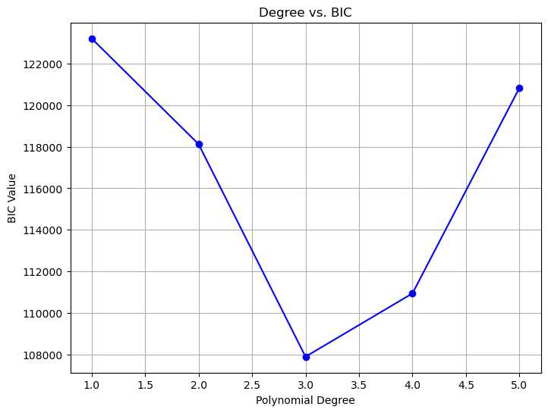
Modeling- Polynomial regression
Bayesian Information Criteria (BIC)
BIC = ln(MSE)+k*ln(n)
Optimal degree of polynomial according to BIC = 3

Slide 6
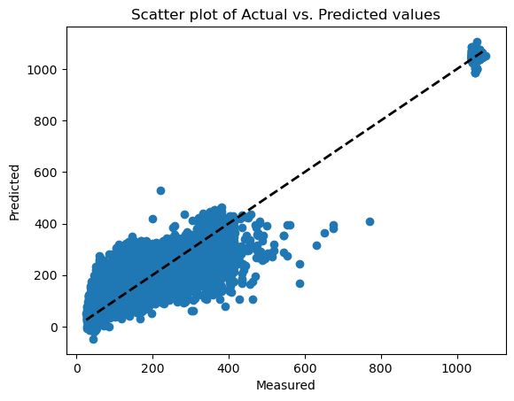
Modeling- Polynomial regression
Naive Evaluation:
MSE: 29285.80
RMSE: 171.13
R2 Score: ~0
std deviation: 171.13
Model Evaluation:
MSE: 4809.76
RMSE: 69.35
R2 Score: 0.836
Mean Absolute Error: 52.74
Cross Validation(5 fold) Evaluation:
AVG MSE: 4933.41
AVG RMSE: 70.24

Slide 7
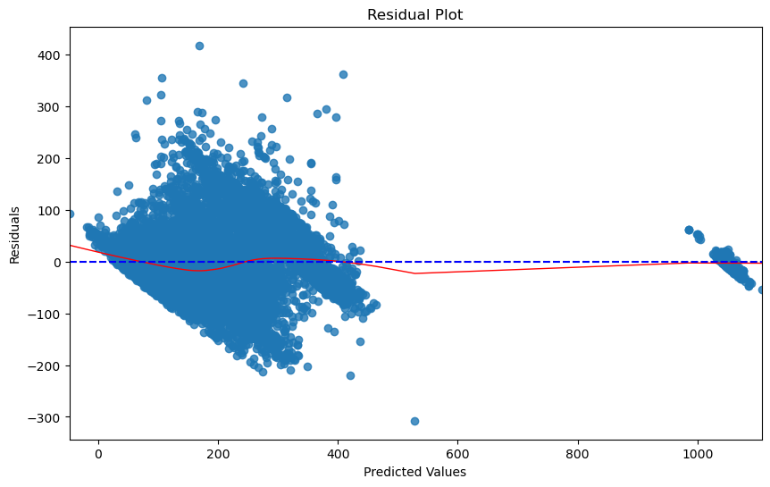
Polynomial regression – Residual Plot
Observation:
Zero-centricity
Absence of patterns

Slide 8
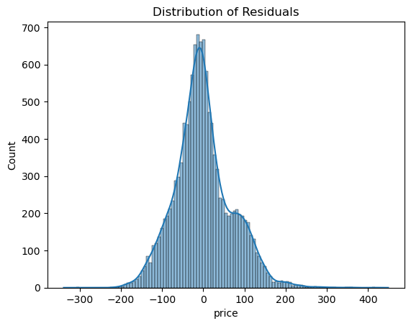
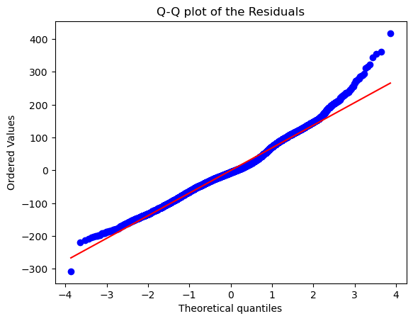
Polynomial regression – QQ Plot
Number of larger observations are more than that is expected from a normal distribution.
Dataset has skewed information.
Limited variability in data.

Slide 9
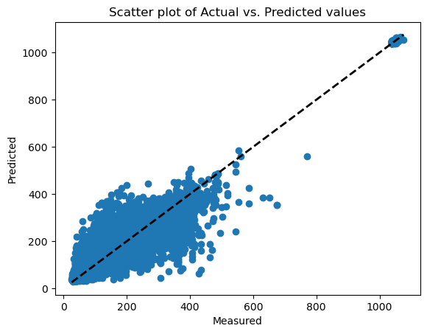
KNN Regressor
Optimal number of neighbors (GridSearchCV, scikit-learn)= 3
Model Evaluation:
RMSE: 55.81
R2 Score: 0.893
Mean Absolute Error: 34.49

Slide 10
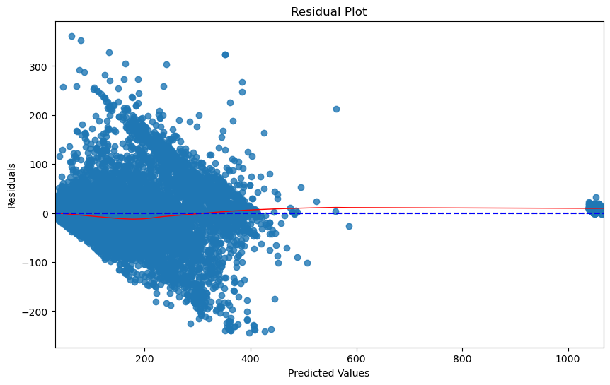
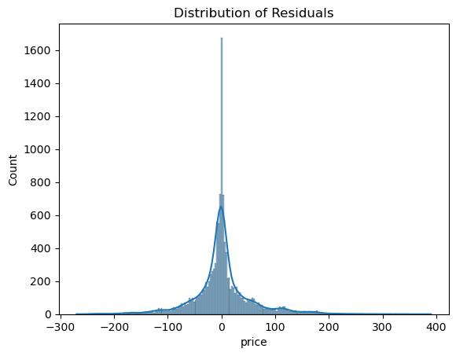
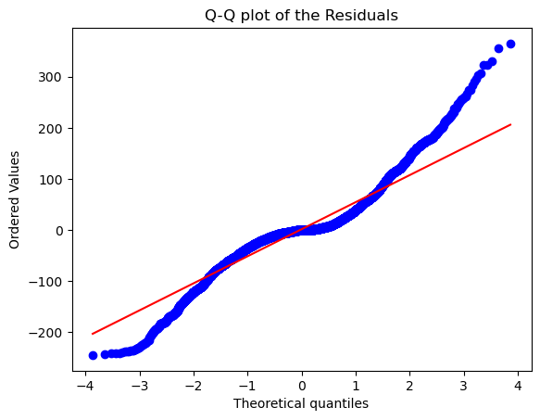
KNN Regressor- residual plots
‘S-pattern’ exhibited by the QQ plot.
Indicates large number of outliers as observed by the model

Slide 11
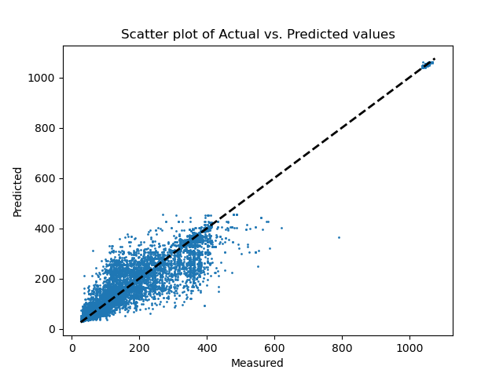
Regression tree
Model Evaluation:
MSE: 2633.92
RMSE: 51.32
R2 Score: 0.906
std deviation: 160.01

Slide 12
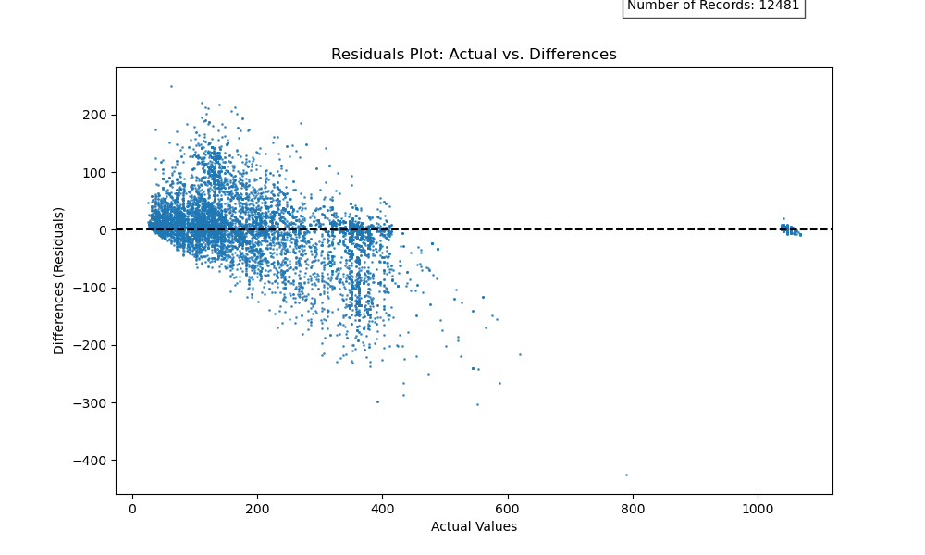
Regression tree – Residual Plot

Slide 13
Regression tree – feature importance
() () () () () () () () ()
feature importance:
departure city = 0.2507903415110873
arrival city = 0.29847602002449236
departure date distance = 0.03517340910766325
departure weekday = 0.010522775784703555
departure time hour = 0.013966494108150646
travel time = 0.007410473419308662
days until holiday = 0.011293022266687552
airline = 0.031638340433263766
stops = 0.34072912334464295

Slide 14
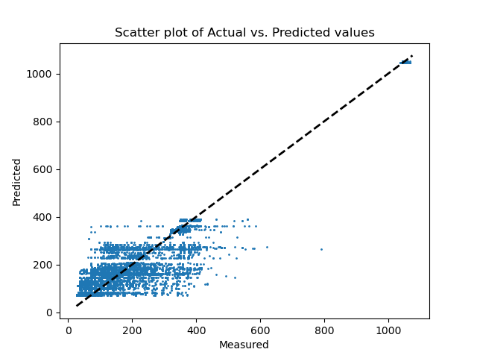
Regression tree
Model Evaluation:
MSE: 4856.71
RMSE: 69.69
R2 Score: 0.827
std deviation: 152.49

Slide 15
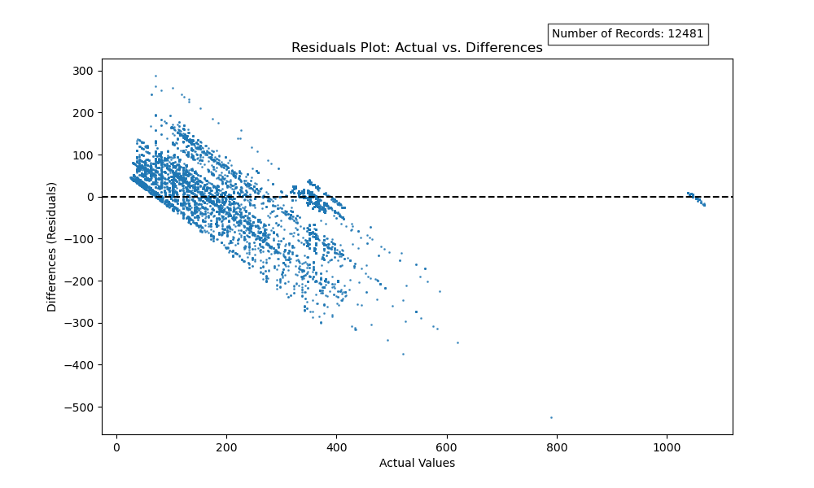
Regression tree – Residual Plot

Slide 16
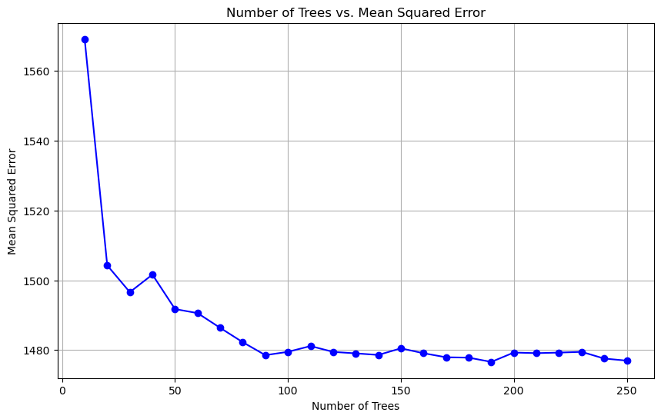
Random Forests - Number of trees
Graph to display the number of trees with the best MSE
Best value is 190

Slide 17
Finding the best params
Using GridSearchCV to find the best params
Turns out, min_samples_split=5 is the best value.
It is the minimum number of samples requires to split a “middle node”

Slide 18
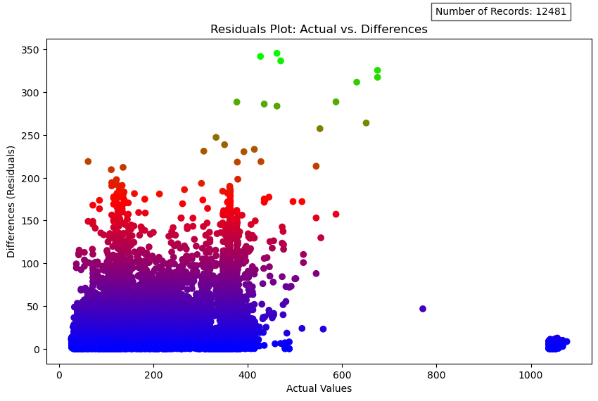
Random Forest – Absolute Residual Plot
The graph displays the correctness of the regressor.
By comparing the predictions and the actual values.

Slide 19
Weighted Random Forests
Attempted to implement weighted forests.
By calculating the OOB error of each tree
Changing the structure of RF model

Slide 20
Conclusion
Different regression algorithms were studied for the prediction of german local airfares.
The dataset did not sufficiently capture the full variability of the features, possibly due to the very short data collection time span and limited variability of the available dataset.
The simpler regression algorithms- polynomial regression & KNN were sensitive to the distribution errors.
Decision trees were implemented, so that the results would be less sensitive to outliers.
Additionally, they are made for non-linear data.
Random Forest was used to minimize the over-fitting rates, and better prediction results.
A simple weighted RF model was also implemented, which did not show much benefit.

Slide 21
Thank you for your attention!

