Slide 1

Prediction of German Air Fares
Presented by: Dominik Geffert, Jossin Antony, Yassine Ben Slama

Slide 2
Presentation Outline
Goal of the project
Data understanding
Data preparation
Modeling
Polynomial Regression
Regression Tree
Random Forest
Conclusion

Slide 3
Goal of the project
The dataset: German domestic airfares between major airports in Germany.
Source: https://www.kaggle.com/datasets/darjand/domestic-german-air-fares)
Data generation mode: web scraping
Time period considered: 25-10-2019 to 24-04-2020 (6 months).
Total entries: (62626, 10)
“To be able to predict the air fares for local German flights”

Slide 4
Data Understanding & Preparation
Existent Features:
Departure city
Arrival city
Scrape date
Departure date
Departure date distance
Departure time
Arrival time
Airline
Stops
Price (€)
Additional Features:
Departure weekday
Departure time (Hour)
Travel time
Days until next holiday

Slide 5
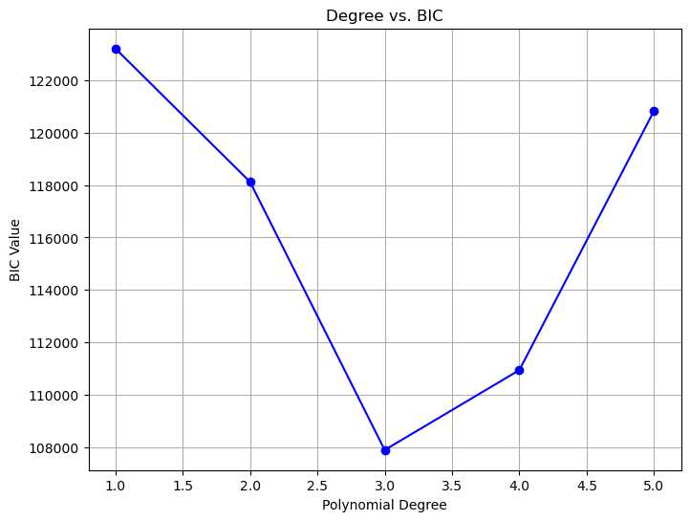
Modeling- Polynomial regression
Bayesian Information Criteria (BIC)
BIC = ln(MSE)+k*ln(n)
Optimal degree of polynomial according to BIC = 3

Slide 6
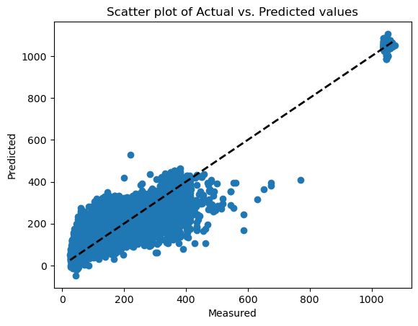
Modeling- Polynomial regression
Naive Evaluation:
MSE: 29285.80
RMSE: 171.13
R2 Score: ~0
std deviation: 171.13
Model Evaluation:
MSE: 4809.76
RMSE: 69.35
R2 Score: 0.836
std deviation: 156.41
Cross Validation(5 fold) Evaluation:
AVG MSE: 4933.41
AVG RMSE: 70.24

Slide 7
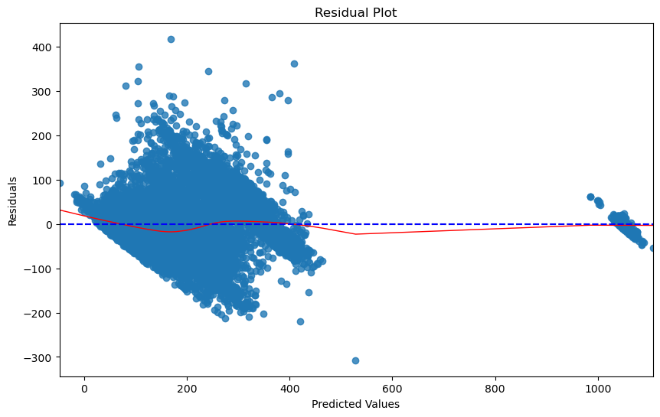
Polynomial regression – Residual Plot
Observation:
Zero-centricity
Absence of patterns

Slide 8
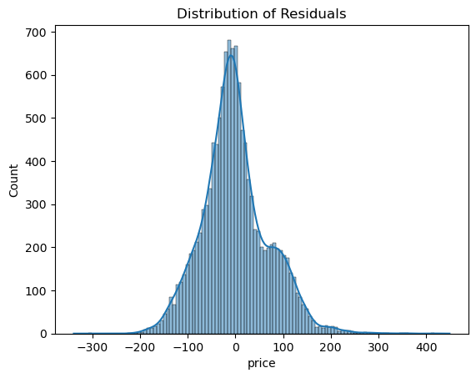
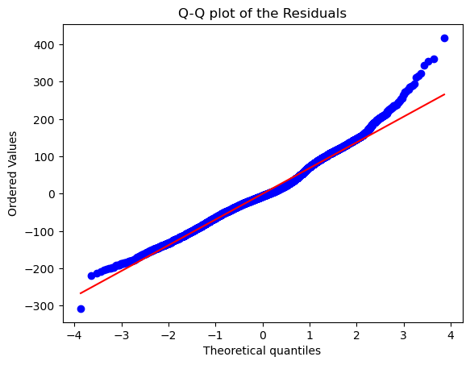
Polynomial regression – QQ Plot
Conclusions:
Number of larger observations are more than that is expected from a normal distribution.
Dataset has skewed information.
Limited variability in data.

Slide 9
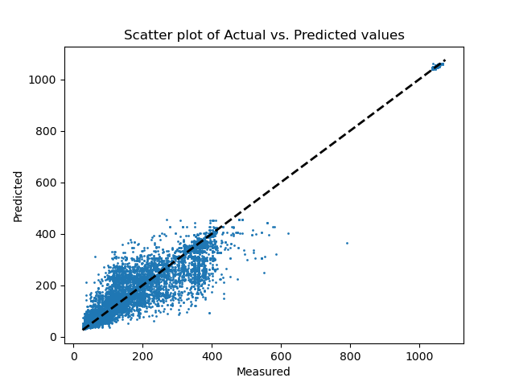
Regression tree
Model Evaluation:
MSE: 2633.92
RMSE: 51.32
R2 Score: 0.906
std deviation: 160.01

Slide 10
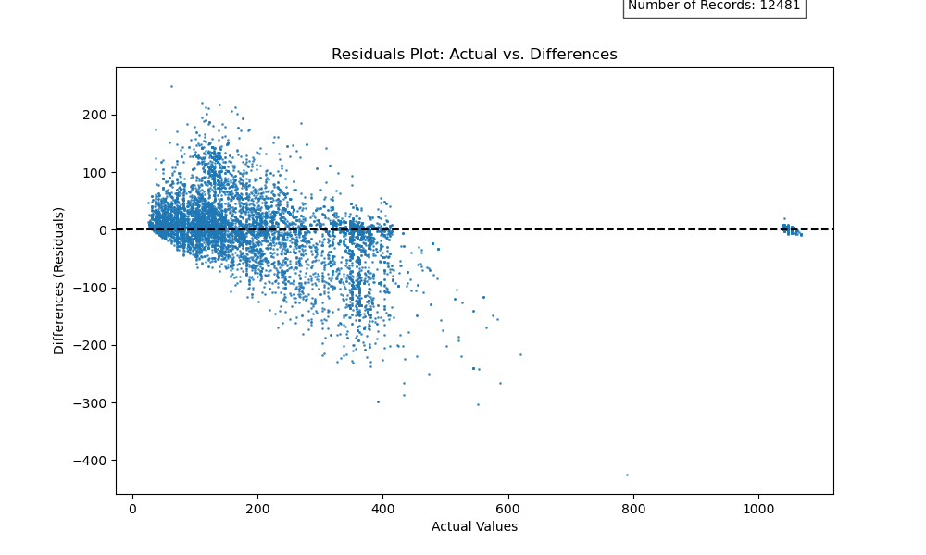
Regression tree – Residual Plot

Slide 11
Regression tree – feature importance
() () () () () () () () ()
feature importance:
departure city = 0.2507903415110873
arrival city = 0.29847602002449236
departure date distance = 0.03517340910766325
departure weekday = 0.010522775784703555
departure time hour = 0.013966494108150646
travel time = 0.007410473419308662
days until holiday = 0.011293022266687552
airline = 0.031638340433263766
stops = 0.34072912334464295

Slide 12
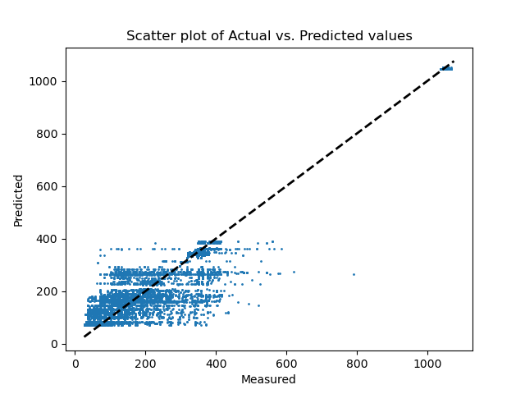
Regression tree
Model Evaluation:
MSE: 4856.71
RMSE: 69.69
R2 Score: 0.827
std deviation: 152.49

Slide 13
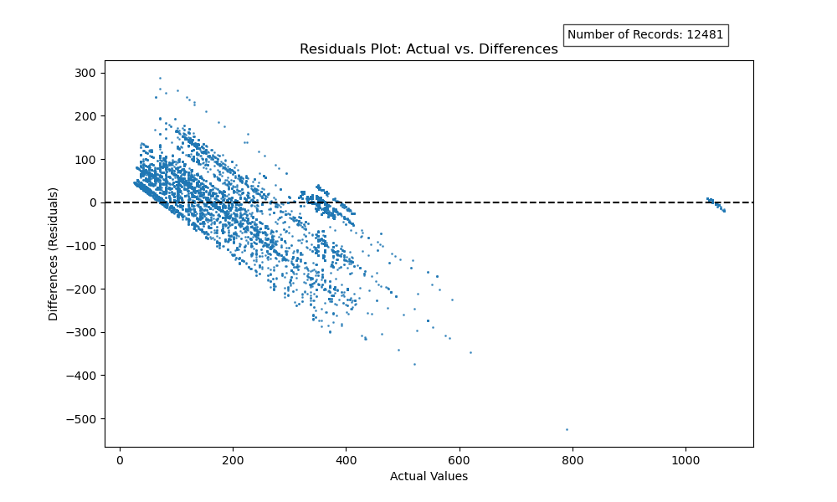
Regression tree – Residual Plot

Slide 14
Conclusion

Slide 15
Thank you for your attention!

