Slide 1

WEATHER TREND FORECASTING
From data cleaning to multi-model ensembles — a PM Accelerator technical assessment, basic through advanced tier
Ayoola Balogun · Global Weather Repository Dataset (Kaggle)

Slide 2

PROGRAM CONTEXT
PM Accelerator Mission
We’ve designed this platform to offer training, education, and job opportunities for Product Managers, creating room for constant improvement and shaping the next generation of PMs. Whether you’re a newbie or you’ve spent years in the industry, you’re guaranteed to find a new opportunity with the help of PM Accelerator.
By making industry-leading tools and education available to individuals from all backgrounds, we level the playing field for future PM leaders. This is the PM Accelerator motto, as we grant aspiring and experienced PMs what they need most – Access. We introduce you to industry leaders, surround you with the right PM ecosystem, and discover the new world of AI product management skills. https://www.linkedin.com/school/pmaccelerator/
Weather Trend Forecasting | PM Accelerator Technical Assessment
2

Slide 3



THE DATASET
Global Weather Repository
Daily weather readings scraped from a live weather API, covering the world at city-level granularity.
162,939
211
268
May 2024 – Sep 2026
records × 41 features
countries covered
distinct locations
daily-updating time span
Target variable: global average daily temperature (°C)
Weather Trend Forecasting | PM Accelerator Technical Assessment
3

Slide 4


BASIC TIER · STEP 1
Data Cleaning & Preprocessing
Zero missing values across all 162,939 × 41 cells — plausible for a live, API-scraped dataset. But that's not the same as clean. A min/max plausibility sweep surfaced corruption the missing-value check couldn't see: individually impossible readings hiding in otherwise complete rows.
4 corrupted rows dropped
Temperature
79.3°C
Suva, Fiji — hottest ever recorded on Earth is 56.7°C
Wind speed
1,841 mph
Bujumbura, Burundi — no surface wind on record exceeds ~253 mph
Domain context saved good data: 14 rows flagged as "low pressure outliers" turned out to be high-altitude cities (Addis Ababa, Mexico City, Nairobi...) — genuine physics, not errors. Only 2 of 14 were real corruption.
Pressure
3,006 mb
Tegucigalpa, Honduras — ~3× normal sea-level pressure
Pressure
3,000 mb
Tehran, Iran — same implausible spike, separate date
Weather Trend Forecasting | PM Accelerator Technical Assessment
4

Slide 5
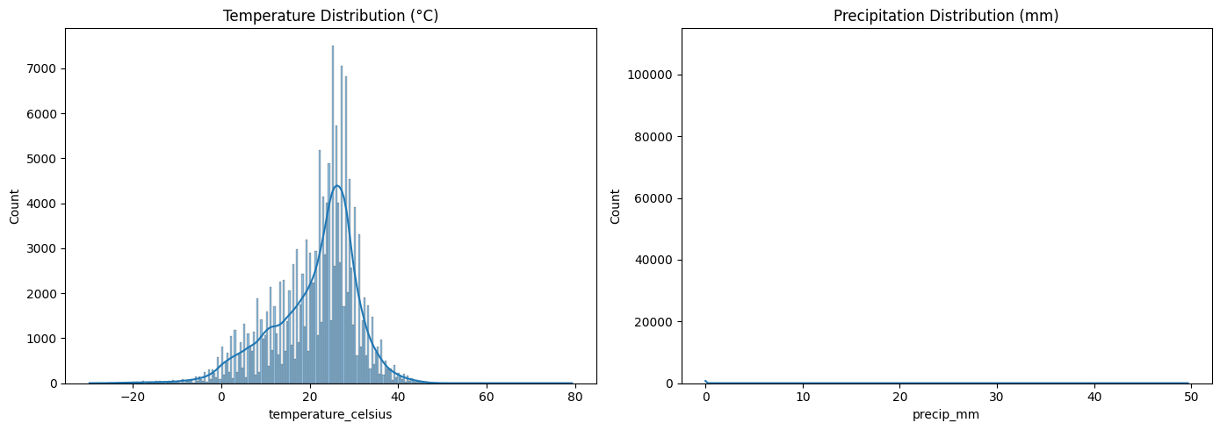


BASIC TIER · STEP 2
Exploratory Data Analysis
Temperature
Roughly normal, centered 24–26°C.
Precipitation
Heavily right-skewed — mostly 0mm, long tail. Log-transform before distance-based modeling.
Weather Trend Forecasting | PM Accelerator Technical Assessment
5

Slide 6
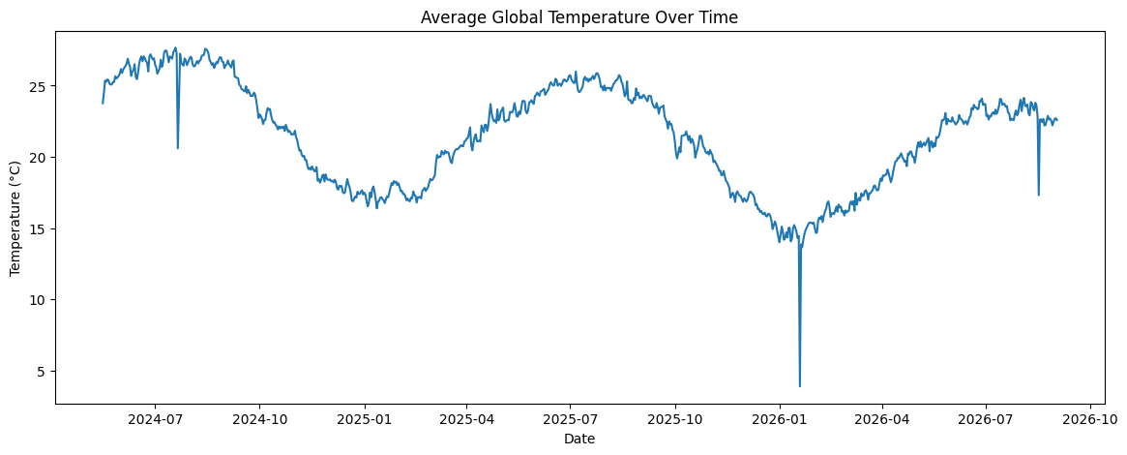
BASIC TIER · STEP 2
A Clear Seasonal Signal — With Some Wrinkles
A real annual cycle (peak ~Jun–Jul, trough ~Dec–Jan) — but with sharp single-day dips that don't fit the pattern. Investigated in the Anomaly Detection step.
Weather Trend Forecasting | PM Accelerator Technical Assessment
6

Slide 7

BASIC TIER · STEP 3
Basic Forecasting Model
Linear Regression with a trend term plus annual Fourier (sin/cos) seasonal terms, evaluated on a temporal holdout against a naive persistence baseline.
Model | MAE | RMSE | MAPE
Naive persistence | 0.590 | 0.881 | 2.60%
Linear Regression + seasonality | 0.454 | 0.755 | 2.06%
~23% reduction in MAE vs. the naive baseline — the seasonal structure is doing real work, not just fitting noise.
Weather Trend Forecasting | PM Accelerator Technical Assessment
7

Slide 8
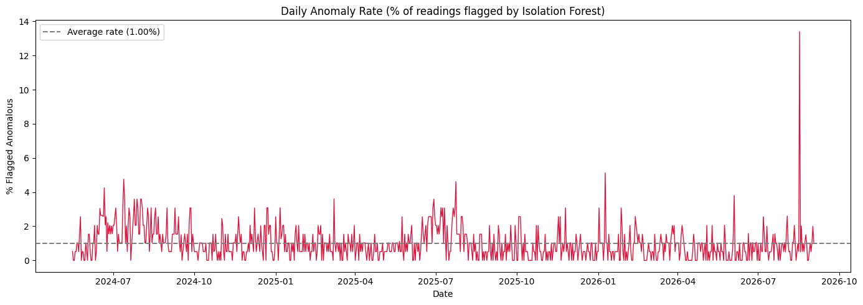

ADVANCED TIER · STEP 1
Anomaly Detection
Multivariate Isolation Forest across 7 features (temperature, humidity, wind, pressure, precipitation, cloud cover, UV index), flagging the top 1% as anomalous.
A single date stands out
>13% of readings flagged anomalous on one date — vs. a ~1% baseline average, nearly 3× the next-worst day. Investigation: Northern Hemisphere cities showing winter conditions in August — Baghdad 40.6°C→17.3°C week-over-week, blizzards recorded in London & Dublin. Flagged as a data pipeline artifact and excluded from modeling.
Weather Trend Forecasting | PM Accelerator Technical Assessment
8

Slide 9

ADVANCED TIER · STEP 2
Multiple Models + Ensemble
The ensemble doesn't win
Linear Regression alone matches or beats the 4-model ensemble on every metric. Why: error correlation between models was 0.79–0.95 — all four keyed off the same dominant seasonal signal. Averaging correlated models pulls the best one toward the weaker ones instead of cancelling error. Takeaway: ensembling adds value in proportion to model diversity — not model count.
Model | MAE | RMSE | MAPE
Linear Regression | 0.449 | 0.846 | 2.08%
SARIMAX | 0.465 | 0.897 | 2.17%
XGBoost | 0.528 | 0.938 | 2.43%
Momentum (lag-based) | 0.538 | 0.901 | 2.43%
Ensemble (4-model avg) | 0.449 | 0.864 | 2.08%
Weather Trend Forecasting | PM Accelerator Technical Assessment
9

Slide 10

KEY INSIGHTS
What This Project Actually Showed
"Zero missing values" ≠ clean data
Statistical outliers need domain context
Disguised corruption (physically impossible single-row readings) required a separate physical-plausibility check the missing-value scan couldn't catch.
Geography (altitude) explained most of what looked like pressure anomalies — only 2 of 14 flagged rows were real errors.
Anomaly detection traced a real root cause
More models ≠ better forecasts
An unexplained dip in the forecasting chart was traced to a specific, evidenced data pipeline event on one date.
A 4-model ensemble underperformed the single best model — diversity between models matters more than how many you combine.
Weather Trend Forecasting | PM Accelerator Technical Assessment
10

Slide 11


LOOKING AHEAD
Limitations & Future Work
Unique advanced analyses
Long-term regional climate patterns, air-quality/weather correlation, formal feature-importance analysis, and spatial/geographic pattern visualization are natural next steps.
Day-of-week signal
Forecast residuals showed weekends running ~0.2–0.3°C cooler — an interesting lead, but the test window is too small to confirm it isn't noise.
Rolling-origin backtesting
Evaluation used a single train/test split. Refitting across multiple split points would give a more robust performance estimate than one fixed holdout.
Weather Trend Forecasting | PM Accelerator Technical Assessment
11

Slide 12


Thank You
Full code, notebooks, and the README are available in the project repository.
[https://github.com/josse07/Weather-Trend-Forecasting]
[https://www.awesomescreenshot.com/video/56167497?key=51e0dc759bda138a40d848525f95090a]
Weather Trend Forecasting | PM Accelerator Technical Assessment
12

