Slide 1
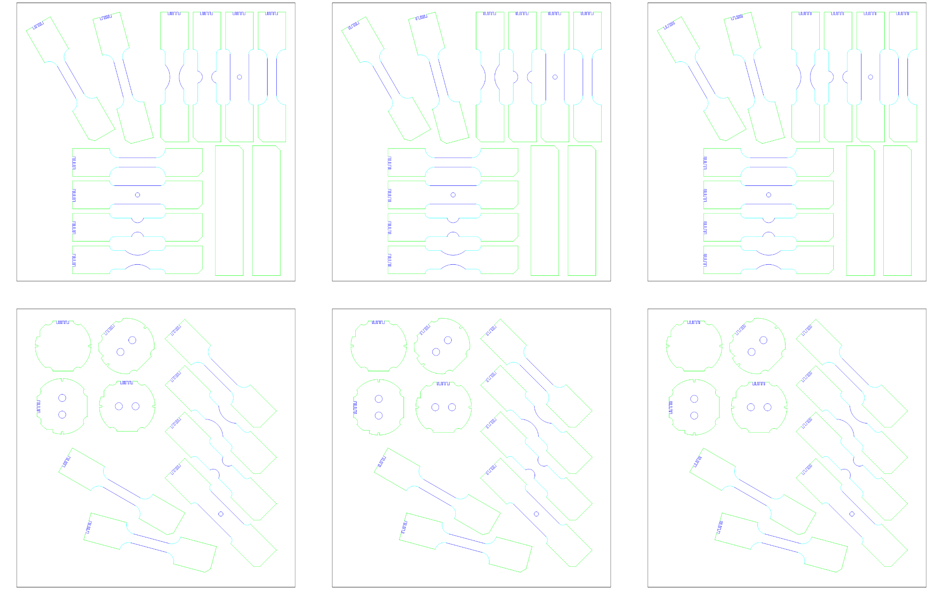
Rolling Direction
0°
ETH/300x300mm_6_SHEET_1-6
v20250509
Normal quality
(Q3)
Medium quality (Q4)
Highest quality (Q5)
Mikrosteg
30mm
SHEET_1
SHEET_2
SHEET_3
min 300mm
SHEET_4
SHEET_5
SHEET_6
min 300 mm

