Slide 1
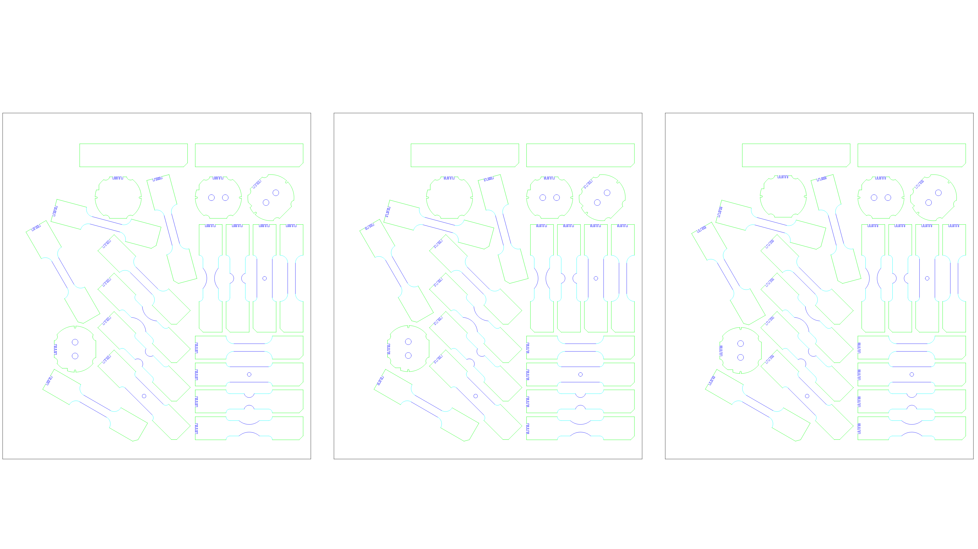
ETH/450x400mm_3_SHEET_1
v20250509
Rolling Direction
0°
Mikrosteg
Normal quality
(Q3)
Medium quality (Q4)
30mm
Highest quality (Q5)
450mm
SHEET 1
min 400 mm

Slide 2
ETH/450x400mm_3_SHEET_2
v20250509
Rolling Direction
0°
Mikrosteg
Normal quality
(Q3)
Medium quality (Q4)
30mm
Highest quality (Q5)
450mm
SHEET 2
min 400 mm

Slide 3
ETH/450x400mm_3_SHEET_3
v20250509
Rolling Direction
0°
Mikrosteg
Normal quality
(Q3)
Medium quality (Q4)
30mm
Highest quality (Q5)
450mm
SHEET 3
min 400 mm

