Slide 1
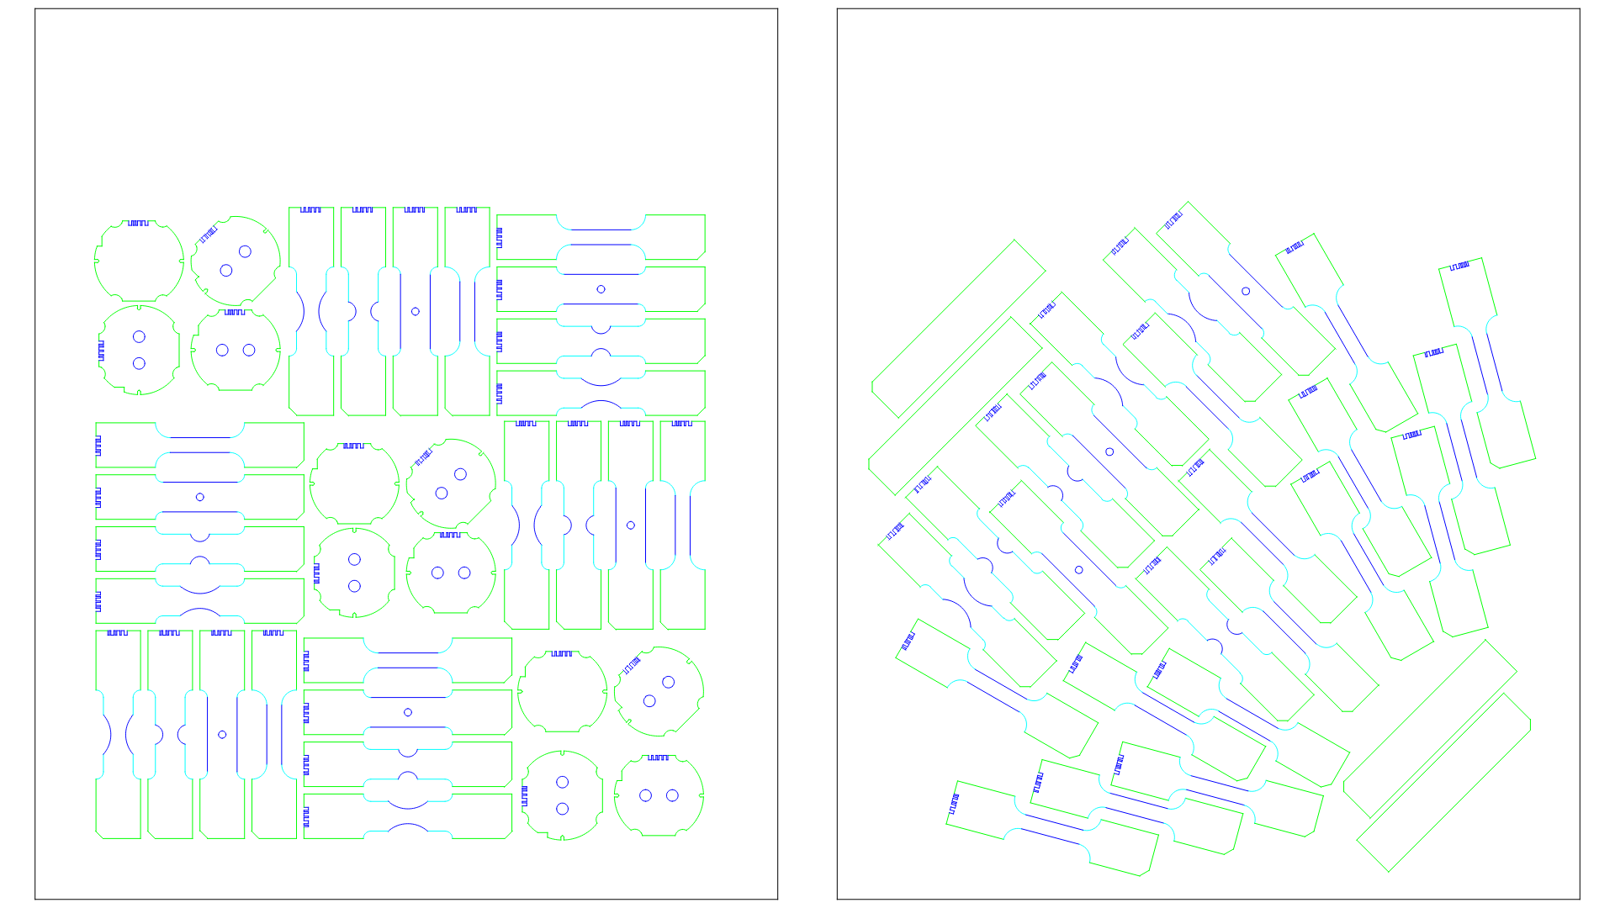
Rolling Direction
0°
Normal quality
(Q3)
Medium quality (Q4)
Highest quality (Q5)
600mm
Mikrosteg
ETH/600x500mm_2_SHEET_1
v20250220
min 500 mm

Slide 2
Rolling Direction
0°
Normal quality
(Q3)
Medium quality (Q4)
Highest quality (Q5)
600mm
Mikrosteg
ETH/600x500mm_2_SHEET_2
v20250220
min 500 mm

