Slide 1
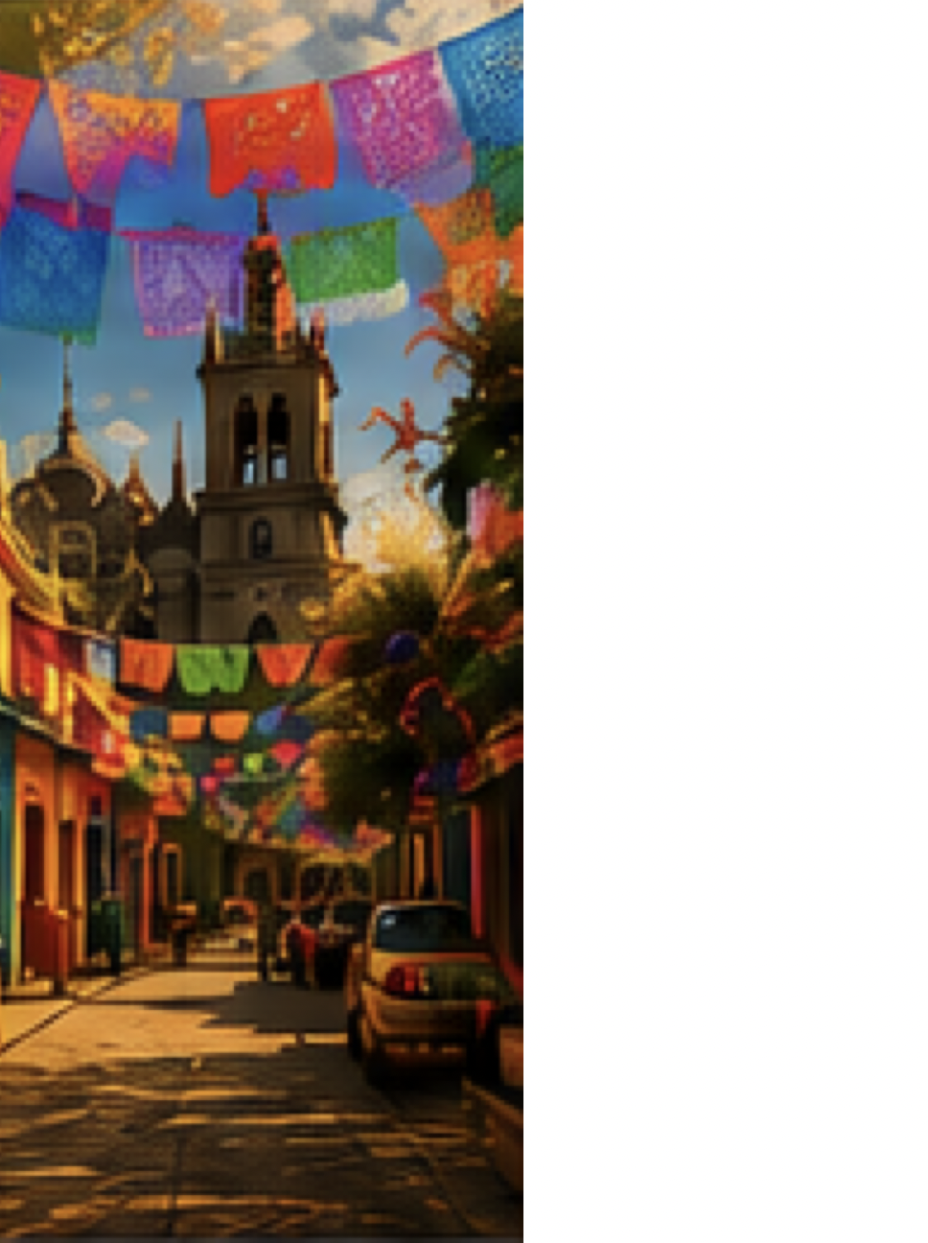
V
VIRREYES-SINCRETICO
DIGITAL PASSPORT &
TOKEN REWARDS
Tokens awarded by social contribution to the local economy of the places you visit, and redeemed in the hotel like points.
A Web3-powered cultural experience that rewards travelers while boosting local communities.
01

Slide 2





CONCEPT OVERVIEW
Book a tour
Build your digital passport as you explore.
Visit checkpoints and support local
Complete challenges with social impact
Earn tokens for your contribution
Every action that benefits the local economy earns you tokens.
Redeem tokens at the hotel
02

Slide 3




MVP CORE ROLES
Tourist
Guide
Hotel Staff
Admin
Books tours, completes challenges that support locals and earns tokens.
Verifies tourists at the start and supports them during the tour.
Redeems tokens for perks and enhances guest experience.
Manages tours, checkpoints, rewards and views dashboards.
03

Slide 4





DIGITAL PASSPORT FLOW
Book a tour
Visit locals
Challenges
+10 Tokens
Redeem
Tokens (SNT) are awarded by social contribution to the local economy and are redeemable in the hotel like points.
04

Slide 5

KEY FEATURES (MVP)
Tour catalog & real-time capacity
My Passport
Digital passport with checkpoints
Zocalo
+10 SNT
Simulated arrival (GPS ready)
Local Artisan Market
+10 SNT
Challenges that generate social impact
Tokens awarded for contribution
Coyoacan Neighborhood
+10 SNT
QR code for identity & balance
Historic Center Walk
+10 SNT
Redeem tokens at hotel (burn tokens)
Chapultepec Castle
+10 SNT
Admin dashboards (sales & tokens)
3 / 5 Completed
05

Slide 6

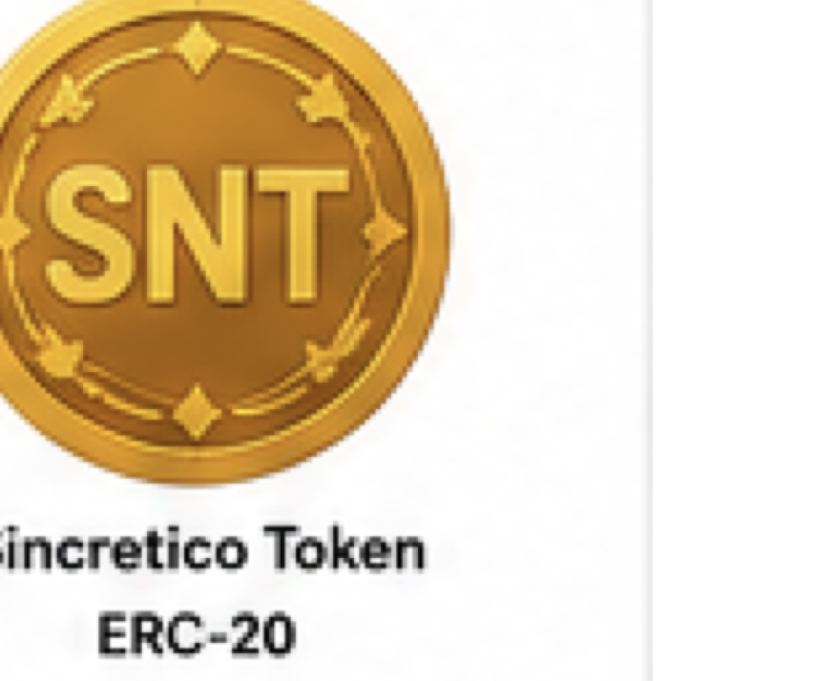




BLOCKCHAIN & TOKEN
ERC-20 Token
Sincretico Token (SNT)
Mint
Backend operator only
Burn
On redemption
Network
Polygon Amoy Testnet
Verification
Real, verifiable transactions on-chain
06

Slide 7
REWARDS EXAMPLES (REDEEM IN HOTEL)
Extra Night
Gourmet Dinner
Room Upgrade
3,000 SNT
1,500 SNT
2,500 SNT
Redeem your tokens in the hotel for unforgettable experiences.
07

Slide 8
ADMIN DASHBOARDS
Tours
Sales
Token Stats
Mexico City Tour
Last 30 days
Total Minted
128,450 SNT
$24,560
Coyoacan Experience
Total Redeemed
Historic Center Walk
64,320 SNT
Frida Kahlo Tour
Outstanding
64,130 SNT
W1
W2
W3
W4
08

Slide 9




TECH STACK
Frontend (Tourist App)
Blockchain
React + Tailwind (PWA)
Solidity + Hardhat | ethers.js
Frontend (Admin)
Testnet
React + Tailwind
Polygon Amoy
Backend
QR & Scanner
Node.js (Express)
qrcode + html5-qrcode
Database
Verification
PostgreSQL
On-chain transactions
09

Slide 10
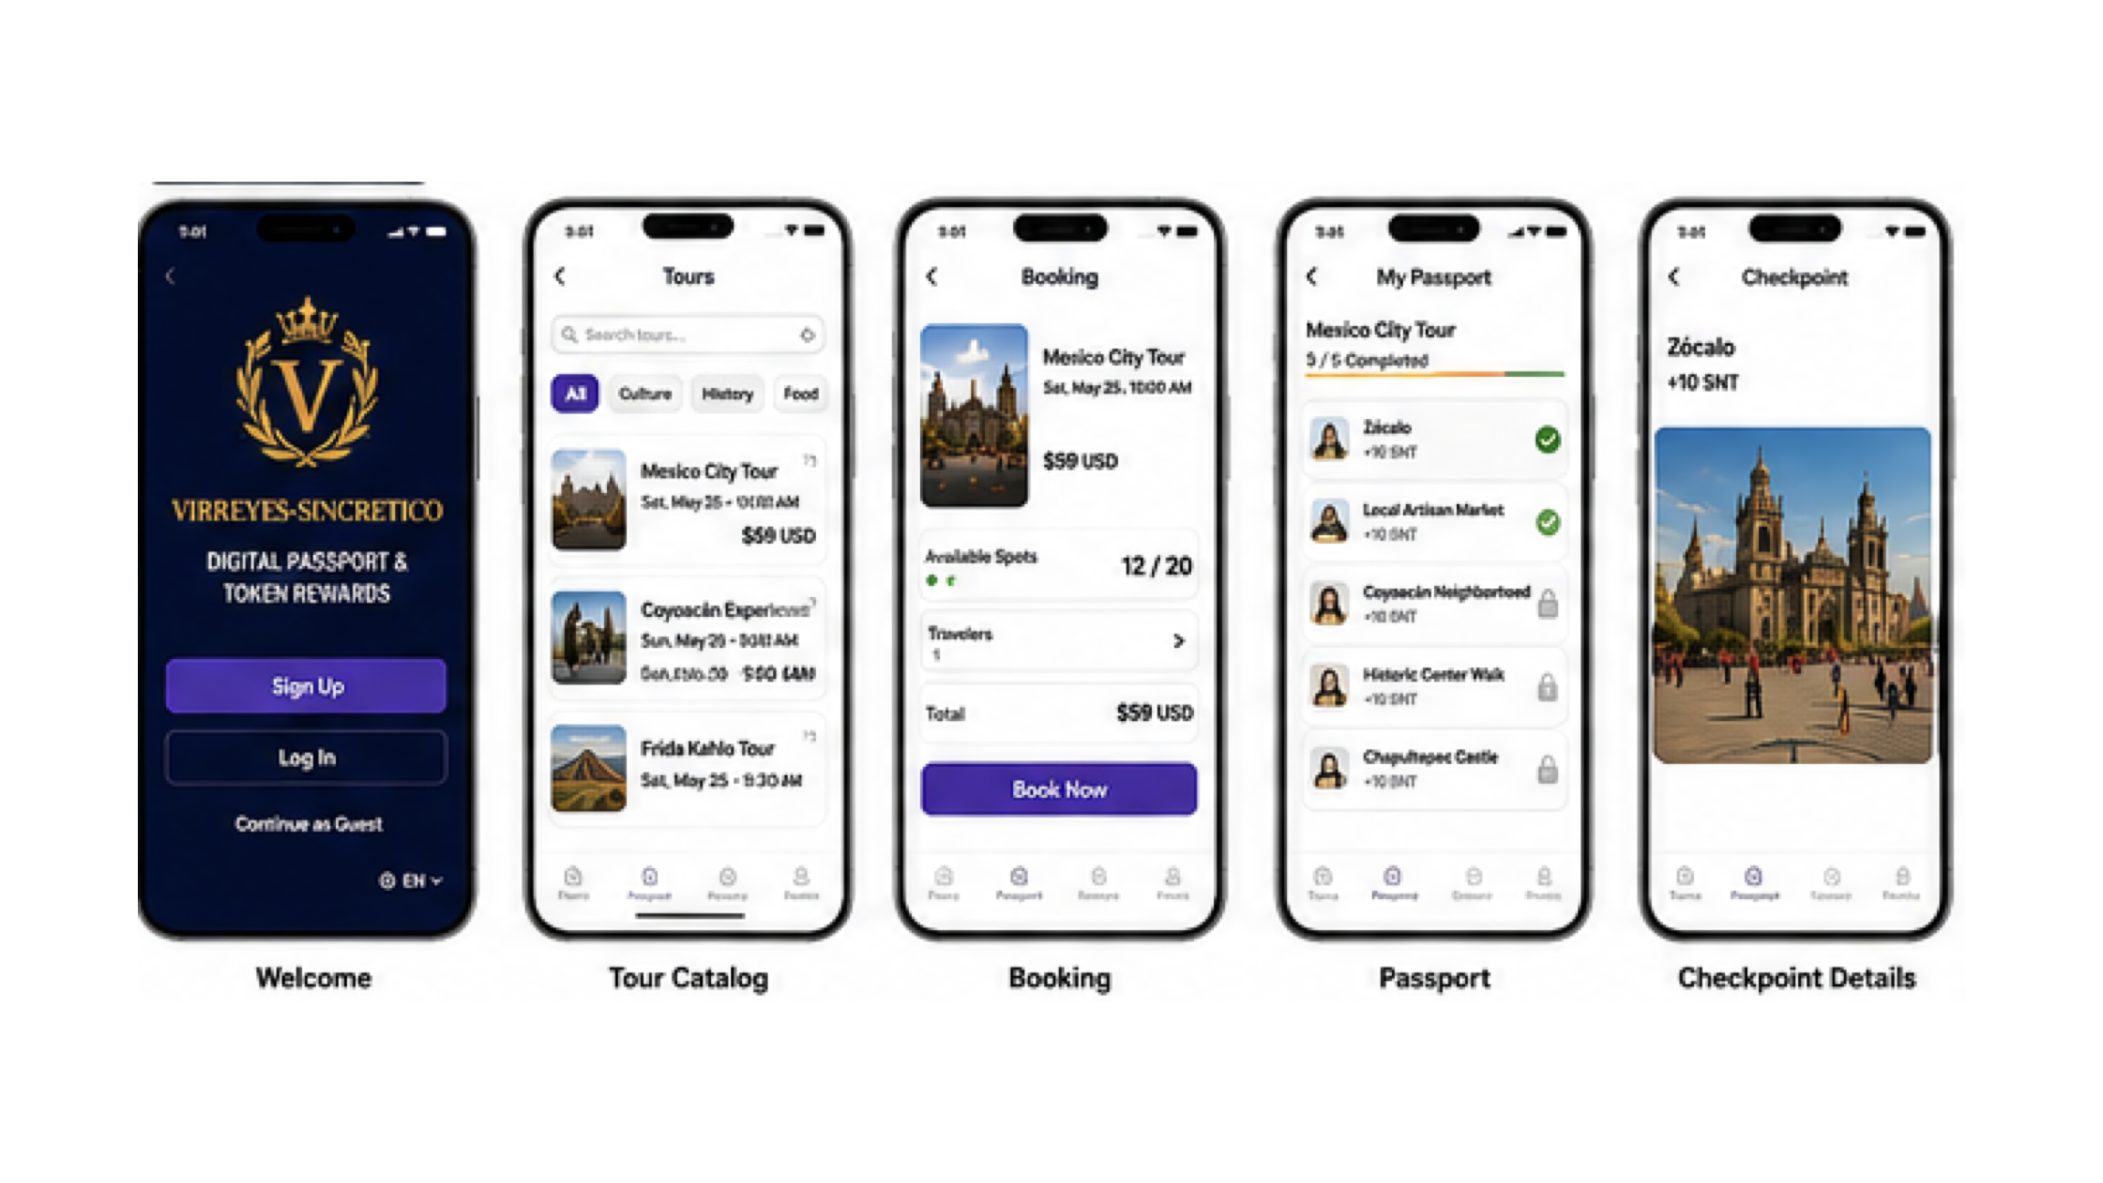
PRODUCT UI
Tourist Journey
10

Slide 11
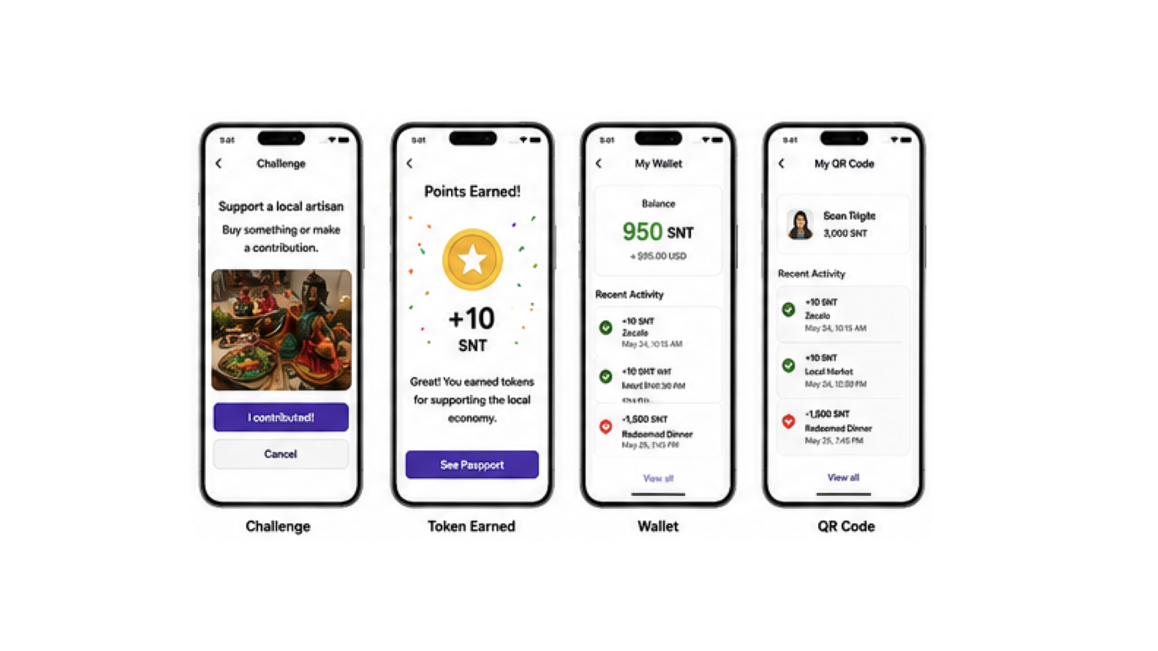
PRODUCT UI
Challenge > Earn > Wallet > QR
11

Slide 12
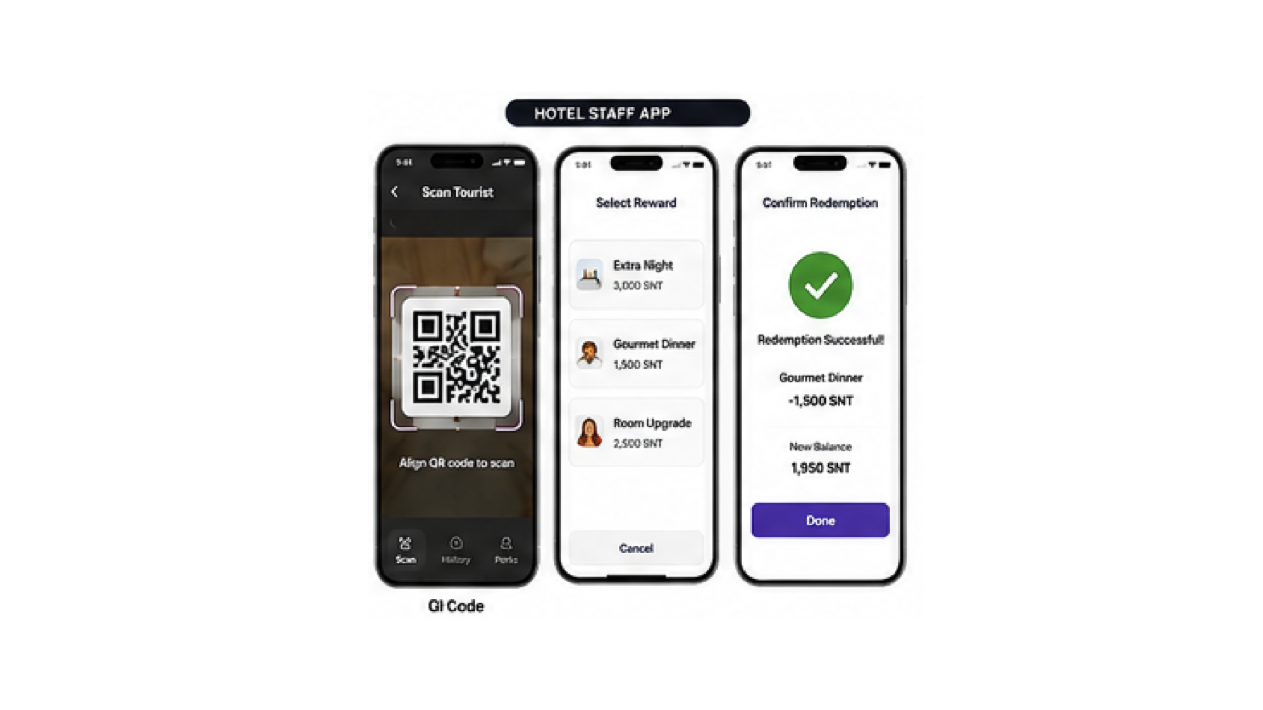
HOTEL STAFF APP
Scan > Select reward > Confirm redemption (burn SNT)
12

Slide 13
VIRREYES-SINCRETICO
V
TRAVEL WITH PURPOSE.
SUPPORT LOCALS.
EARN REWARDS.
THANK YOU
13

