Slide 1
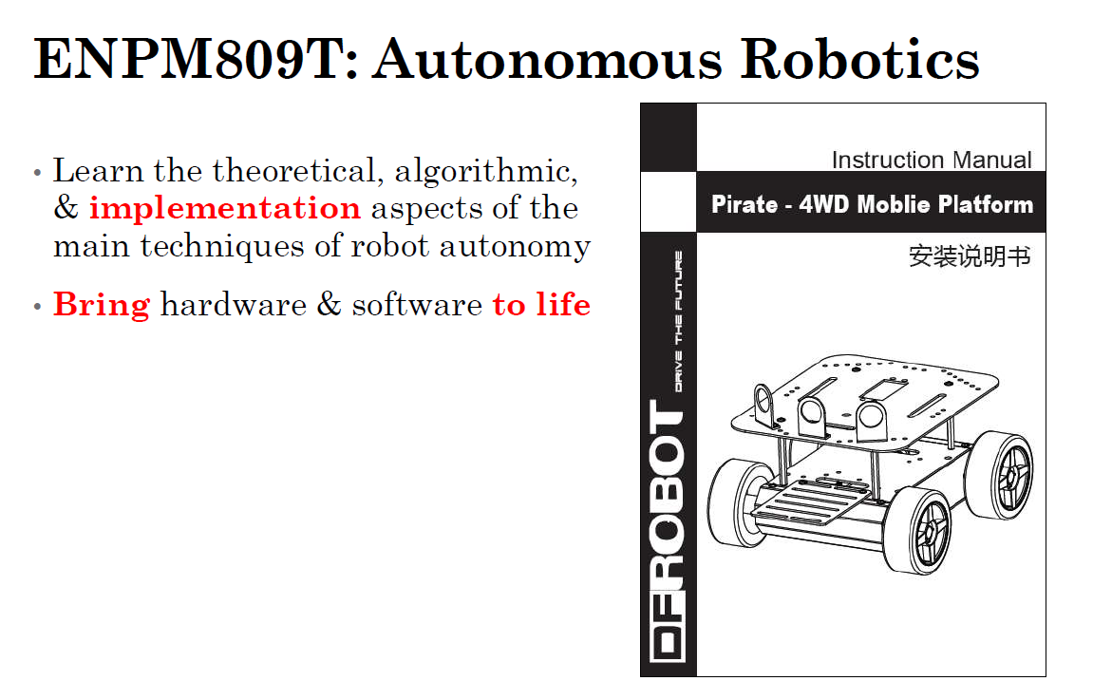
The Grand Challenge
ENPM 701: Autonomous Robotics Spring 2024

Slide 2
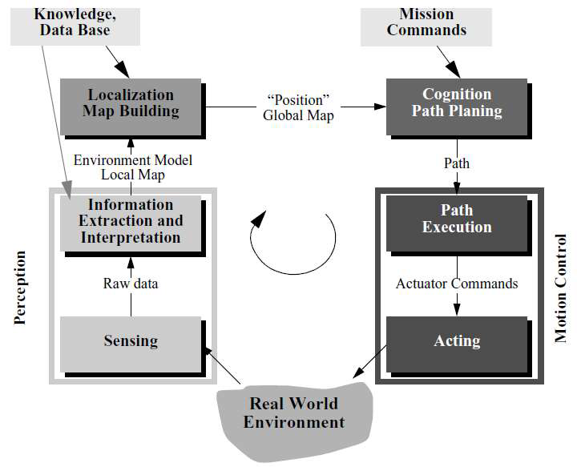
General Objectives

Slide 3
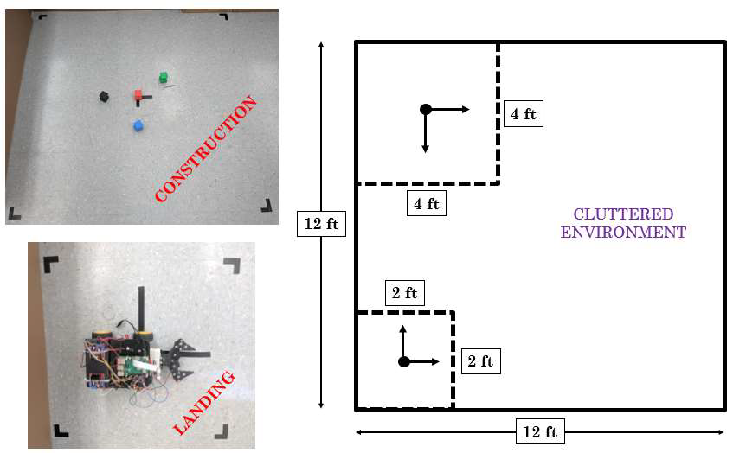
GC – competition arena

Slide 4
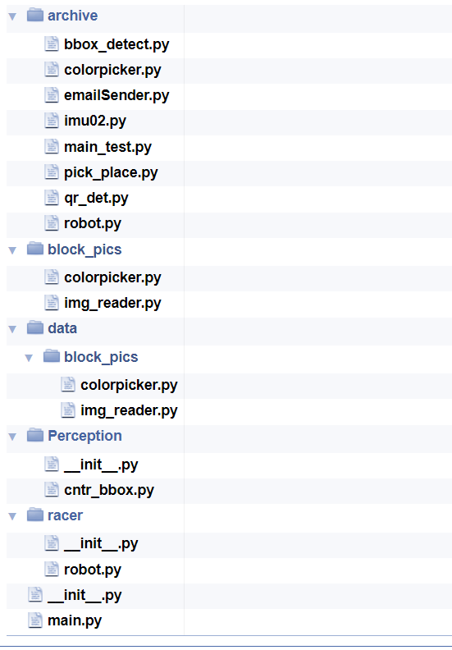
Code Repository (workspace)

Slide 5
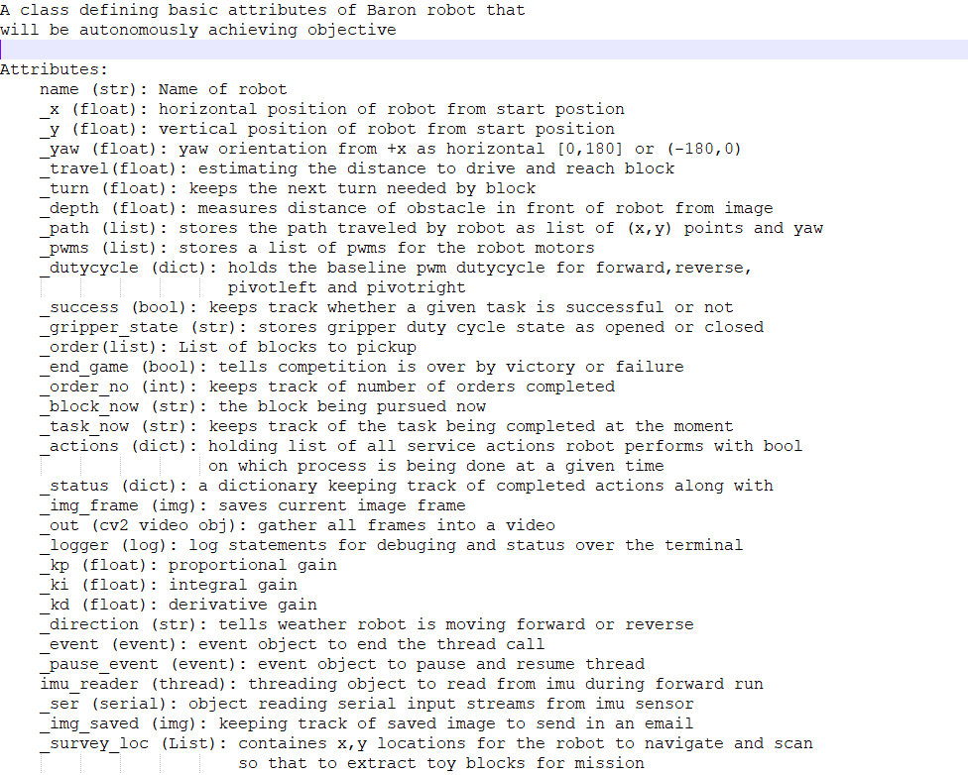
Robot Class attributes

Slide 6
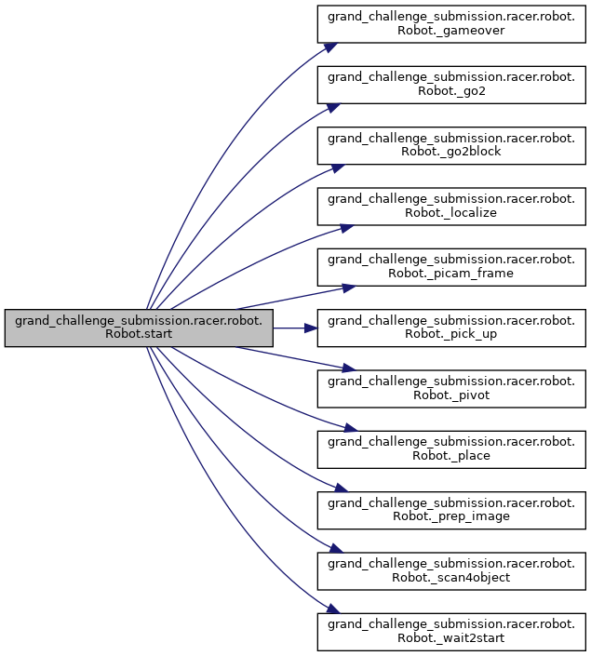
List of tasks to pick and place one block

Slide 7
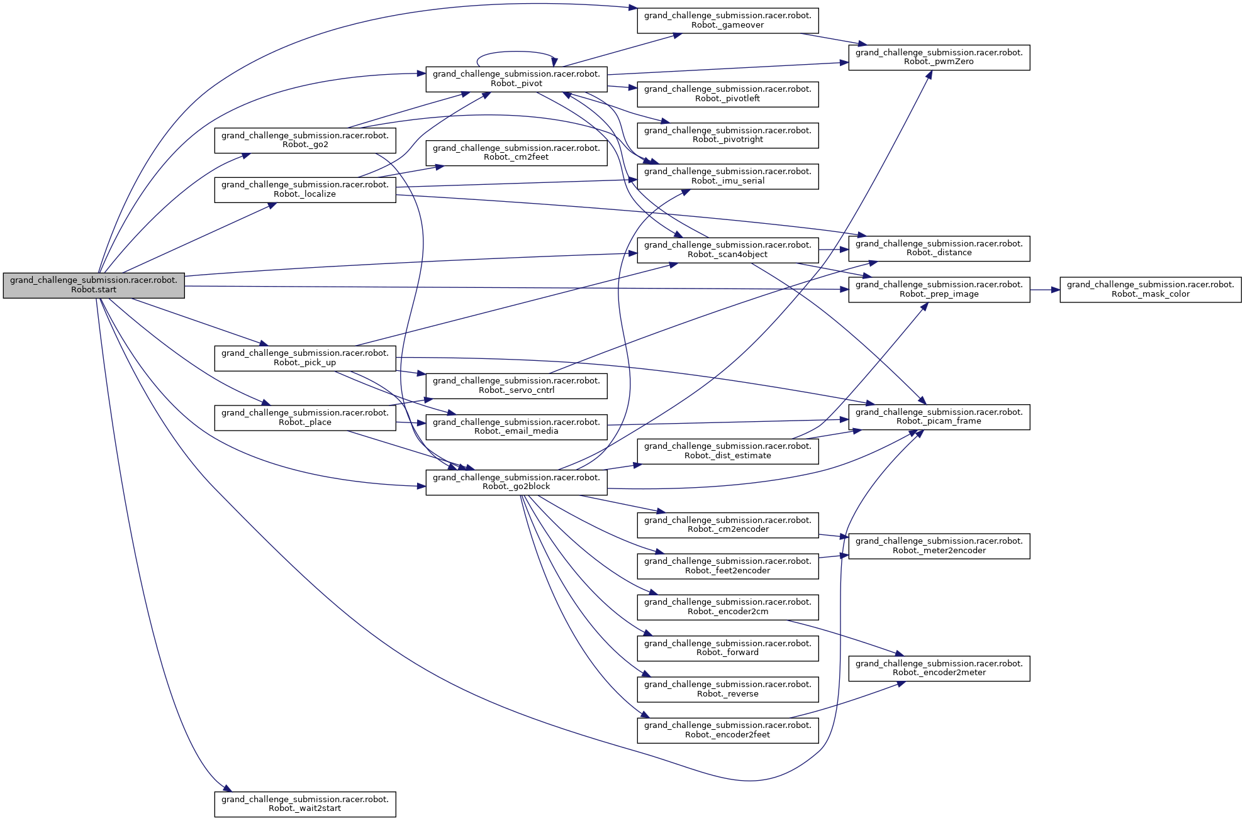
Task Planning Architecture

Slide 8
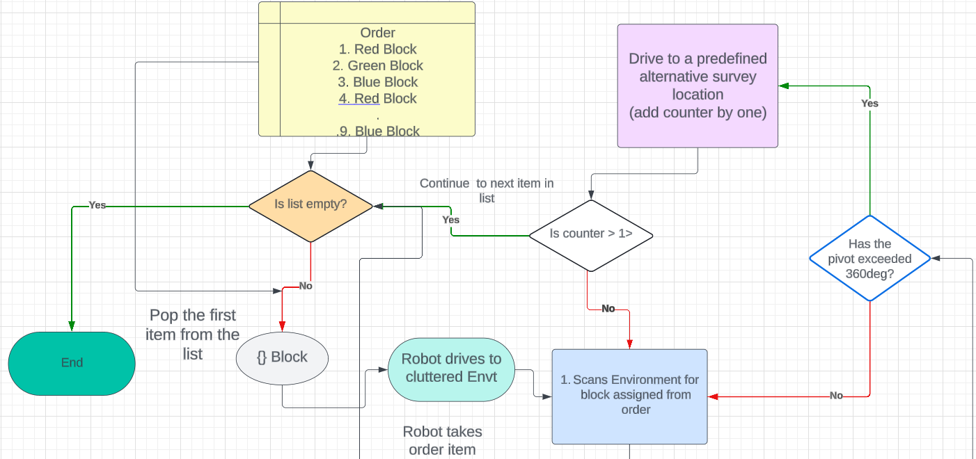

Slide 9
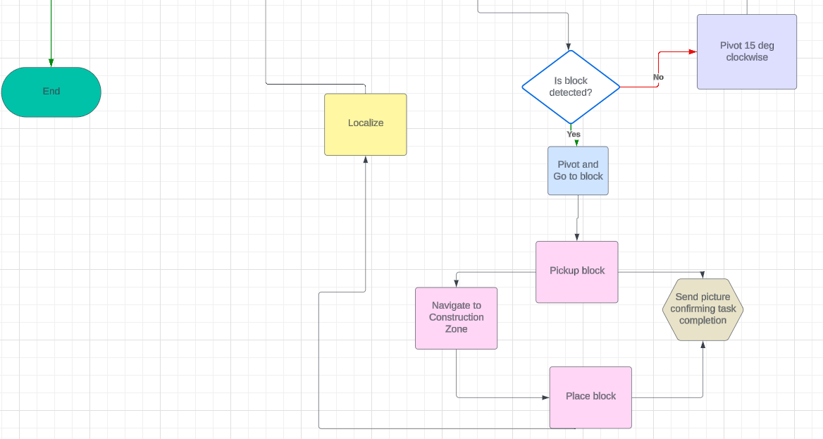

Slide 10
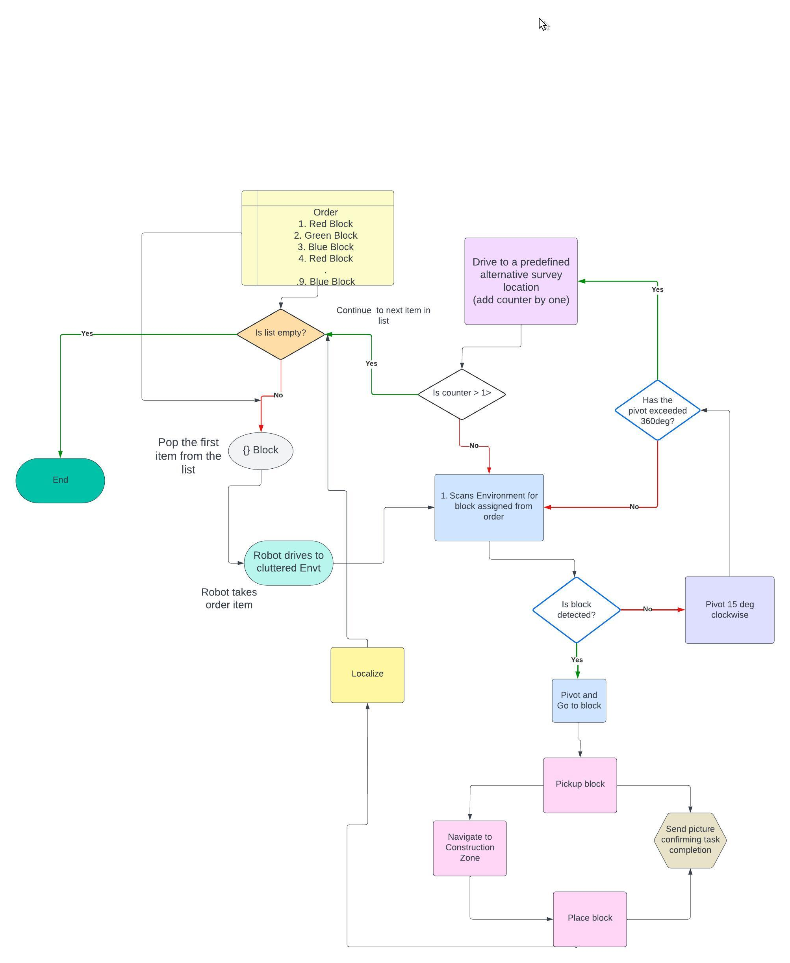
… in high level

