Slide 1

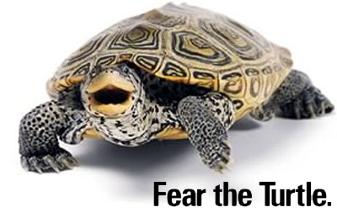

Book Shelving Robot
By: Yoseph Kebede
ENPM 662: Intro to Robot Modeling – Fall 2022
Project 2
Submitted to: Dr. Reza Monfaredi

Slide 2

Outline
Intro
Motivation
Hypothesis
Methodology
Challenges
Results and Discussion
Conclusion
Appendix
https://www.tripadvisor.com/Attraction_Review-g60763-d116236-Reviews-New_York_Public_Library-New_York_City_New_York.html

Slide 3

Intro
Goal: Project aims at utilizing robots to simplify mundane tasks
Case study: Making book selection accessible for everyone
Objective: Easy to assemble and configurable for libraries with high capacity than finance
Approach: Provide a velocity vector only to end effector to control 8 DoF or more via Inverse Kinematics
Display: Use Simulation in ROS to demo practicality
Future: Analyze end result and assess application

Slide 4
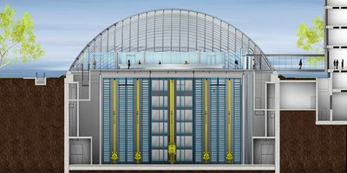
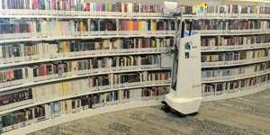
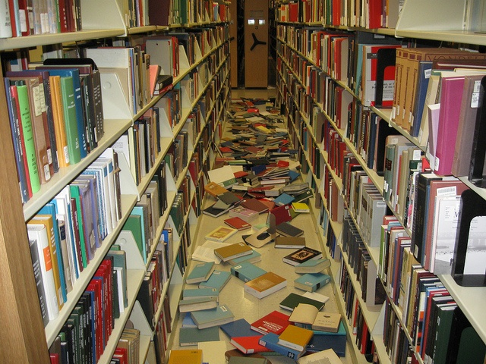
Motivation
Univ of Chicago –
Joe and Rika Mansueto Library
Public libraries not funded as service
1.32 billion times visited in 2017 (imls.gov)
Current implementations
Autonomous robot, and huge library systems
Work strain on the staff (shelving/aligning)
Not everyone can access all rows of the shelves
Tall shelves, disabilities
Finding the book you want can be daunting
Who’s been lost finding a book in Mckeldin?
AuRoSS - https://phys.org/news/2016-06-automated-robot-scans-library-shelves.html
Mckelding 7th floor
https://www.pinterest.com/pin/53761789271240651/

Slide 5
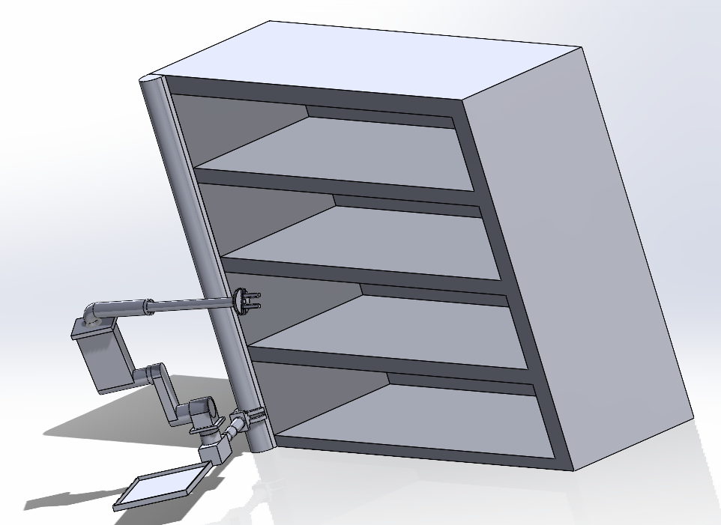
Hypothesis
Proposing a book shelving robot
8 DoF Robot, Teleoperable
Takes user input
User provides book location (Eg F6-Ch)
E.g. F6-Ch < Fiction 6 (Sci-Fi) Author last name
Translates to location on shelf for robot to extract
Extracts book on plate and provide to user

Slide 6
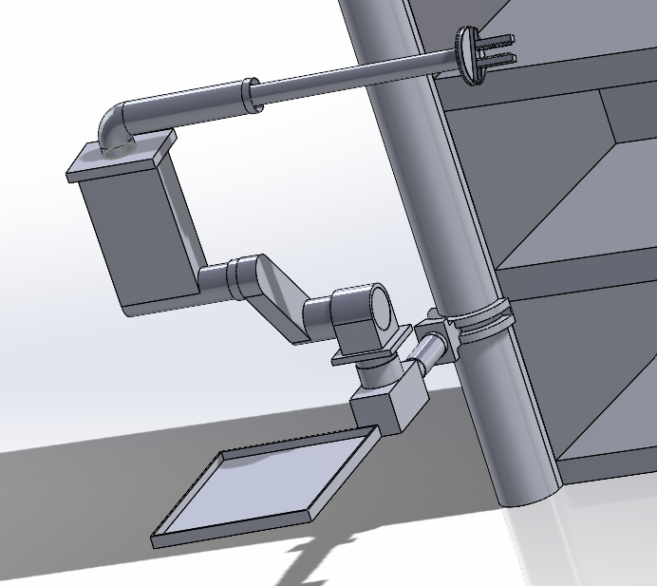
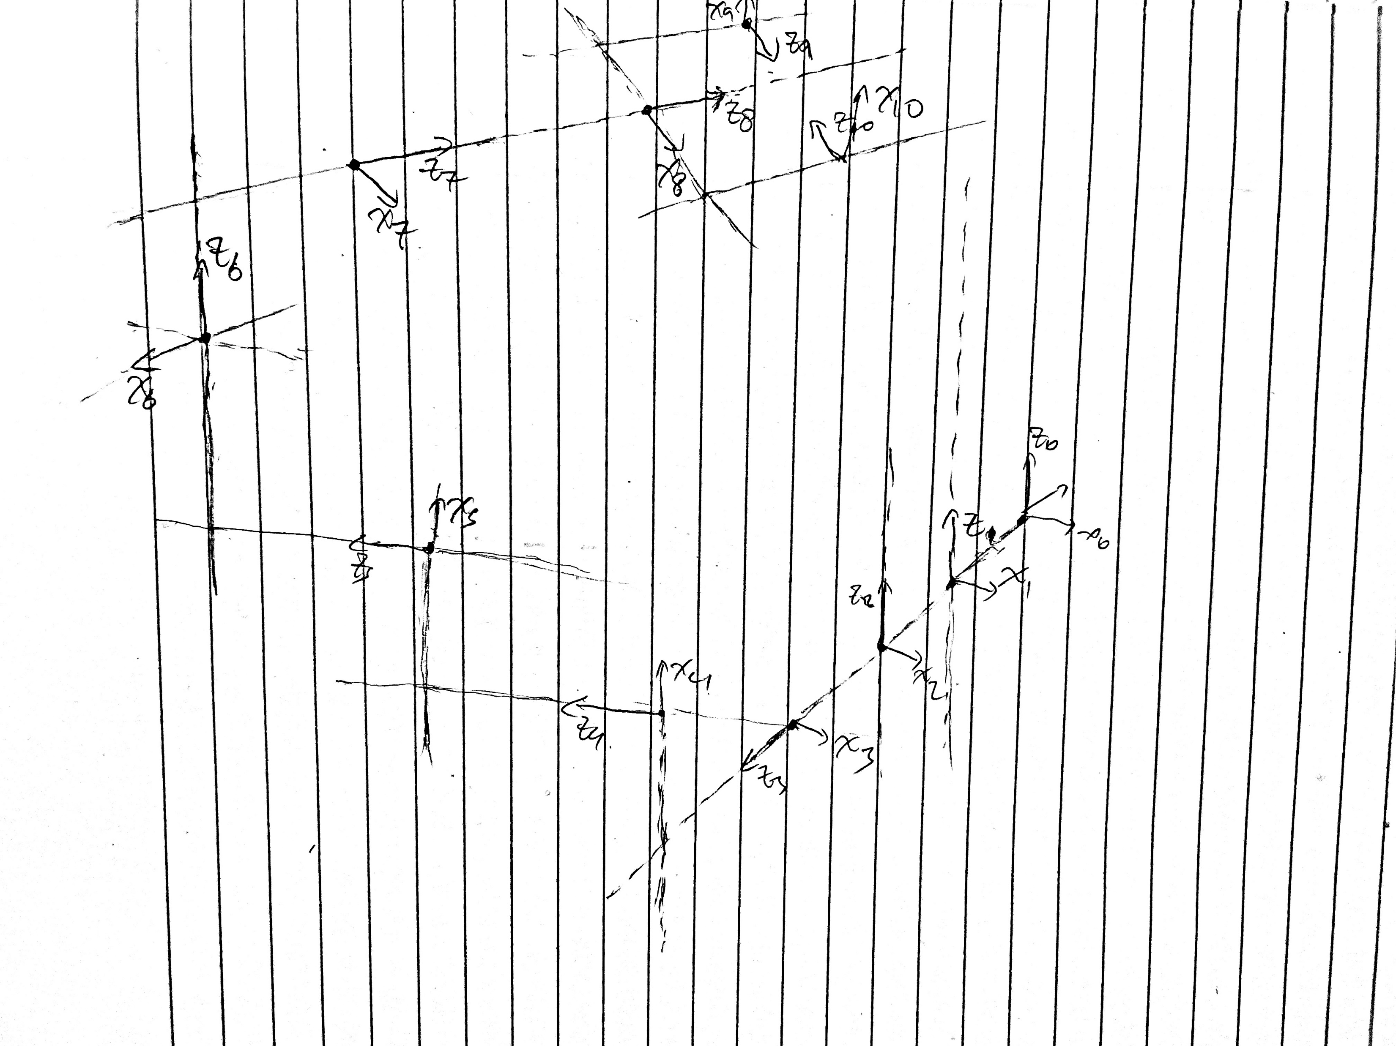
Methodology
Inverse Kinematics
Velocity Command to Angular speed for each link
links | a(mm) | alpha(deg) | d(mm) | theta(deg)
1 | 25 | 0 | d_1(t) | 0
2 | 145 | 0 | 0 | Theta2(t)
3 | 0 | 90 | d_3(t) | 0
4 | 250 | -90 | 170 | Theta4(t)
5 | 250 | 0 | 150 | Theta5(t)
6 | 200 | 90 | 350 | Theta6(t)
7 | 75 | -90 | 75 | 0
8 | 605 | 0 | 0 | Theta8(t)
9 | 50 | -90 | 0 | 0
Picture of robot frames here

Slide 7
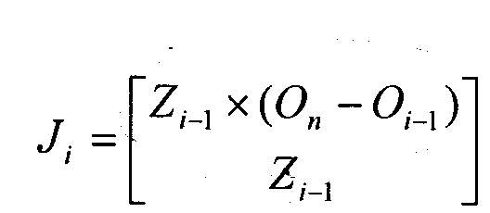
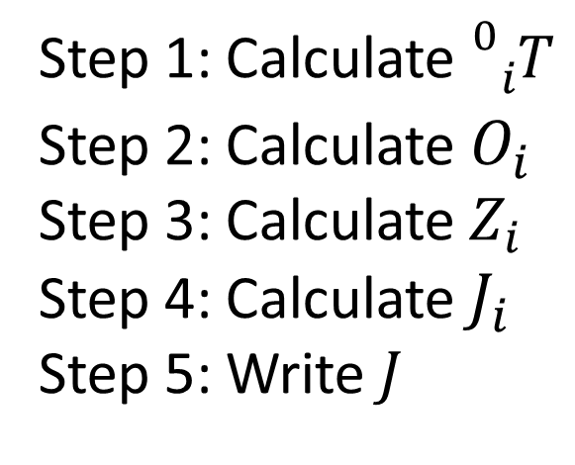




Methodology (cont…)
Used 1st method to compute Jacobian for 7 DoF system
Received velocity input from keyboard
Then performed inverse kinematics to
Obtain
$\dot{X}$=($\dot{x}$, $\dot{y}$, $\dot{z}$)
Step 1: Calculate${}_{ }^{0}{{}_{i}^{ }T}$
Step 2: Calculate${ O}_{i}$
Step 3: Calculate $Z_{i}$
Step 4: Calculate $J_{i}$
Step 5: Write $J_{ }$
$\dot{q}$=(${\dot{q}}_{1}$,${\dot{q}}_{2}$, …,${\dot{q}}_{n}$)
$$J^{−1}$$
Input
Teleop Keyboard
$\dot{X}$=($\dot{x}$, $\dot{y}$, $\dot{z}$,theta, pinch speed)
Robot joint controllers
Sub_pub node
/vel_cmd
Subscribes to /vel_cmd, converts to links translation and rotation value, publishes to controllers

Slide 8
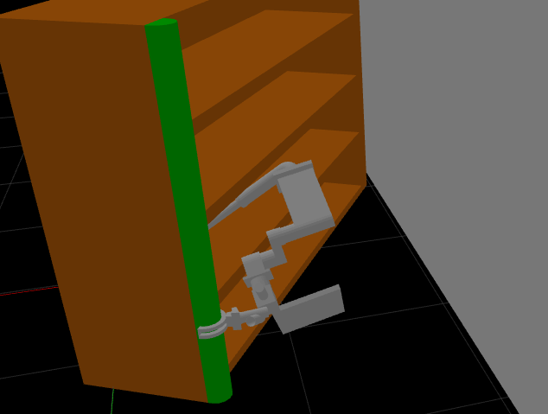
Results and Discussion
Simulation was 60% accurate
Existence of multiple joints and simplification on joint control hindered expected performance
More work needs be done to make algorithm efficient

Slide 9

Challenges
Complicated CAD Design
Simple IK conversion method used for 8+ DoF
Robot configuration needed to get simplified to 7 DoF to perform simple Jacobian computation, but hindered realistic simulation
Project goals were broader than estimated time

Slide 10

Conclusion
Proved implementation Jacobian in controlling one joint (end effector) to control rest links
Need to consider complex algorithms that can handle singularity efficiently than simple algorithms that restrict testing
Simple implementations make difference, so idea should be pursued in future.
https://www.istockphoto.com/photo/blank-directional-signs-over-sunny-blue-sky-gm1405291088-457245885?utm_source=unsplash&utm_medium=affiliate&utm_campaign=srp_photos_top&utm_content=https%3A%2F%2Funsplash.com%2Fs%2Fphotos%2Fconclusion&utm_term=conclusion%3A%3A%3A

Slide 11
Questions?
Special thanks to:
Dr. Reza
Adarsh and Pavan

Slide 12
References
The University of Chicago Library. The Joe and Rika Mansueto Library - The University of Chicago Library. (n.d.). Retrieved November 7, 2022, from https://www.lib.uchicago.edu/mansueto/tech/asrs/
Phys.org (2016, June 2). Automated robot that scans library shelves using laser mapping and radio tags can ensure no book is misplaced again. Phys.org. Retrieved November 7, 2022, from https://phys.org/news/2016-06-automated-robot-scans-library-shelves.html

Slide 13
Appendix
Add reference and other computation details here

