Slide 1

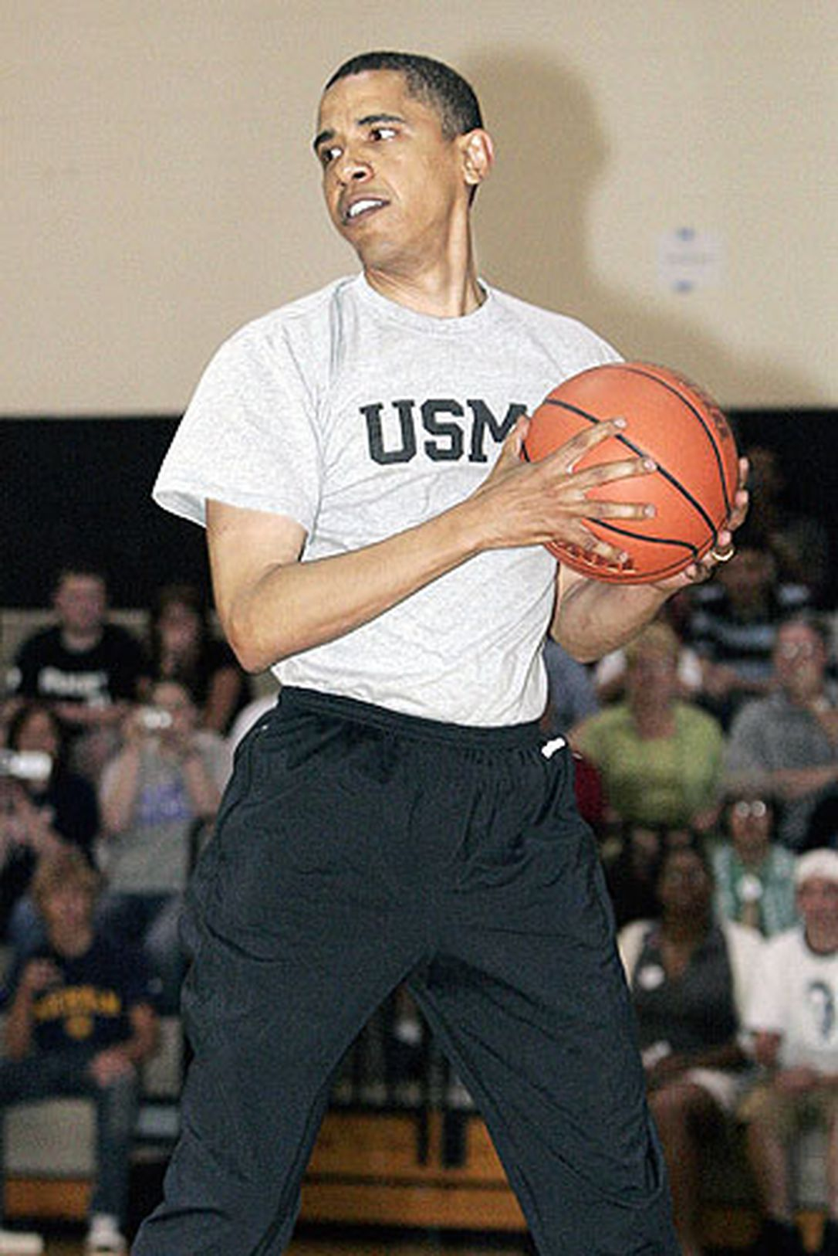
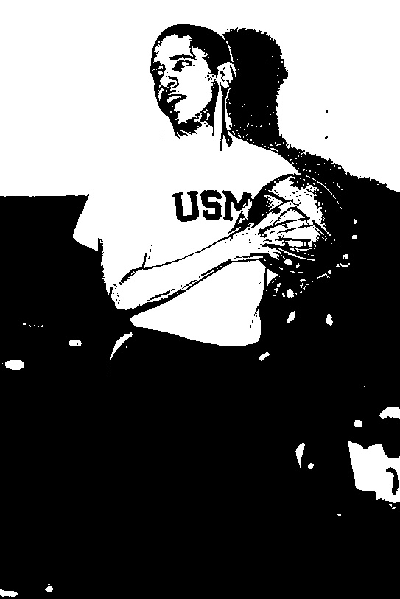
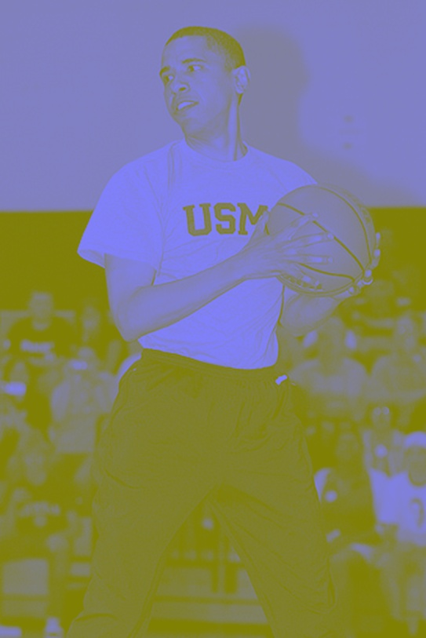
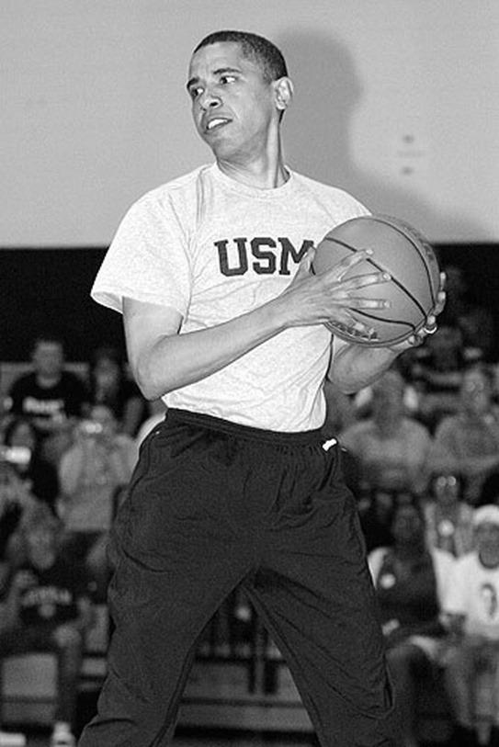

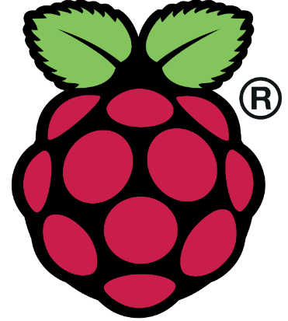
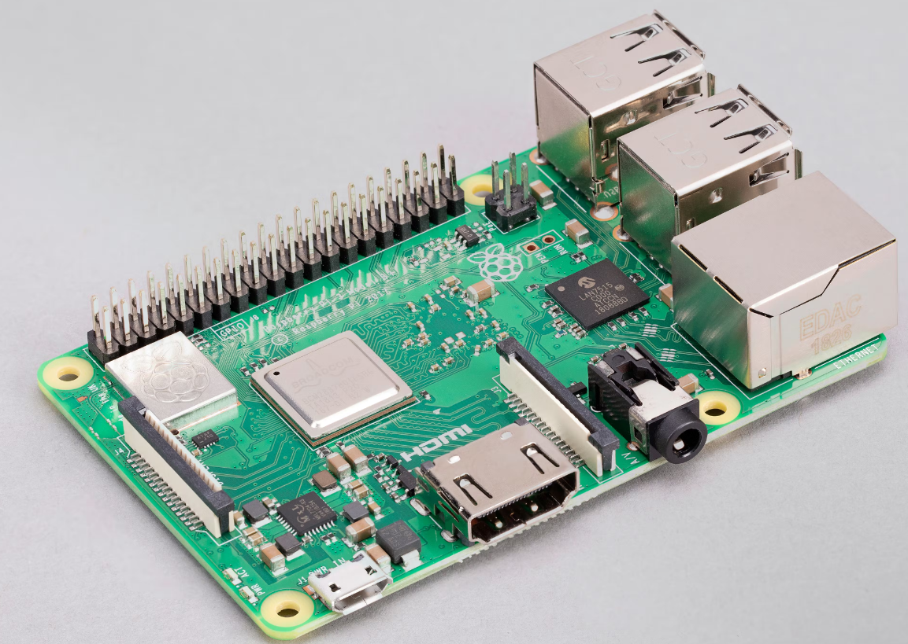
Embedded System Performance Research : Raspberry pi Image processing using OpenCV
Jose Soto-Covarrubias, Bruce Chua, Cedrik Jay Toledo, Tomik Baghramian, Dr. Mohamed El-Hadedy
Electrical and Computer Engineering Department at California State Polytechnic University, Pomona
Contact: jls1@cpp.edu, bpchua@cpp.edu, ctoledo@cpp.edu, baghramian@cpp.edu mealy@cpp.edu
Abstract
Because of the increase in technology of software and hardware devices, there have been breakthroughs on how single board computer devices run on a operating systems. With the help of the Linux community, there are different flavors of operating systems that can be put into computers such as TinyOS, ChromeOS and RaspbianOS. In this project, we introduce raspberry pi model b with 1gb ram to use for image processing. For the purpose of this project, we will be using OpenCV, a open-source software that provides tools for image processing. Raspberry pi OS, previously called RaspbianOS, has a large community following for people interested in tinkering, designing and prototyping . Specifically, the task is to implement image processing techniques from OpenCV and study the performance with the hardware that we have. Furthermore, utilizing the programing language, Python, for rapid prototyping on the single board computer. Linux terminal was also used to update software that was loaded into the board to current standards. With this in mind, this project aims to enhance the what can be done using single board computers and shows how powerful these devices can become.
Introduction
Images Processed
Digital image processing is the alteration of images through the use of digital computers. The uses for image processing ranges from entertainment, medicine, remote sensing, and geological mapping. Images can be manipulated through enhancement, restoration, analysis, and compression. Unfortunately, there is single board computer shortage for raspberry pi. The price found online are not what the hardware designers wanted but can be found at a reasonable price with patience and time. OpenCV was used for its highly regarded image processing software that is often used with raspberry pi.
Hardware
Grey threshold image
Color put back into grey scale
The Raspberry Pi 3 model B has a quad core 1.2GHz 64-bit CPU, 1GB of RAM, 100 Base Ethernet, 4 USB 2.0 ports, and a HDMI port. The boot device that is being used is a Sandisk micro sd card with a storage of 64gb. The operating system that the single board computer will use is Raspberry Pi OS(Previously known as Raspbian).
Original jpg image that was used
Conclusion
In conclusion, the implementation operating system onto a single board computer was a success. When viewing the images processed using OpenCV built in functions, original image was processed in a variety of ways and saved onto the board. However, performance review was not complete success. OpenCV can also run C++ language to see if processes ran quicker. Due to limited time, hardware limitations, and insufficient research, C language implementation was not successfully. Ultimately, the project can be expanded by having more ram to run other software such as Visual Studio Code
Grey scale image
Blurred image

