Slide 1
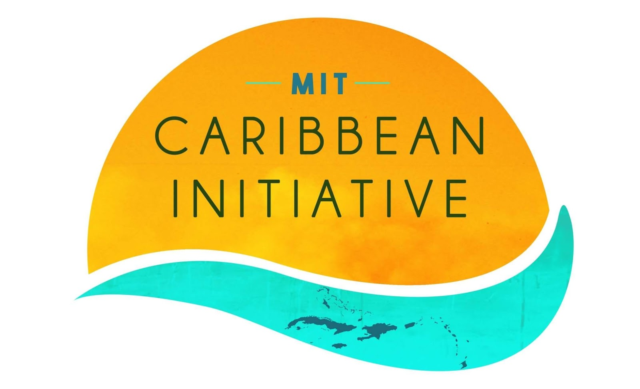
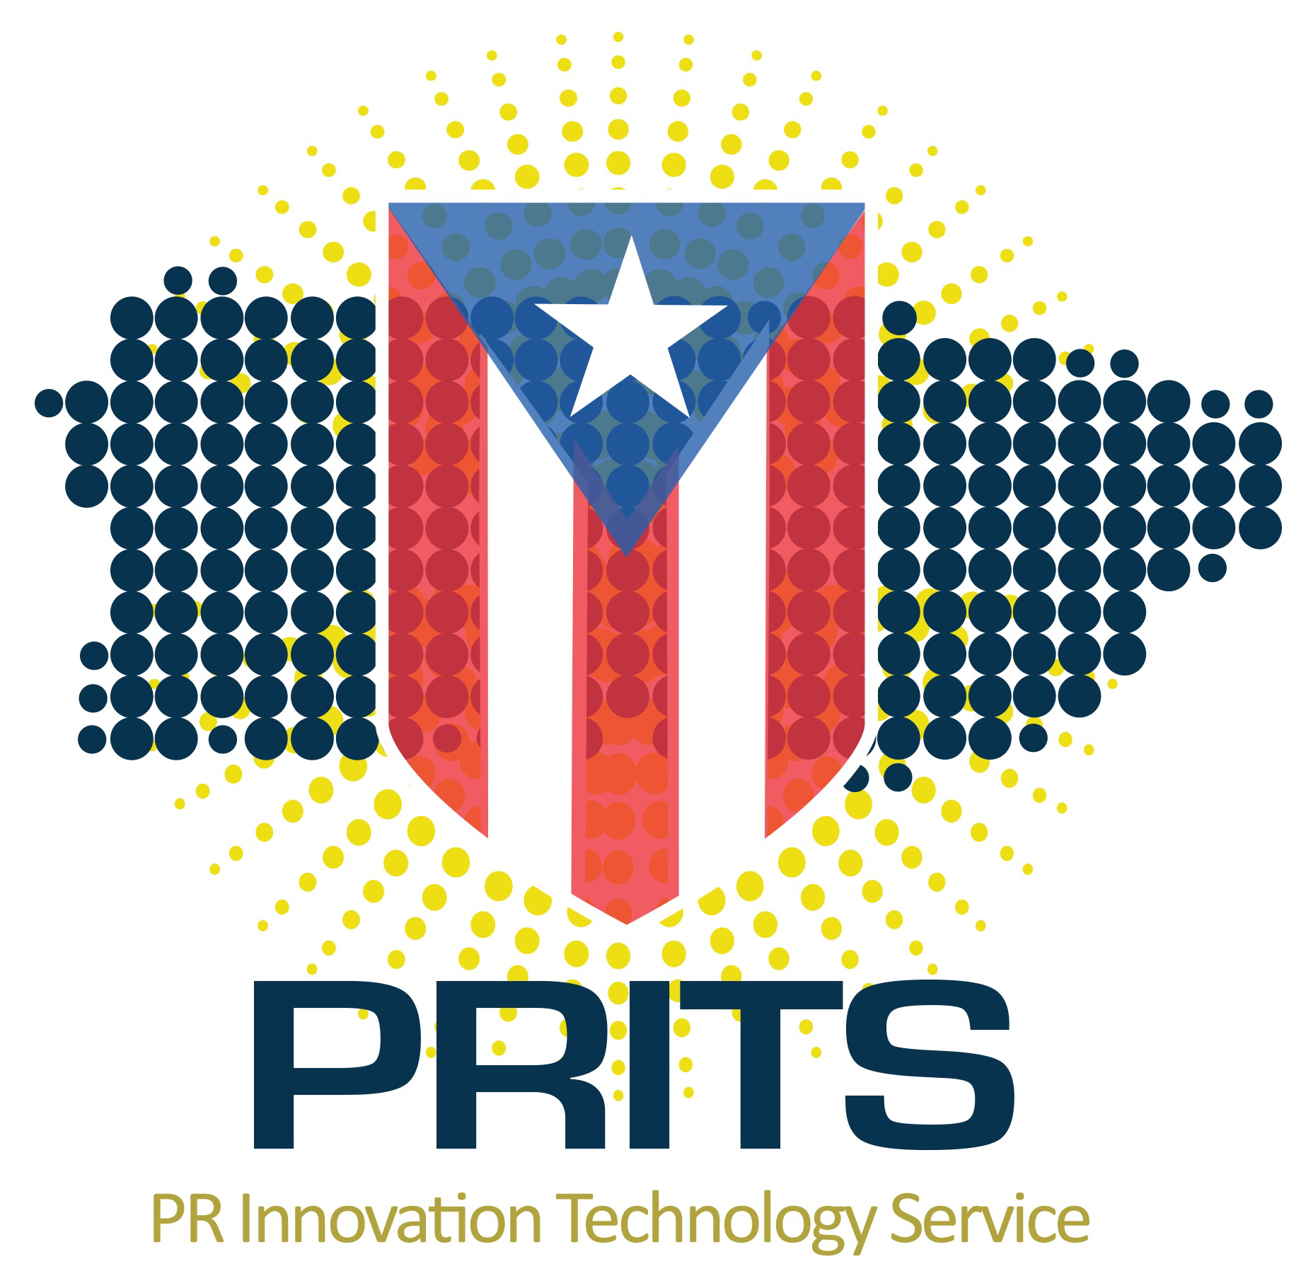
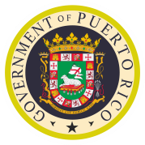


APR
Roles:
Government: MIT students in this environment will learn collaboration skills, data analysis skills, and how to build policy to effectively solve a country’s hardest problems . PRITS would be a good partner for this.
NGO’s & Non-Profit: The Caribbean has been ravaged by the hurricanes and there are a lot of communities around the Caribbean that need help rebuilding and redesigning them. NGO’s are constantly understaffed and need any help that they can get. The Caribbean Science Foundation and Foundation for Puerto Rico would be good partners for this.
Private Industry; Private industries in the Caribbean can benefit from hosting MIT students the same way any other private industry could. MIT students are brilliant creative students with innovative ideas. The students could benefit by seeing what is being implemented in the field and help expand their technical skills. Banco Popular or the Eastern Caribbean Central Bank could be valid partners.
Research @ Universities: MIT students will be able to tackle some of the hardest research problems that Caribbean researchers are facing today. These research problems range from sustainable engineering to industrial engineering & economics. The University of Puerto Rico and the the University Of West Indies Mona could be valid partners.
(Potential/Interested)Partners:
MISTI Caribbean
The Caribbean is a paradise location with clear beaches, diverse wildlife and natural wonders. Unknown to many is that the Caribbean is also host to many manufacturing facilities, major international research and is very active in the environmentalist scene. Students have wanted this program to exist for years and we believe that now is the right to implement it.
Student Interest:
Students will be able to gain experience while working on relevant projects that can directly impact the community they are working in. Students will not only be able to experience a welcoming and vibrant culture, but also be able to positively impact the community they are experiencing.
Example of Partnerships:
Students can coordinate with the Puerto Rico Technology Service to créate a centralized governmental data bank. Students can work together with the Caribbean Science Foundation’s SPISE program to tutor underprivilaged students in STEM fields over a summer. Students can work together with the Urban Planning Development Centers of Puerto Rico and Barbados to make sure that these communities are built better than they were before.
MISTI Caribbean Benefit
The Caribbean is interested in MISTI Caribbean because through this program the islands of the Caribbean can promote STEM in the Caribbean islands, while attracting specialized talent to the island. MIT Students are resourceful innovators that brighten most environments that they are in and are craved in any work environment.

