Slide 1

AgriHealth
By: José D. Soto Rivera
Julio Morales
Jia Liu
Eduardo Villa

Slide 2
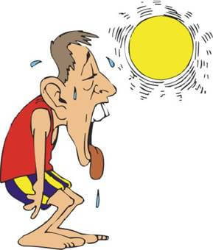

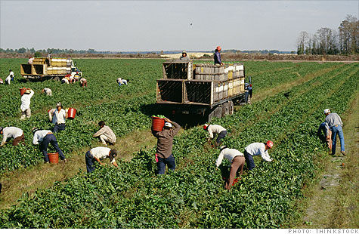
Problem

Slide 3
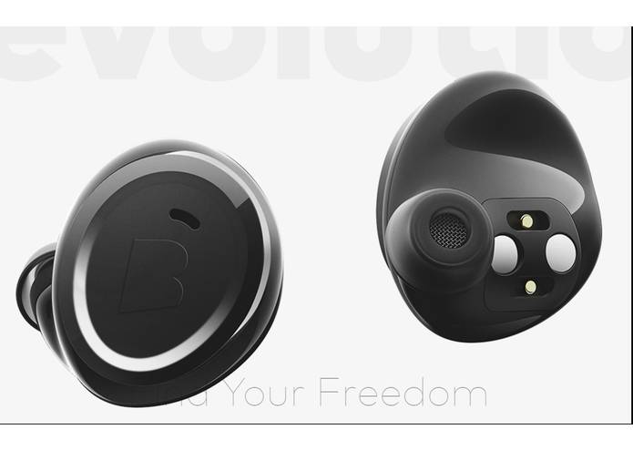


Agrihealth Device

Slide 4
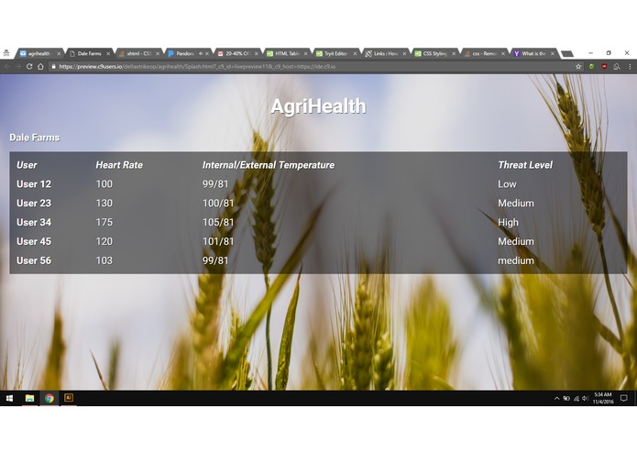
User Interface

Slide 5
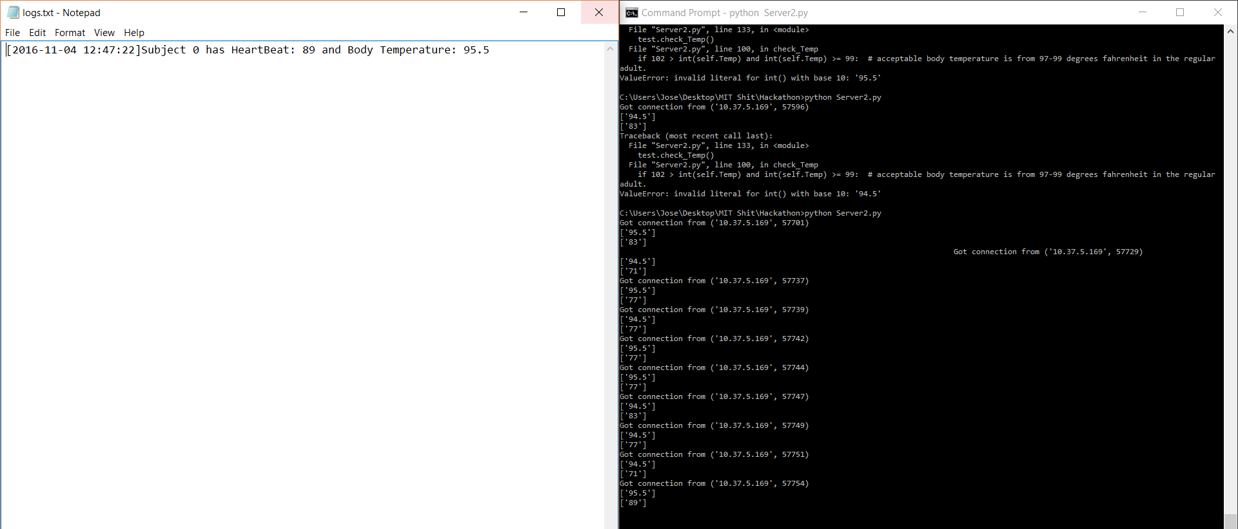
Live Logging

Slide 6
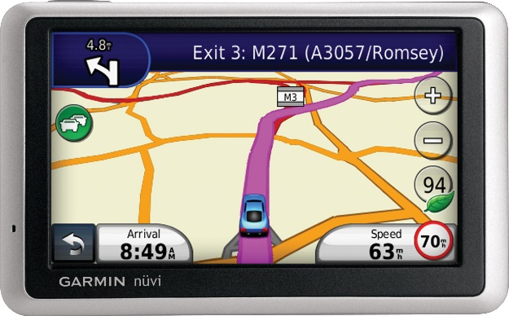
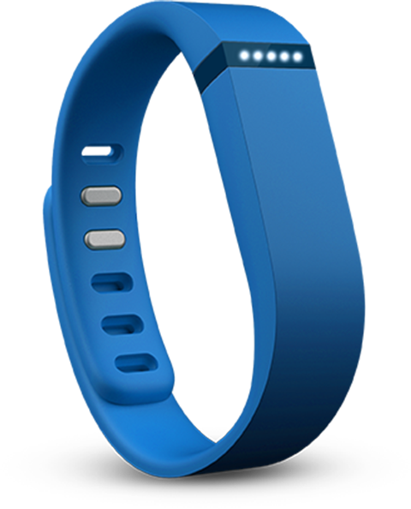

Future Development

Slide 7
References
http://i2.cdn.turner.com/money/2010/07/07/news/economy/farm_worker_jobs/migrant_workers_ji.top.jpg
http://images.wisegeek.com/male-sweats-outside.jpg
http://www.doctorsexpressdanbury.com/wp-content/uploads/heat-stroke.jpg
http://cdn.marksdailyapple.com/wordpress/wp-content/uploads/2014/10/heartrate.jpg
https://static.bhphotovideo.com/explora/sites/default/files/Color-Temperature.jpg
http://static1.fitbit.com/simple.b-cssdisabled-png.hc67aac363566dacfc23446af553b9bd8.pack?items=%2Fcontent%2Fassets%2Fflex%2Fimages%2Fapp-dashboard%2Fflex.png
http://eatdrinkbetter.com/wp-content/uploads/2014/08/Happy-Farmer.jpg

