Slide 1
INTRODUCTION TO programming using python

Slide 2
Outline
Modules
Packages
Python Standard Library
External Libraries
Automation demo

Slide 3
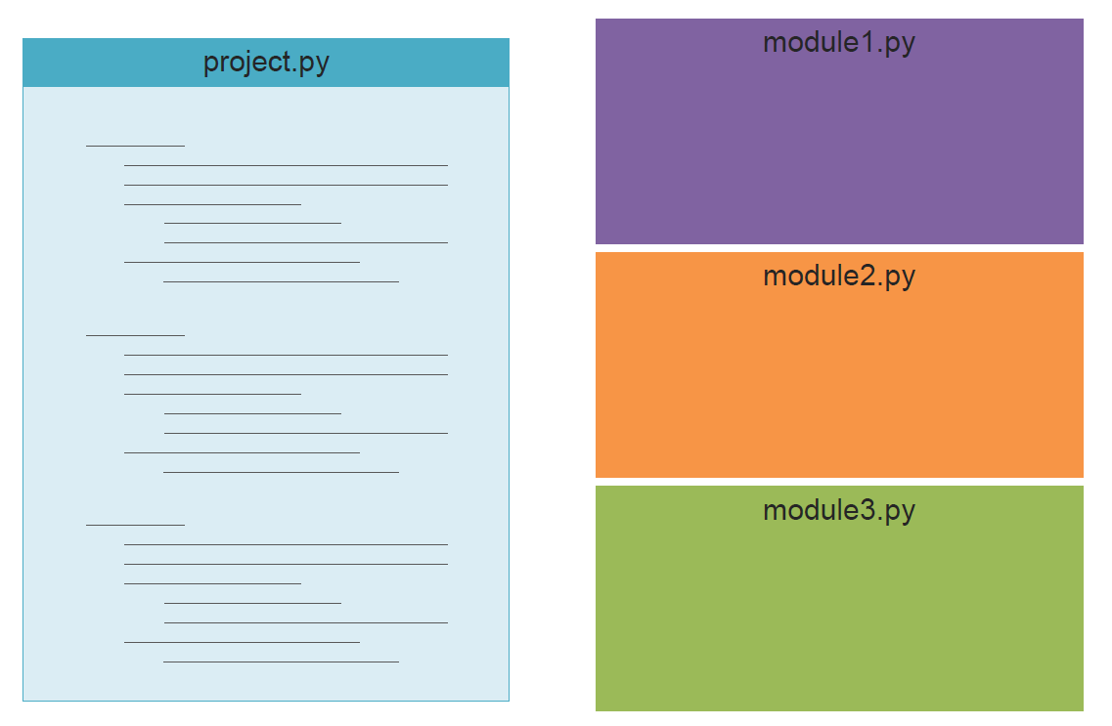
Modules
To make your code more modular

Slide 4
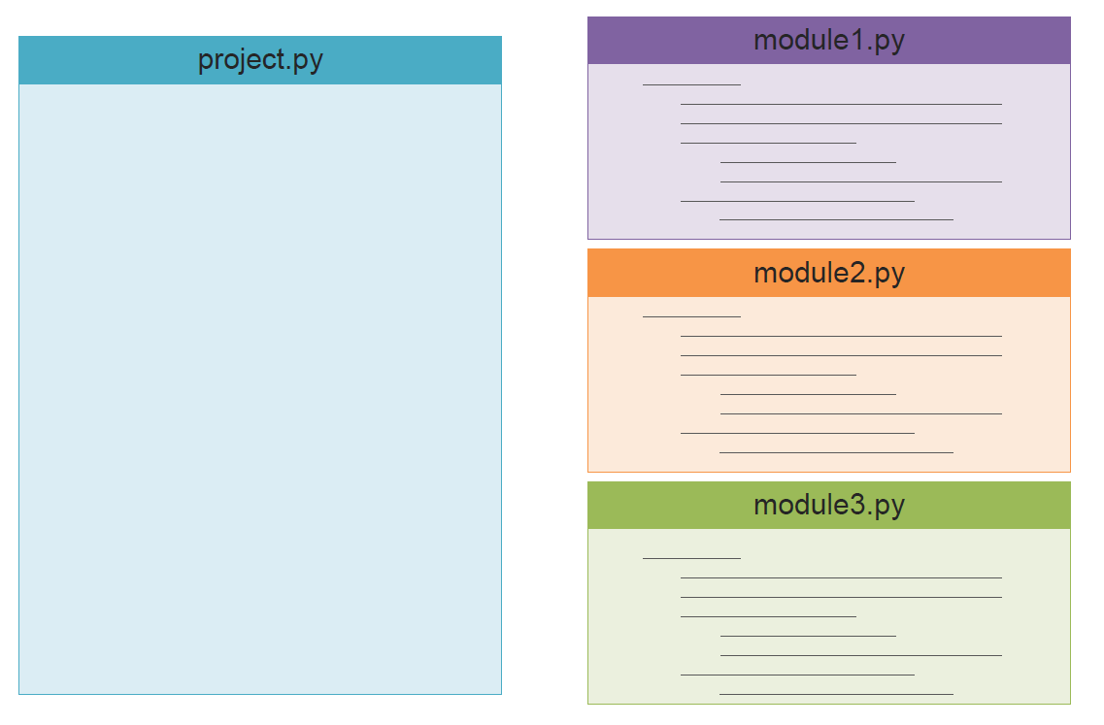
Modules

Slide 5
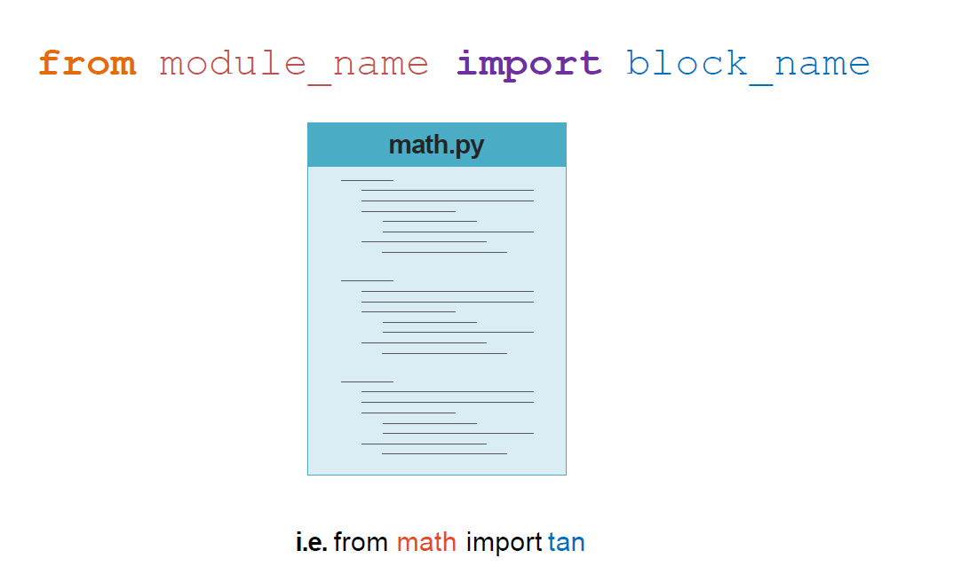
How To

Slide 6
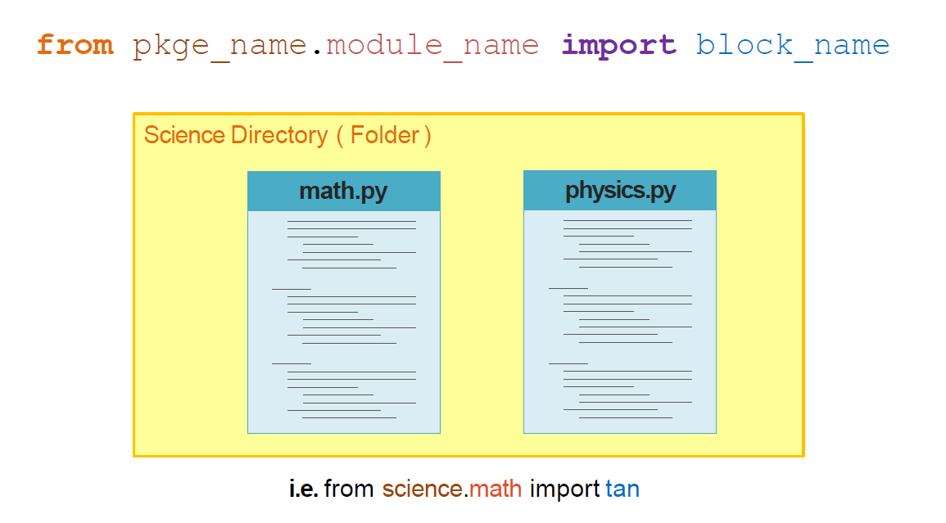
Packages

Slide 7
Standard Library
os
math
re
Sys
socket

Slide 8
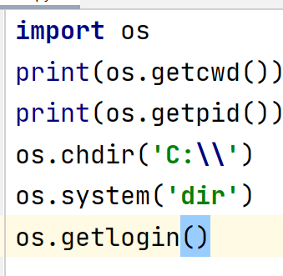
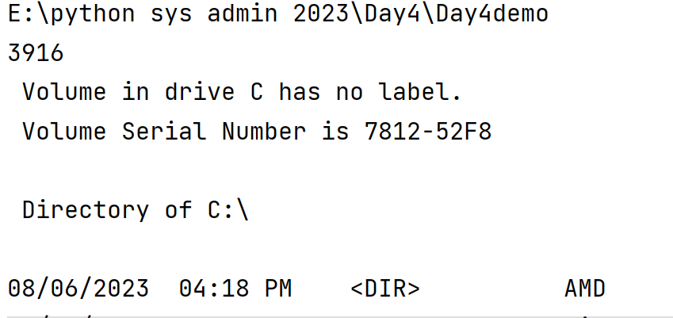

os
module provides functions for interacting with the operating system

Slide 9
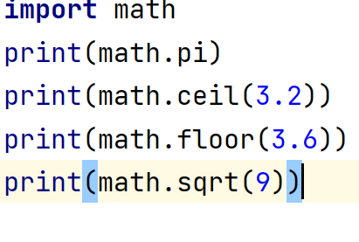
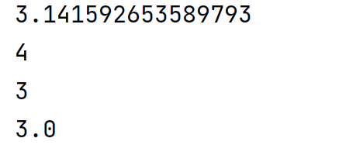
math
module provides access to the mathematical functions by the C standard

Slide 10
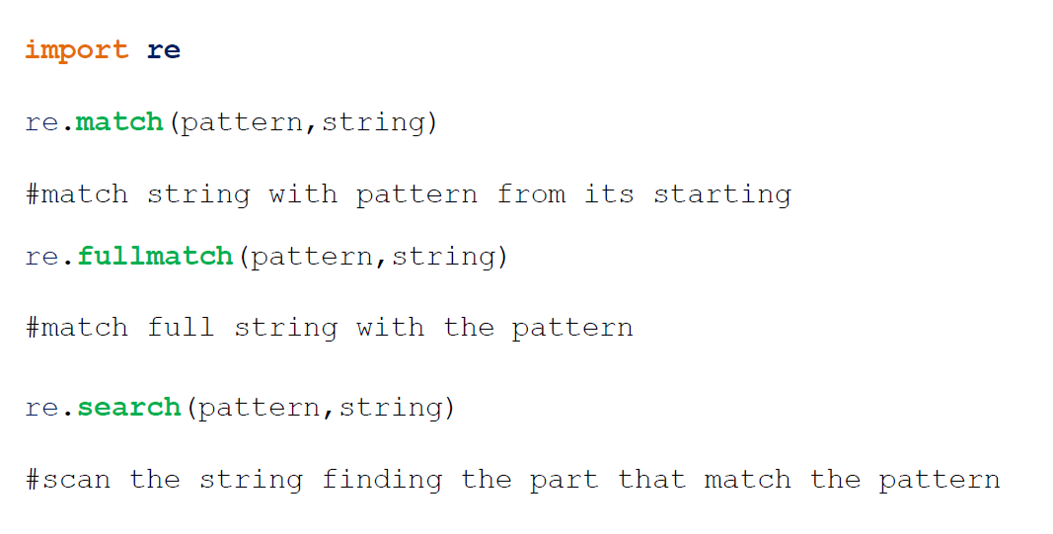
re
provides regular expression matching operations

Slide 11
re
import re
emailregulareexression=''
statment='asd@yahoo.com'
re.fullmatch(statment,emailregulareexression)
statment='asd@yahoo.com plpalapl plaplspals'
re.match(statment,emailregulareexression)
statment='palpalp asd@yahoo.com palpalp asd@yahoo.com'
re.search(statment,emailregulareexression)
re.findall(statment,emailregulareexression)

Slide 12
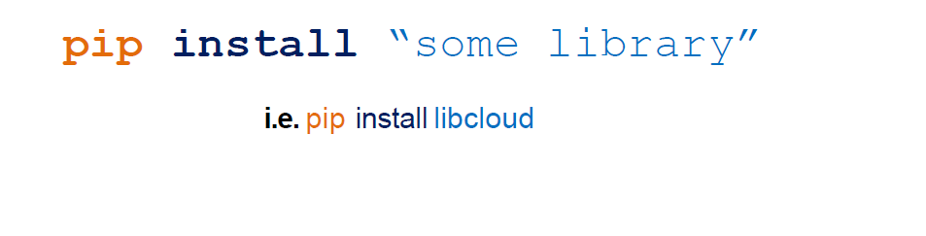
External Libraries
Pip is a package management system used to install and manage software packages written in Python

Slide 13
Demo

Slide 14
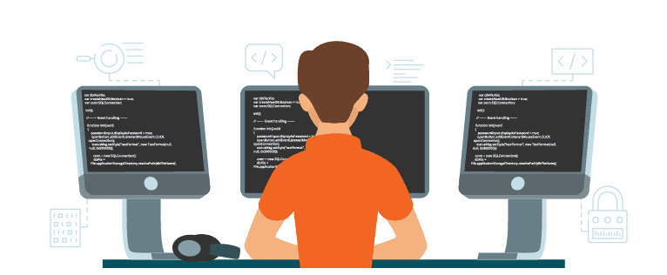
Exercises

Slide 15


