Slide 1
Database Fundamentals & Design
Presented by
Josephine Boles

Slide 2
Outline
What is a Relational Database?
Basic Database Structure.
Entity Relationship Modeling.
ERD.
Foreign Key
Mapping

Slide 3
What is a Relational Database?
A data structure through which data is stored in tables that are related to one another in some way.
The way the tables are related is described through a relationship

Slide 4
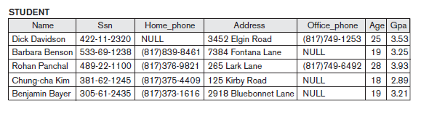
Basic Database Structure
Column
Row

Slide 5
Entity Relationship Modeling
Entity-Relationship Diagram (ERD): identifies information required by the business by displaying the relevant entities and the relationships between them.
Notes:
5

Slide 6
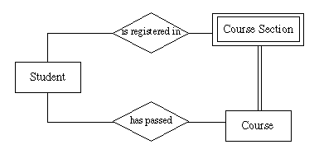
Definitions
Entity :
It is any thing about which data is collected
(any thing a user want to track) .
Weak Entity :
It is an entity whose existence is dependent on
another entity.
Existence of course_section depend on Course
Notes:
6

Slide 7
Definitions
Entity instance: An instance is a particular occurrence of an
entity.
For example:
each Student is an instance of an entity
each car is an instance of an entity, etc.
Notes:
7

Slide 8
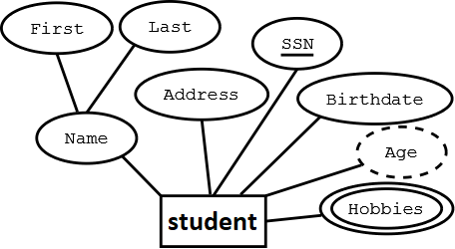
Definitions (cont.)
Attributes :
They are the Characteristics of entities.
Types of attributes :
Simple (Scalars) –
smallest semantic unit of data,
atomic (no internal structure)
singular e.g. ssn,birthdate
Notes:
8

Slide 9
Definitions (cont.)
Types of attributes :
Composite - group of attributes
e.g. address (street, city, state, zip)
Multi-valued (list)
multiple values e.g. phone numbers.
Derived.
Notes:
9

Slide 10
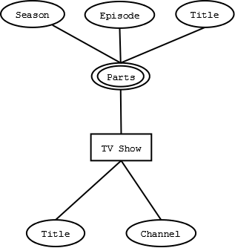
Definitions (cont.)
Types of attributes :
Complex attribute:
Those attributes, which can be formed by the nesting of composite and multi-valued attributes
Notes:
10

Slide 11
Definitions (cont.)
Attribute Values
Sometimes attribute values is set to null.
There are two meanings of null
either not applicable
unknown values.
Default Value.
Notes:
11

Slide 12
Definitions (cont.)
Primary Key:
Identifier used to uniquely identify one particular instance of an entity.
Can be one or more attributes. (consider substituting a single concatenated key attribute for multiple attribute key).
Must be unique .
Value should not change over time.
Must always have a value .
Notes:
12

Slide 13
Definitions (cont.)
Candidate Key :
when multiple possible identifiers exist, each is a candidate key.
Foreign Keys :
Foreign keys reference a related table through the primary key of that
related table.
Referential Integrity Constraint:
For every value of a foreign key there is a primary key with that value in the referenced table e.g.
if student name is to be used in a dormitory table then that name must exist in the student table.
Notes:
13

Slide 14
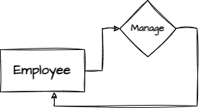

Relationships
A relationship is a connection between entity
classes.
Degree of Relationship:
Unary :relationships exist when both entity types are the same and we call them the degree of relationship is 1
Binary:relationship exists when there are two types of entity and we call them a degree of relationship is 2
Notes:
Relationship: Establishes a connection or correspondence or link between a pair of tables in a database, or between a pair of entities in an entity-relationship diagram (ERD).
One-to-one relationship: A single record in table A is related to only one record in table B, and vice versa.
One-to-many relationship: A single record in table A can be related to one or more records in table B, but a single record in table B can be related to only one record in table A.
Many-to-many relationship: A single record in table A can be related to one or more records in table B, and vice versa. Problems with many-to-many relationships: one of the tables will contain a large amount of redundant data, both tables will contain some duplicate data, it will be difficult to add, update, delete records because of the duplication of fields between tables.
14

Slide 15
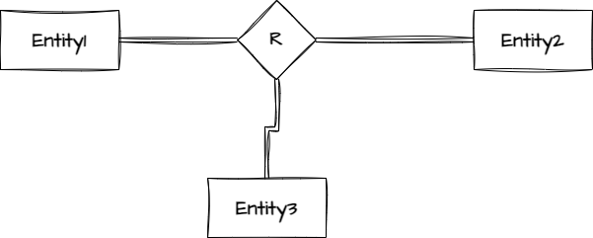
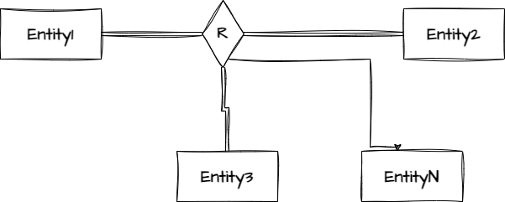
Relationships
Degree of Relationship:
Ternary: relationship exists when there are three types of entity and we call them a degree of relationship is 3
N-ary: relationship exists when there are n types of entities. There is one limitation of the N-ary relationship
Notes:
Relationship: Establishes a connection or correspondence or link between a pair of tables in a database, or between a pair of entities in an entity-relationship diagram (ERD).
One-to-one relationship: A single record in table A is related to only one record in table B, and vice versa.
One-to-many relationship: A single record in table A can be related to one or more records in table B, but a single record in table B can be related to only one record in table A.
Many-to-many relationship: A single record in table A can be related to one or more records in table B, and vice versa. Problems with many-to-many relationships: one of the tables will contain a large amount of redundant data, both tables will contain some duplicate data, it will be difficult to add, update, delete records because of the duplication of fields between tables.
15

Slide 16
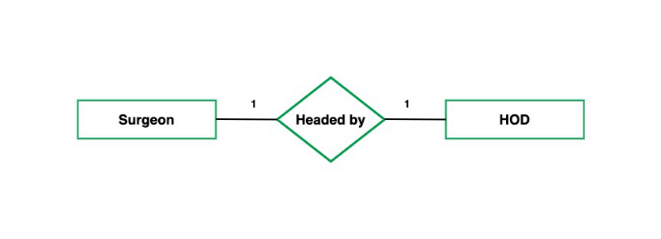
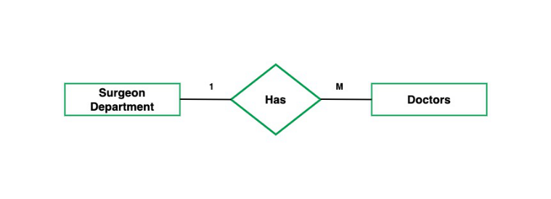
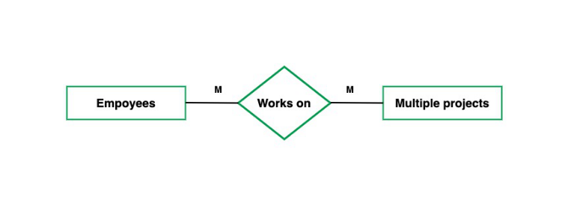
Relationships
Cardinality represent maximum number of relationships that can occur with these instance .
Types of relationships (cardinality) :
One-to-one relationship (1:1)
One-to-many relationship (1:M)
Many-to-many relationship
(N:M)
Notes:
Relationship: Establishes a connection or correspondence or link between a pair of tables in a database, or between a pair of entities in an entity-relationship diagram (ERD).
One-to-one relationship: A single record in table A is related to only one record in table B, and vice versa.
One-to-many relationship: A single record in table A can be related to one or more records in table B, but a single record in table B can be related to only one record in table A.
Many-to-many relationship: A single record in table A can be related to one or more records in table B, and vice versa. Problems with many-to-many relationships: one of the tables will contain a large amount of redundant data, both tables will contain some duplicate data, it will be difficult to add, update, delete records because of the duplication of fields between tables.
16

Slide 17
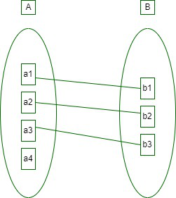
Relationships (cont.)
One-to-one relationship (1:1) :
A single record in table A is related to only one
record in table B, and vice versa.
Ex. : Emp. Uses at most one car,
a car is used at most by one
emp.
Notes:
17

Slide 18
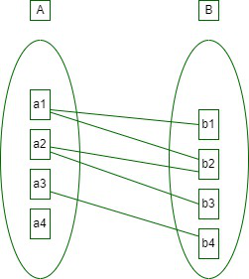
Relationships (cont.)
One-to-many relationship (1:M) :
A single record in table (A) can be related
to one or more records in table (B),
but a single record in table (B) can be related
to only one record in table (A).
Ex. : Emp. Uses at most one car, a car is used by many or
several employees, student-advisor, customer-order
Notes:
18

Slide 19
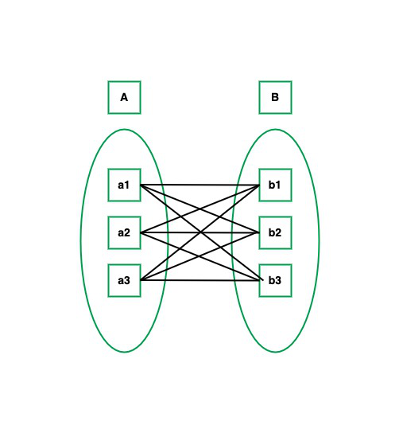
Relationships (cont.)
Many-to-many relationship (M:M) :
A single record in table A can be related to
one or more records in table B,
and vice versa.
Ex. An emp. Uses several cars, a car can be used by several employees. Student-Club, order-products.
Notes:
19

Slide 20
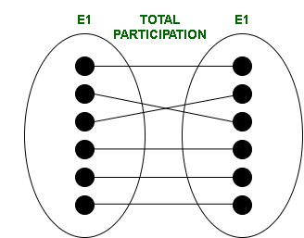
Relationships (cont.)
Participation Constraints (opposite of cardinality)
Represent minimum number of relationships that can occur with these instance .
Total Participation − Each Row is involved in the relationship. Total participation is represented by double lines.
Notes:
20

Slide 21
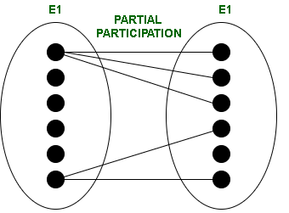
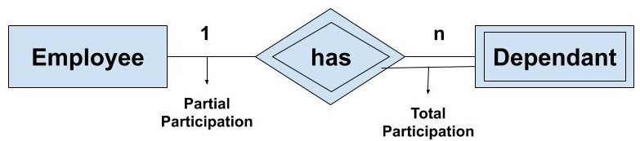
Relationships (cont.)
Participation Constraints
Partial participation − Not all Rows are involved in the relationship. Partial participation is represented by single lines.
Any weak entity must be totally Participation
Notes:
21

Slide 22
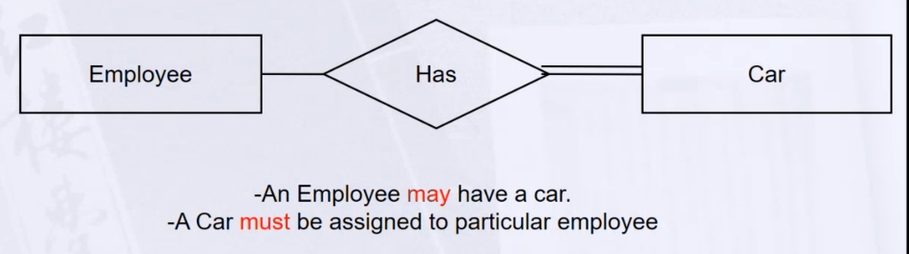
Relationships (cont.)
Notes:
22

Slide 23
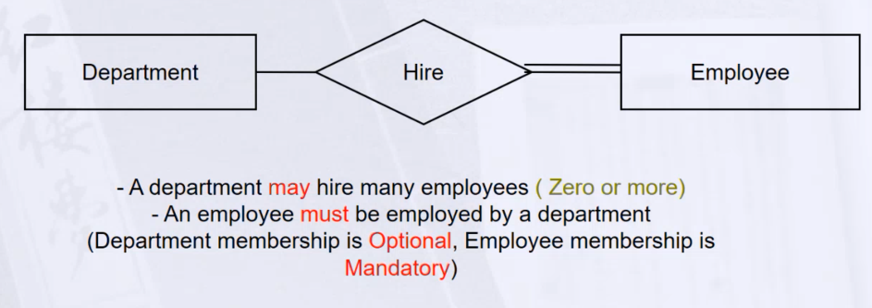
Relationships (cont.)
Notes:
23

Slide 24
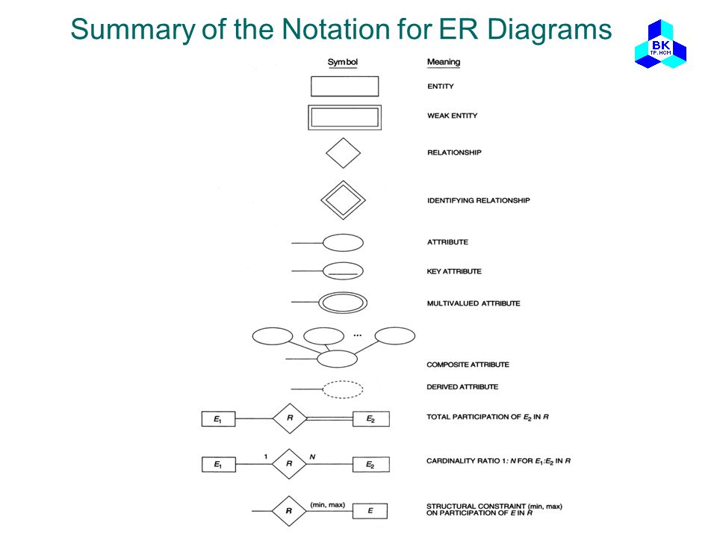
SUMMARY OF ERD NOTATION
Notes:
Guidelines:
• The existence of a relationship between two entities is drawn as a line connecting the entities.
• Arrows at the ends of the lines indicate different types of relationships (one-to-one, one-to-many, many-to-many)
• Verbs may be placed on the relationship lines that describe what the relationships mean (e.g. “addresses locate businesses”, where “addresses” and “businesses” are related entities, and “locate” is
the verb describing the relationship.)
• Lists of attributes are developed as you go. (An attribute is a single piece of information that is descriptive of an entity, e.g. friend name, friend e-mail.)
• A single attribute for each entity is selected (or an arbitrary one is assigned) as being the unique identifier for each occurrence of the entity (e.g. business id number to uniquely identify a business).
24

Slide 25
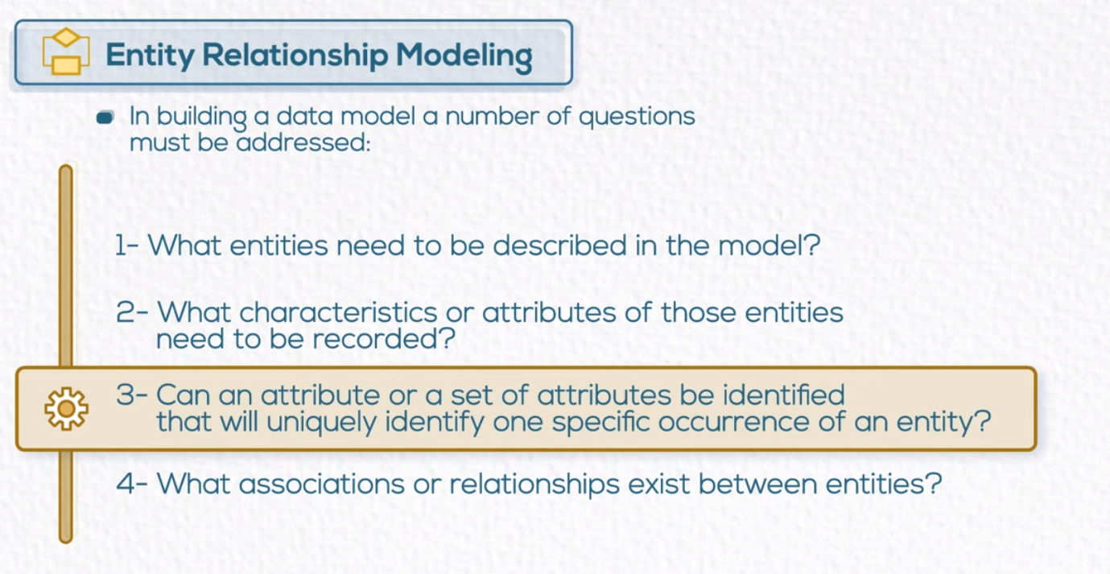
Notes:
25

Slide 26
An Example
A company is organized into departments. Each department has a unique name, a unique number, and a particular employee who manages the department. A department may have several locations.
A department may control a number of projects, each of which has a unique name, a unique number, and a single location. A project must controlled by department
Notes:
26

Slide 27
An Example (Cont’d)
We store employee’s name, social security number, address, salary, gender and birth date. An employee must be assigned to one department and must work on one or more projects, which are not necessarily controlled by the same department. We keep track of the number of hours per week that an employee works on each project. We also keep track of the direct supervisor of each employee.
We want to keep track of the dependents of each employee for insurance purposes. We keep each dependent’s first name, gender, birth date and relationship to that employee.
Notes:
27

Slide 28
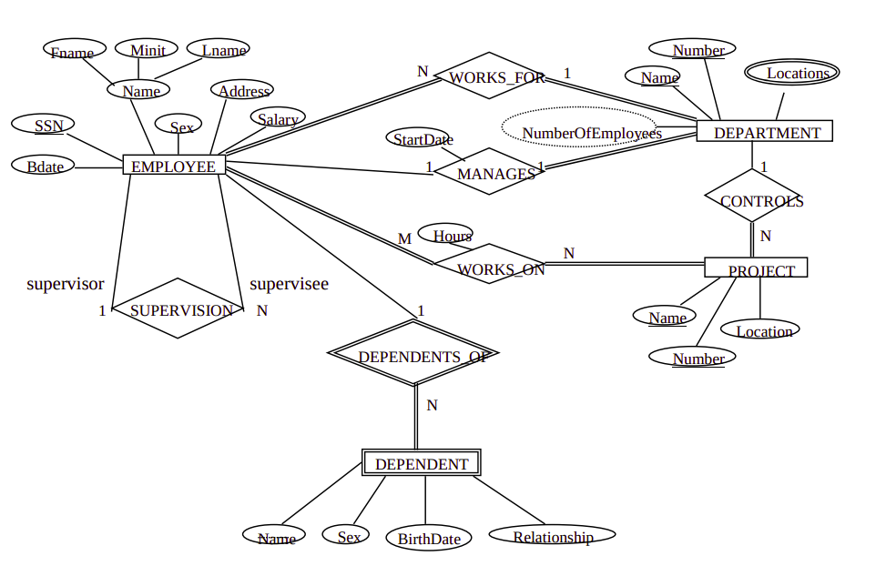
Notes:
28

Slide 29
Definitions (cont.)
Foreign Keys :
is a column that refers to the primary key/unique key of other table. So it demonstrates relationship between tables and act as cross reference among them
Fk in A must be same type of pk in B
Referential Integrity Constraint:
For every value of a foreign key there is a primary key with that value in the referenced table
Each value of fk in A must match value in pk in B
e.g. if student name is to be used in a dormitory table then that name must exist in the student table.

Slide 30
ER-to-Relational Mapping
Step 1: Mapping of Regular Entity Types
Step 2: Mapping of Weak Entity Types
Step 3: Mapping of Binary 1:1 Relation Types
Step 4: Mapping of Binary 1:N Relationship Types.
Step 5: Mapping of Binary M:N Relationship Types.
Step 6: Mapping of Multi-valued attributes.
Step 7: Mapping of N-ary Relationship Types.

Slide 31
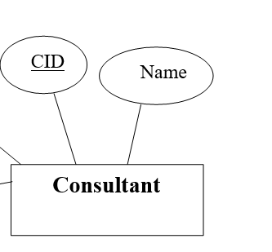
Step 1: Mapping of Regular Entity Types
Create table for each entity type
Choose one of key attributes to be the primary key
Consultant
Name | CID ______

Slide 32
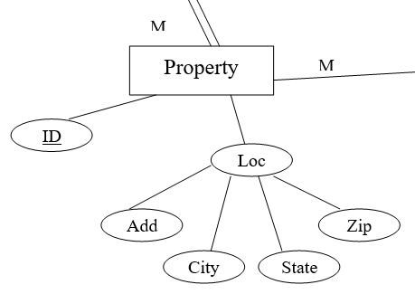
Step 1: Mapping of Regular Entity Types
Regular entity with composite attribute
Property
Zip | State | City | Add | ID ______
Leave note about Loc

Slide 33
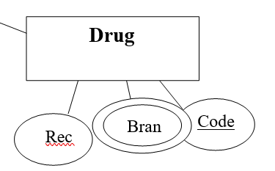
Step 6: Mapping of Multi-valued attributes.
Create new table for each multi-valued attribute
Table will include two columns.
one for multi-valued attribute + FK column.
Drug
Zip | State | City | Rec | Code ______
Drug_Brand
Brand ____ | Code - - - - ______
Composite pk

Slide 34
Step 2: Mapping of Weak Entity Types
Create table for each weak entity.
Add foreign key that correspond to the owner entity type.
Choose the primary key : ( FK + weak entity Partial PK if any)

Slide 35
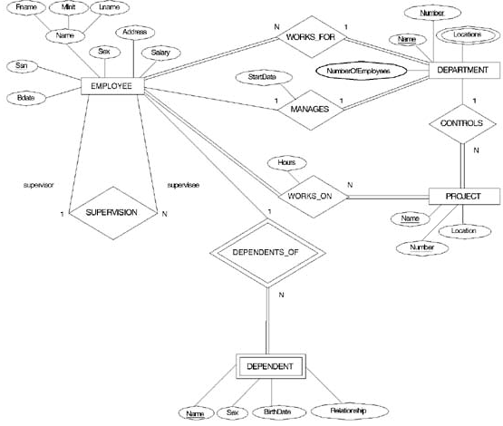
Step 2: Mapping of Weak Entity Types

Slide 36
Step 2: Mapping of Weak Entity Types
Employee
address | Salary | Gender | mname | Lname | Fname | Bdate | SSN ______
Dependent
Relation | Bdate | Gender | SSN -------- _____ | Name ______
 |  |  | Composite pk

Slide 37
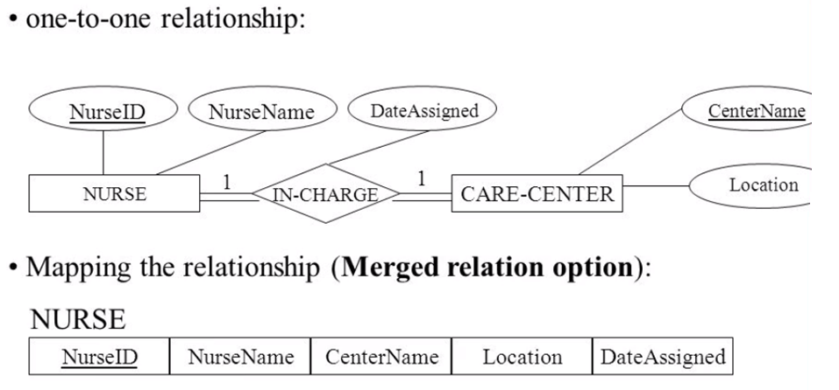
Step 3: Mapping of Binary 1:1 Relation Types
Merged two tables if both sides are Mandatory.
Add FK into table with the total participation relationship to represent optional side.
Create third table if both sides are optional.

Slide 38
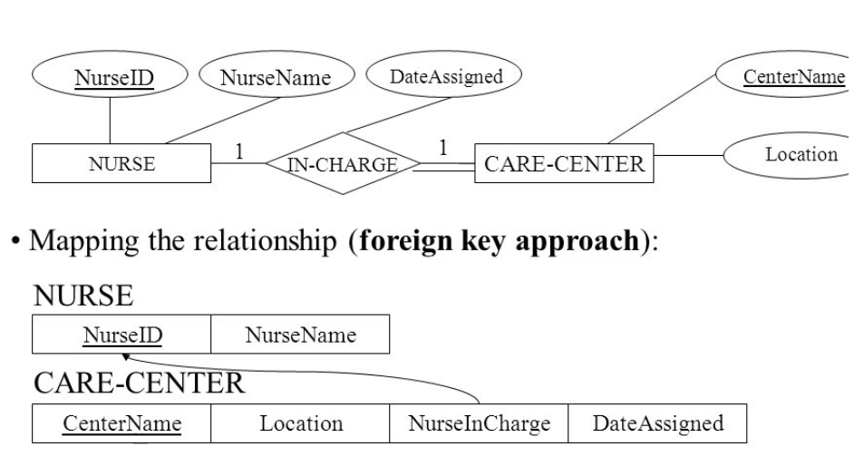
Step 3: Mapping of Binary 1:1 Relation cont.
Add FK into table with the total participation relationship to represent optional side.

Slide 39
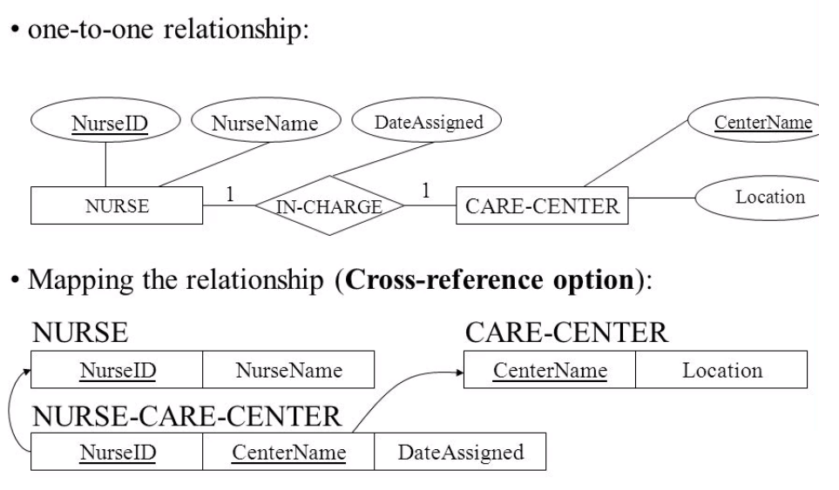
Step 3: Mapping of Binary 1:1 Relation cont.
Create third table if both sides are optional.

Slide 40
Step 4: Mapping of Binary 1:N Relationship Types.
Add FK to N-side table
Add any simple attributes of relationship as column to N-side table.

Slide 41
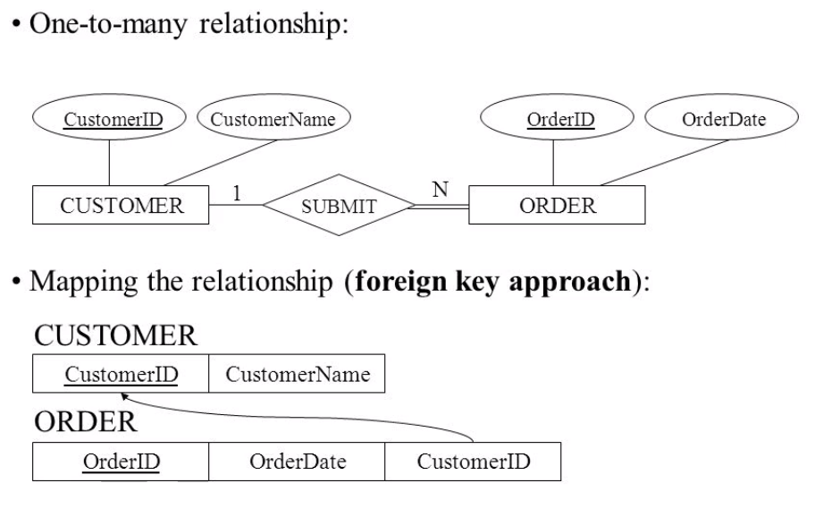
Step 4: Mapping of Binary 1:N Relationship Types.
Add FK to N-side table
Add any simple attributes of relationship as column to N-side table.

Slide 42
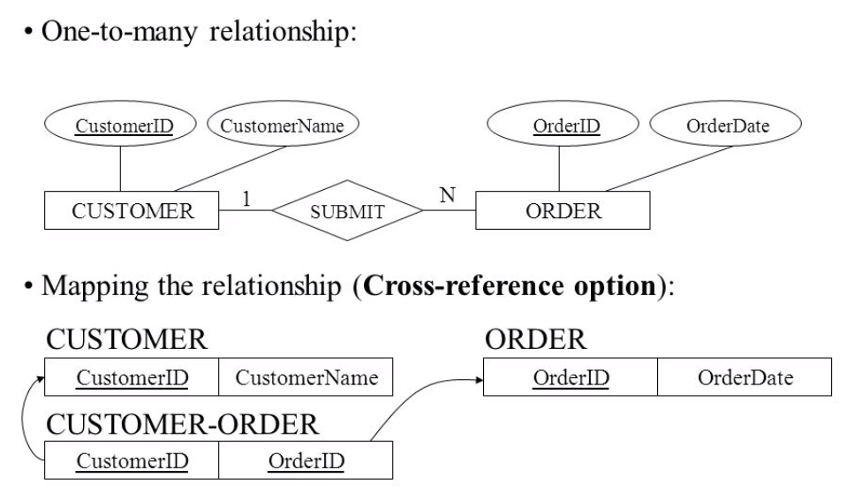
Step 4: Mapping of Binary 1:N Relationship Types.
Add FK to N-side table
Add any simple attributes of relationship as column to N-side table.

Slide 43
Step5: Mapping of Binary M:N Relationship
Create a new third table
Add FKs to the new table for both parent tables
Add simple attributes of relationship to the new table if any .

Slide 44
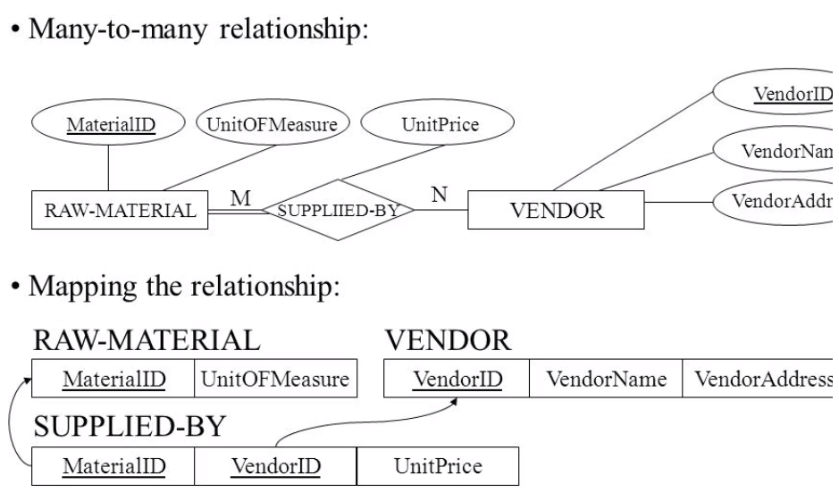
Step5: Mapping of Binary M:N Relationship
Create a new third table
Add FKs to the new table for both parent tables
Add simple attributes of relationship to the new table if any .

Slide 45
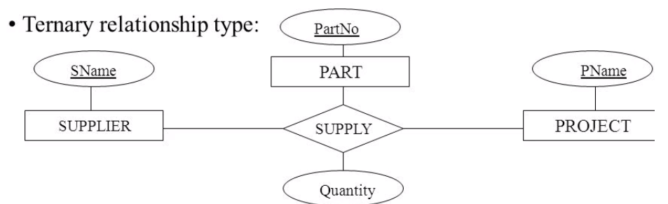
Step7: Mapping of N-ary Relationship
If n > 2 then :
Create a new third table
Add FKs to the new table for all parent tables
Add simple attributes of relationship to the new table if any .

Slide 46
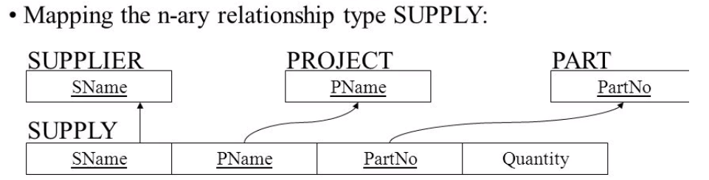
Step7: Mapping of N-ary Relationship

Slide 48
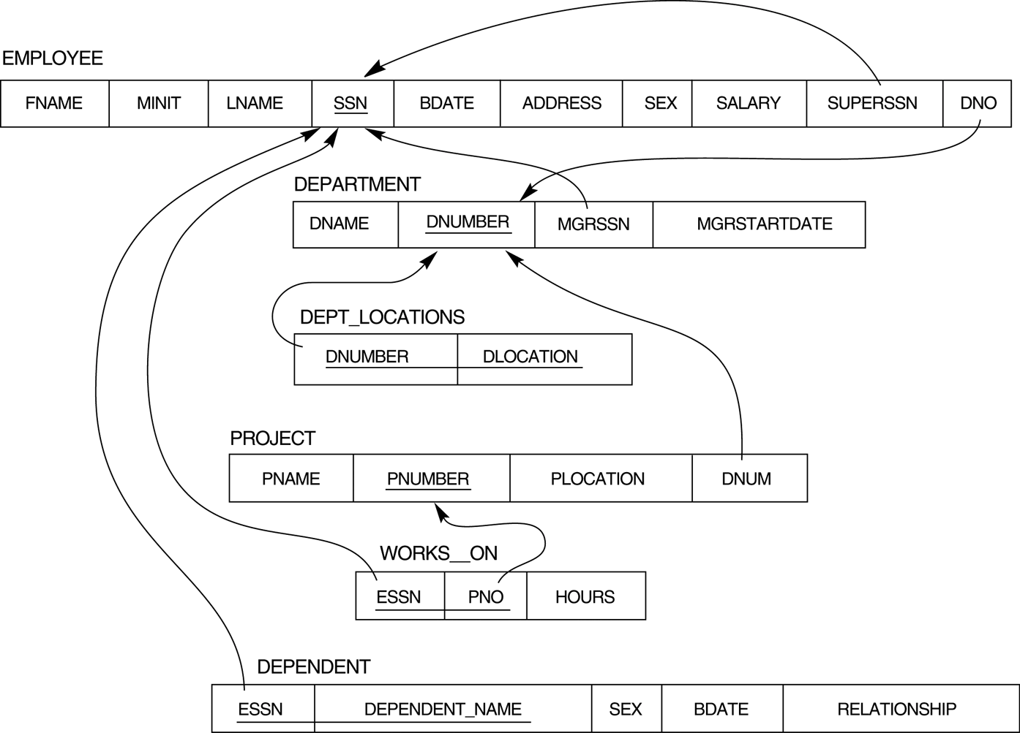
Mapping Result

Slide 49
Self Study
IS A Relation
Notes:
49

Slide 50
Questions ?
Notes:
50

Slide 51

Exercises

Slide 52


