Slide 1
REST Framework
Django

Slide 2
Outline
Overview
Benefits
Installation and setup of Django REST Framework
Serializers and Models
Views and Viewsets
Authentication and Permissions
Serialization Formats and Response Types
Pagination and Filtering
Notes:
Introduction to Django REST Framework (30 minutes)
Overview of Django and Django REST Framework
Benefits of using Django REST Framework for building APIs
Installation and setup of Django REST Framework
Serializers and Models (1 hour)
Creating Django models to represent data
Introduction to serializers and their role in data serialization/deserialization
Creating serializers for models
Performing CRUD operations using serializers
Nested serializers and handling related data
Views and Viewsets (1 hour)
Understanding views and viewsets in Django REST Framework
Creating API views and class-based views
Mapping views to URLs using URL patterns
Using viewsets for creating CRUD endpoints
Configuring routing for viewsets
Authentication and Permissions (30 minutes)
Introduction to authentication and authorization in Django REST Framework
Built-in authentication classes and their usage
Implementing token-based authentication
Applying permissions and role-based access control
Handling authentication and permissions in views and viewsets
Serialization Formats and Response Types (30 minutes)
Exploring different serialization formats (JSON, XML, etc.)
Configuring the default serialization format
Customizing response types (status codes, headers, content negotiation)
Handling errors and exceptions in API responses
Pagination and Filtering (30 minutes)
Implementing pagination for large result sets
Configuring pagination settings
Filtering and querying data using query parameters
Implementing filtering and search capabilities

Slide 3
Introduction

Slide 4
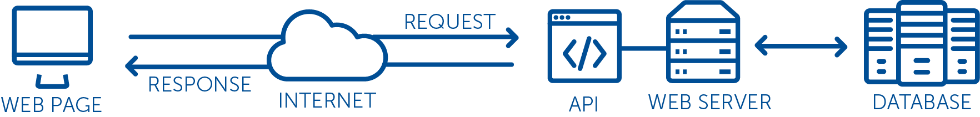
What is an API?
Application Programming Interfaces as a way to enable communication and data exchange between different systems or applications.
Notes:
Key features and benefits of Django include:
Object-Relational Mapping (ORM): Django provides a powerful and intuitive ORM that allows developers to interact with the database using Python objects, making it easier to manage and query data.
URL routing: Django's URL routing system maps URLs to corresponding views or actions, making it easy to create clean and user-friendly URLs for different pages and functionality within a web application.
Template system: Django comes with a built-in template engine that allows developers to separate the design and presentation logic from the application's business logic, promoting code reusability and maintainability.
Forms handling: Django provides a forms library that simplifies the handling of HTML forms, including form validation, data binding, and error handling.
Authentication and authorization: Django offers robust authentication and authorization mechanisms, including user management, login/logout functionality, and permission-based access control.
Admin interface: Django's admin interface is a powerful feature that automatically generates a user-friendly administration interface for managing data models, making it easy to perform CRUD operations (Create, Read, Update, Delete) on database records.
Security features: Django includes various built-in security features, such as protection against common web vulnerabilities like cross-site scripting (XSS), cross-site request forgery (CSRF), and SQL injection.
Scalability and extensibility: Django is designed to handle large-scale applications and supports modular and reusable code through the use of apps and plugins. It also offers support for database migration, caching, and asynchronous tasks.

Slide 5
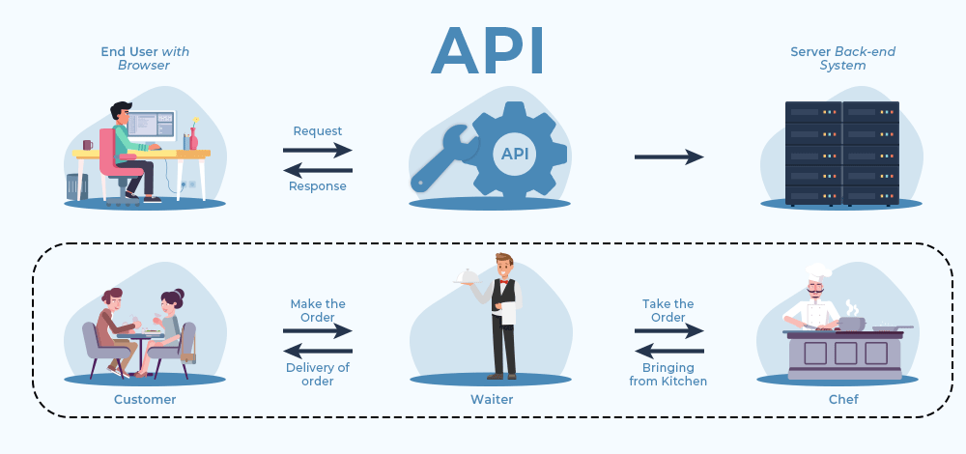
What is an API?
Application Programming Interfaces as a way to enable communication and data exchange between different systems or applications.
Notes:
Key features and benefits of Django include:
Object-Relational Mapping (ORM): Django provides a powerful and intuitive ORM that allows developers to interact with the database using Python objects, making it easier to manage and query data.
URL routing: Django's URL routing system maps URLs to corresponding views or actions, making it easy to create clean and user-friendly URLs for different pages and functionality within a web application.
Template system: Django comes with a built-in template engine that allows developers to separate the design and presentation logic from the application's business logic, promoting code reusability and maintainability.
Forms handling: Django provides a forms library that simplifies the handling of HTML forms, including form validation, data binding, and error handling.
Authentication and authorization: Django offers robust authentication and authorization mechanisms, including user management, login/logout functionality, and permission-based access control.
Admin interface: Django's admin interface is a powerful feature that automatically generates a user-friendly administration interface for managing data models, making it easy to perform CRUD operations (Create, Read, Update, Delete) on database records.
Security features: Django includes various built-in security features, such as protection against common web vulnerabilities like cross-site scripting (XSS), cross-site request forgery (CSRF), and SQL injection.
Scalability and extensibility: Django is designed to handle large-scale applications and supports modular and reusable code through the use of apps and plugins. It also offers support for database migration, caching, and asynchronous tasks.

Slide 6
Django REST Framework (DRF)
\a powerful and flexible toolkit for building Web APIs using Django, It provides a set of tools and features that make it easy to create, manage, and secure APIs.
provides a comprehensive set of tools, serializers, views, and authentication mechanisms specifically designed for building APIs,
Notes:
Key features and benefits of Django include:
Object-Relational Mapping (ORM): Django provides a powerful and intuitive ORM that allows developers to interact with the database using Python objects, making it easier to manage and query data.
URL routing: Django's URL routing system maps URLs to corresponding views or actions, making it easy to create clean and user-friendly URLs for different pages and functionality within a web application.
Template system: Django comes with a built-in template engine that allows developers to separate the design and presentation logic from the application's business logic, promoting code reusability and maintainability.
Forms handling: Django provides a forms library that simplifies the handling of HTML forms, including form validation, data binding, and error handling.
Authentication and authorization: Django offers robust authentication and authorization mechanisms, including user management, login/logout functionality, and permission-based access control.
Admin interface: Django's admin interface is a powerful feature that automatically generates a user-friendly administration interface for managing data models, making it easy to perform CRUD operations (Create, Read, Update, Delete) on database records.
Security features: Django includes various built-in security features, such as protection against common web vulnerabilities like cross-site scripting (XSS), cross-site request forgery (CSRF), and SQL injection.
Scalability and extensibility: Django is designed to handle large-scale applications and supports modular and reusable code through the use of apps and plugins. It also offers support for database migration, caching, and asynchronous tasks.

Slide 7
Key Features of Django REST Framework:
Serializers: allow for easy conversion between complex Python objects and JSON/XML representations, facilitating data serialization and deserialization.
Views and Viewsets: DRF offers various views and viewsets that handle HTTP methods (GET, POST, PUT, DELETE) for API endpoints.
Authentication and Permissions: DRF provides built-in support for authentication mechanisms such as token-based authentication, session authentication, and OAuth. It also offers permissions to control access to APIs based on user roles and privileges.
Notes:
Key features and benefits of Django include:
Object-Relational Mapping (ORM): Django provides a powerful and intuitive ORM that allows developers to interact with the database using Python objects, making it easier to manage and query data.
URL routing: Django's URL routing system maps URLs to corresponding views or actions, making it easy to create clean and user-friendly URLs for different pages and functionality within a web application.
Template system: Django comes with a built-in template engine that allows developers to separate the design and presentation logic from the application's business logic, promoting code reusability and maintainability.
Forms handling: Django provides a forms library that simplifies the handling of HTML forms, including form validation, data binding, and error handling.
Authentication and authorization: Django offers robust authentication and authorization mechanisms, including user management, login/logout functionality, and permission-based access control.
Admin interface: Django's admin interface is a powerful feature that automatically generates a user-friendly administration interface for managing data models, making it easy to perform CRUD operations (Create, Read, Update, Delete) on database records.
Security features: Django includes various built-in security features, such as protection against common web vulnerabilities like cross-site scripting (XSS), cross-site request forgery (CSRF), and SQL injection.
Scalability and extensibility: Django is designed to handle large-scale applications and supports modular and reusable code through the use of apps and plugins. It also offers support for database migration, caching, and asynchronous tasks.

Slide 8
Key Features of Django REST Framework:
Serialization Formats and Response Types: DRF supports multiple serialization formats like JSON, XML, and more. It also allows customization of API responses, including status codes, headers, and content negotiation.
Pagination and Filtering: DRF provides tools for handling pagination of large result sets and filtering/querying data based on user-defined parameters.
Testing and Documentation: DRF includes tools for writing unit tests for APIs and generating API documentation automatically.
Notes:
Key features and benefits of Django include:
Object-Relational Mapping (ORM): Django provides a powerful and intuitive ORM that allows developers to interact with the database using Python objects, making it easier to manage and query data.
URL routing: Django's URL routing system maps URLs to corresponding views or actions, making it easy to create clean and user-friendly URLs for different pages and functionality within a web application.
Template system: Django comes with a built-in template engine that allows developers to separate the design and presentation logic from the application's business logic, promoting code reusability and maintainability.
Forms handling: Django provides a forms library that simplifies the handling of HTML forms, including form validation, data binding, and error handling.
Authentication and authorization: Django offers robust authentication and authorization mechanisms, including user management, login/logout functionality, and permission-based access control.
Admin interface: Django's admin interface is a powerful feature that automatically generates a user-friendly administration interface for managing data models, making it easy to perform CRUD operations (Create, Read, Update, Delete) on database records.
Security features: Django includes various built-in security features, such as protection against common web vulnerabilities like cross-site scripting (XSS), cross-site request forgery (CSRF), and SQL injection.
Scalability and extensibility: Django is designed to handle large-scale applications and supports modular and reusable code through the use of apps and plugins. It also offers support for database migration, caching, and asynchronous tasks.

Slide 9
Outline
Overview
Benefits
Installation and setup of Django REST Framework
Serializers and Models
Views and Viewsets
Authentication and Permissions
Serialization Formats and Response Types
Pagination and Filtering
Notes:
Introduction to Django REST Framework (30 minutes)
Overview of Django and Django REST Framework
Benefits of using Django REST Framework for building APIs
Installation and setup of Django REST Framework
Serializers and Models (1 hour)
Creating Django models to represent data
Introduction to serializers and their role in data serialization/deserialization
Creating serializers for models
Performing CRUD operations using serializers
Nested serializers and handling related data
Views and Viewsets (1 hour)
Understanding views and viewsets in Django REST Framework
Creating API views and class-based views
Mapping views to URLs using URL patterns
Using viewsets for creating CRUD endpoints
Configuring routing for viewsets
Authentication and Permissions (30 minutes)
Introduction to authentication and authorization in Django REST Framework
Built-in authentication classes and their usage
Implementing token-based authentication
Applying permissions and role-based access control
Handling authentication and permissions in views and viewsets
Serialization Formats and Response Types (30 minutes)
Exploring different serialization formats (JSON, XML, etc.)
Configuring the default serialization format
Customizing response types (status codes, headers, content negotiation)
Handling errors and exceptions in API responses
Pagination and Filtering (30 minutes)
Implementing pagination for large result sets
Configuring pagination settings
Filtering and querying data using query parameters
Implementing filtering and search capabilities

Slide 10
Install
pip install django
pip install djangorestframework
Setup
django-admin startproject apidemo
cd apidemo
python manage.py startapp myapp
Notes:
Key features and benefits of Django include:
Object-Relational Mapping (ORM): Django provides a powerful and intuitive ORM that allows developers to interact with the database using Python objects, making it easier to manage and query data.
URL routing: Django's URL routing system maps URLs to corresponding views or actions, making it easy to create clean and user-friendly URLs for different pages and functionality within a web application.
Template system: Django comes with a built-in template engine that allows developers to separate the design and presentation logic from the application's business logic, promoting code reusability and maintainability.
Forms handling: Django provides a forms library that simplifies the handling of HTML forms, including form validation, data binding, and error handling.
Authentication and authorization: Django offers robust authentication and authorization mechanisms, including user management, login/logout functionality, and permission-based access control.
Admin interface: Django's admin interface is a powerful feature that automatically generates a user-friendly administration interface for managing data models, making it easy to perform CRUD operations (Create, Read, Update, Delete) on database records.
Security features: Django includes various built-in security features, such as protection against common web vulnerabilities like cross-site scripting (XSS), cross-site request forgery (CSRF), and SQL injection.
Scalability and extensibility: Django is designed to handle large-scale applications and supports modular and reusable code through the use of apps and plugins. It also offers support for database migration, caching, and asynchronous tasks.

Slide 11
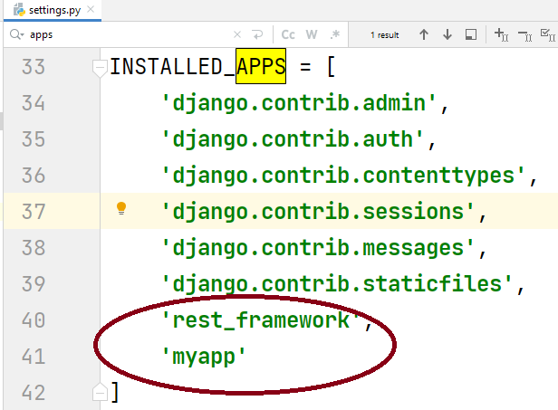
Setup
Notes:
Key features and benefits of Django include:
Object-Relational Mapping (ORM): Django provides a powerful and intuitive ORM that allows developers to interact with the database using Python objects, making it easier to manage and query data.
URL routing: Django's URL routing system maps URLs to corresponding views or actions, making it easy to create clean and user-friendly URLs for different pages and functionality within a web application.
Template system: Django comes with a built-in template engine that allows developers to separate the design and presentation logic from the application's business logic, promoting code reusability and maintainability.
Forms handling: Django provides a forms library that simplifies the handling of HTML forms, including form validation, data binding, and error handling.
Authentication and authorization: Django offers robust authentication and authorization mechanisms, including user management, login/logout functionality, and permission-based access control.
Admin interface: Django's admin interface is a powerful feature that automatically generates a user-friendly administration interface for managing data models, making it easy to perform CRUD operations (Create, Read, Update, Delete) on database records.
Security features: Django includes various built-in security features, such as protection against common web vulnerabilities like cross-site scripting (XSS), cross-site request forgery (CSRF), and SQL injection.
Scalability and extensibility: Django is designed to handle large-scale applications and supports modular and reusable code through the use of apps and plugins. It also offers support for database migration, caching, and asynchronous tasks.

Slide 12
Outline
Overview
Benefits
Installation and setup of Django REST Framework
Serializers and Models
Views and Viewsets
Authentication and Permissions
Serialization Formats and Response Types
Pagination and Filtering
Notes:
Introduction to Django REST Framework (30 minutes)
Overview of Django and Django REST Framework
Benefits of using Django REST Framework for building APIs
Installation and setup of Django REST Framework
Serializers and Models (1 hour)
Creating Django models to represent data
Introduction to serializers and their role in data serialization/deserialization
Creating serializers for models
Performing CRUD operations using serializers
Nested serializers and handling related data
Views and Viewsets (1 hour)
Understanding views and viewsets in Django REST Framework
Creating API views and class-based views
Mapping views to URLs using URL patterns
Using viewsets for creating CRUD endpoints
Configuring routing for viewsets
Authentication and Permissions (30 minutes)
Introduction to authentication and authorization in Django REST Framework
Built-in authentication classes and their usage
Implementing token-based authentication
Applying permissions and role-based access control
Handling authentication and permissions in views and viewsets
Serialization Formats and Response Types (30 minutes)
Exploring different serialization formats (JSON, XML, etc.)
Configuring the default serialization format
Customizing response types (status codes, headers, content negotiation)
Handling errors and exceptions in API responses
Pagination and Filtering (30 minutes)
Implementing pagination for large result sets
Configuring pagination settings
Filtering and querying data using query parameters
Implementing filtering and search capabilities

Slide 13
Serializers
Provide a way to serialize and deserialize data, allowing for easy data validation and transformation.
Serializers are defined as classes that inherit from Django REST Framework's Serializer class or its subclasses (ModelSerializer, etc.).
Notes:
Key features and benefits of Django include:
Object-Relational Mapping (ORM): Django provides a powerful and intuitive ORM that allows developers to interact with the database using Python objects, making it easier to manage and query data.
URL routing: Django's URL routing system maps URLs to corresponding views or actions, making it easy to create clean and user-friendly URLs for different pages and functionality within a web application.
Template system: Django comes with a built-in template engine that allows developers to separate the design and presentation logic from the application's business logic, promoting code reusability and maintainability.
Forms handling: Django provides a forms library that simplifies the handling of HTML forms, including form validation, data binding, and error handling.
Authentication and authorization: Django offers robust authentication and authorization mechanisms, including user management, login/logout functionality, and permission-based access control.
Admin interface: Django's admin interface is a powerful feature that automatically generates a user-friendly administration interface for managing data models, making it easy to perform CRUD operations (Create, Read, Update, Delete) on database records.
Security features: Django includes various built-in security features, such as protection against common web vulnerabilities like cross-site scripting (XSS), cross-site request forgery (CSRF), and SQL injection.
Scalability and extensibility: Django is designed to handle large-scale applications and supports modular and reusable code through the use of apps and plugins. It also offers support for database migration, caching, and asynchronous tasks.

Slide 14
Outline
Overview
Benefits
Installation and setup of Django REST Framework
Serializers and Models
Views and Viewsets
Authentication and Permissions
Serialization Formats and Response Types
Pagination and Filtering
Notes:
Introduction to Django REST Framework (30 minutes)
Overview of Django and Django REST Framework
Benefits of using Django REST Framework for building APIs
Installation and setup of Django REST Framework
Serializers and Models (1 hour)
Creating Django models to represent data
Introduction to serializers and their role in data serialization/deserialization
Creating serializers for models
Performing CRUD operations using serializers
Nested serializers and handling related data
Views and Viewsets (1 hour)
Understanding views and viewsets in Django REST Framework
Creating API views and class-based views
Mapping views to URLs using URL patterns
Using viewsets for creating CRUD endpoints
Configuring routing for viewsets
Authentication and Permissions (30 minutes)
Introduction to authentication and authorization in Django REST Framework
Built-in authentication classes and their usage
Implementing token-based authentication
Applying permissions and role-based access control
Handling authentication and permissions in views and viewsets
Serialization Formats and Response Types (30 minutes)
Exploring different serialization formats (JSON, XML, etc.)
Configuring the default serialization format
Customizing response types (status codes, headers, content negotiation)
Handling errors and exceptions in API responses
Pagination and Filtering (30 minutes)
Implementing pagination for large result sets
Configuring pagination settings
Filtering and querying data using query parameters
Implementing filtering and search capabilities

Slide 15
Outline
Overview
Benefits
Installation and setup of Django REST Framework
Serializers and Models
Views and Viewsets
Authentication and Permissions
Serialization Formats and Response Types
Pagination and Filtering
Notes:
Introduction to Django REST Framework (30 minutes)
Overview of Django and Django REST Framework
Benefits of using Django REST Framework for building APIs
Installation and setup of Django REST Framework
Serializers and Models (1 hour)
Creating Django models to represent data
Introduction to serializers and their role in data serialization/deserialization
Creating serializers for models
Performing CRUD operations using serializers
Nested serializers and handling related data
Views and Viewsets (1 hour)
Understanding views and viewsets in Django REST Framework
Creating API views and class-based views
Mapping views to URLs using URL patterns
Using viewsets for creating CRUD endpoints
Configuring routing for viewsets
Authentication and Permissions (30 minutes)
Introduction to authentication and authorization in Django REST Framework
Built-in authentication classes and their usage
Implementing token-based authentication
Applying permissions and role-based access control
Handling authentication and permissions in views and viewsets
Serialization Formats and Response Types (30 minutes)
Exploring different serialization formats (JSON, XML, etc.)
Configuring the default serialization format
Customizing response types (status codes, headers, content negotiation)
Handling errors and exceptions in API responses
Pagination and Filtering (30 minutes)
Implementing pagination for large result sets
Configuring pagination settings
Filtering and querying data using query parameters
Implementing filtering and search capabilities

Slide 16
Outline
Overview
Benefits
Installation and setup of Django REST Framework
Serializers and Models
Views and Viewsets
Authentication and Permissions
Serialization Formats and Response Types
Pagination and Filtering
Notes:
Introduction to Django REST Framework (30 minutes)
Overview of Django and Django REST Framework
Benefits of using Django REST Framework for building APIs
Installation and setup of Django REST Framework
Serializers and Models (1 hour)
Creating Django models to represent data
Introduction to serializers and their role in data serialization/deserialization
Creating serializers for models
Performing CRUD operations using serializers
Nested serializers and handling related data
Views and Viewsets (1 hour)
Understanding views and viewsets in Django REST Framework
Creating API views and class-based views
Mapping views to URLs using URL patterns
Using viewsets for creating CRUD endpoints
Configuring routing for viewsets
Authentication and Permissions (30 minutes)
Introduction to authentication and authorization in Django REST Framework
Built-in authentication classes and their usage
Implementing token-based authentication
Applying permissions and role-based access control
Handling authentication and permissions in views and viewsets
Serialization Formats and Response Types (30 minutes)
Exploring different serialization formats (JSON, XML, etc.)
Configuring the default serialization format
Customizing response types (status codes, headers, content negotiation)
Handling errors and exceptions in API responses
Pagination and Filtering (30 minutes)
Implementing pagination for large result sets
Configuring pagination settings
Filtering and querying data using query parameters
Implementing filtering and search capabilities

Slide 17
Outline
Overview
Benefits
Installation and setup of Django REST Framework
Serializers and Models
Views and Viewsets
Authentication and Permissions
Serialization Formats and Response Types
Pagination and Filtering
Notes:
Introduction to Django REST Framework (30 minutes)
Overview of Django and Django REST Framework
Benefits of using Django REST Framework for building APIs
Installation and setup of Django REST Framework
Serializers and Models (1 hour)
Creating Django models to represent data
Introduction to serializers and their role in data serialization/deserialization
Creating serializers for models
Performing CRUD operations using serializers
Nested serializers and handling related data
Views and Viewsets (1 hour)
Understanding views and viewsets in Django REST Framework
Creating API views and class-based views
Mapping views to URLs using URL patterns
Using viewsets for creating CRUD endpoints
Configuring routing for viewsets
Authentication and Permissions (30 minutes)
Introduction to authentication and authorization in Django REST Framework
Built-in authentication classes and their usage
Implementing token-based authentication
Applying permissions and role-based access control
Handling authentication and permissions in views and viewsets
Serialization Formats and Response Types (30 minutes)
Exploring different serialization formats (JSON, XML, etc.)
Configuring the default serialization format
Customizing response types (status codes, headers, content negotiation)
Handling errors and exceptions in API responses
Pagination and Filtering (30 minutes)
Implementing pagination for large result sets
Configuring pagination settings
Filtering and querying data using query parameters
Implementing filtering and search capabilities

Slide 18
Lab

Slide 19
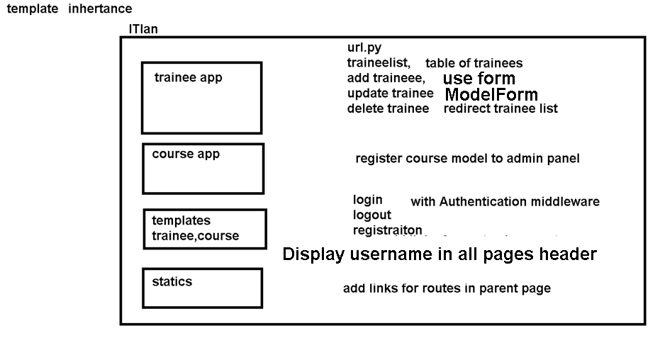
Complete previous lab
Notes:
Key features and benefits of Django include:
Object-Relational Mapping (ORM): Django provides a powerful and intuitive ORM that allows developers to interact with the database using Python objects, making it easier to manage and query data.
URL routing: Django's URL routing system maps URLs to corresponding views or actions, making it easy to create clean and user-friendly URLs for different pages and functionality within a web application.
Template system: Django comes with a built-in template engine that allows developers to separate the design and presentation logic from the application's business logic, promoting code reusability and maintainability.
Forms handling: Django provides a forms library that simplifies the handling of HTML forms, including form validation, data binding, and error handling.
Authentication and authorization: Django offers robust authentication and authorization mechanisms, including user management, login/logout functionality, and permission-based access control.
Admin interface: Django's admin interface is a powerful feature that automatically generates a user-friendly administration interface for managing data models, making it easy to perform CRUD operations (Create, Read, Update, Delete) on database records.
Security features: Django includes various built-in security features, such as protection against common web vulnerabilities like cross-site scripting (XSS), cross-site request forgery (CSRF), and SQL injection.
Scalability and extensibility: Django is designed to handle large-scale applications and supports modular and reusable code through the use of apps and plugins. It also offers support for database migration, caching, and asynchronous tasks.

