Slide 1
INTRODUCTION TO programming using python

Slide 2
Outline
Files
Function
Scope
Error handling

Slide 3
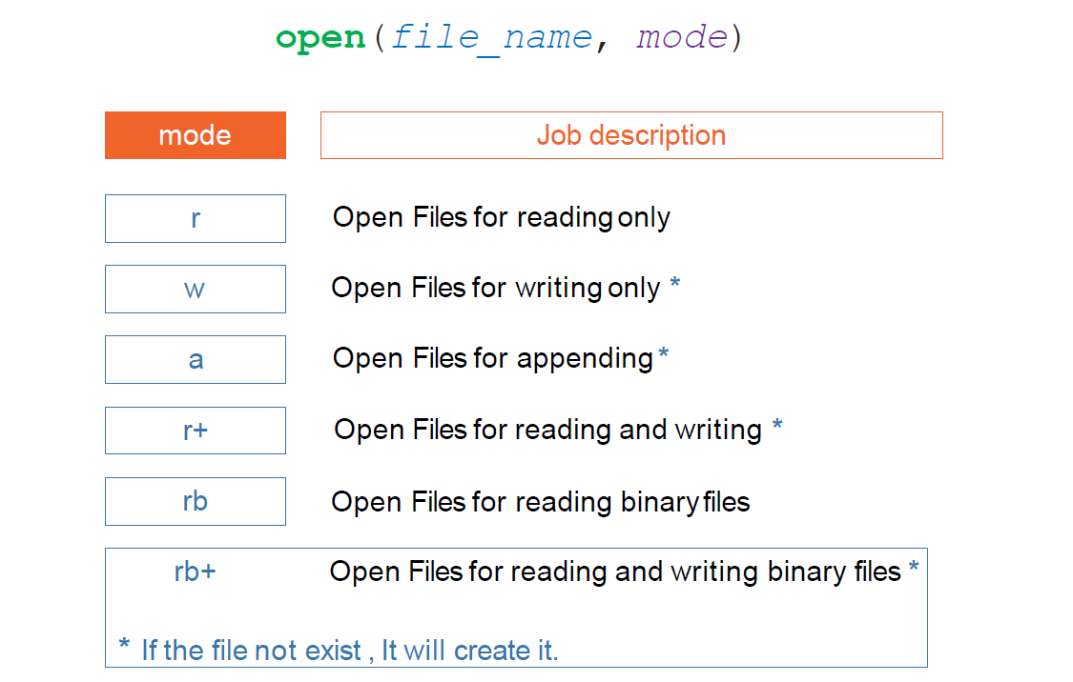
File Input Output (Open)
Open file

Slide 4
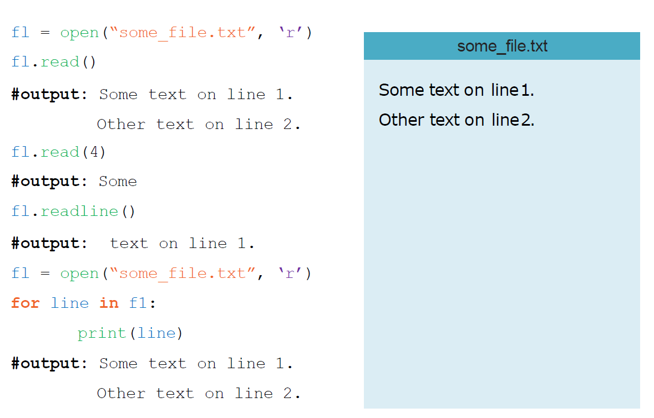
File Input Output (Read)
Open file

Slide 5
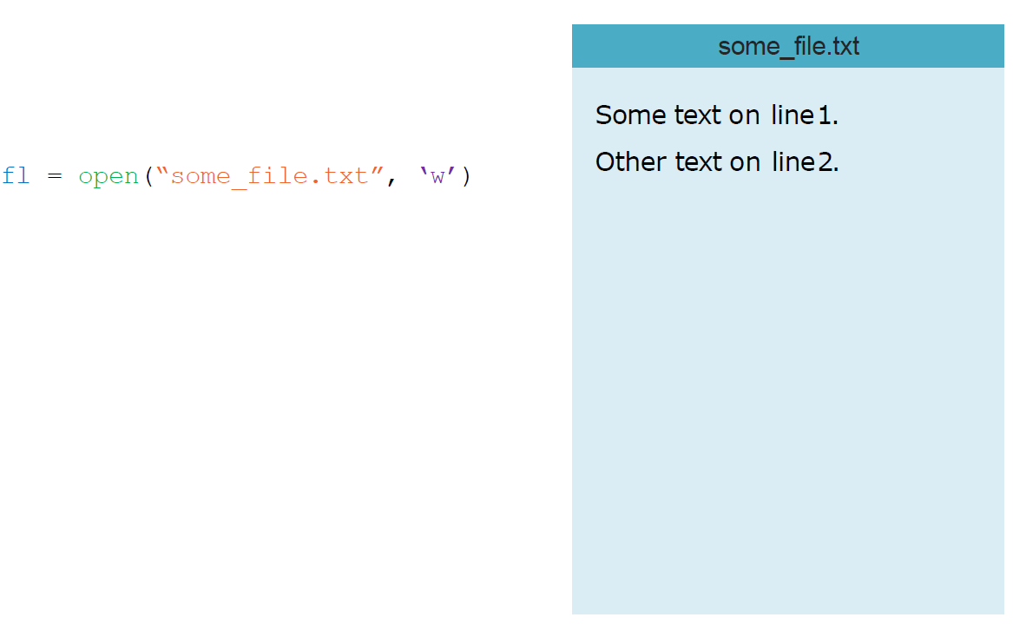
File Input Output (Write)
Open file

Slide 6
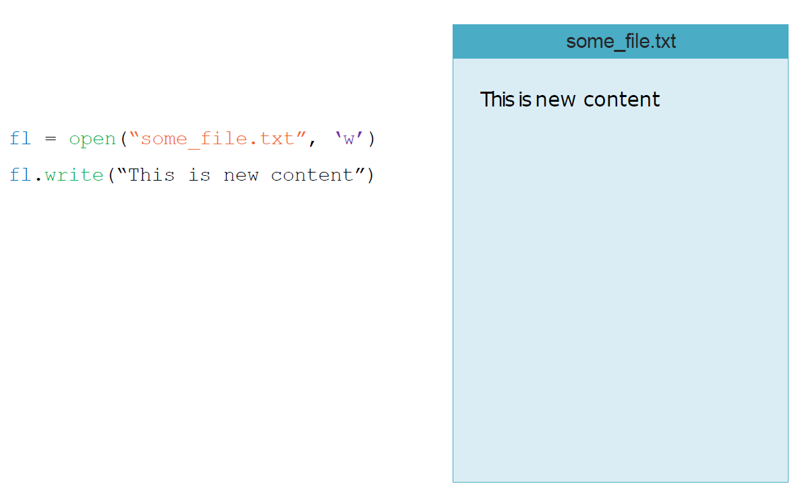
File Input Output (Write)
Open file

Slide 7
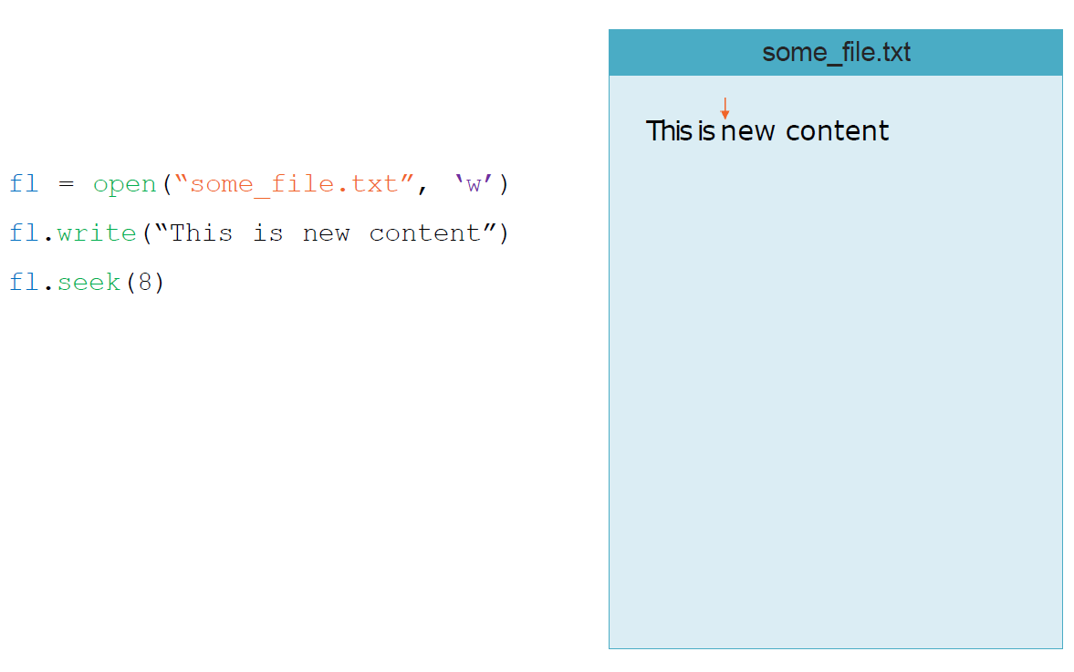
File Input Output (Write)
Open file

Slide 8
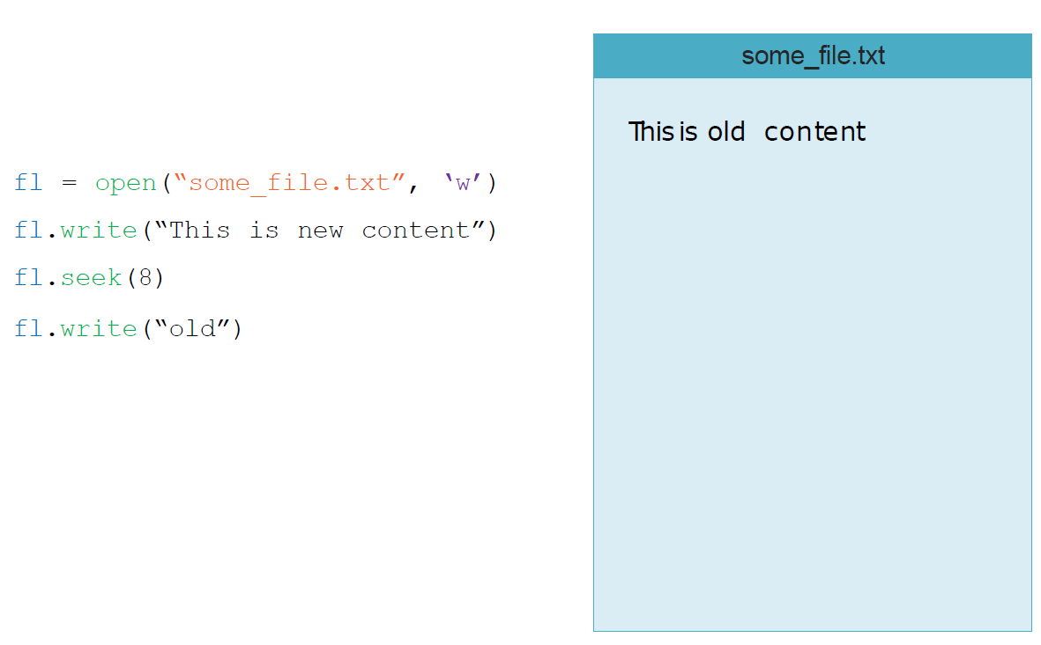
File Input Output (Write)
Open file

Slide 9
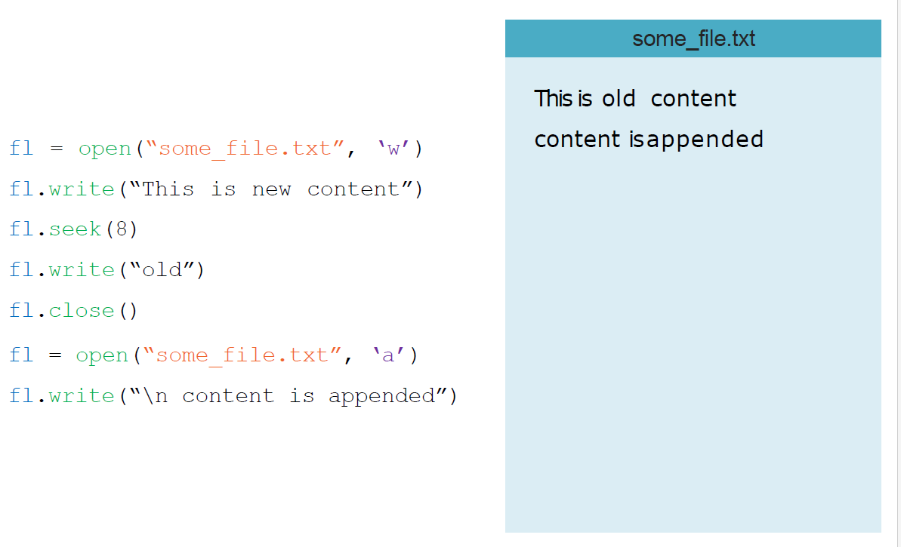
File Input Output (Write)
Open file

Slide 10
Functions
Is reusable block of code
Run when you call it
Accept parameters to deal with it
Can return data after job finished
Types of functions
return
Built in
User defined
Make your code more generic

Slide 11
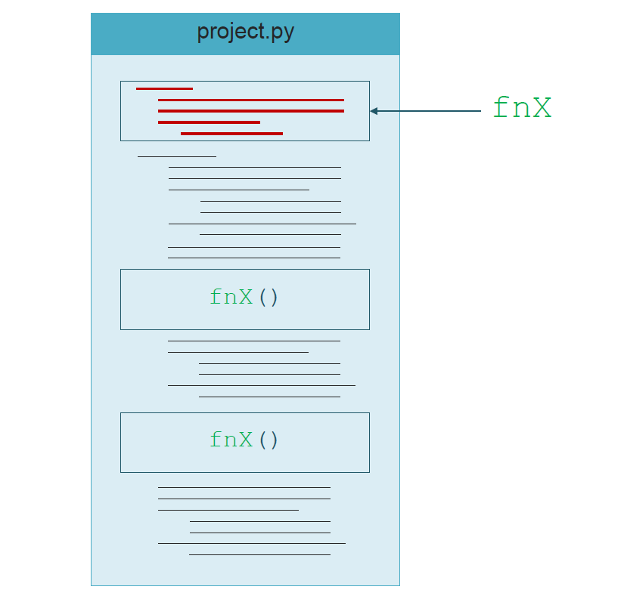
Functions

Slide 12
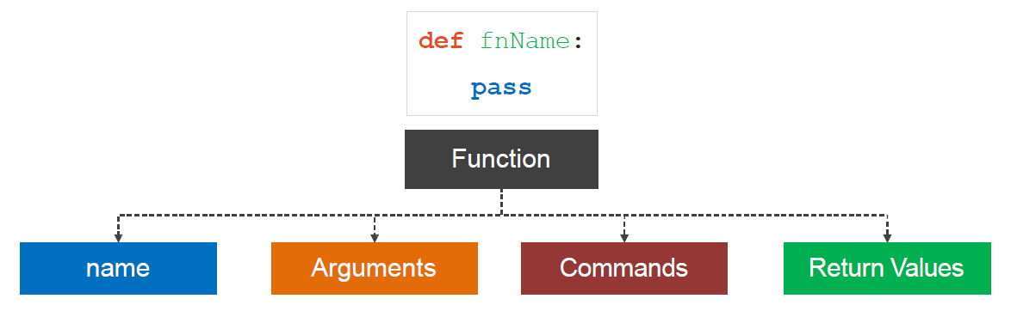
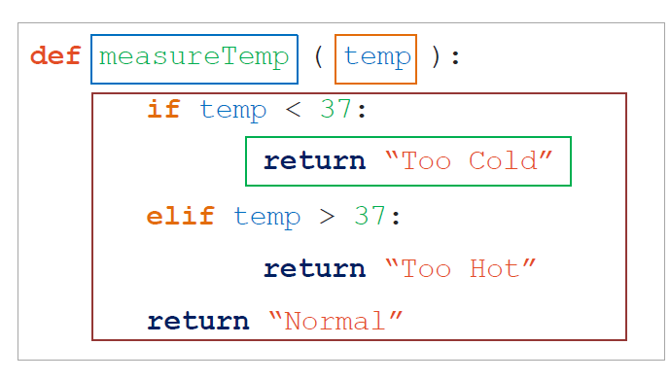
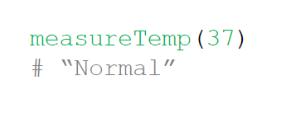
Function (Defining)
Defining example
Calling

Slide 13
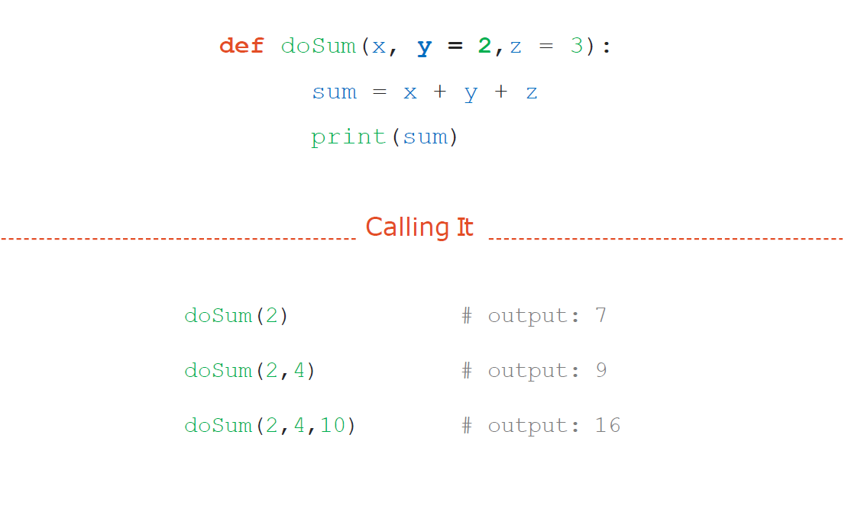
Function (Default Arguments)

Slide 14
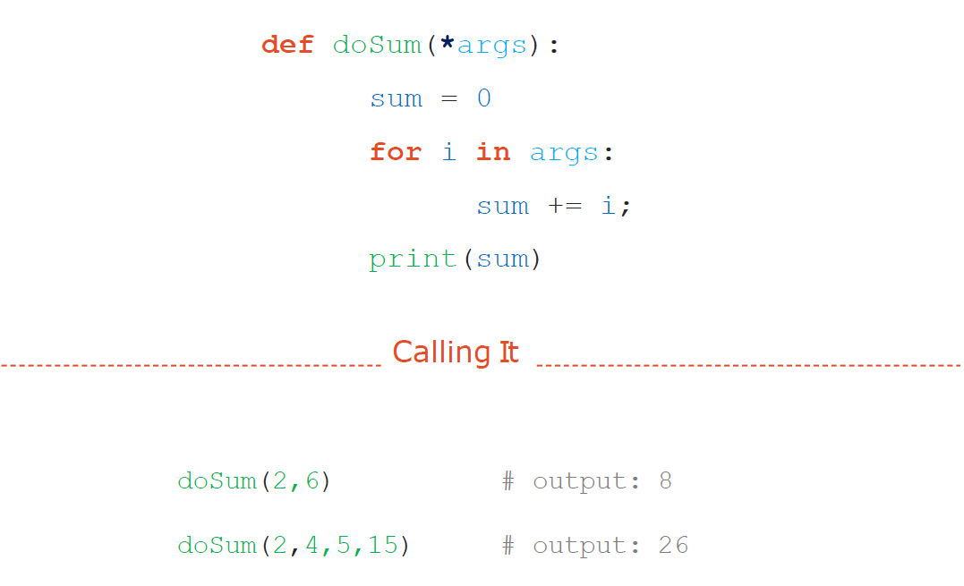
Function (*arguments)

Slide 15
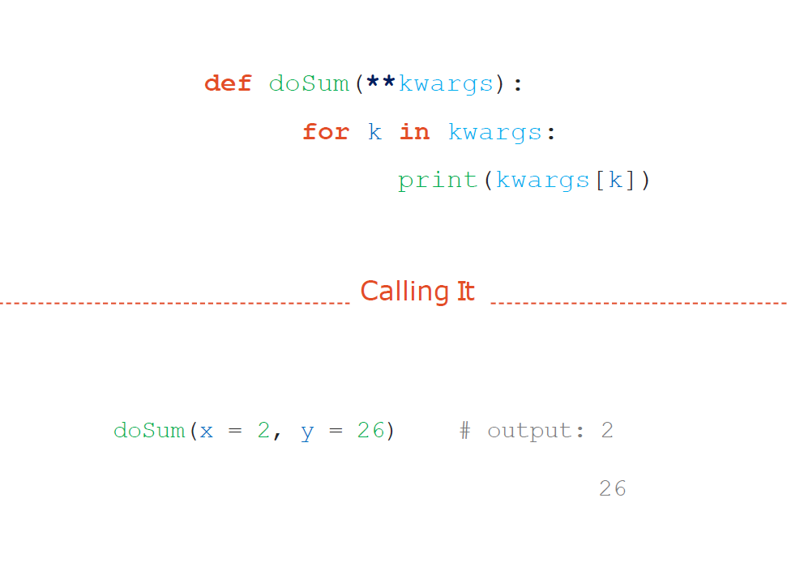
Function (**keywords)

Slide 16
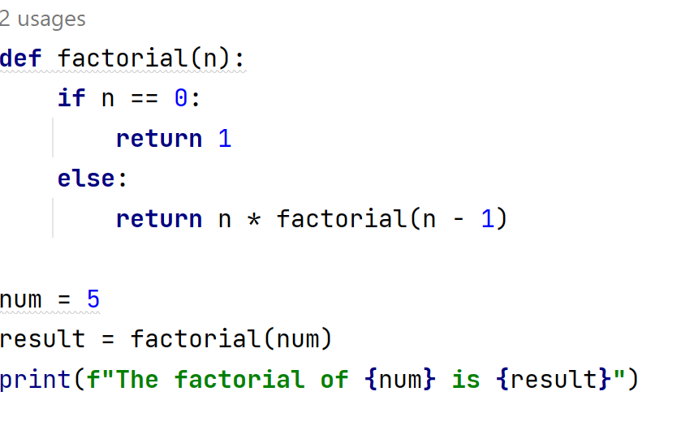

Recursion
function calls itself in order to solve a problem
calls itself

Slide 17
Scope
To know your limits

Slide 18
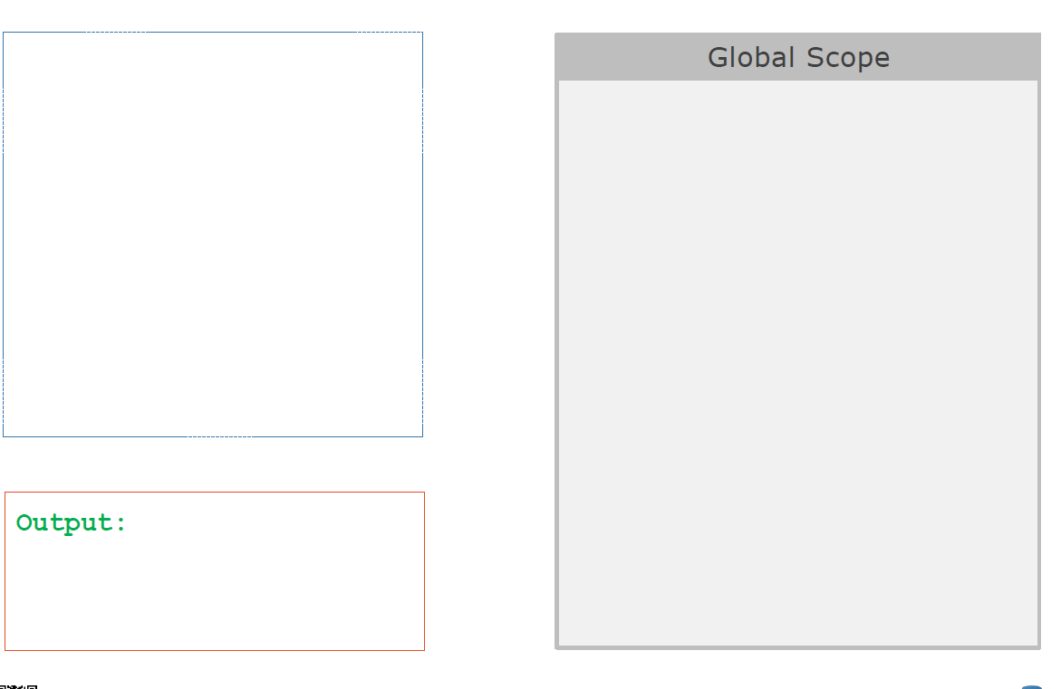
Lexical Scope

Slide 19
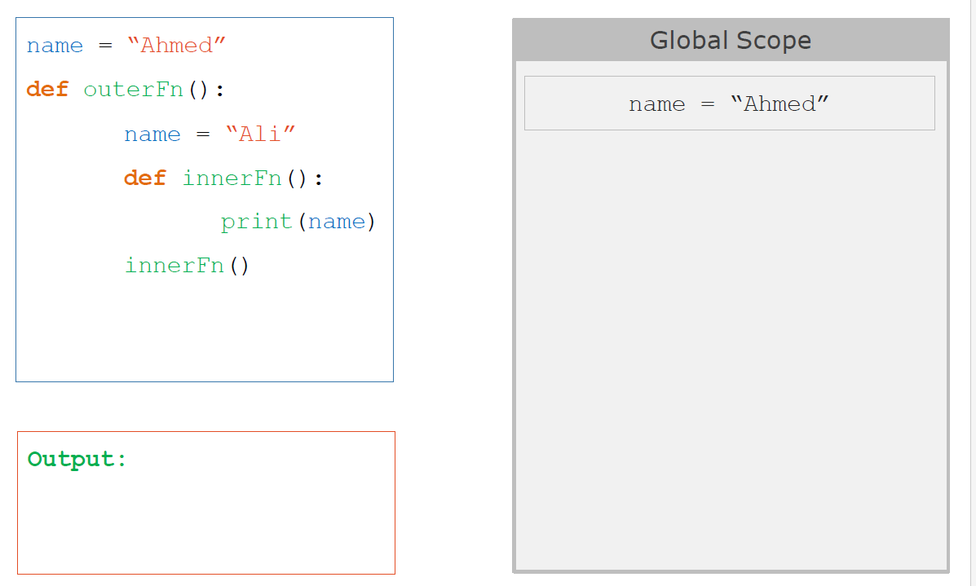
Lexical Scope

Slide 20
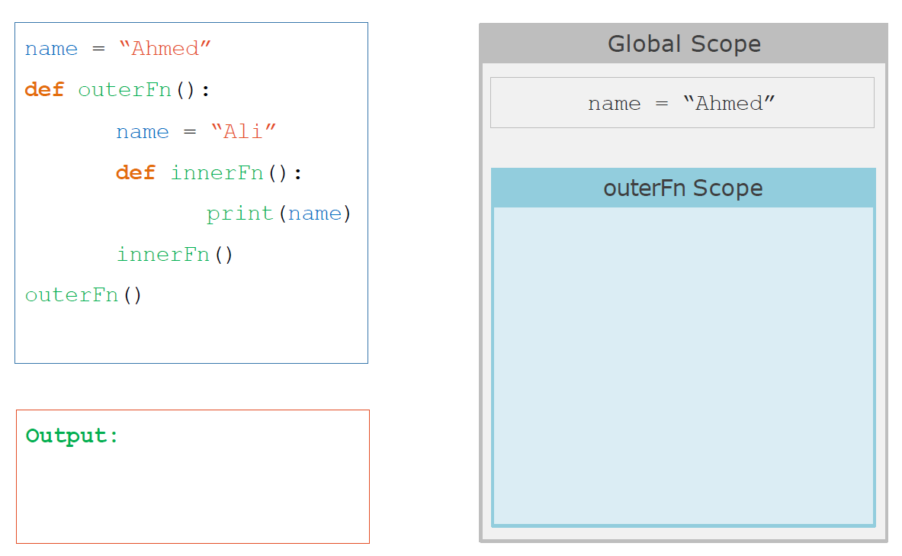
Lexical Scope

Slide 21
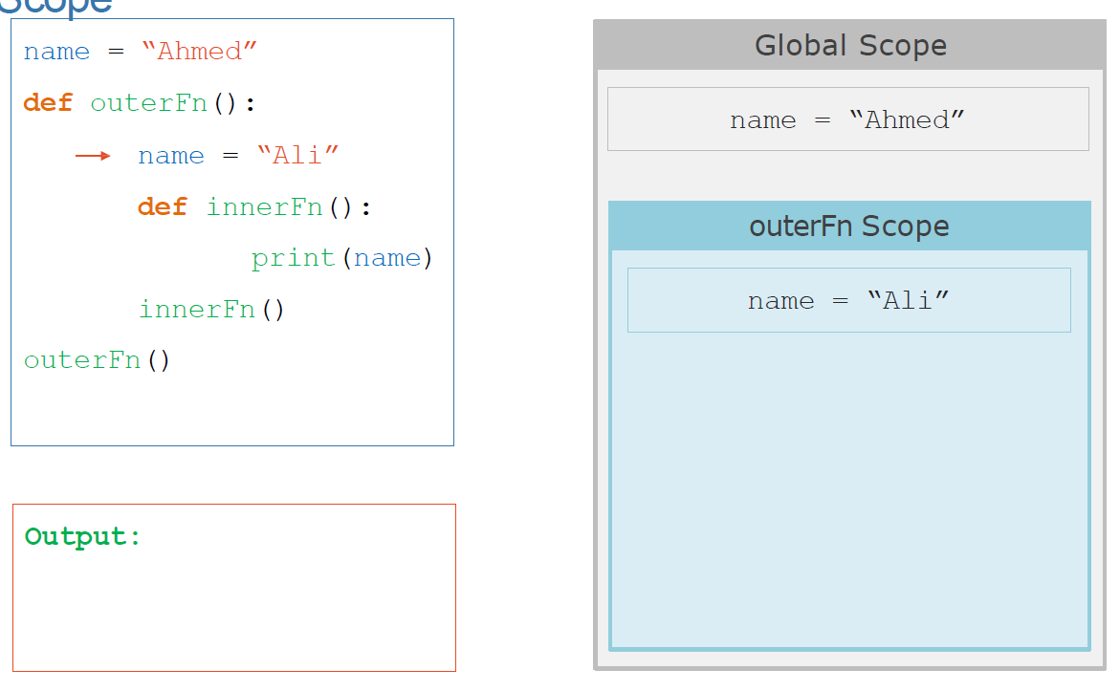
Lexical Scope

Slide 22
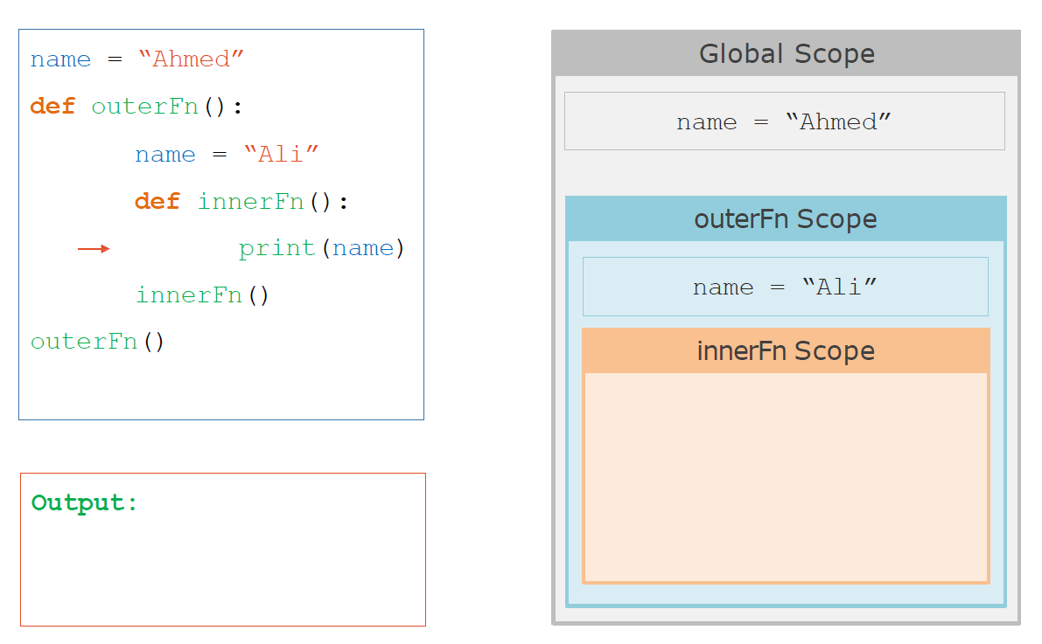
Lexical Scope

Slide 23
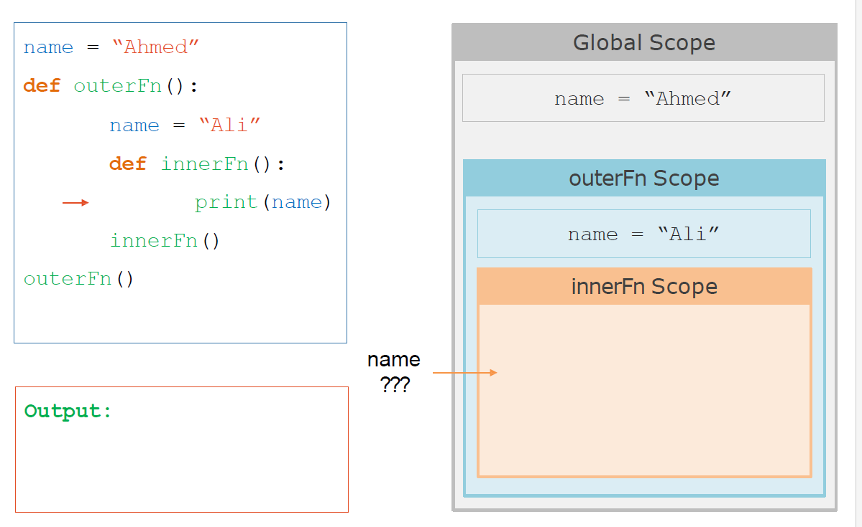
Lexical Scope

Slide 24
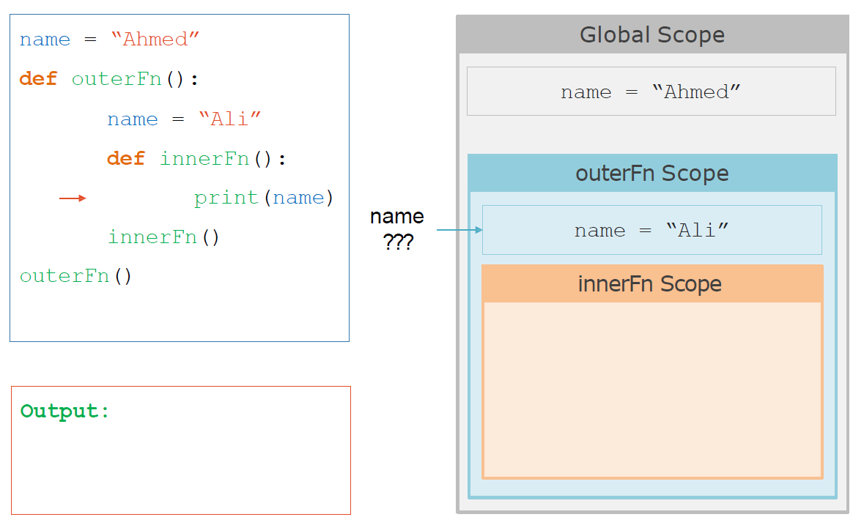
Lexical Scope

Slide 25
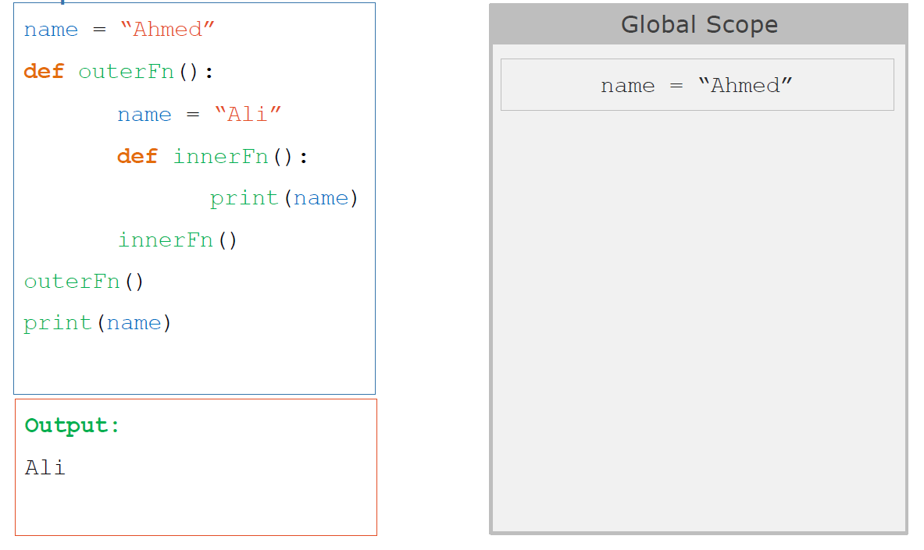
Lexical Scope

Slide 26
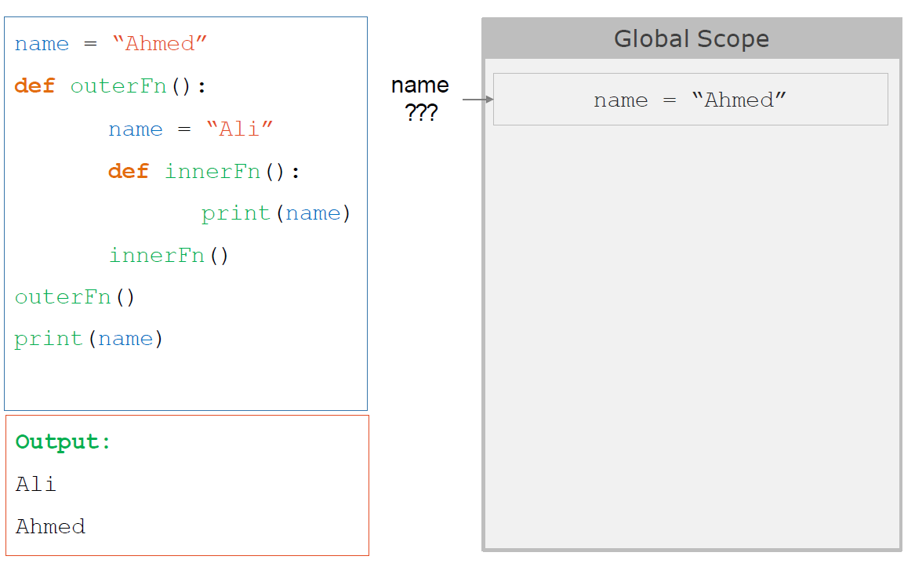
Lexical Scope

Slide 27
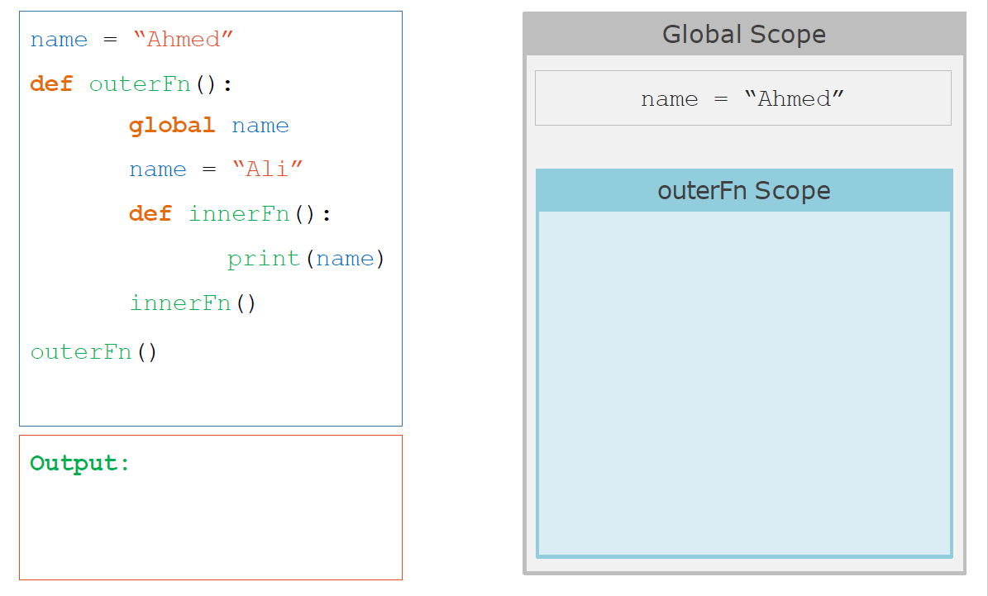
global Keyword

Slide 28
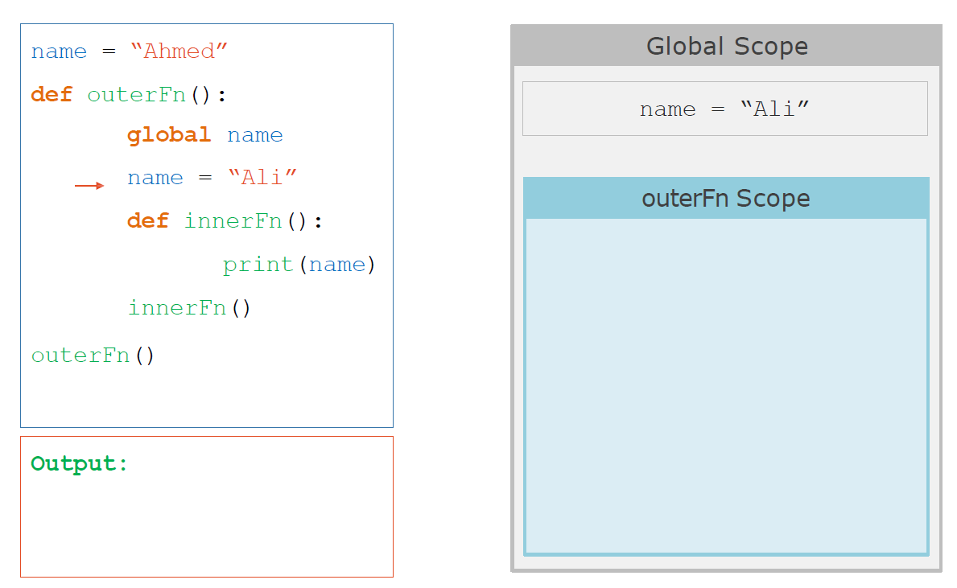
global Keyword

Slide 29
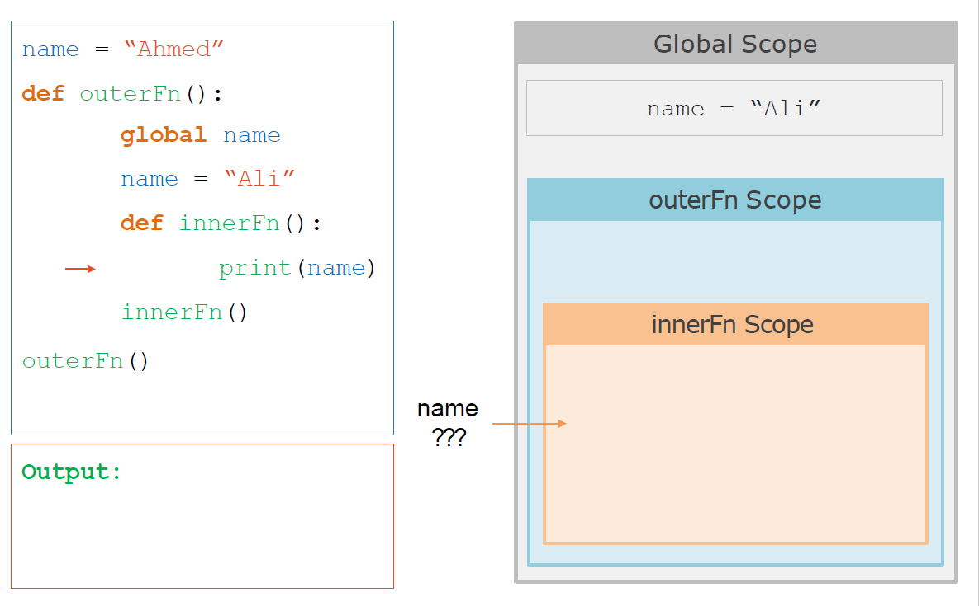
global Keyword

Slide 30
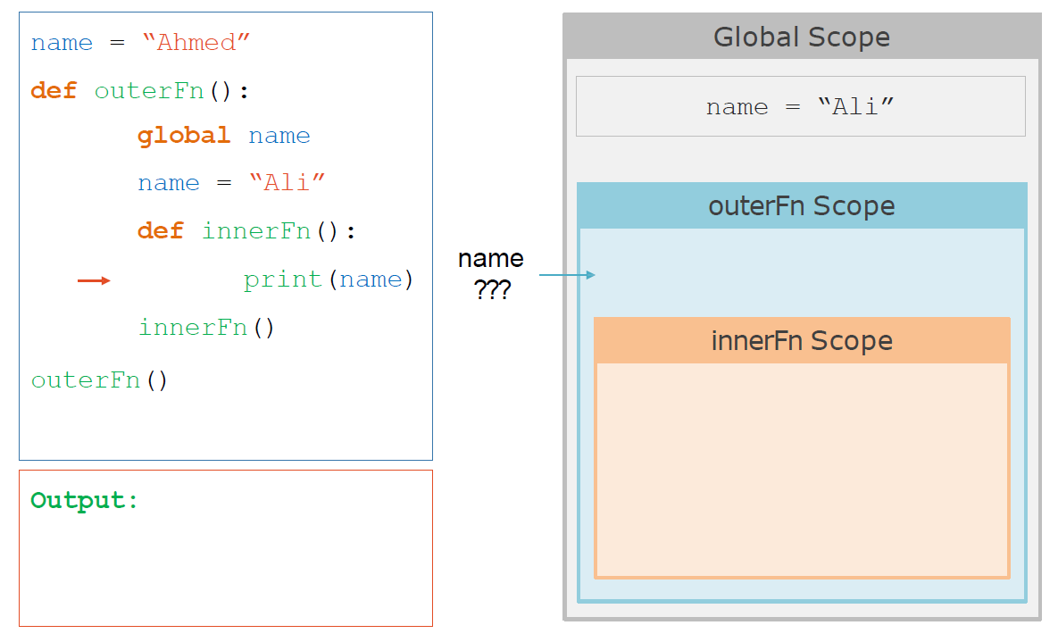
global Keyword

Slide 31
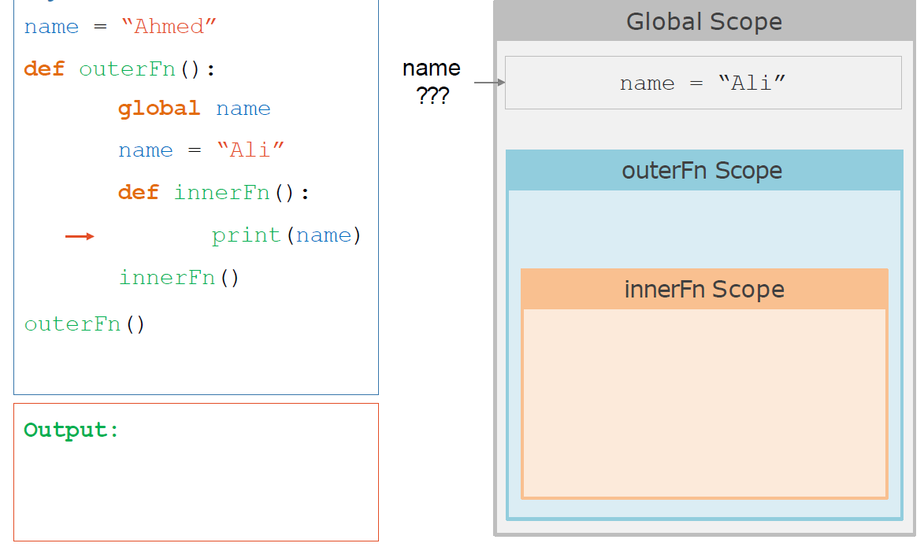
global Keyword

Slide 32
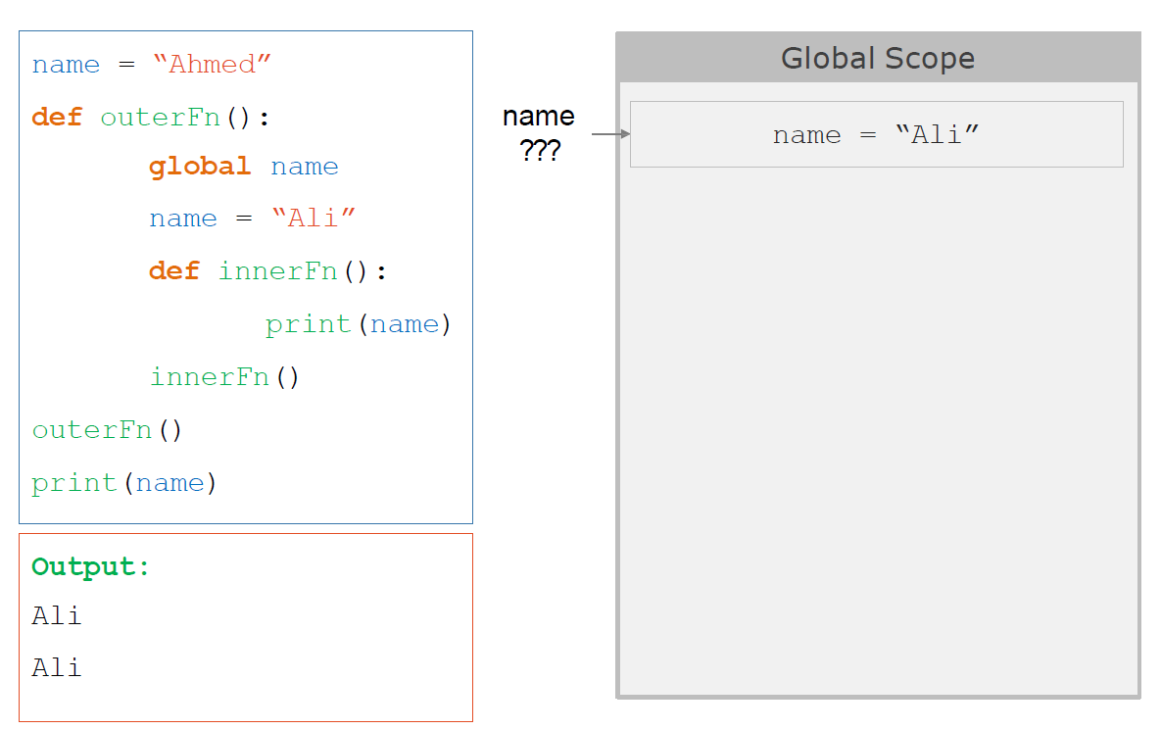
global Keyword

Slide 33
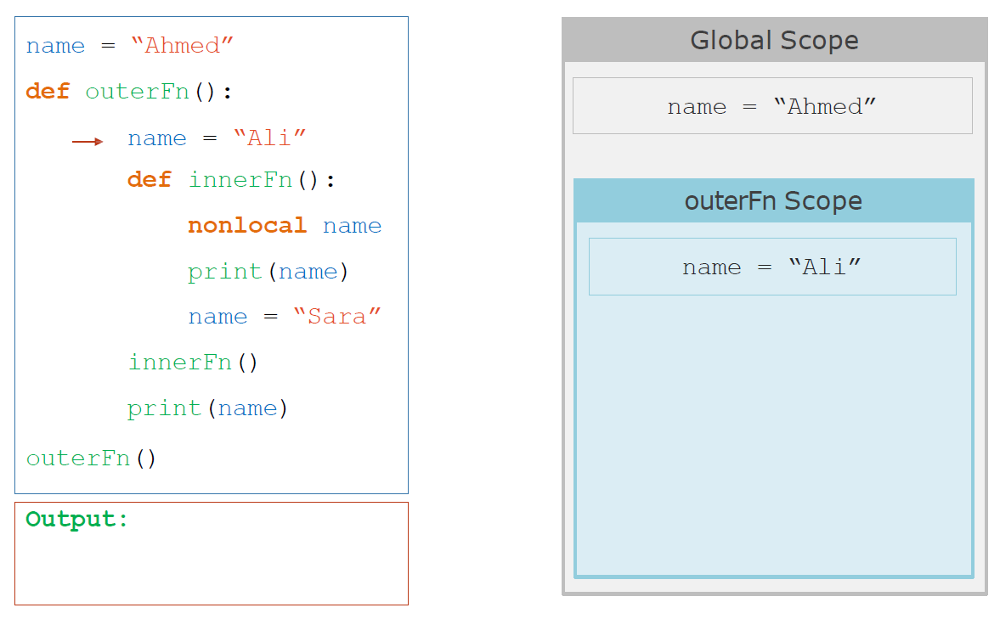
nonlocal Keyword

Slide 34
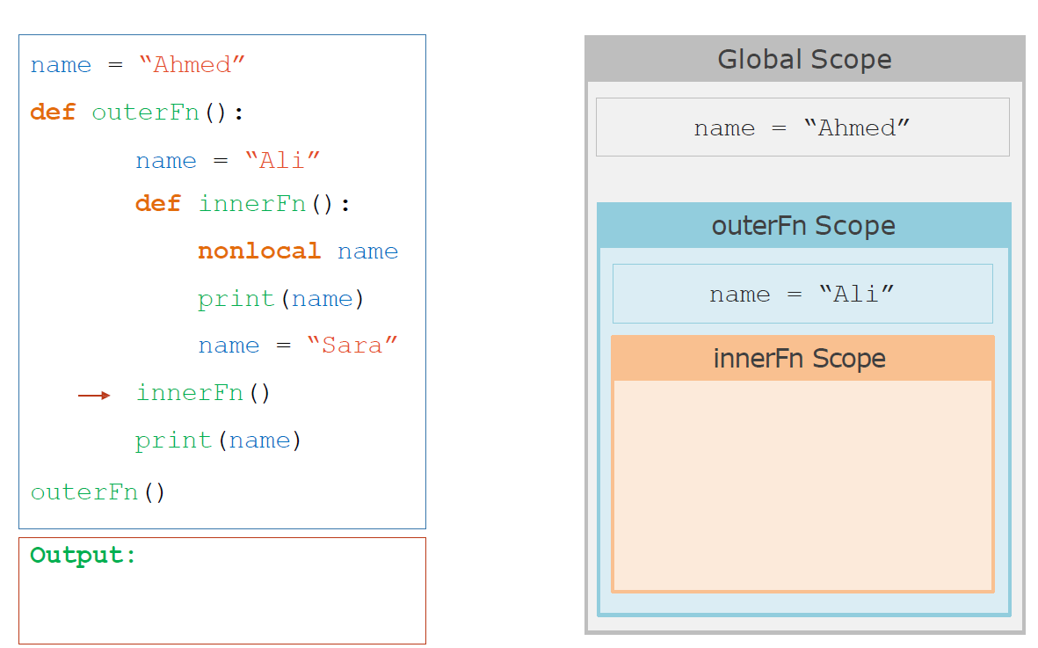
nonlocal Keyword

Slide 35
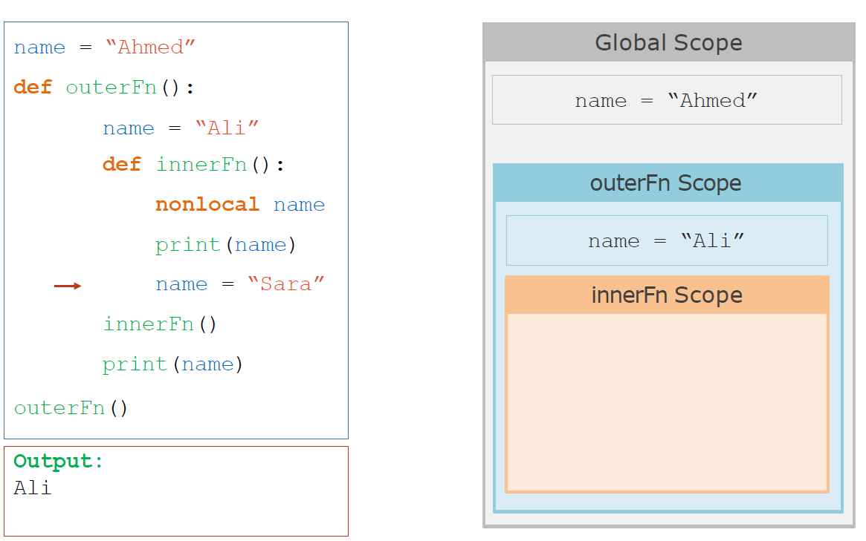
nonlocal Keyword

Slide 36
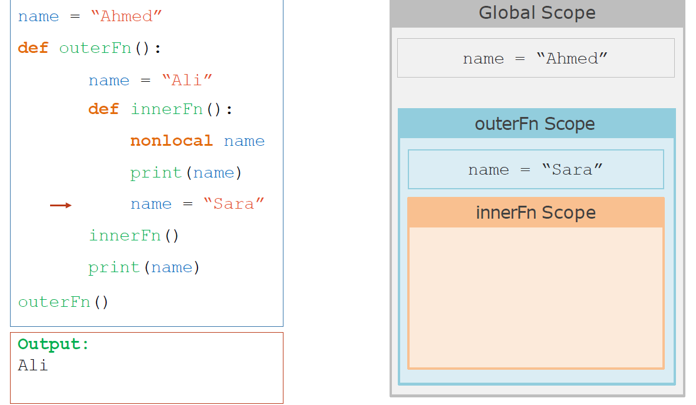
nonlocal Keyword

Slide 37
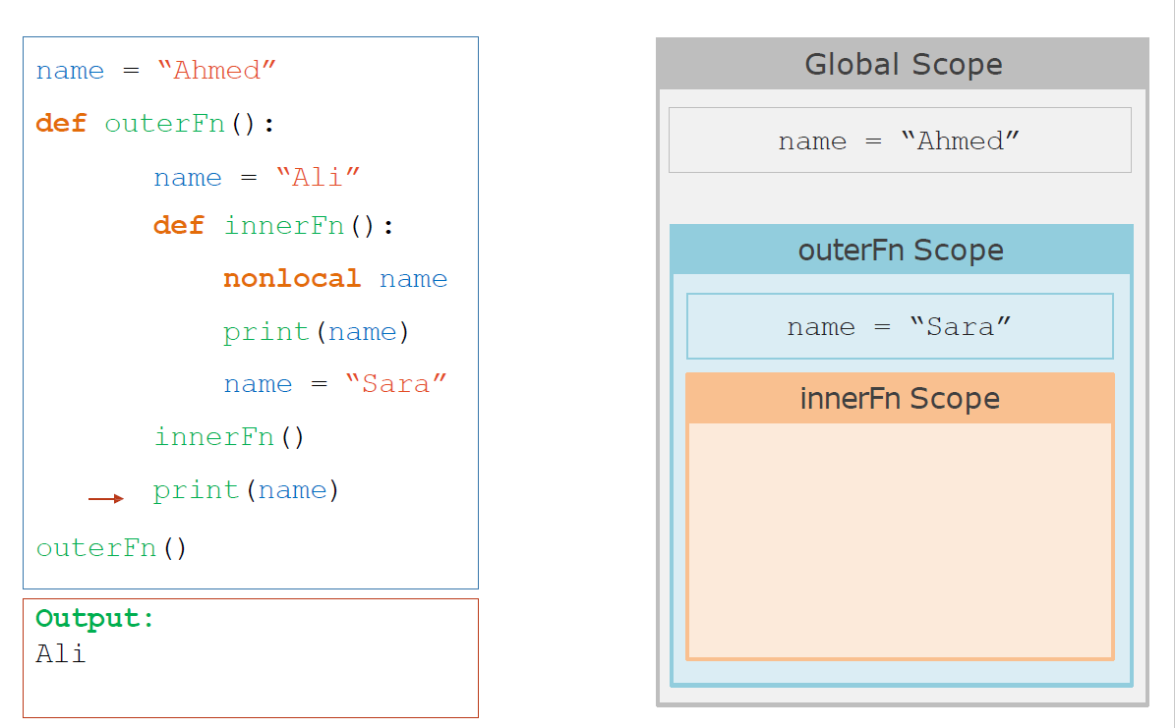
nonlocal Keyword

Slide 38
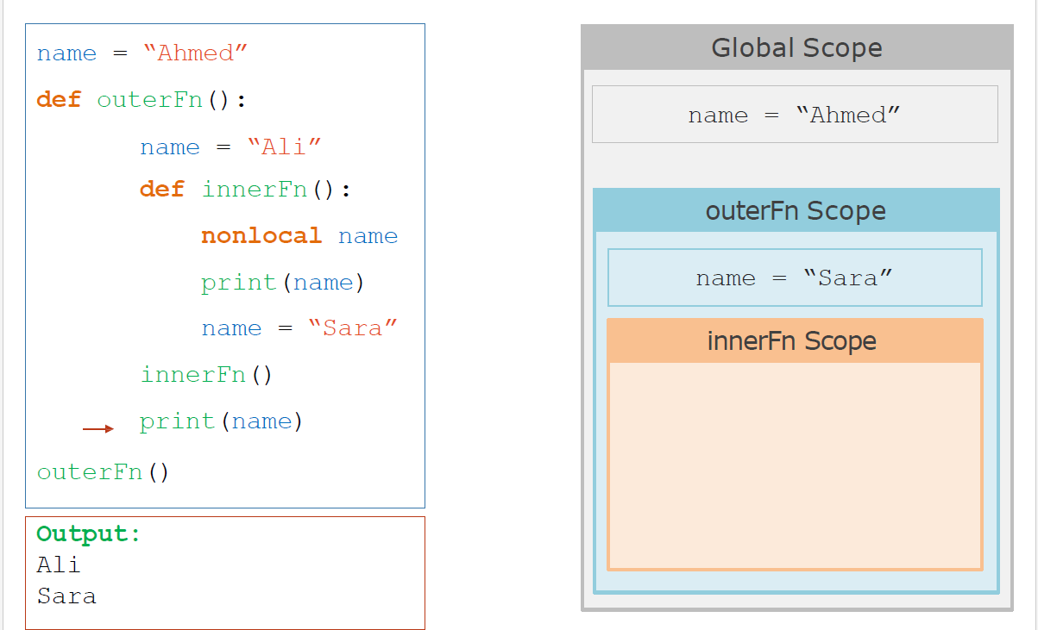
nonlocal Keyword

Slide 39
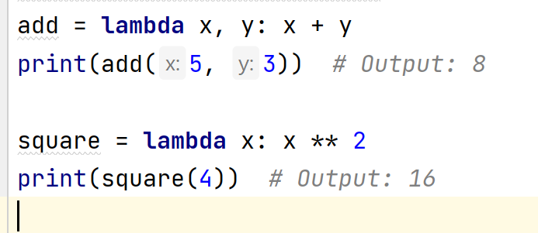
Lambda
small anonymous function that can have any number of arguments, but can only have one expression.
used for simple tasks
lambda arguments: expression

Slide 40
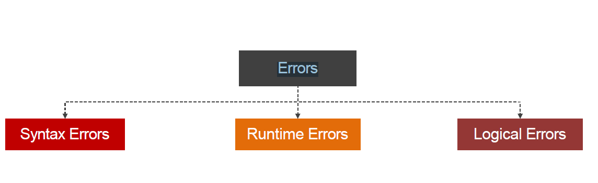
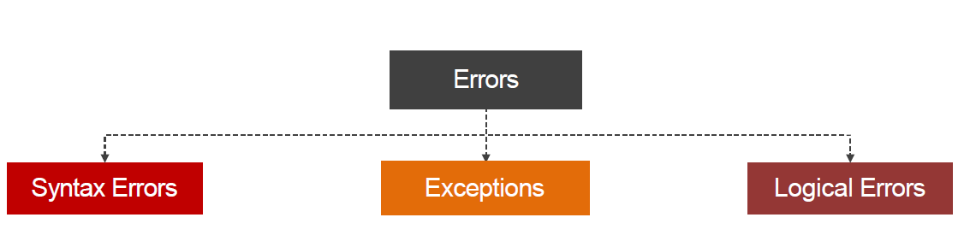
Error handling

Slide 41

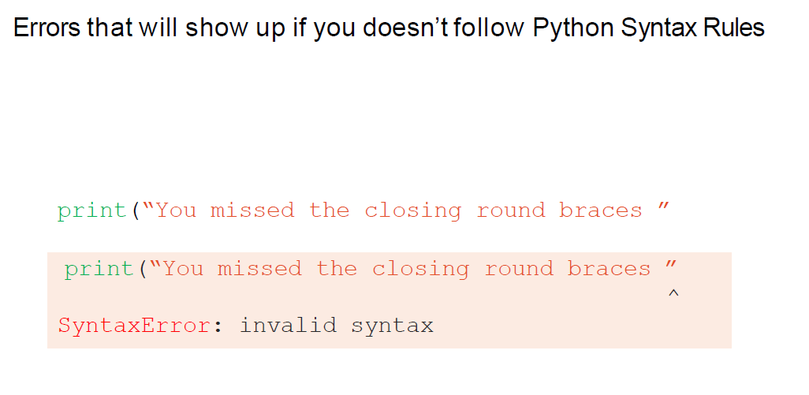
Error handling

Slide 42

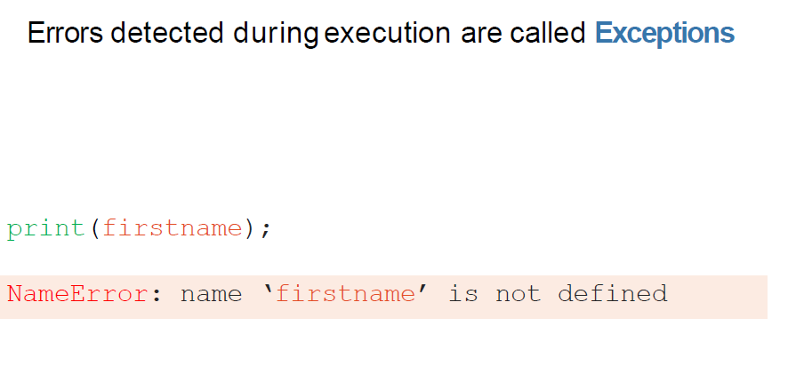
Error handling

Slide 43

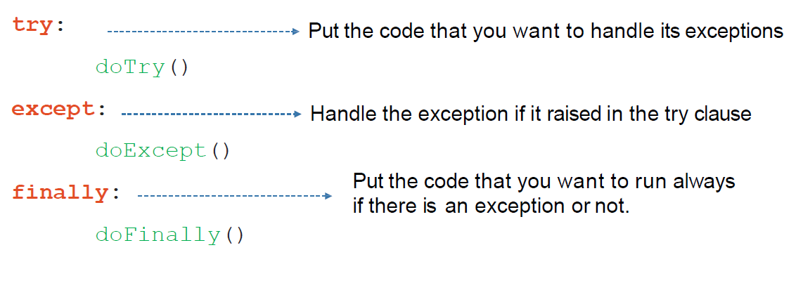
Error handling

Slide 44
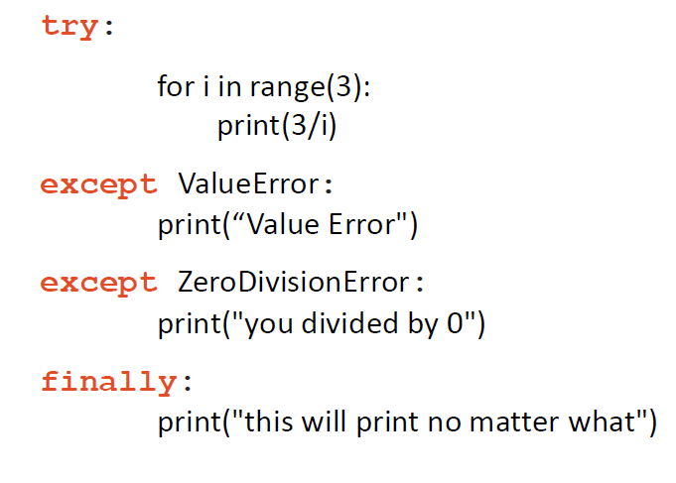
Error handling

Slide 45
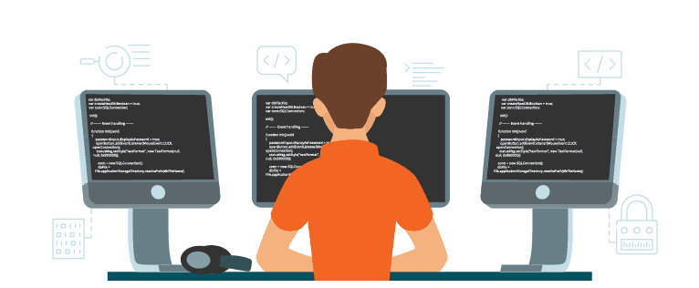
Exercises

Slide 46


