Slide 1
INTRODUCTION TO programming using python
Prepared by
Josephine Boles

Slide 2
Outline
Course Objectives
History & features
Why Python?
How does python work?
Install & Hello World
Variables & Data Types
Operators
Data types
Control Flow
Data structure
Exercises

Slide 3
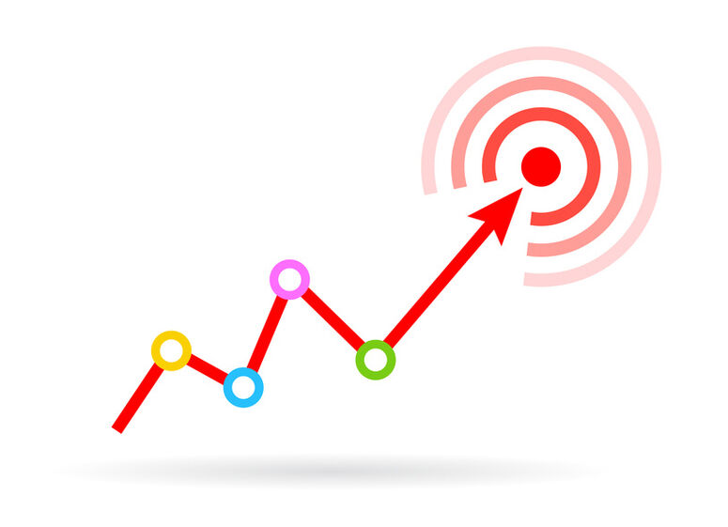
Course Objectives
Learn about Python, its uses and really understand it

Slide 4
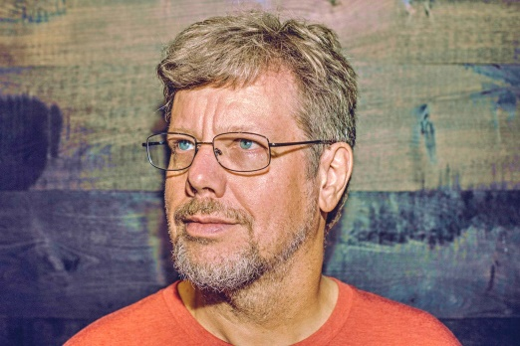
History
The implementation of Python was started in December 1989 by Guido Van Rossum at CWI in Netherland
In February 1991, Guido Van Rossum published the code (labeled version 0.9.0)
In 1994, Python 1.0 was released with new features like lambda, map, filter, and reduce.

Slide 5
History
Python 2.0 added new features such as list comprehensions, garbage collection systems.
On December 3, 2008, Python 3.0 (also called "Py3K") was released. It was designed to rectify the fundamental flaw of the language.
comedy series "Monty Python's Flying Circus". It was late on-air 1970,he select a name which unique, sort, and little-bit mysterious.
used in every technical field, such as Machine Learning, Artificial Intelligence, Web Development, Mobile Application, Desktop Application, Scientific Calculation, etc.

Slide 6
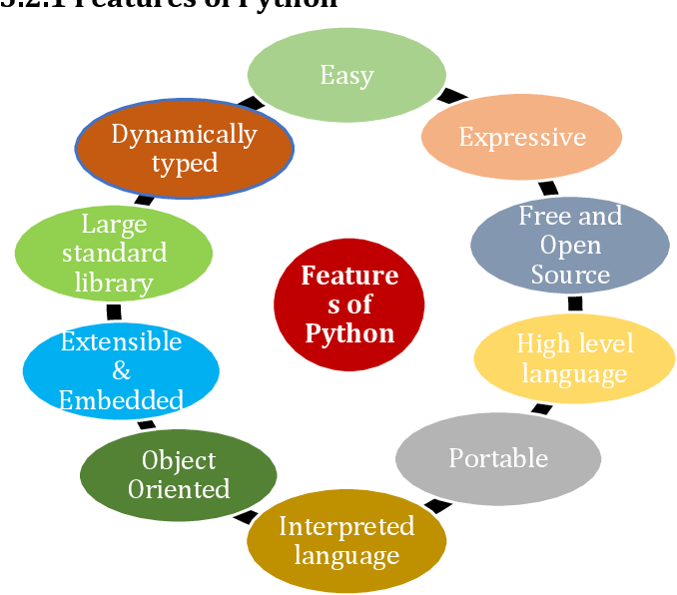
Features

Slide 7

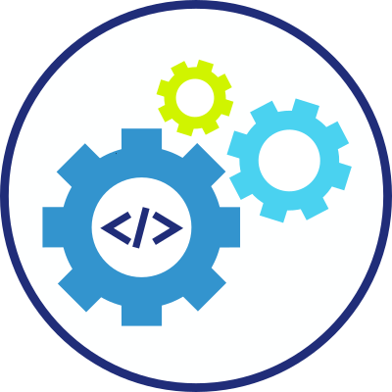

Why Python
General Purpose
Language
Rapid Development
Easy To learn

Slide 8
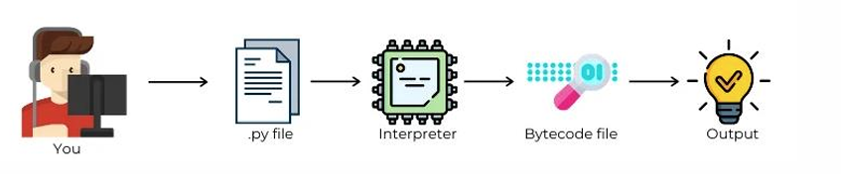
How does python work?
Python is an interpreted language

Slide 9
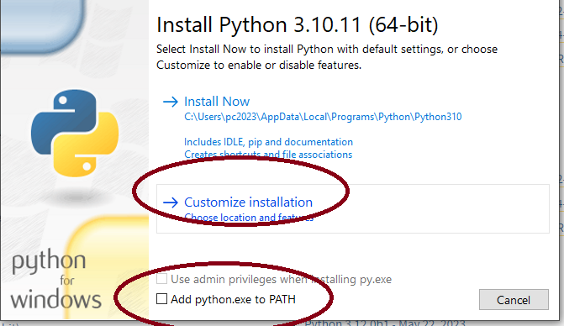
Install & Hello World
Install python
https://www.python.org/downloads/
In windows
check add python to environment path
Install pycharm community edition editor
https://www.jetbrains.com/pycharm/download/?section=windows

Slide 10
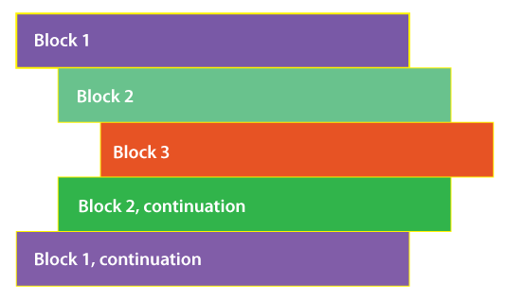
Line Indentations

Slide 11
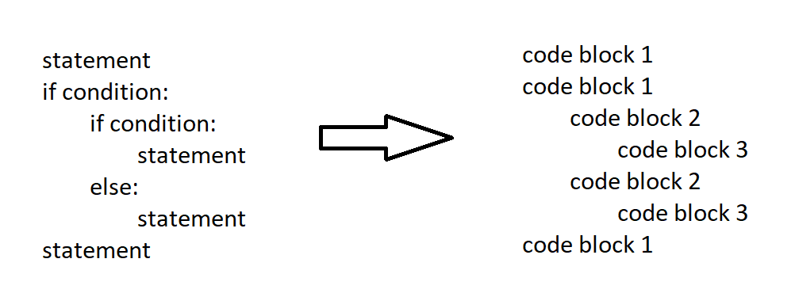
Line Indentations

Slide 12
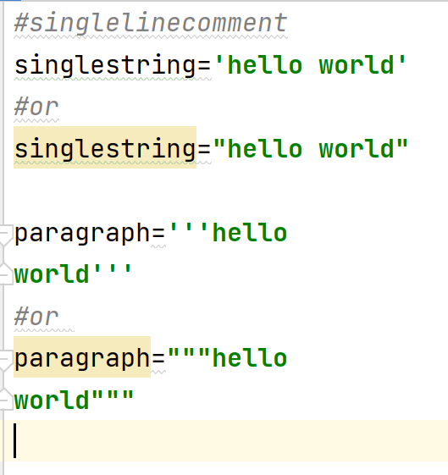
Quotes …1.. 2 ...3

Slide 13
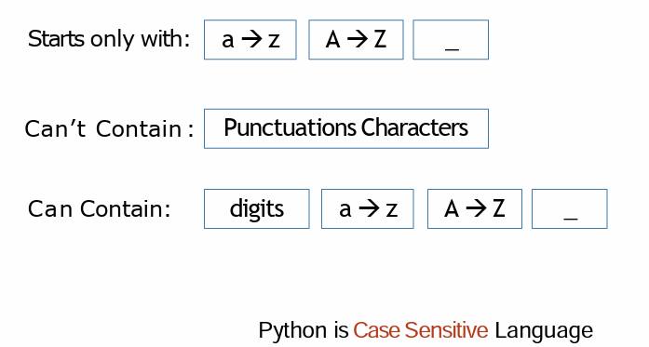
Variables & Data Types
Variable is a name that is used to refer to memory location.
Python variable or identifier and used to hold value.
Identifier can be used with variables, functions ,classes and modules

Slide 14
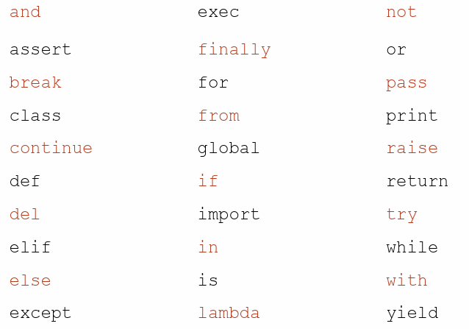
Variables & Data Types
Identifier doesn’t be one of these word
Reserved Words:
Notes:
<number>

Slide 15
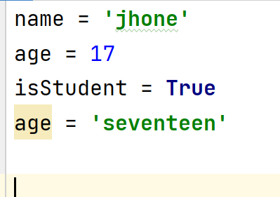
Variables & Data Types
Python is loosely typed language.
○ No need to define the variable, the interpreter will do everything.
To define a variable
Variable identifier
=
Value
Notes:
<number>

Slide 16
Variables & Data Types
Primitive
The primitive or basic data structures are the building blocks for data manipulation.
They contain pure and simple values of data. In Python.
Non-Primitive Data Types
Non-primitive not just store a value, but rather a collection of values in various formats.
Numbers
String
Boolean
Tuples
Lists
Dictionaries
Sets
Notes:
<number>

Slide 17
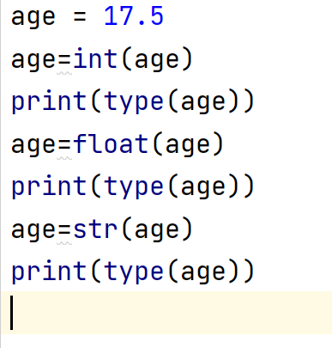
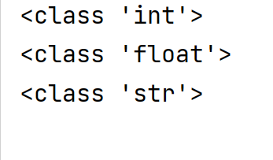
Variables & Data Types
Type Conversion
Notes:
<number>

Slide 18
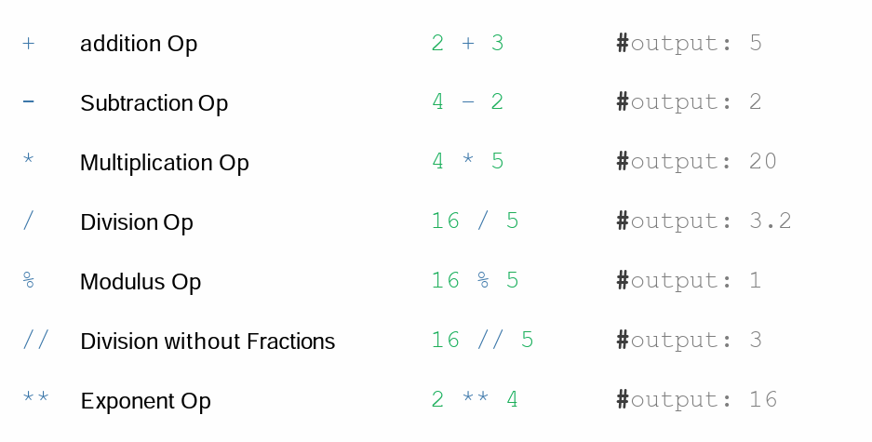
Operators (Arithmetic)

Slide 19
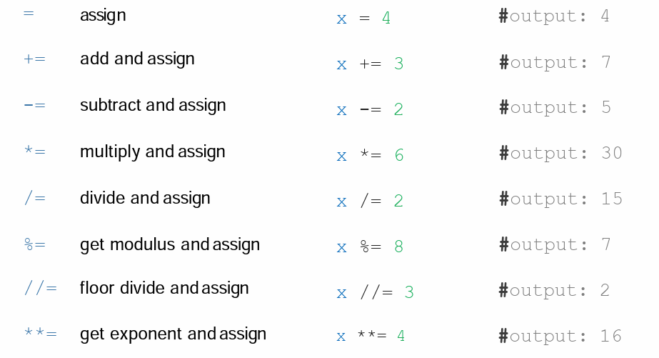
Operators (Assignment)
Notes:
<number>

Slide 20
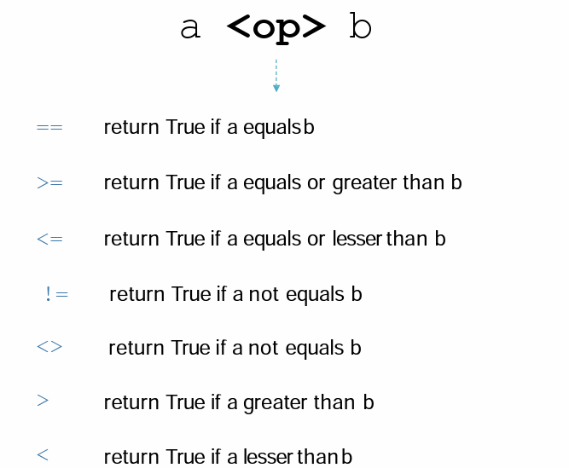
Operators (Comparison)

Slide 21
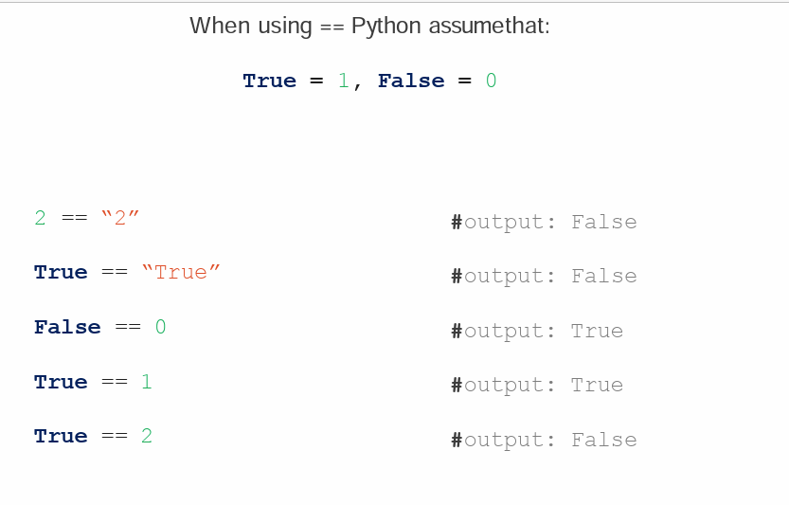
Operators (Comparison)

Slide 22
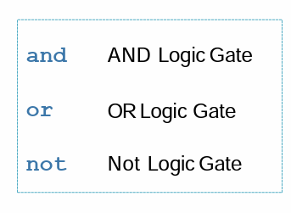
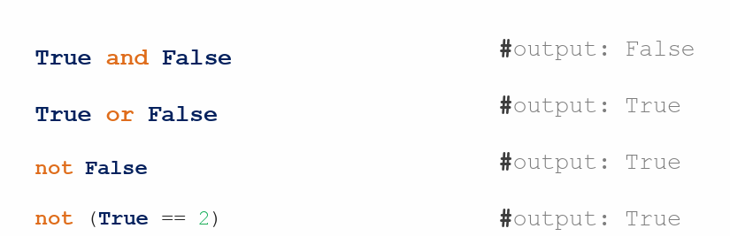
Operators (Logic Gate)

Slide 23
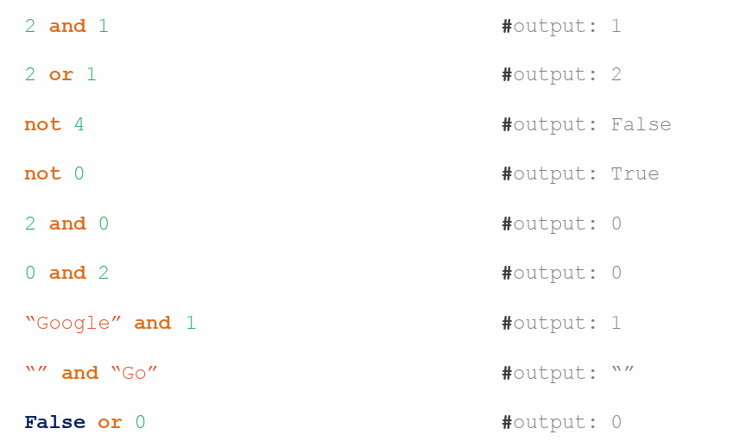
Falsy Values
None, False, 0 , Empty collections: "", (), [], {}

Slide 24
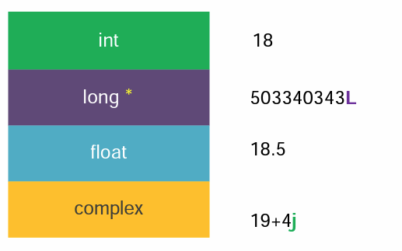
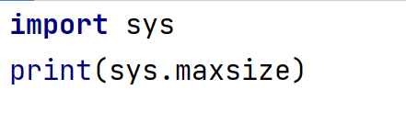

Numbers
Long removed from python3

Slide 25
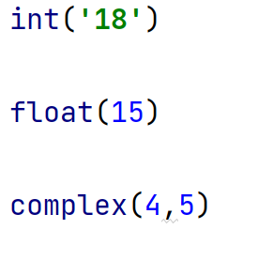
Numbers(Type Conversion)
int
float
complex

Slide 26
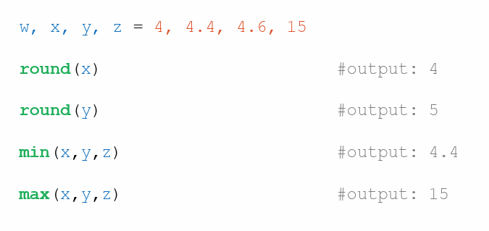
Numbers(functions)

Slide 27
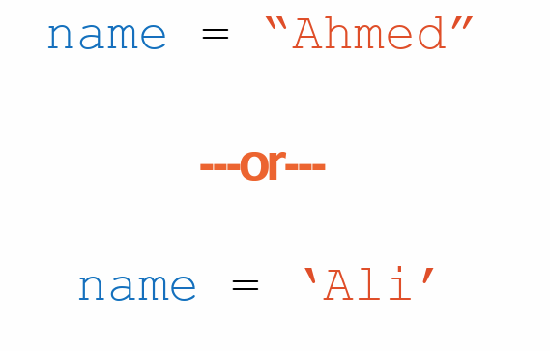
Strings

Slide 28
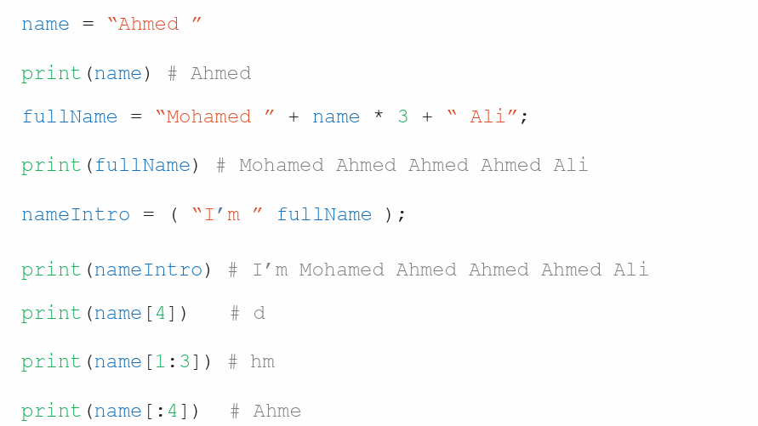
Strings

Slide 29
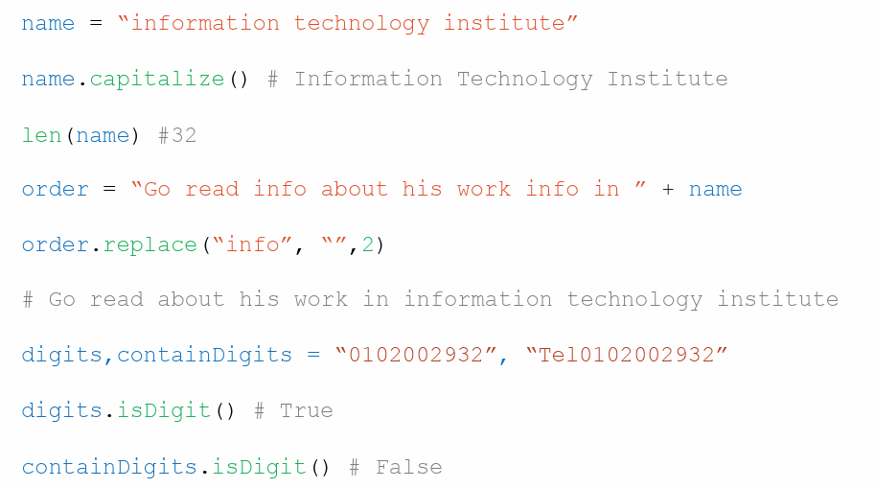
Strings

Slide 30
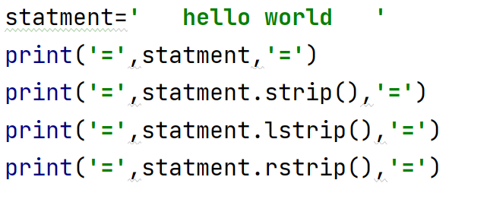
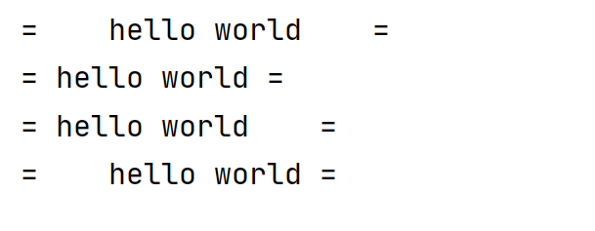
Strings
OUTPUT

Slide 31
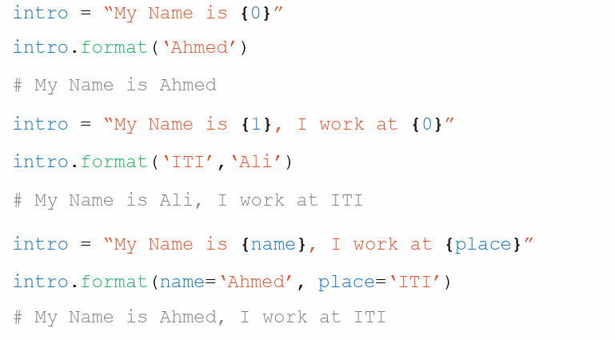
Strings (Formatting)

Slide 32
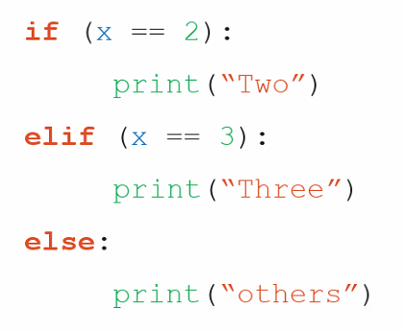
If Statement
level1
level2

Slide 33
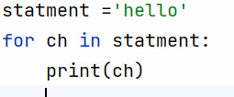
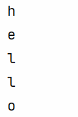
for …in

Slide 34
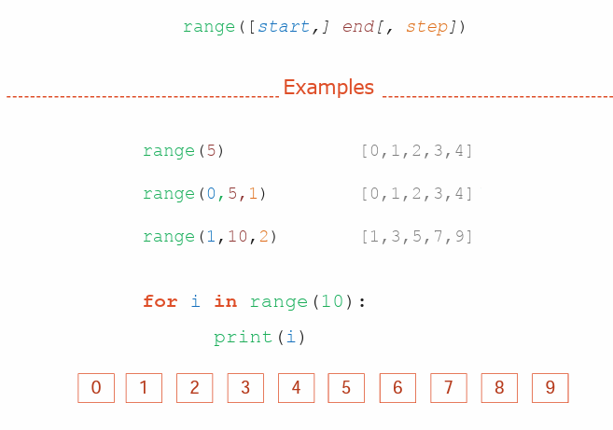
Range Function

Slide 35
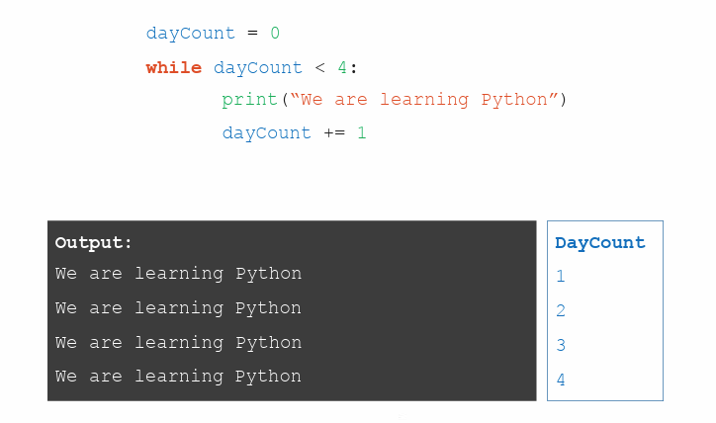
while

Slide 36
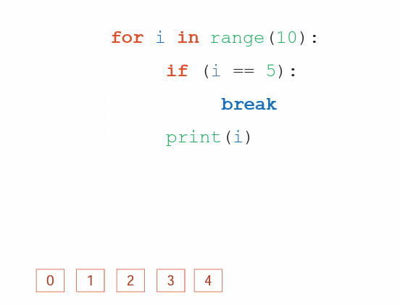
Break Statement

Slide 37
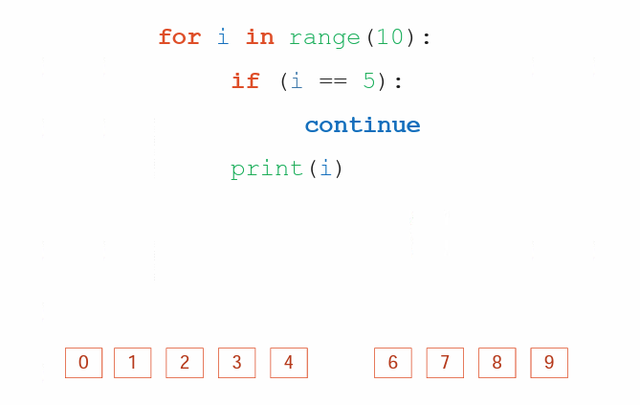
Continue Statement

Slide 38
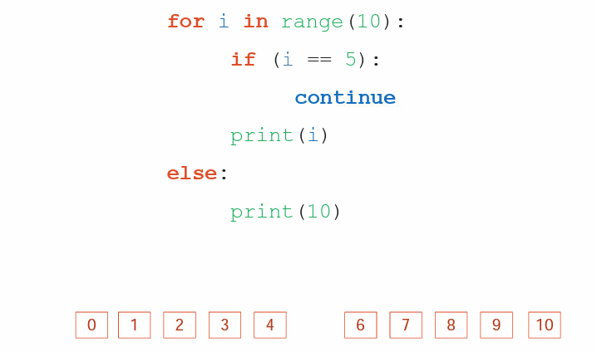
Else Statement

Slide 39
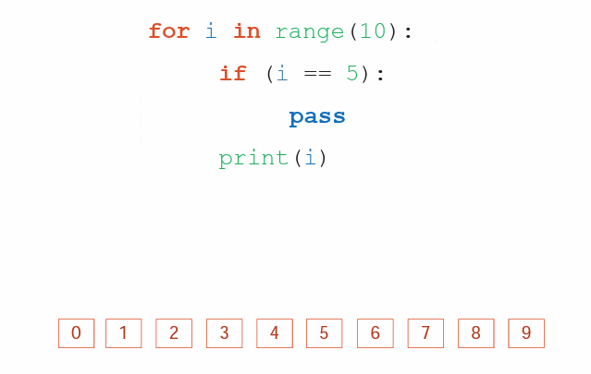
Pass Statement

Slide 40
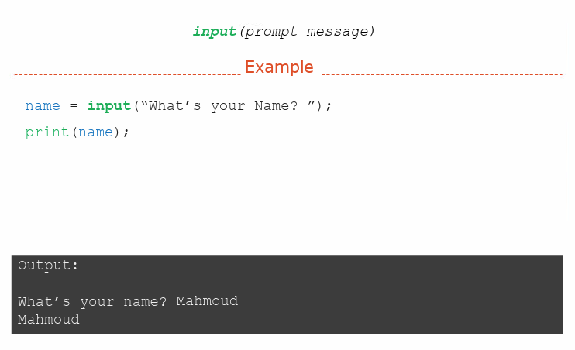
input Function

Slide 41
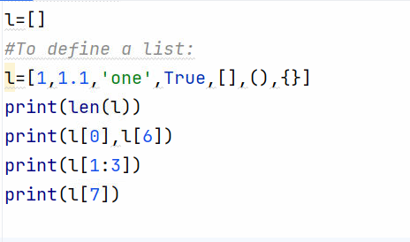
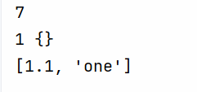
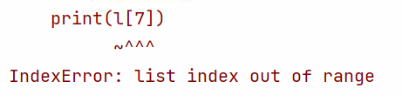
lists

Slide 42
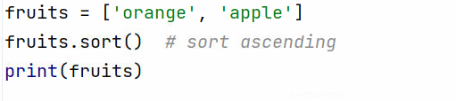



lists

Slide 43
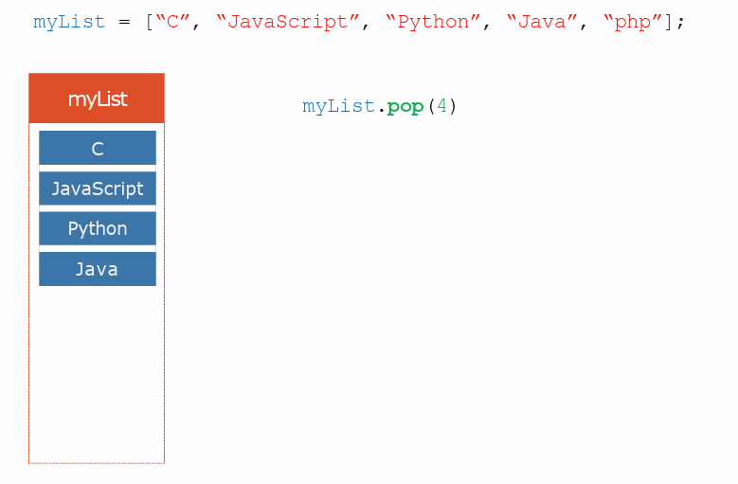
Lists

Slide 44
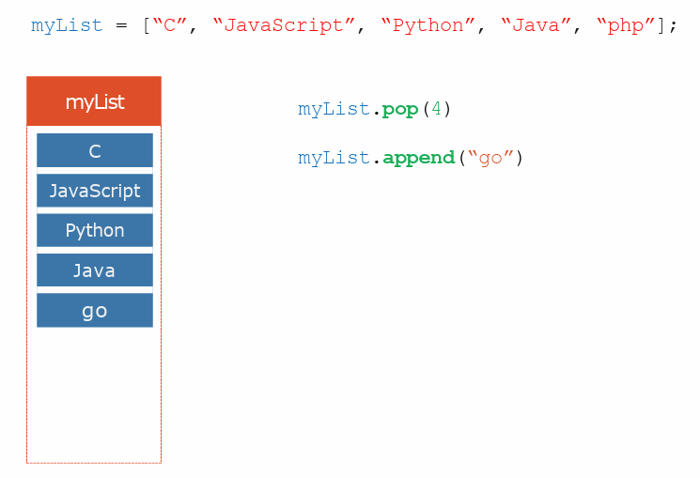
Lists

Slide 45
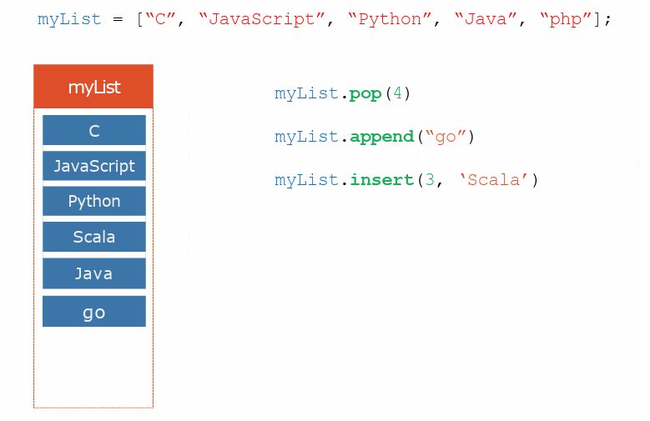
Lists

Slide 46
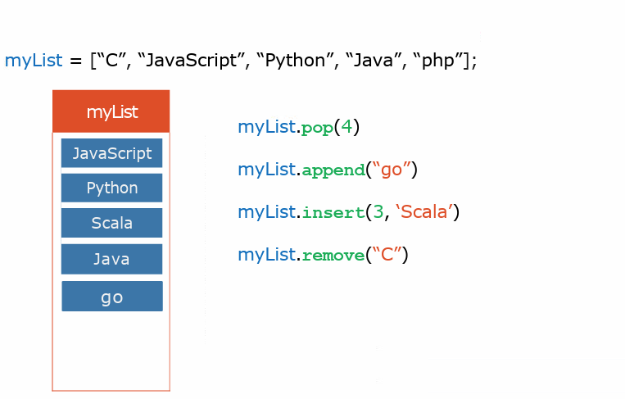
Lists

Slide 47
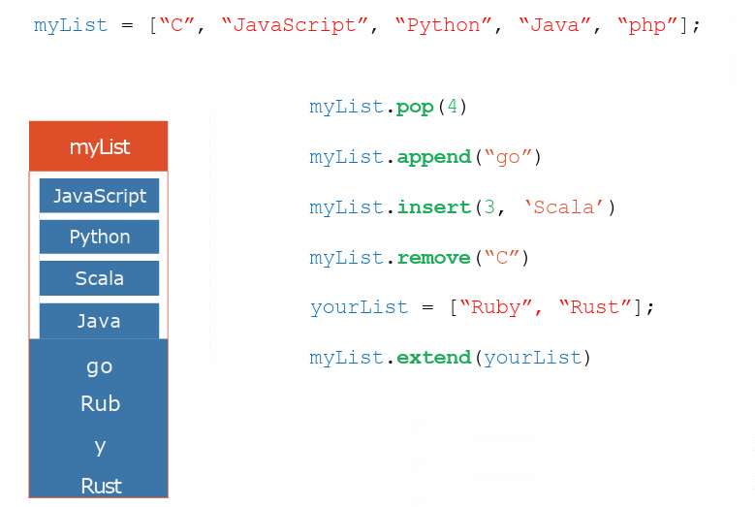
Lists

Slide 48

Tuples

Slide 49


Dictionaries
A dictionary: key: value comma separated elements data structure
doesn't allow duplicates for keys

Slide 50

Dictionaries

Slide 51

Tips and Trick

Slide 52

Tips and Trick

Slide 53

Exercises

Slide 54


