Slide 1
Database Fundamentals
Presented by:
Josephine Boles
Notes:
http://www.youtube.com/watch?v=IzbCLooj-M8

Slide 2
ER-to-Relational Mapping
Step 1: Mapping of Regular Entity Types
Step 2: Mapping of Weak Entity Types
Step 3: Mapping of Binary 1:1 Relation Types
Step 4: Mapping of Binary 1:N Relationship Types.
Step 5: Mapping of Binary M:N Relationship Types.
Step 6: Mapping of Multi-valued attributes.
Step 7: Mapping of N-ary Relationship Types.

Slide 3
Step 1: Mapping of Regular Entity Types
Create table for each entity type
Choose one of key attributes to be the primary key

Slide 4
Step 2: Mapping of Weak Entity Types
Create table for each weak entity.
Add foreign key that correspond to the owner entity type.
Choose the primary key : ( FK + weak entity Partial PK if any)

Slide 5
Step 3: Mapping of Binary 1:1 Relation Types
Merged two tables if both sides are Mandatory.
Add FK into table with the total participation relationship to represent optional side.
Create third table if both sides are optional.

Slide 6
Step 4: Mapping of Binary 1:N Relationship Types.
Add FK to N-side table
Add any simple attributes of relationship as column to N-side table.

Slide 7
Step 5: Mapping of Binary M:N Relationship Types.
Create a new third table
Add FKs to the new table for both parent tables
Add simple attributes of relationship to the new table if any .

Slide 8
Step 6: Mapping of Multi-valued attributes.
Create new table for each multi-valued attribute
Table will include two columns.
one for multi-valued attribute + FK column.

Slide 9
Step 7: Mapping of N-ary Relationship Types.
If n > 2 then :
Create a new third table
Add FKs to the new table for all parent tables
Add simple attributes of relationship to the new table if any .

Slide 10
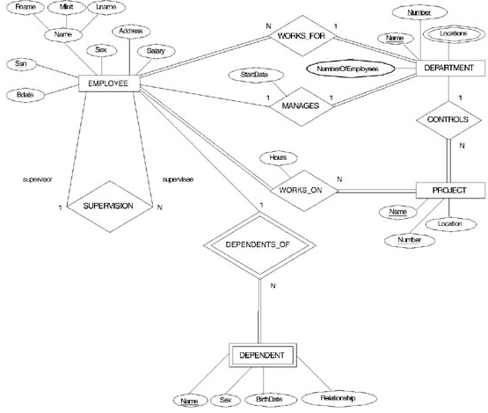


Slide 11

Mapping Result

Slide 12
Structured Query Language (SQL)
A standard language used to create,
maintain and control database.
It’s devided into:
  Data Definition Language (DDL).
  Data Manipulation Language (DML).
  Data Control Language (DCL).

Slide 13
Data types
A data type determines the type of data that can be stored in a database column. The most commonly used data types are:
Alphanumeric: data types used to store characters, numbers, special characters, or nearly any combination.
Numeric.
Date and Time .

Slide 14
Database Constraints
Not Null.
Primary Key.
Unique Key.
Referential Integrity ( FK ).
Check .

Slide 15
Data Manipulation Language
Insert.
Update.
Delete.
Select.

Slide 16
INSERT Command
Person table
LastName | FirstName | Address | City
El-Sayed | Mohamed | Nasr City | Cairo
INSERT INTO "table_name” VALUES ("value1", "value2", ...)
Insert a New Row:
INSERT INTO Person VALUES (‘Saleh’, ‘Ahmed', ‘Moharam bak', ‘Alex.')
Person table
LastName | FirstName | Address | City
El-Sayed | Mohamed | Nasr City | Cairo
Saleh | Ahmed | Moharam bak. | Alex.

Slide 17
INSERT Command (cont.)
Insert Data in Specified Columns:
Person table
LastName | FirstName | Address | City
El-Sayed | Mohamed | Nasr City | Cairo
Insert a New Row:
INSERT INTO Person (LastName, City) VALUES (‘Hassan', ‘Assuit')
Person table
LastName | FirstName | Address | City
El-Sayed | Mohamed | Nasr City | Cairo
Hassan |  |  | Assuit.

Slide 18
Update Command
UPDATE "table_name"
SET "column_1" = {new value}
[WHERE {condition} ]
Example (2)
UPDATE Person
SET City= ‘Assiut’
Where FirstName = ‘Ahmed’
Example (1)
UPDATE Person
SET City= ‘Assiut’
All records will be updated
Only records with first name ‘Ahmed’ will be updated

Slide 19
Update Command (cont.)
Update several Columns in a Row:
LastName | FirstName | Address | City
El-Sayed | Mohamed | Nasr City | Cairo
Saleh | Ahmed | Moharam bak. | Alex.
UPDATE Person
SET Address = ‘241 El-haram ', City = ‘Giza'
WHERE LastName = ‘El-Sayed'
LastName | FirstName | Address | City
El-Sayed | Mohamed | 241 El-haram | Giza
Saleh | Ahmed | Moharam bak. | Alex.

Slide 20
Delete Command
DELETE FROM "table_name"
[WHERE {condition} ]
Example (2)
DELETE FROM Person
Where FirstName = ‘Ahmed’
Example (1)
DELETE FROM Person
All records will be deleted
Only records with first name ‘Ahmed’ will be deleted

Slide 21
Simple Queries
Select <attribute list >
From < table list>
[ Where <condition> ]
select *
from departments;
select emp_id, emp_name, dept_id
from employees;
select distinct dept_id
from employees;

Slide 22
Simple Queries (cont.)
Select dept_id, dept_name
from departments
where location = ‘Cairo’;

Slide 23
Comparison Conditions
= Equal.
> greater than.
>= greater than or equal.
< less than.
<= less than or equal.
<>not equal.
Select last_name, salary from employees
where salary >1000

Slide 24
Other Comparison Conditions
Between …… AND ….. (between two values - Inclusive).
Select last_name, salary
from employees
where salary between 1000 and 3000;
IN (set) (Match any of a list of values)
Select emp_id, last_name, salary, manager_id
From employees
where manager_id IN (100, 101, 200);
Like (Match a character Pattern)
Select first_name
from employees
where first_name Like ‘_s%’;

Slide 25
Logical Conditions
AND.
  Select last_name, salary
  from employees
  where city = ‘Assiut’ and salary > 1000;
OR.
  Select last_name, salary
  from employees
  where city = ‘Assiut’ OR salary > 1000;

Slide 26
Logical Conditions
NOT.
  Select emp_id, last_name, salary, manager_id
  From employees
  where manager_id NOT IN (100, 101, 200);

Slide 27
Arithmetic Expressions
Select last_name, salary, salary + 300
from employees;
Order of precedence: * , / , +, -
You can enforce priority by adding parentheses.
Select last_name, salary, 10 * (salary + 300)
from employees;

Slide 28
Questions?

