Slide 1
NFL Touchdowns!
MSDS 7330 – 404
Dave Dyer, Jostein Barry-Straume, Robert Flamenbaum, & Bryan Cikatz

Slide 2
Introduction

Slide 3
Abstract
This study investigates how the average and variance of yards gained impacts a given team's ability to get touchdowns in the NFL. The theory is that teams with high average yards gained, but with low variance, would get more touchdowns than those with higher average yards gained, but higher variance. In other words, consistency is more important than big plays.

Slide 4
The Data
2015 play-by-play records available at Kaggle
14.7 MB
46,129 rows
65 columns

Slide 5
The Tools
MongoDB
Data mining and basic statistics
R
Data visualization and Markdown
Mongolite package

Slide 6
Previous Work
Underrated NFL Stats
Based on 2010 season
Looks at the relationship between big-plays allowed and touchdowns allowed
Big-play defined as 20 or more yards
How to Quantify the NFL
Based on 2015 season
Looks at five different statistics – we focus on big-play percentage
Big-play defined as runs of more than 10 yards or passes of more than 25 yards

Slide 7
"Underrated NFL stats"
Best Teams at Preventing Big-Plays
Worst Teams at Preventing Big-Plays
1. Steelers (36, 5 TDs)
2. Chargers (43, 5 TDs)
3. Falcons (48, 9 TDs)
4. Vikings (49, 9 TDs)
5. Buccaneers (51, 9 TDs)
32. Broncos (84, 20 TDs)
31. Seahawks (76, 14 TDs)
30. Cardinals (74, 14 TDs)
29. Jaguars (72, 16 TDs)
28. Redskins (70, 10 TDs)

Slide 8
"Underrated NFL Stats" (Cont.)
Takeaway Points
"Only six of [the top ten teams] finished .500 or better last season, but those six teams fall in the top seven on the list."
"Of [the bottom ten teams], only Seattle, with a sub-.500 record, and Philadelphia made the playoffs."

Slide 9
"How to Quantify the NFL"
Takeaway Points
Teams with the best big-play percentage were the Bills, Vikings, Seahawks, Panthers, Chiefs, and Steelers (roughly 9% of all plays were big-plays).
Five of these six teams made the playoffs.

Slide 10
Expanding Upon Previous Work
Ultimately, we are looking to expand upon the role of big-plays in the NFL. Previous work looked more at the defensive side (only touching lightly on offense) whereas we are focusing on the offensive side of the equation. Furthermore, we seek to discover the importance of consistency in relation to big-plays. We want to know if smaller but more consistent gains are more effective than larger but more irregular gains.

Slide 11
Data & Analysis

Slide 12
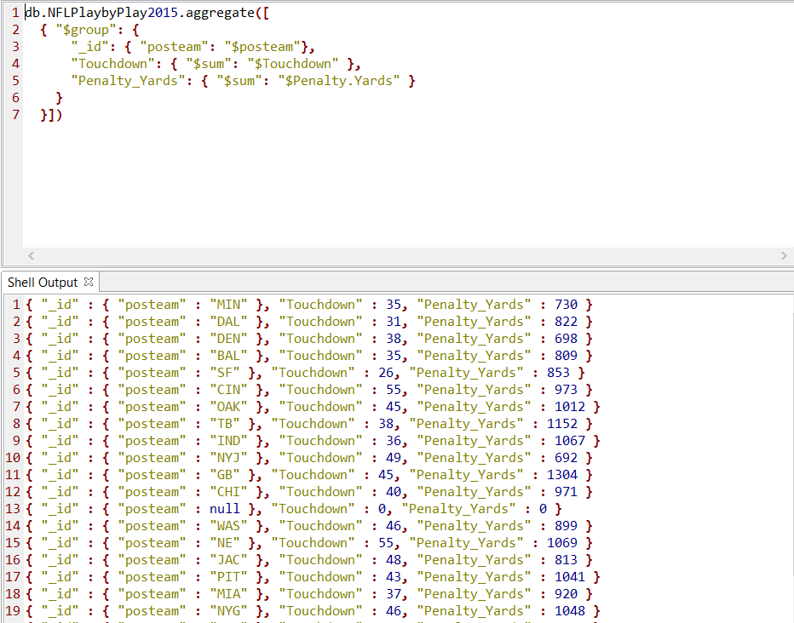
Initial Queries in MongoDB
We ran queries on:
Total TD's for the season by team
Total TD's for each quarter by team
Average yards gained per play by team
Average TD's earned per play by team
Total TD's with penalty yards for the team

Slide 13
List of R Packages
library("mongolite")
library("dplyr")
library("knitr")
library("tibble")
library("kableExtra")
library("ggplot2")

Slide 14
Mongolite
# Returns sum of touchdowns and sum of penalty yards per team
sumTdsPenYds <- m$aggregate ( ' [
{ "$group": {
"_id": { "posteam": "$posteam"},
"Touchdown": { "$sum": "$Touchdown" },
"Penalty_Yards": { "$sum": "$Penalty.Yards" }
}
} ] ' )

Slide 15
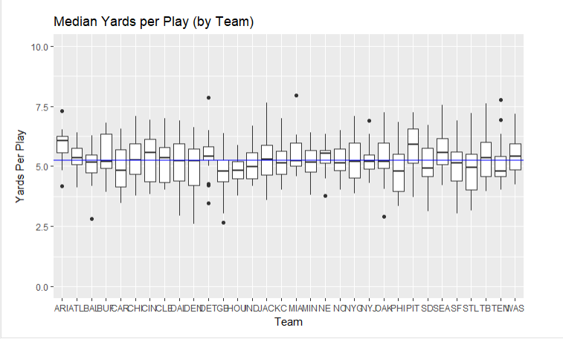
Median Yards per Play
Insights
Not a large amount of variance between medians
What we expected – NFL is highly competitive
Large difference in outer quartiles and number of outliers
Supports our investigation into whether or not a large variance changes team performance

Slide 16
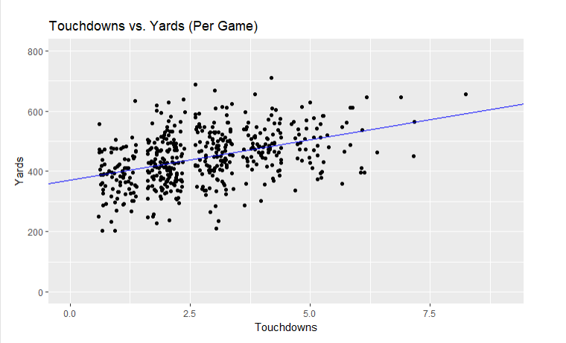
TD's vs. Yards
Insights
Upward trend
As yards increase, so do the number of touchdowns
However, yards per play is not normalized

Slide 17
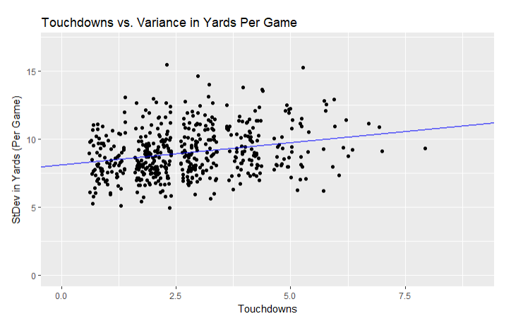
TD's vs. Stddev in Yards
Insights
Relationship is relatively static, with a slight rise as standard deviations go up.
Again, data are not normalized

Slide 18
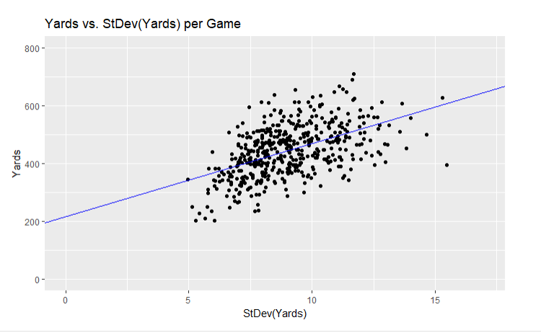
Yards vs. Stddev of Yards
Insights
Spread increases as yards and standard deviation increase
You can get more yards with higher a standard deviation but run risk of not getting as many yards

Slide 19
Conclusion
Higher, not lower, standard deviation results in more touchdowns based on unnormalized data
Need to remove impact of yards per game on touchdowns per game but is not feasible
Ultimately, unclear relationship between standard deviation of yards and touchdowns
Warrants more analysis

Slide 20
Lessons Learned
Anticipated using MySQL
Great learning experience with MongoDB and R
Integration through mongolite
Combination of MongoDB and R will be a powerful tool in future projects

Slide 21
Specifications & REferences

Slide 22
Computer/Program Specifications
MongoDB
OS X El Capitan
Version 10.11.6
Bluemix Storage: 1GB
Data Size: 14.3MB
Database Server: Compose for MongoDB-jj
Database Version: 3.2.11
Database Location: US South
Cloud Hosting Service: IBM Bluemix
1 x 2.0 GHz Cores
1GB RAM
MacBook Pro (Retina 15-inch, Mid 2015)
Processor: 2.2 GHz Intel Core i7
Memory: 16 GB 1600 MHz DDR3
Graphics: Intel Iris Pro 1536 MB

Slide 23
References
2015 NFL Data from Kaggle
https://www.kaggle.com/maxhorowitz/nflplaybyplay2015
NFL Articles
https://www.theringer.com/2016/8/4/16038580/five-better-nfl-stats-teddy-bridgewater-dwight-freeney-187cb19326f1
http://www.sportingnews.com/nfl/news/191984-underrated-nfl-stats-big-plays-allowed
GitHub Link For Our Project
https://github.com/tigerninjaproject1/nfl

Slide 24
References (Cont.)
R and R packages
https://www.R-project.org/
https://yihui.name/knitr/
https://CRAN.R-project.org/package=dplyr
http://arxiv.org/abs/1403.2805 (mongolite)
https://CRAN.R-project.org/package=bindrcpp
https://CRAN.R-project.org/package=tibble
http://ggplot2.org

Slide 25
Q & A

