Slide 1
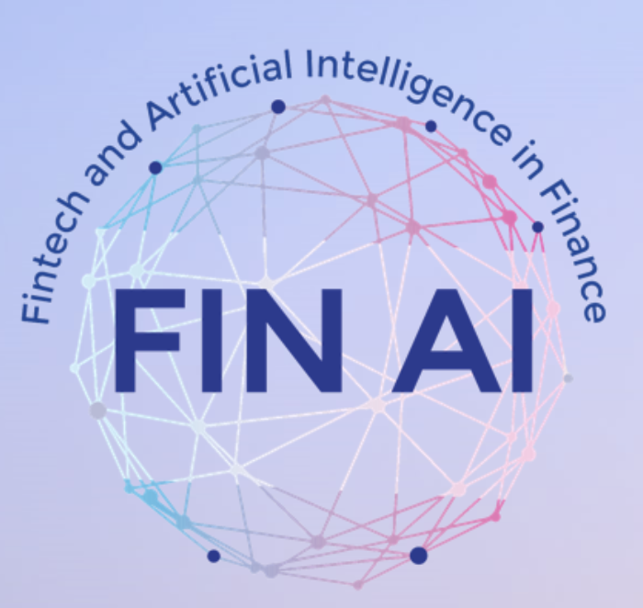
Portugal
Country Updates, MC Meeting, September 28, 2023

Slide 2
FinAI – MC Committee
Bernardete Ribeiro, Joana Costa - MC
Catarina Silva, Luisa Morgado - MC Substitutes
University of Coimbra, University UTAD

Slide 3
Main Aims
Contribution Topics
Building network to conduct multidisciplinary research
Participation in joint data collection efforts
Participation in joint research proposal writing efforts
Providing mobility of doctoral students at other universities
WG2 – Transparent versus Black Box Decision-Support Models in the Financial Industry
WG3 – Transparency into Investment Product Performance for Clients

Slide 4
Line of research 1
We extended the LIME (Local Interpretable Model-agnostic Explanations) framework to be used with YOLO models. The main contribution is a public add-on to LIME that can effectively improve YOLO interpretability.
C. Silva, A. Morais and B. Ribeiro, A Generic Approach to Extend Interpretability of Deep Networks, in Progress in Artificial Intelligence, pp. 488–499-488–499, 2022, DOI:10.1007/978-3-031-16474-3_40
Research Coordination 2:
The development of conceptual and methodological tools for establishing when black-box models are admissible and, to the extent possible, making them more transparent and/or replacing them with interpretable and explainable models.
Line of research 2
We explored the visualization and meaning of intelligent models including interpretability to explain the models ``thought process’’ via SHapley Addictive exPlanations (SHAP).
C. Silva, M. Carvalho and B. Ribeiro, Leveraging Information Visualization and Model Interpretability (in preparation)

Slide 5
Participation on the7th European COST Conference on Artificial Intelligence in Finance with a presentation on “Algorithmic biases in financial applications”
https://conference.fin-ai.eu/AI-Conference-in-Finance/
Cooperation with Prof. Vassilios Papavassiliou from the University College Dublin, UCD Michael Smurfit Graduate Business School, and Prof Alessandra Tanta, University of Pavia to contribute to the study of the cost/benefit relation of black box and white box models.
Capacity Building 1:
Create an excellent network of researchers in Europe with lasting collaboration beyond the lifetime of the Action.

Slide 6
International Symposium on Intelligence Technologies (June 8,15,22,29 2022): 4 sessions:
  Session 1 (June 8, 2022): Ethics and Legislation in the Use of Artificial Intelligence: Perspectives Brazil and Portugal
  Session 2 (June 15, 2022): Uncovering the Codes: Transparency and Explainability for AI Algorithms
  Session 3 (June 22, 2022): The 4th Technological revolution and the future of jobs
  Session 4: Artificial Intelligence in the Financial Sector – Frauds, Risks and Biases
Detailed information (Portuguese): https://www.even3.com.br/technoin/
Capacity Building 2:
Bringing technological, quantitative and economic researchers together, to tackle future research that can only be done in an interdisciplinary setting and getting actively involved in the blockchain and FinTech communities across Europe, to constantly monitor developments, get input and disseminate results.

Slide 7
Coffee Session with debate (September 21 and September 28, 2022): A series of 2 workshops in collaboration with juridical researchers of the University of Coimbra, Portugal to discuss “Artificial Intelligence and Accountability: current legal and technical panorama”
  Artificial Intelligence and Accountability (Part I)
  Artificial Intelligence and Accountability (Part II)
The first workshop is specially targeted to juridical stakeholders, while the second is targeted for engineers.
Capacity Building 3:
Bridging the gap between practitioners from the finance industry, academics and regulators by setting up a common knowledge exchange platform.

Slide 8
STSM co-Coordination activities (Catarina Silva)
Work in progress with Vassilios Papavassiliou, that visited Coimbra in July 2023, considering the prediction of financial time series -> one paper being prepared
Organization of “Women in Fintech” June, 1-2 (Catarina Silva, Joana Dias, Bernardete Ribeiro)
   Workshop on Responsible AI - technical and lawful perspectives planned for 2024
Susana Aires de Sousa, from the Law Faculty of University of Coimbra and specialist in the legal implications of AI implications, has joined the action.
Activities in 2023

