Slide 1
DESIGN OF CONTROLLER FOR WIND ENERGY CONVERSION SYSTEMS STABILITY STUDIES (WECS)
BATCH NO. B34
JOSEPH DIVYAN THOMAS-1051310052
V.S.SHIVRAM-1051310057
N.KRIPA KUMARAN-1051310119
Under the guidance of
Dr.C.SUBRAMANI

Slide 2
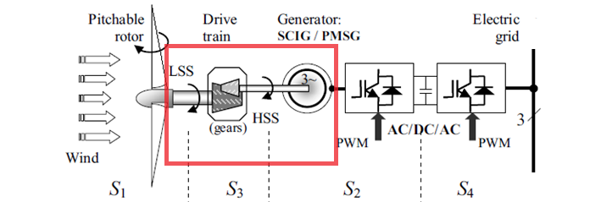
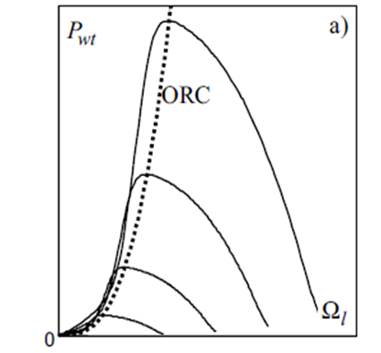
PROBLEM - INVESTIGATION {DIRECT IMPOSING OF OPTIMAL OPERATING POINT}
V

Slide 3
DESIGNED SYSTEM BLOCK DIAGRAM
WIND
ROTOR
WIND TORQUE
GEAR BOX
L.S.S
.
E.M.T TORQUE
H
S
S
H.S.S. SPEED
PI
Controller
VECTOR CONTROL
TORQUE REFERENCE
VOLTAGE
FREQ
OUTPUT CURRENT
S.C.I.G.

Slide 4
PROJECT OVERVIEW
1) SYSTEM MODELLING
2) CONTROLLER DESIGN & FINE TUNING
3) SIMULATION RESULTS & HARDWARE

Slide 5
1) SYSTEM MODELLING
WIND SEQUENCE SELECTOR
ROTOR
GEAR TRAIN
SCIG and VECTOR CONTROL (MACHINE MODELLING)

Slide 6
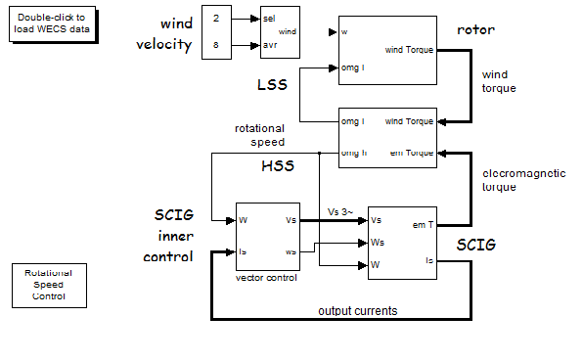
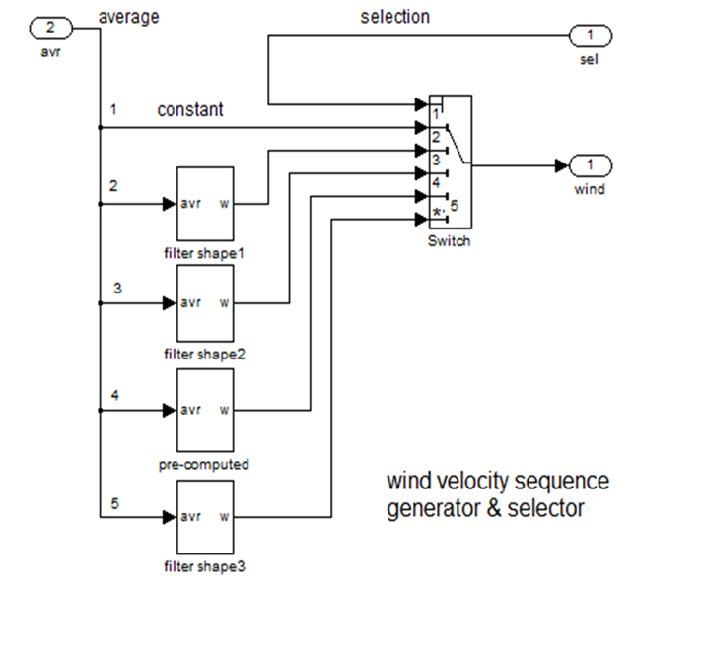
WIND SEQUENCE SELECTOR

Slide 7
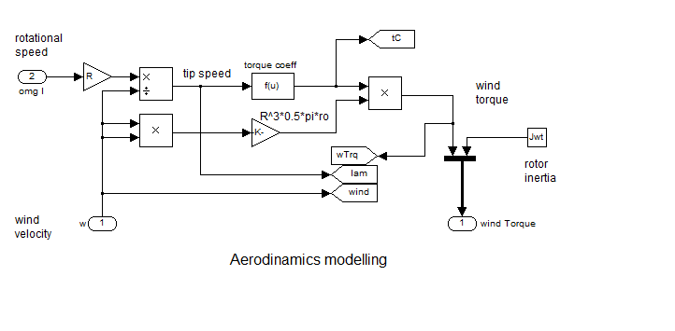



ROTOR MODELLING

Slide 8
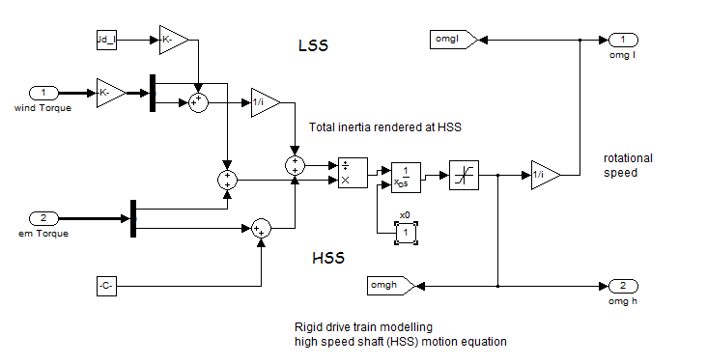


GEAR TRAIN MODELLING

Slide 9
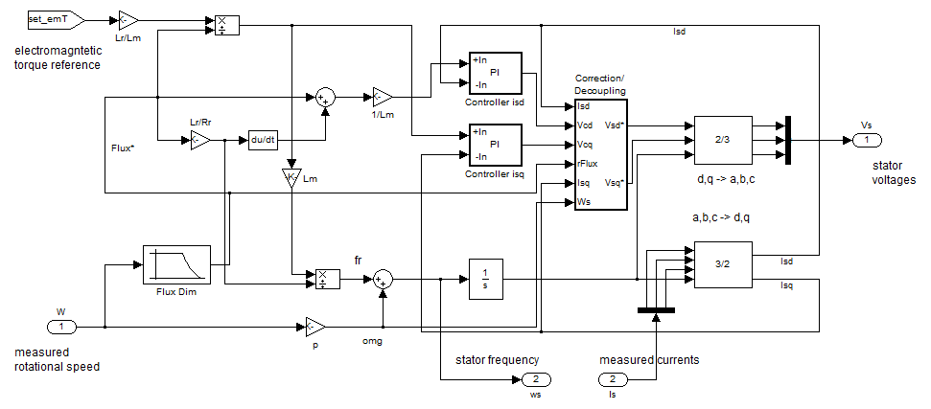
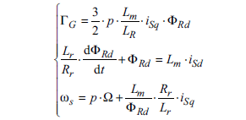
VECTOR CONTROL

Slide 10
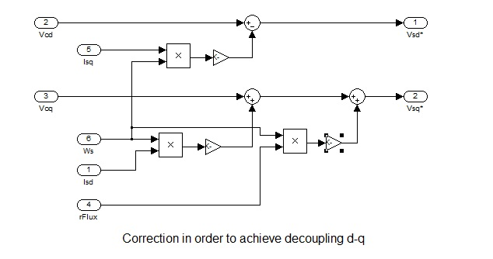
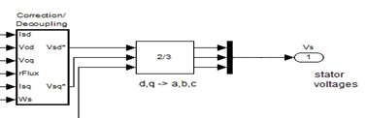

DQ DECOUPLING

Slide 11
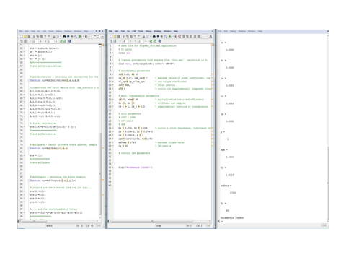
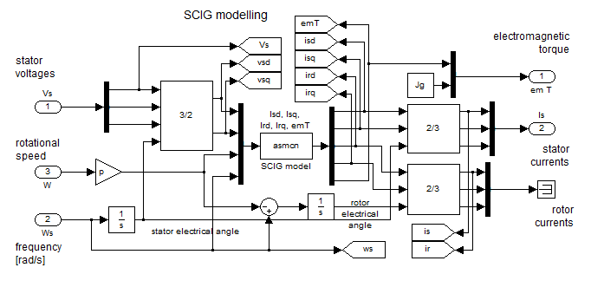
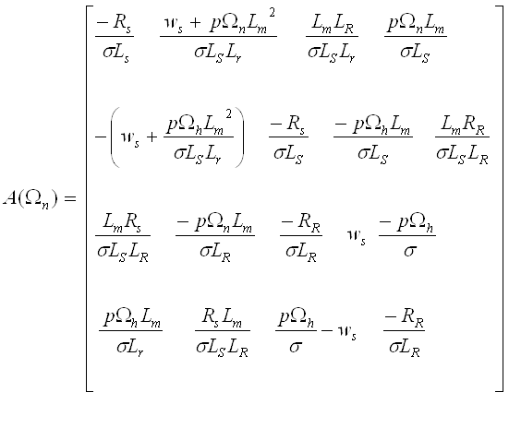
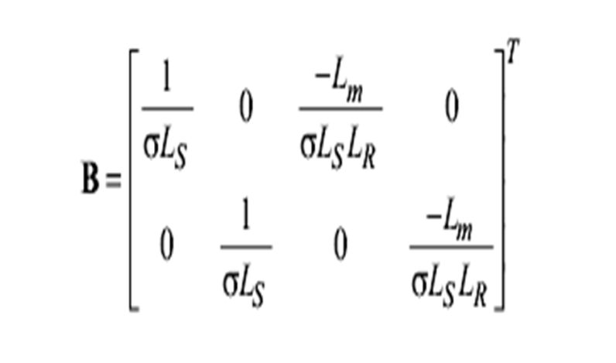
SCIG MODELLING

Slide 12
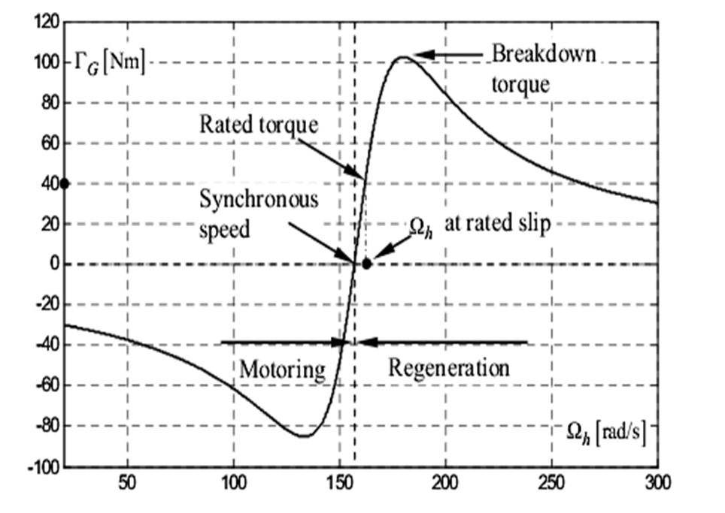
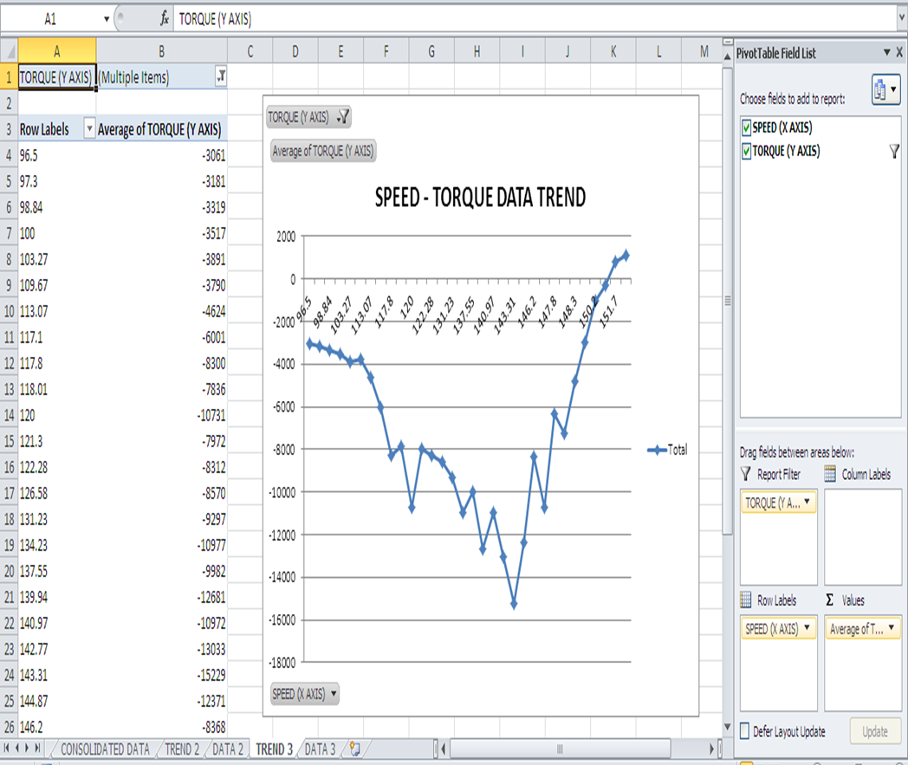
DATA VALIDATION

Slide 13
2) CONTROLLER DESIGN & FINE TUNING

Slide 14
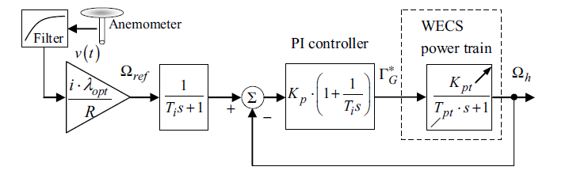
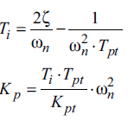
A) PI CONTROLLER DESIGN

Slide 15
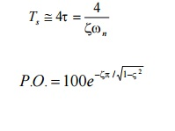



RELATIONSHIP BETWEEN PARAMETERS
For best results :
Power developed should be maximum (Kp must be high)
Settling time must be low ( and Wn should be high)
Peak overshoot must be less than 5% ( should be high)
Torque Limit should not be violated (Kp and Wn should be low)

Slide 16

FINE TUNING CONSTRAINTS
SNO | PARAMETER | RANGE | LOWER LIMIT CONSTRAINT REASON | UPPER LIMIT CONSTRAINT REASON
1 | K_{p} | 200 to 700 | Less power developed | Parameter violation
2 |  | 0.4 to 0.75 | High overshoot and Settling time | System Constraint
3 | W_{n} | 0.2 to 0.7 | More settling time | System Instability

Slide 17
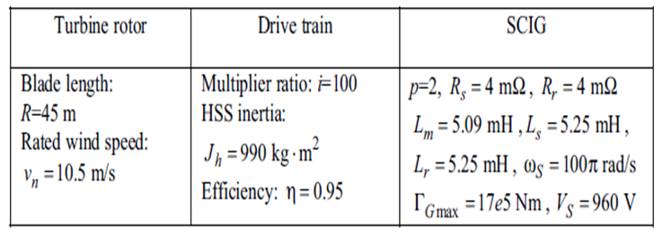
SYSTEM PARAMETERS

Slide 18


B) CONTROLLER FINE TUNING
STEP RESPONSE OF SYSTEM FOR WIND VELOCITY = 8 m/sec
S.No | Kp | Wn (Rad/sec) |  | Time To Reach Ideal Speed [1.244 rad/sec] (in Seconds) | Time Taken To Reach Ideal Torque [-7872N.m] (in seconds)
1. | 280 | 0.238 | 0.73 | 63.18 | 53.18
2. | 435 | 0.396 | 0.74 | 45.84 | 48.79
3. | 620 | 0.525 | 0.73 | 30.05 | 40.41
4. | 682 | 0.566 | 0.735 | 29.13 | 38.35

Slide 19


POWER RESPONSE FOR DIFFERENT Kp VALUES FOR V = 8 m/sec & Turb = 2 m/sec
S.No | Value of Kp | Value of Power (MW) | COMMENTS
1. | 280 | 0.846
2. | 435 | 0.854
3. | 620 | 0.842
4. | 682 | 0.8408

Slide 20
3) SIMULATION RESULTS & HARDWARE

Slide 21
STEP RESPONSE FOR VARIOUS Kp VALUE Wind Velocity = 8 m/sec

Slide 22

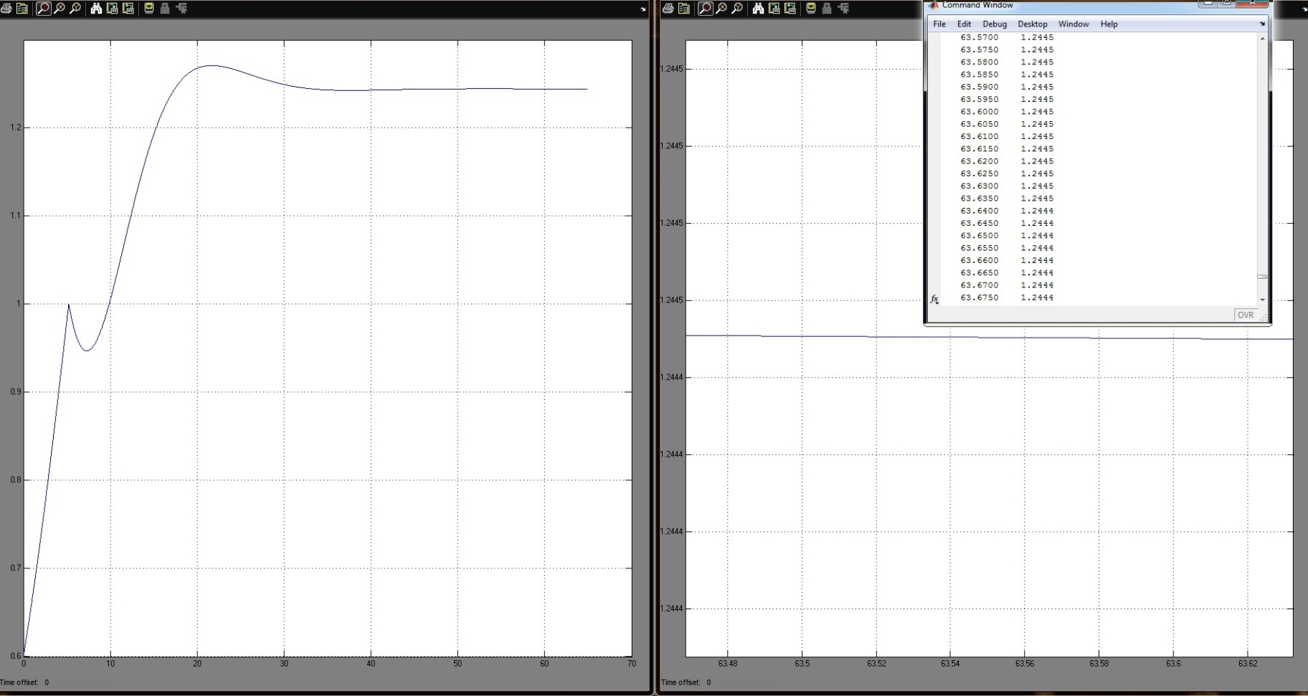
Time for _{opt} (K_{p}=280) : 63.28sec
SPEED
(rad/
s
)
TIME (secs)

Slide 23
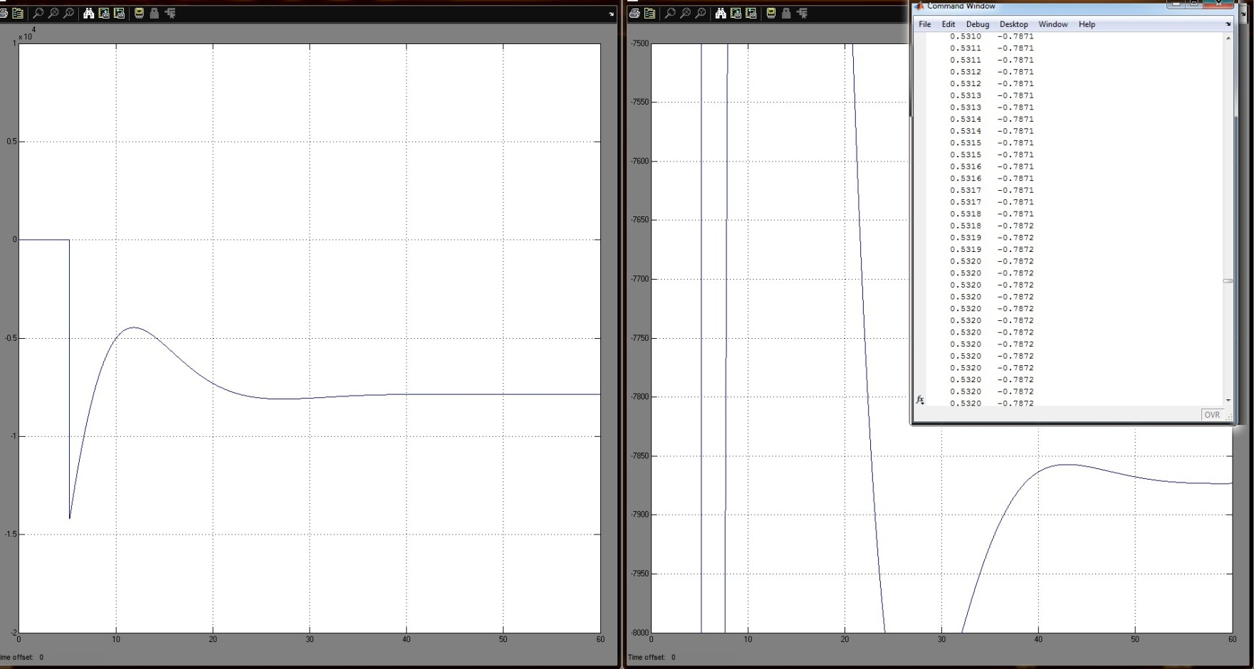
Time for T_{opt} (K_{p}=280) : 53.18sec
TORQUE
(N-m
)
TIME (secs)

Slide 24
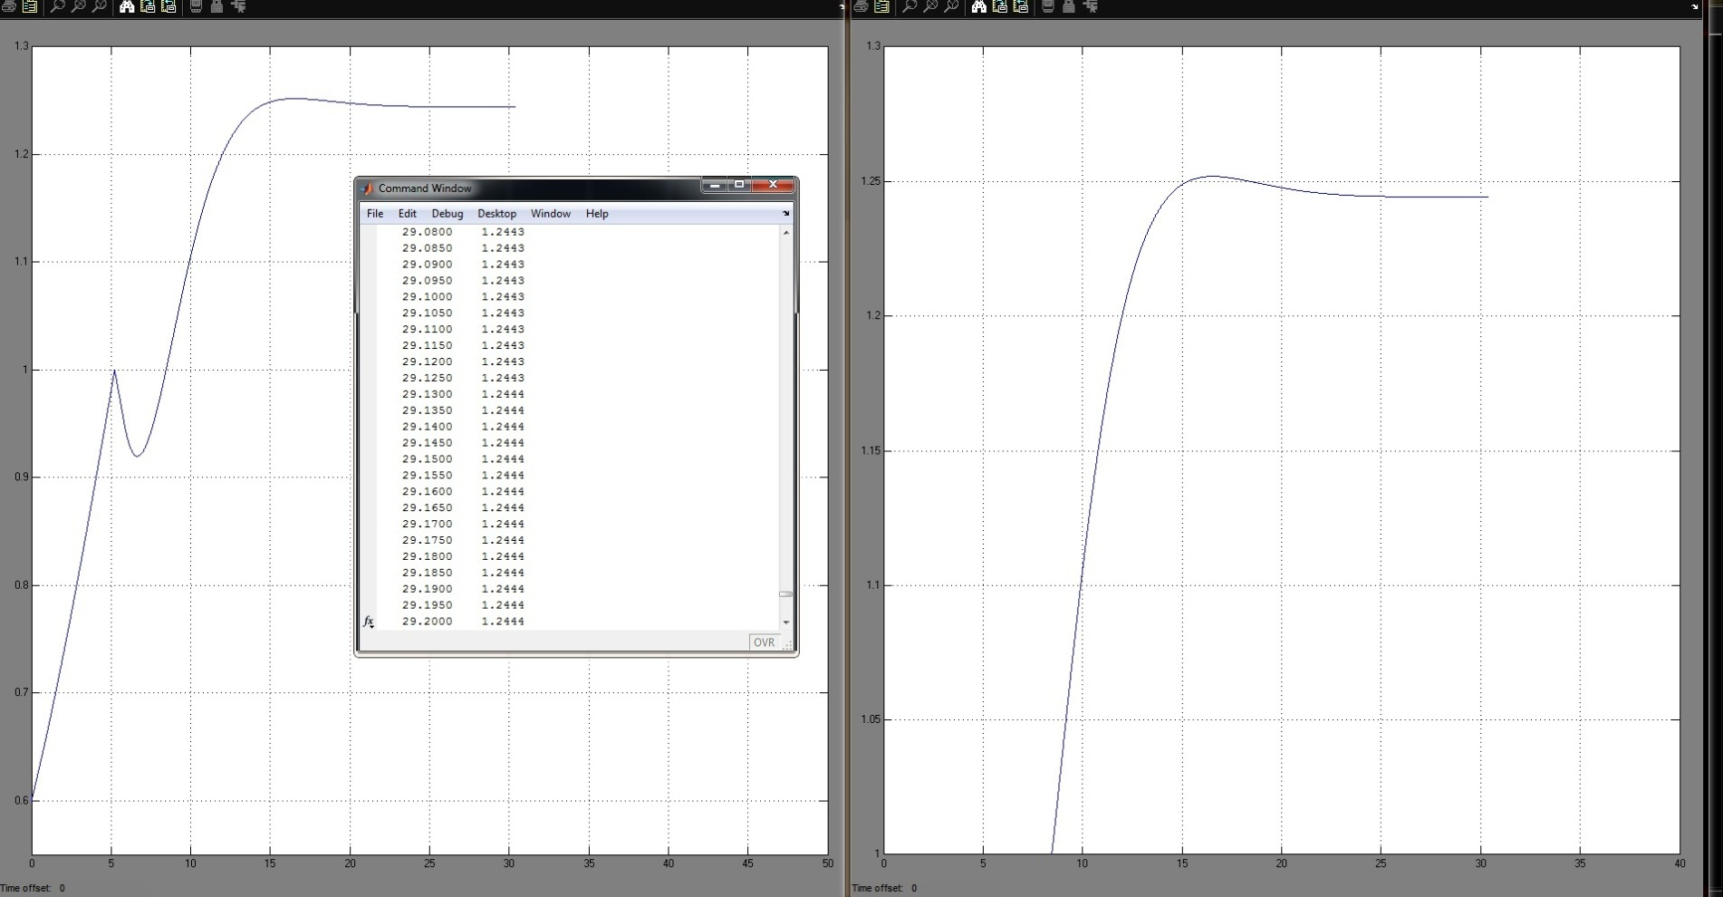
Time for _{opt} (K_{p}=682) : 29.13sec
SPEED
(rad/
s
)
TIME (secs)

Slide 25
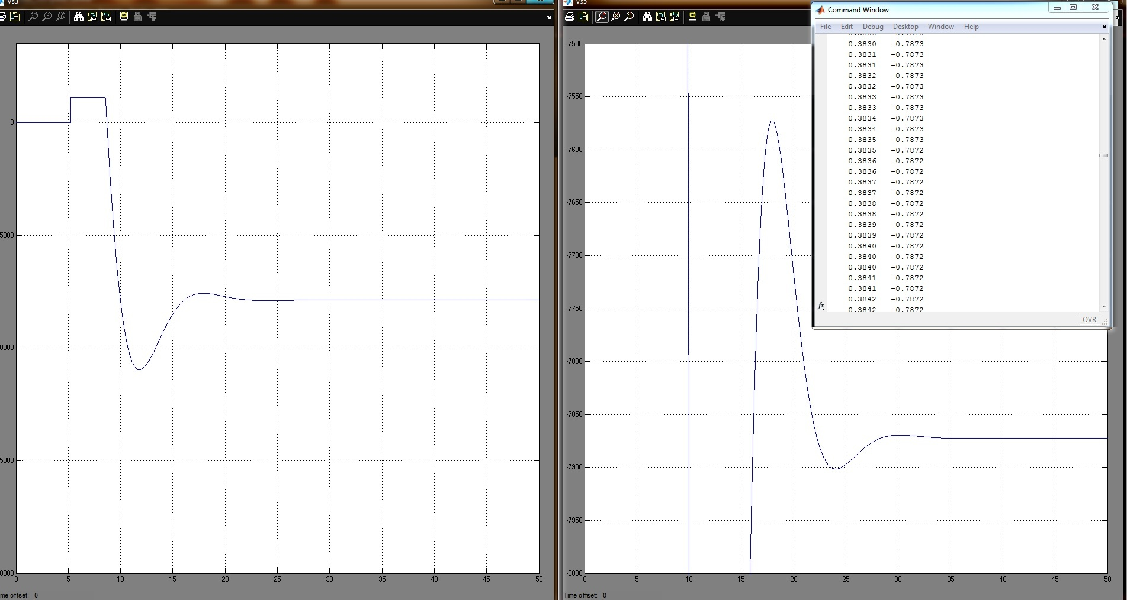
Time for T_{opt} (K_{p}=682) : 38.35sec
TORQUE
(N-m
)
TIME (secs)

Slide 26
POWER RESPONSE FOR VARIOUS Kp VALUES Wind Velocity = 8 m/sec Turbulence = 2 m/sec

Slide 27
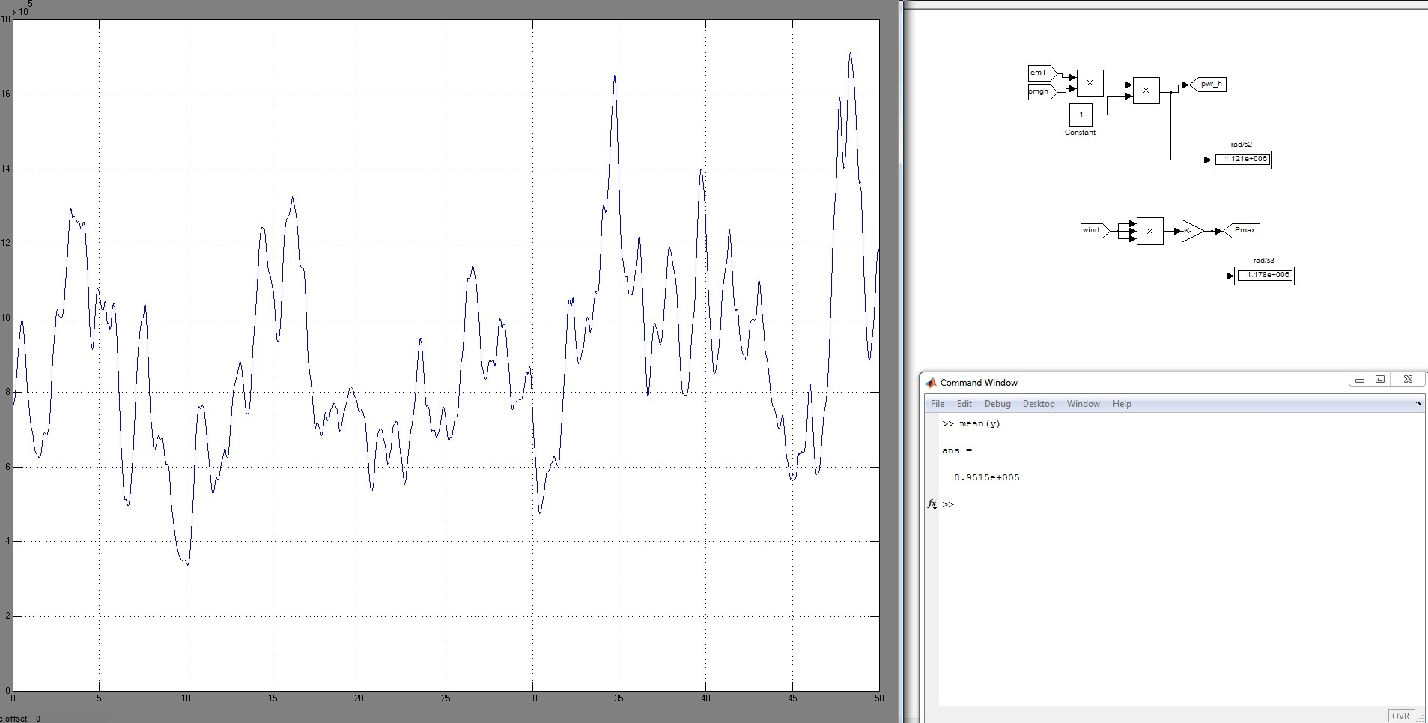
MAXIMUM AVERAGE POWER =0.89MW
POWER
MW
TIME(Secs)

Slide 28
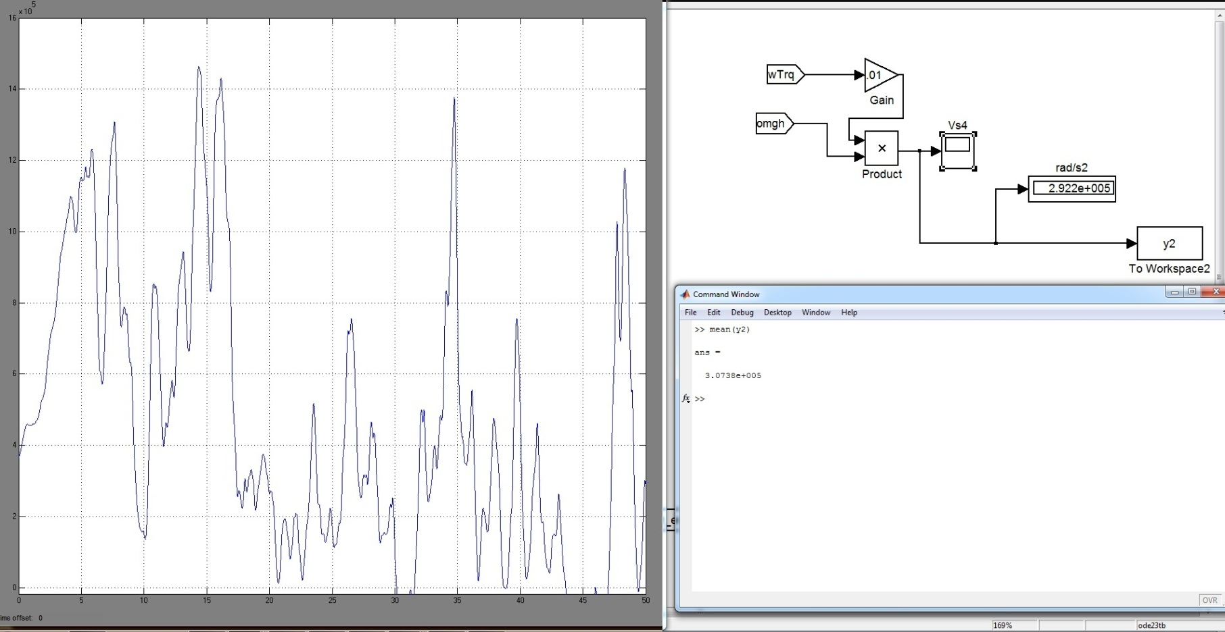
OUTPUT POWER FOR SYSTEM WITHOUT CONTROLLER (P avg=0.307MW)
POWER
MW
TIME(Secs)

Slide 29
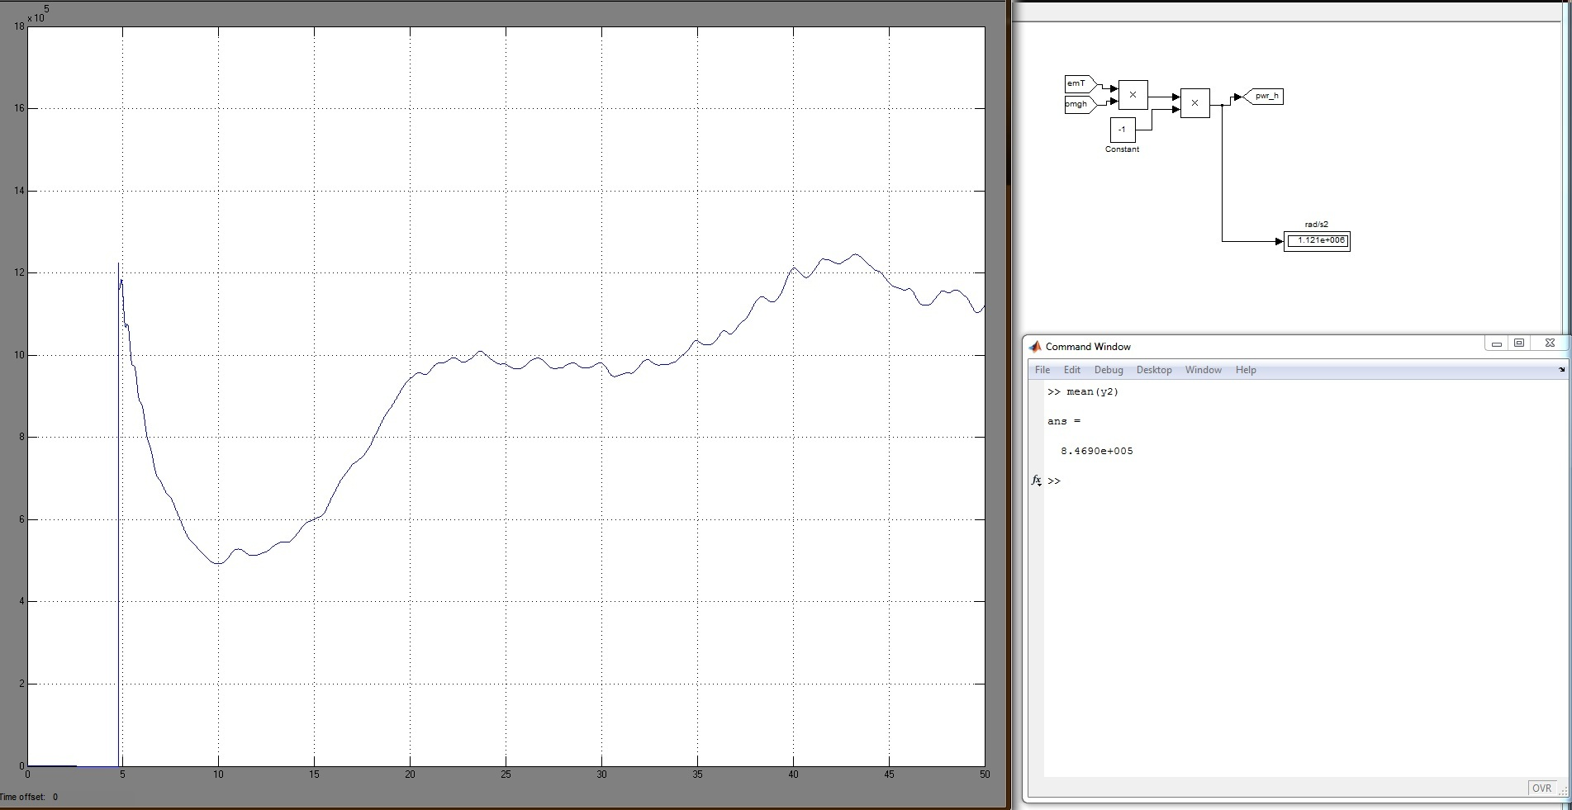
P_{avg} FOR K_{p}=280: 0.8469MW
POWER
(MW)
TIME(Secs)

Slide 30
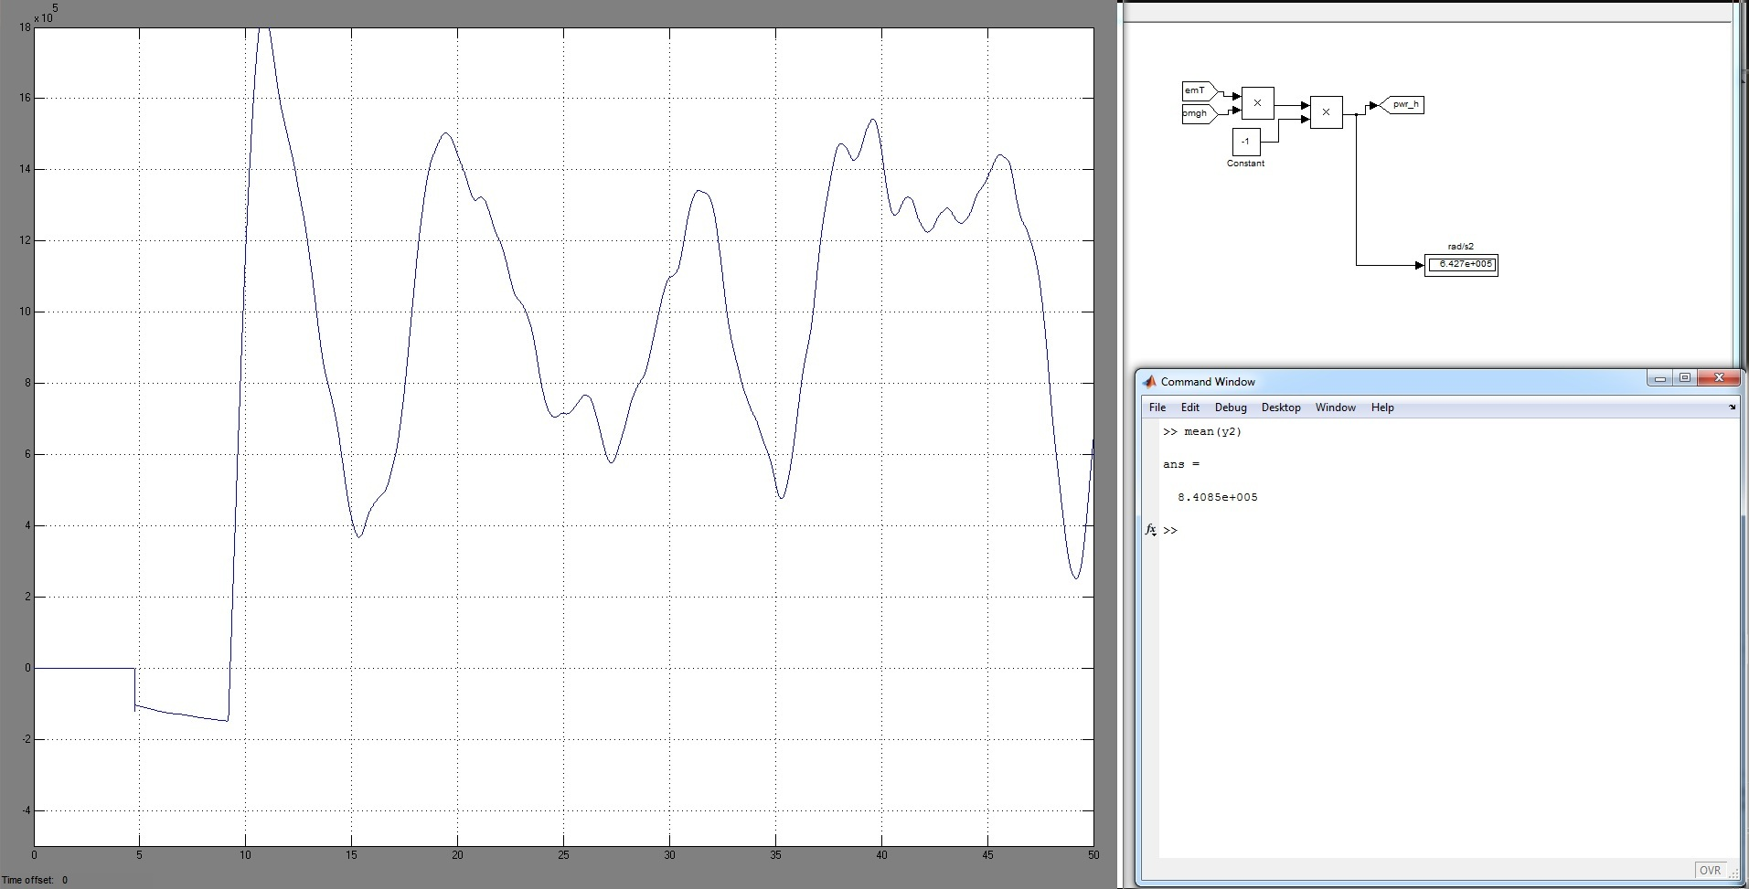
P_{avg} FOR K_{p}=682: 0.8408MW
POWER
MW
TIME(Secs)

Slide 31
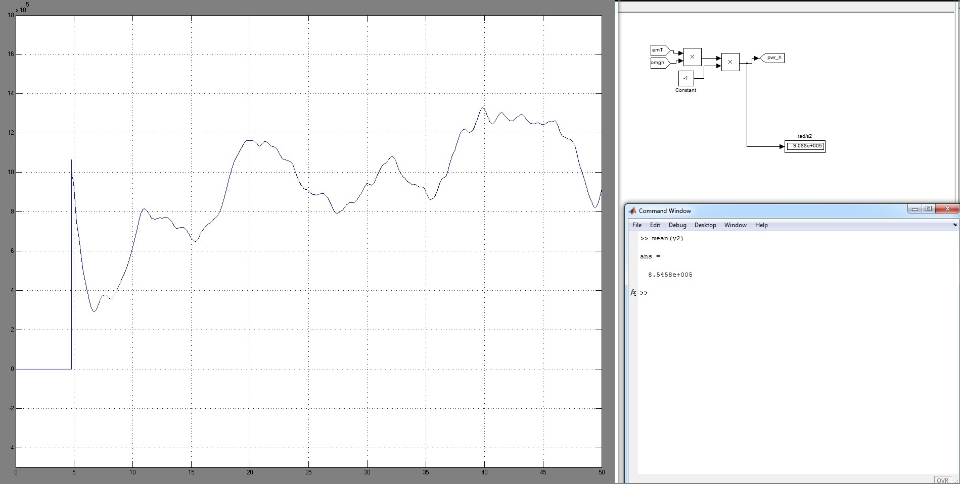
P_{avg} FOR K_{p}=537.2: 0.85458MW (FINE TUNED)
POWER
MW
TIME(Secs)

Slide 32
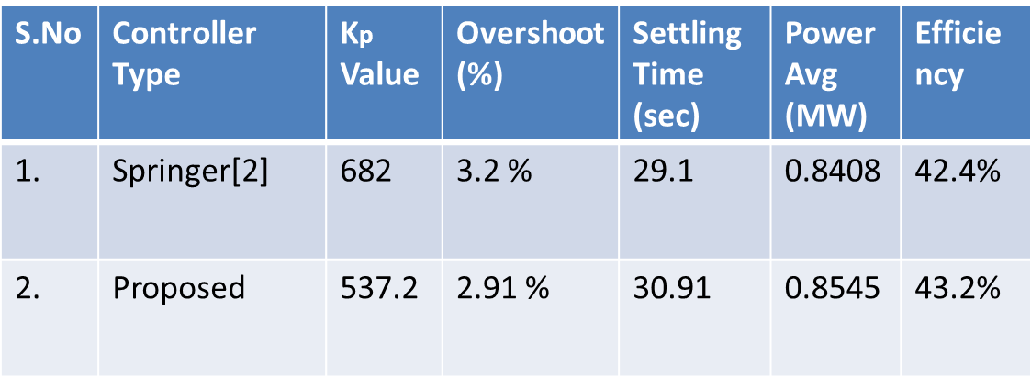
PROJECT OUTCOME
PROPOSED CONTROLLER VALUES IMPROVE EFFICIENCY BY 0.8%
PAPER PRESENTED IN AN INTERNATIONAL CONFERENCE

Slide 33
HARDWARE – SPEED CONTROL APPLICATION
CONTROLLER SPECIFICATION
Controlling input | 0-5Volts dc.
Output | 0-220V ac
Mains Supply | 230V AC @ 50Hz
Output Load Current Max. | 5Amps @ 220V AC
Power Supply | Built-in Power Supply, 12 volts,+5volts

Slide 34
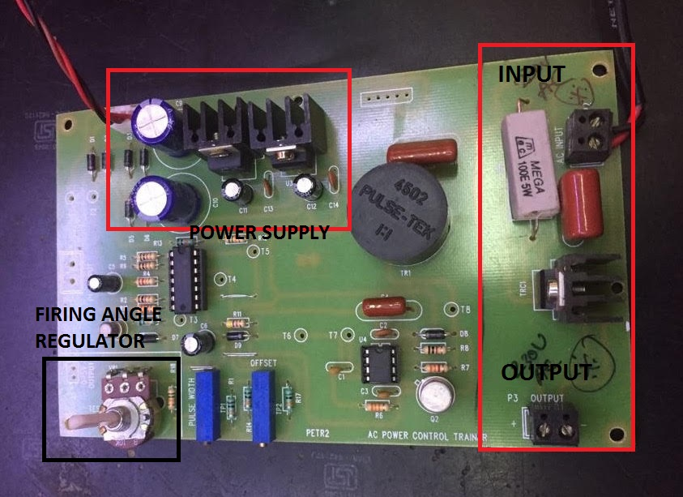
CONTROLLER

Slide 35
DYNAMO SPECIFICATIONS
MOTOR SPECIFICATIONS
RATED VOLTAGE | 24 V
NO LOAD CURRENT | 0.60 A
NO LOAD SPEED | 4400 RPM
ON LOAD CURRENT | 5 A
ON LOAD SPEED | 3550 RPM
RATED OUTPUT | 73W
RATED VOLTAGE | 220 V
RATED SPEED | 5000 RPM
FREQUENCY | 50/60 HZ
RATED POWER | 120 W

Slide 36
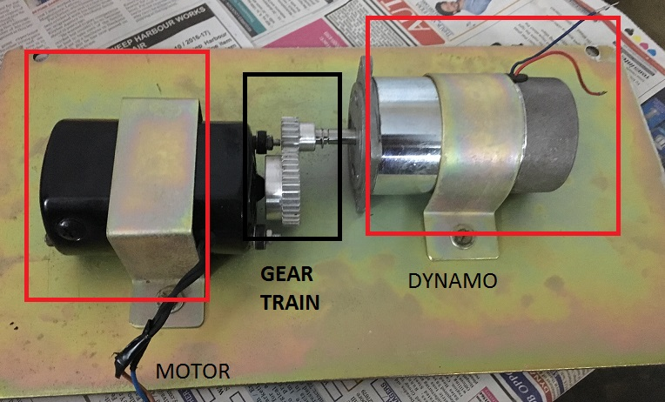
HARDWARE – DYNAMO SET

Slide 37
OUTPUT - TABULATION
FIRING ANGLE | RPM | VOLTAGE {V} | CURRENT {A} | POWER OUTPUT {W}
30 | 300 | 4 | 0.12 | 0.44
60 | 500 | 8 | 0.2 | 1.68
90 | 700 | 13 | 0.29 | 3.77
180 | 900 | 15 | 0.35 | 5.25
270 | 1100 | 17 | 0.42 | 7.31

Slide 38
REFERENCES
[1] Betz A (1926) Wind energy and its use by wind-mills (Wind-Energie und ihre Ausnutzung durch Windmühlen). Vandenhoek & Ruprecht, Göttingen
[2] Optimal Control Of Wind Energy Systems, Towards a global Approach,
Springer, 2008. 2nd Edition
[3] Akhmatov V (2003) Analysis of dynamic behaviour of electric power systems with large amount of wind power. Ph.D. Thesis, Technical University of Denmark, Denmark
[4] PID Controllers, Theory, Design and Tuning, K.Astrom and T. Hagglund,
2nd Edition
[5] Lubosny Z (2003) Wind turbine operation in electric power systems. Springer, Berlin Heidelberg New-York
[6] Hofmann W, Thieme A, Dietrich A, Stoev A (1997) Design and control of a wind power station with double fed induction generator. In:
Proceedings of EPE ’97, pp 2723-2728
[7] Burton T, Sharpe D, Jenkins N, Bossanyi E (2001) Wind energy handbook. John Wiley & Sons, New-York
[8] Ekelund T (1997) Modeling and linear quadratic optimal control of wind turbines. Ph.D. Thesis, Chalmers University of Göteborg, Sweden
[9] Krause PC, Wasynczuk O, Sudhoff SD (2002) Analysis of electric machinery and drive systems, 2nd edition. Wiley-IEEE Press

