Slide 1
Website Style Guide
A guide to the style choices for my portfolio website

Slide 2
Website Overview
This website will serve as a platform to showcase my artwork to the world. My goal is for it to function not only as a portfolio but also as a creative space where others can view, appreciate, and engage with my work. I want visitors, especially other artists to be able to comment on and like my art, helping me identify my strengths, such as character design, and continue growing as an artist.
Purpose Statement
The purpose of this website is to represent my identity as an artist by providing a space where my work can be displayed, critiqued, and shared with others.

Slide 3
Audience
Aspiring digital artists seeking inspiration
Potential collaborators or clients in animation
Art enthusiasts who enjoy stylized character design

Slide 4

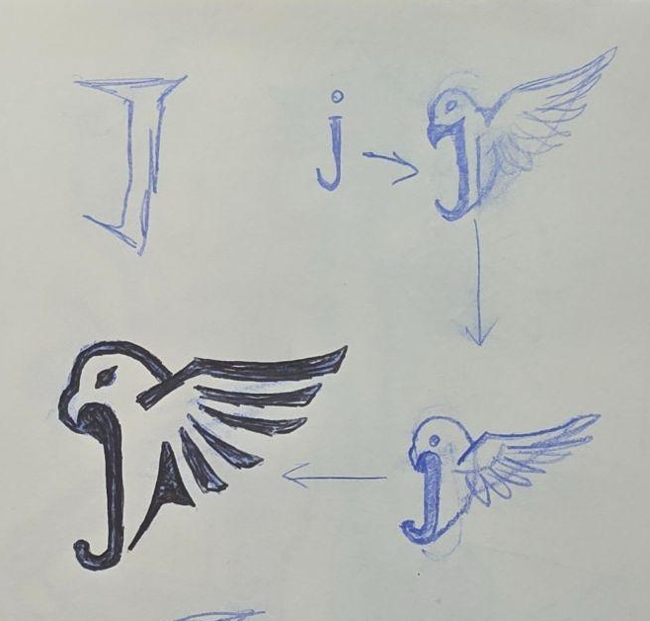
Logo
j

Slide 5









Slide 6
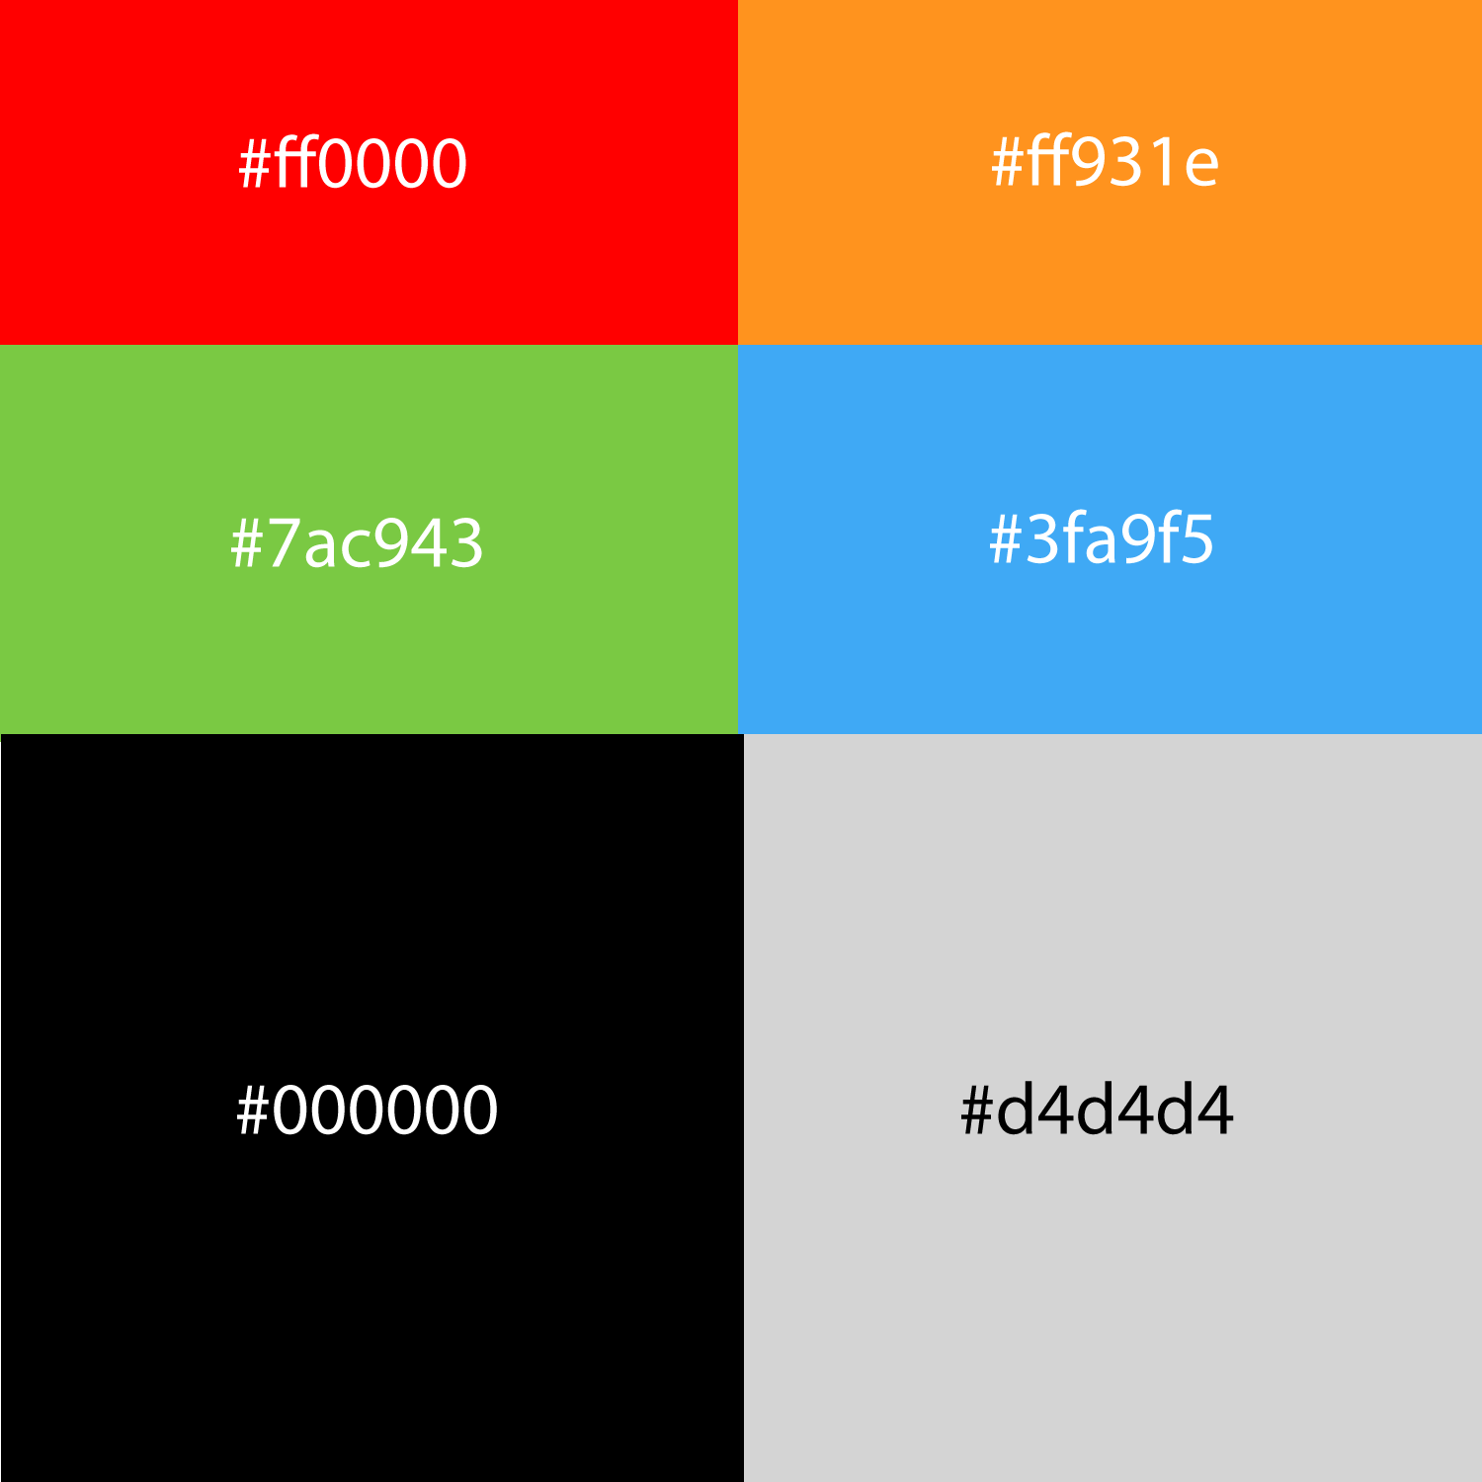
Color Palate
To incorporate the uniqueness of the logo and its colors, I implemented the colors into the websites color palate to introduce a more harmonious color choice.
The Main colors are simple using black white and grey for backround and navegation colors throughout the website, but it is complimented by four bright colors that break the greyscale of the website making it fun to look at.

Slide 7
Site’s Grid

Slide 8
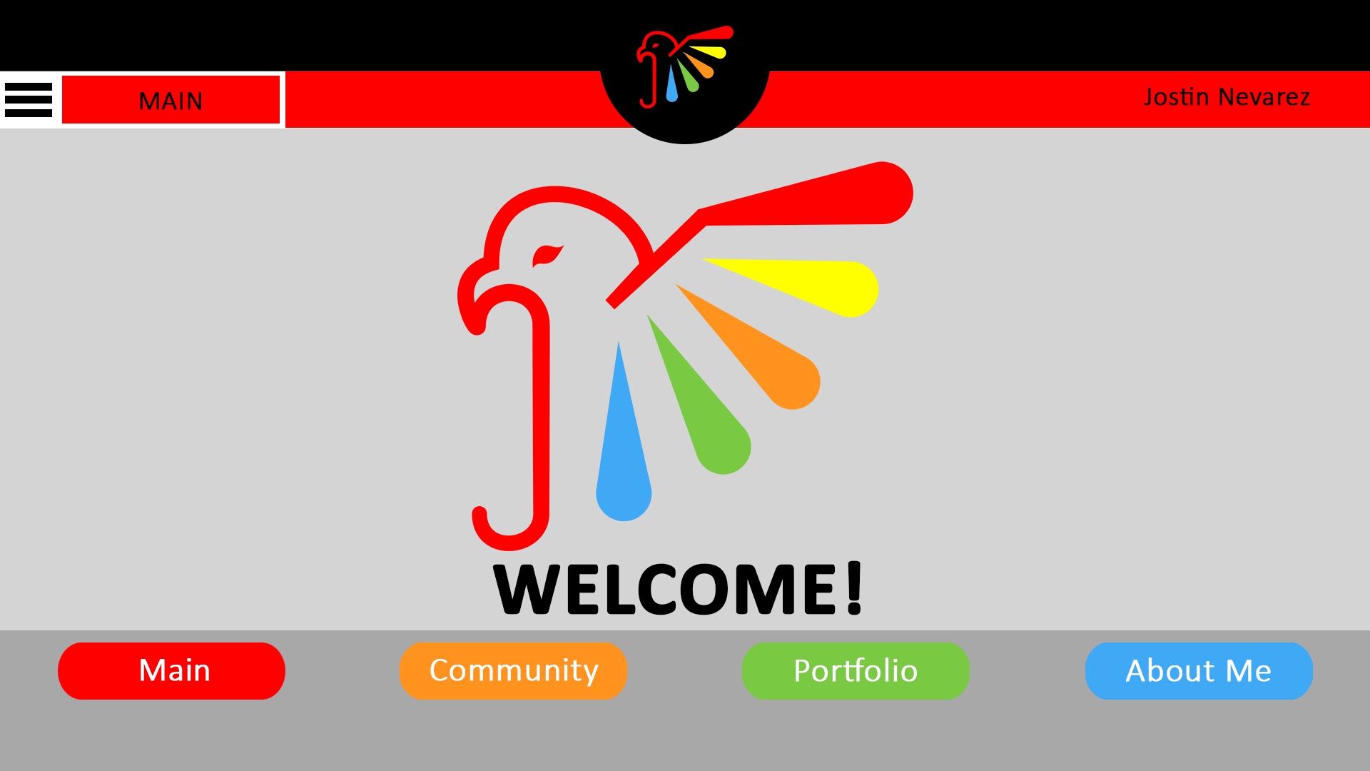

Slide 9
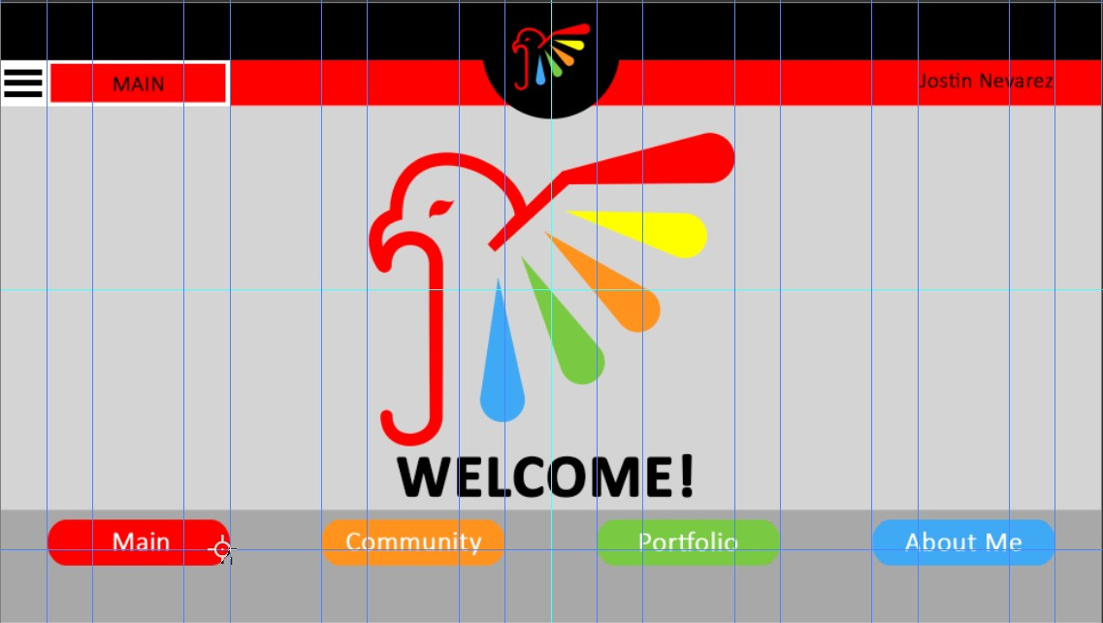

Slide 10
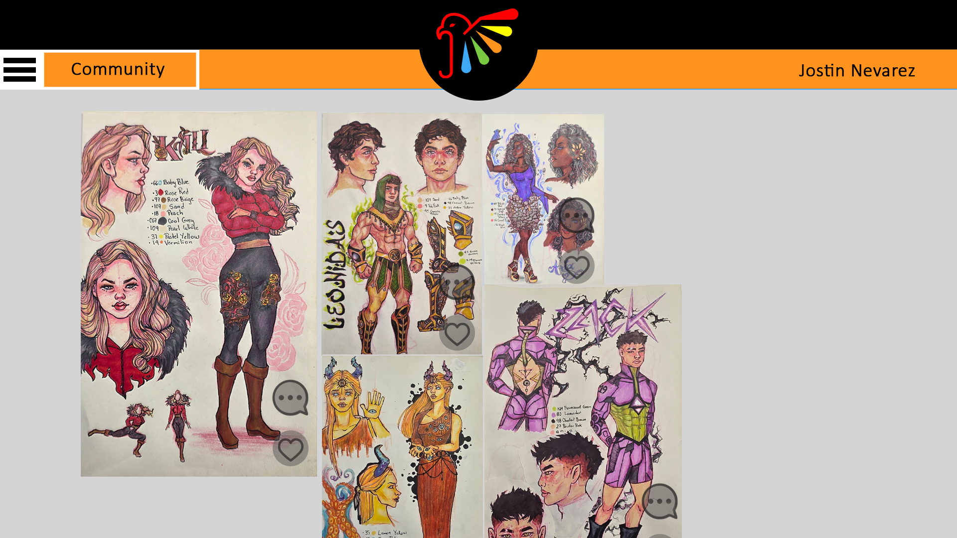

Slide 11
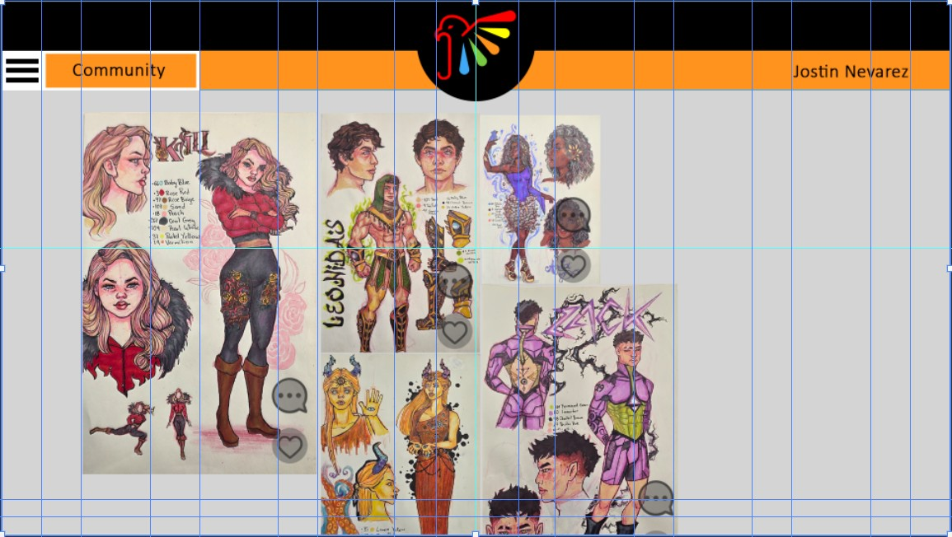

Slide 12
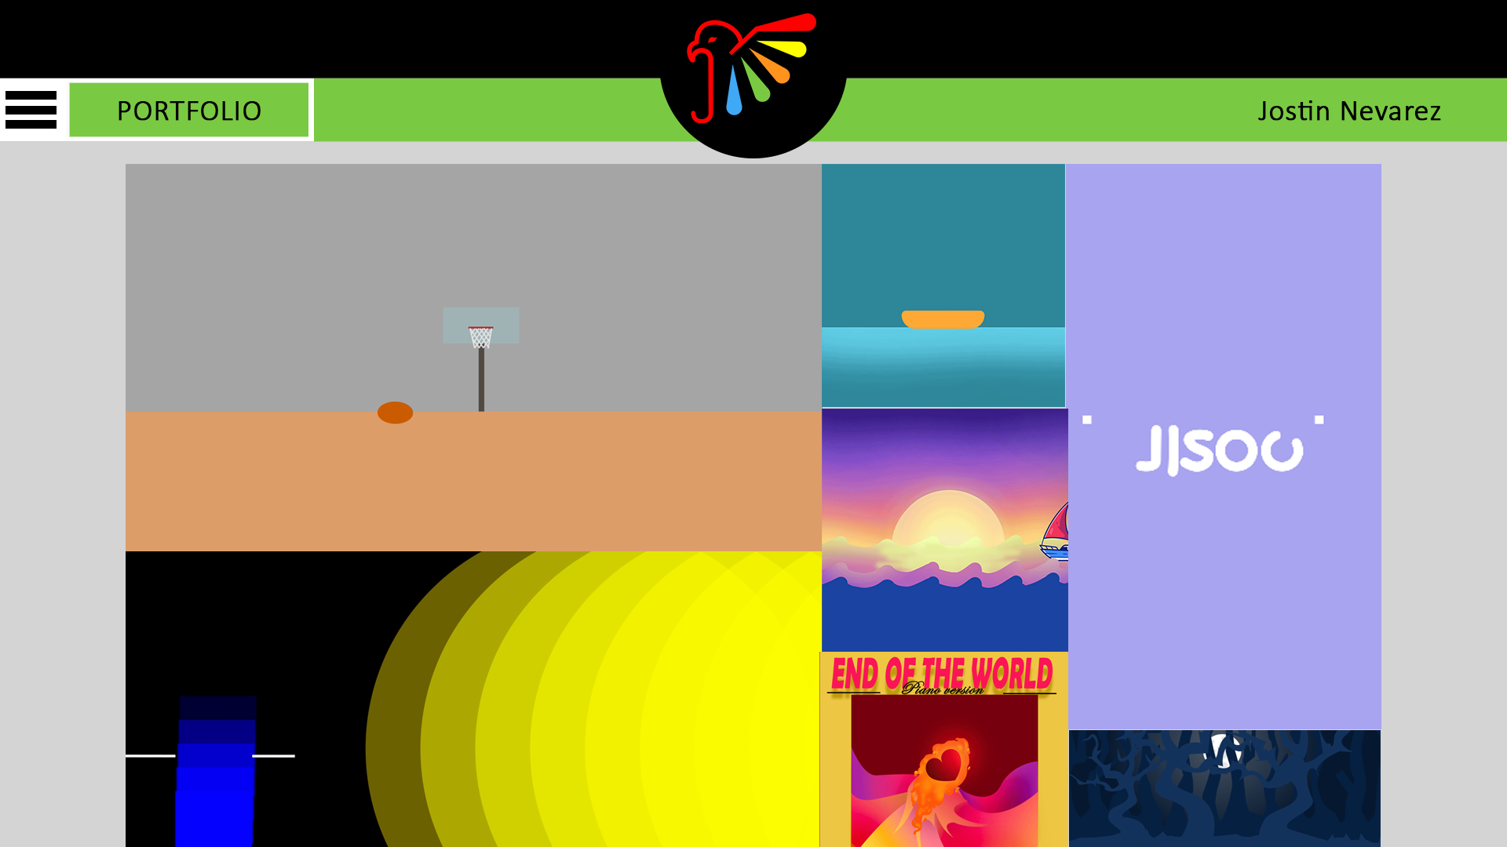

Slide 13


Slide 14
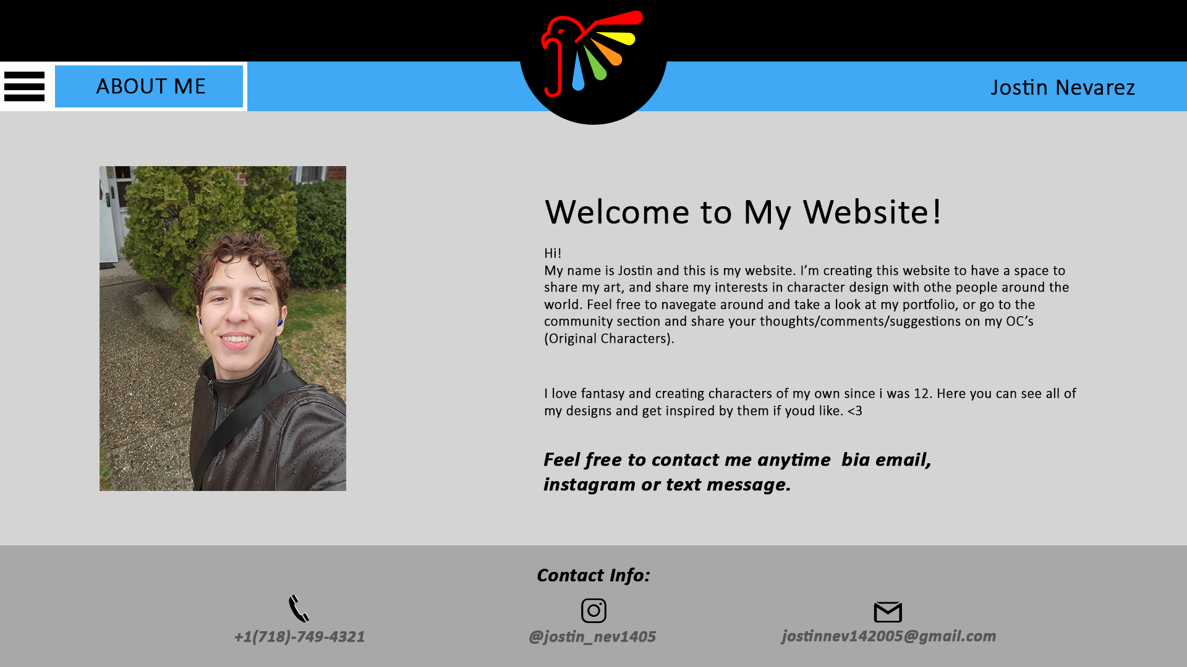

Slide 15
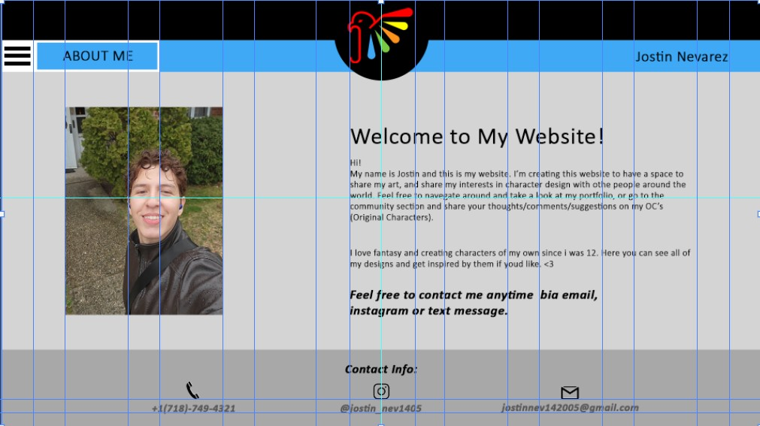

Slide 16
Typography
H1: Calibri Bold, 106px
H2: Calibri Light, 56px
H3: Calibri light, 38px
B1: Calibri light, 23px
B2: Calibri Bold Italic, 33px

Slide 17
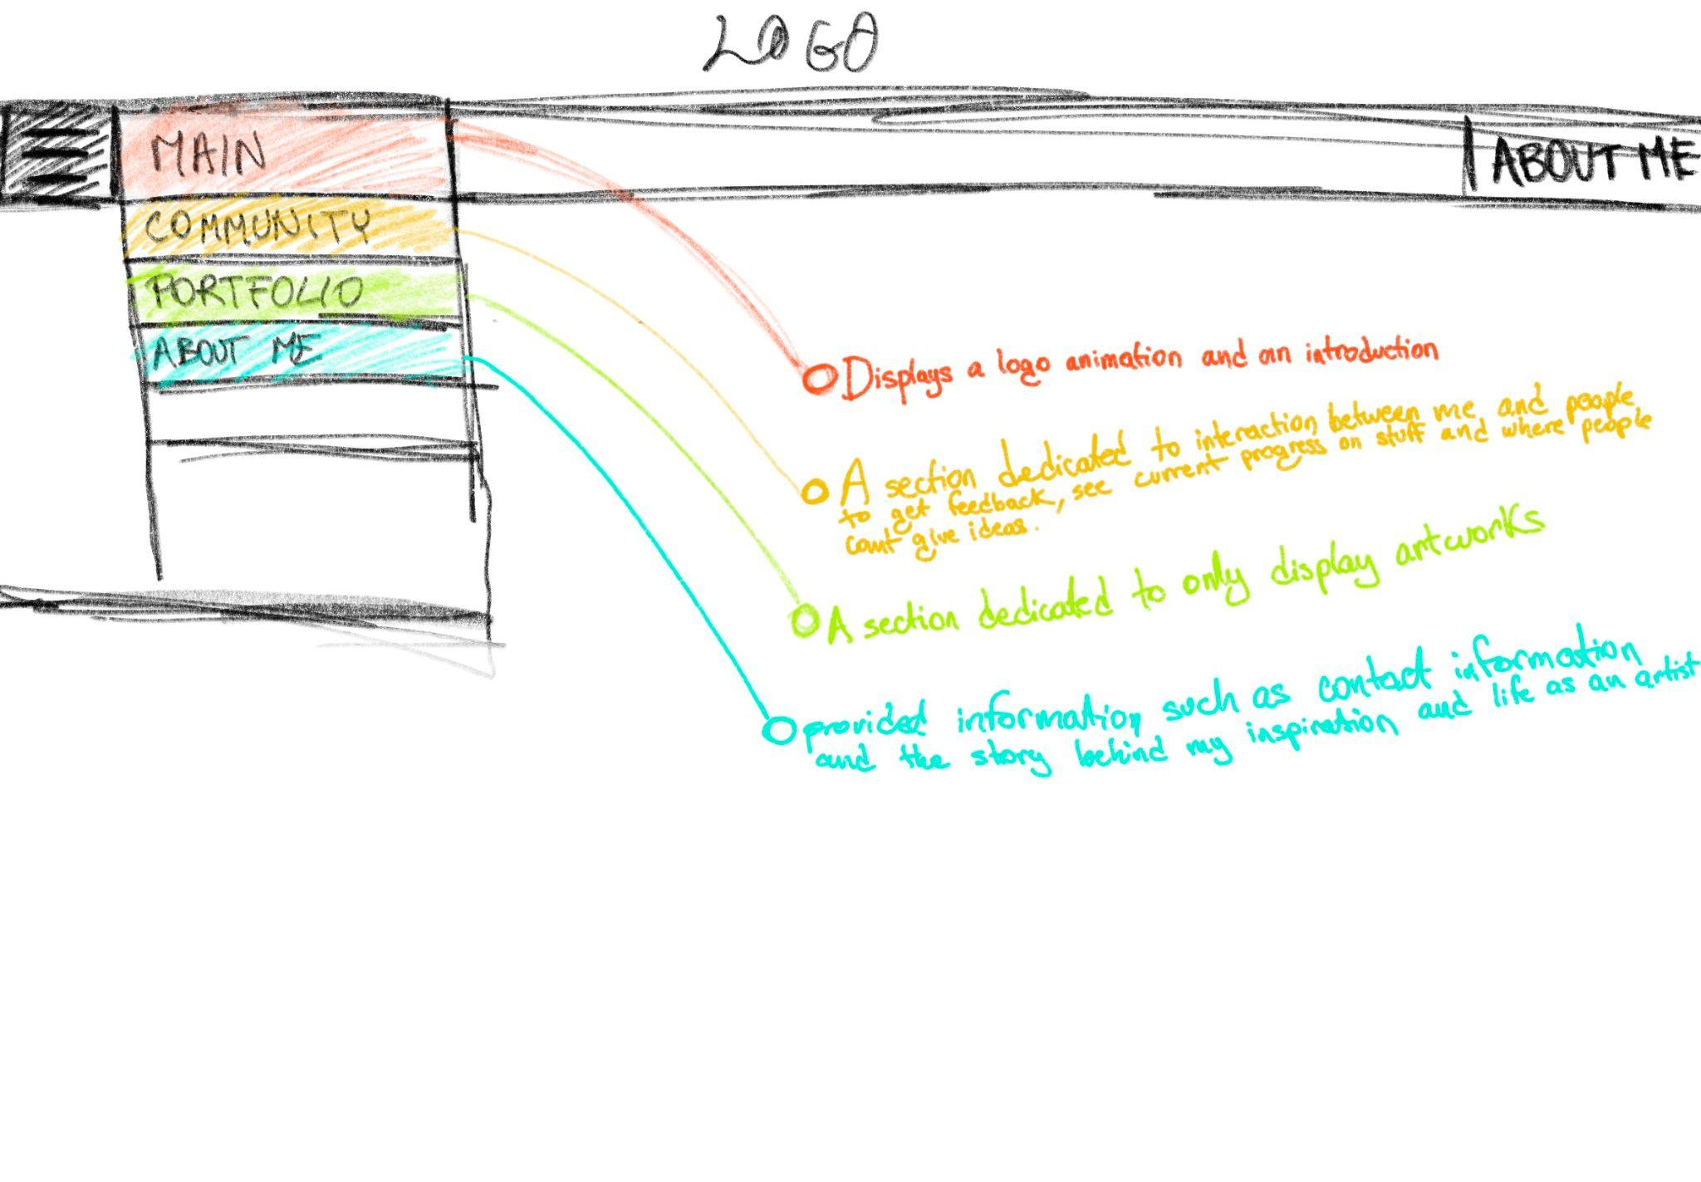
Site Elements and Asset Rules

