Slide 1
TELCO / CUSTOMER CHURN ANALYSIS
Target retention efforts where
churn is most concentrated
Management presentation | Evidence, recommendation and proposed pilot
7,043
26.54%
50.98%
73.49%
customer records
observed churn
billing exposure in key segment
observed churn in priority group
Source: IBM Telco Customer Churn sample data • Findings describe historical records; no pilot has been run

Slide 2
TELCO / CUSTOMER CHURN ANALYSIS
EXECUTIVE RECOMMENDATION
Approve a controlled retention pilot, not a company-wide roll-out
Focus on the segment supported by the analysis; test whether proactive support makes a measurable difference.
EVIDENCE
DECISION REQUEST
Authorise the design of a limited proactive-support pilot
73.49%
50.98%
42.71%
narrow group churn
billing exposure share
monthly-contract churn
341 of 464 records
monthly + high charge
1,655 of 3,875
Target customers with monthly contracts, 0–12 months of tenure and monthly charges above 80.
WHAT IS NOT YET PROVEN
The data identifies where to focus, but it does not show why customers cancel or whether the proposed intervention will work.
Before launch: confirm current eligibility, sample size, budget and evaluation criteria.
Approval now = pilot preparation. Full roll-out depends on measured outcomes and costs.
IBM Telco Customer Churn sample data • Historical analysis; pilot proposed, not implemented
02

Slide 3
TELCO / CUSTOMER CHURN ANALYSIS
THE BASELINE
More than one in four historical customer records were churned
The overall share is a dataset observation — it is not a monthly or annual churn rate.
26.54%
CUSTOMER STATUS
Observed churn
26.54% churned
73.46% non-churned
1,869 of 7,043 customer records
1,869 recorded cancellations
5,174 recorded non-churned
IMPLICATION
Prioritise the groups where cancellations are concentrated, rather than treating every customer as equally at risk.
IBM Telco Customer Churn sample data • Historical analysis; pilot proposed, not implemented
03

Slide 4
TELCO / CUSTOMER CHURN ANALYSIS
CUSTOMER SEGMENTATION
Month-to-month contracts have the highest observed churn: 42.71%
Contract type stands out, but a contract change is not proven to prevent cancellation.
OBSERVED CHURN BY CONTRACT TYPE
1,655
Month-to-month
42.71%
recorded churned customers on month-to-month contracts
One year
11.27%
Two years
2.83%
That is 88.6% of all 1,869 churned records.
IBM Telco Customer Churn sample data • Historical analysis; pilot proposed, not implemented
04

Slide 5
TELCO / CUSTOMER CHURN ANALYSIS
CUSTOMER SEGMENTATION
Short tenure and higher charges point to further retention priorities
Both patterns are observed associations, not evidence of the reasons for cancellation.
CHURN BY TENURE
CHURN BY MONTHLY CHARGE BAND
0–12 months
47.44%
High (>80)
33.98%
13–36 months
25.54%
Medium
29.53%
37–72 months
11.93%
Low (<40)
11.59%
First-year customers: 1,037 recorded cancellations
High-charge customers: 906 recorded cancellations
IBM Telco Customer Churn sample data • Historical analysis; pilot proposed, not implemented
05

Slide 6
TELCO / CUSTOMER CHURN ANALYSIS
BILLING EXPOSURE
One combined segment accounts for 50.98% of churn-associated billing
Month-to-month, high-charge customers contribute the largest share of historical monthly billing exposure.
TOTAL HISTORICAL MONTHLY BILLING ASSOCIATED WITH CHURN
SHARE OF OVERALL CHURN-ASSOCIATED BILLING
Low
Medium
High
139,130.85
Month-to-month
3.56%
32.32%
50.98%
86.86%
One year
0.20%
2.04%
7.91%
from month-to-month contracts
Two years
0.08%
0.45%
2.46%
Amounts are billing units, not verified revenue loss.
The 50.98% cell represents all monthly, high-charge churned records, not only first-year customers.
IBM Telco Customer Churn sample data • Historical analysis; pilot proposed, not implemented
06

Slide 7
TELCO / CUSTOMER CHURN ANALYSIS
PRIORITY POPULATION
The first-year monthly, high-charge group has 73.49% observed churn
This is a narrower group than the billing-exposure segment on the previous slide.
MONTH-TO-MONTH
0–12 MONTHS’ TENURE
MONTHLY CHARGES >80
464 HISTORICAL CUSTOMER RECORDS
73.49%
341 churned · 73.49%
123 non-churned
Observed segment churn
341 of 464 customers in this historic segment were labelled churned.
Historical non-churned ≠ confirmed currently active
CRM must verify up-to-date customer status and eligible numbers before any contact.
IBM Telco Customer Churn sample data • Historical analysis; pilot proposed, not implemented
07

Slide 8
TELCO / CUSTOMER CHURN ANALYSIS
STATISTICAL EVIDENCE
The same churn patterns remain visible in statistical tests and modelling
Significant associations support prioritisation, but do not establish causes.
HYPOTHESIS TESTS
ADJUSTED ODDS RATIOS
H1 · Contract type
p < 0.001
Monthly vs two-year
7.10×
Cramér’s V = 0.4101
One-year vs two-year
2.36×
H2 · Customer tenure
p < 0.001
Rank-biserial r = −0.4797
Tenure (+12 months)
0.66×
H3 · Monthly charges
p < 0.001
Rank-biserial r = +0.2416
Charges (+10 units)
1.34×
Odds ≠ probability. Predictors were adjusted for the other included model variables.
IBM Telco Customer Churn sample data • Historical analysis; pilot proposed, not implemented
08

Slide 9
TELCO / CUSTOMER CHURN ANALYSIS
MODEL VALIDATION
The model ranks historical churn reasonably well, but is not ready for live use
The logistic regression used contract type, tenure and monthly charges on a held-out sample of 1,409 customers.
RANKING PERFORMANCE ACROSS THRESHOLDS
80 / 20
ROC-AUC
0.8239
Stratified train / test split
Chance level: 0.50
Average Precision
Test sample
0.5978
1,409
Churn prevalence: 0.2654
Not assessed on later customer periods; calibration and operational value remain unverified.
IBM Telco Customer Churn sample data • Historical analysis; pilot proposed, not implemented
09

Slide 10
TELCO / CUSTOMER CHURN ANALYSIS
CLASSIFICATION TRADE-OFF
Threshold 0.40 catches 55 more churners — but adds 82 false alerts
Lowering the threshold improves recall while reducing precision. The best threshold depends on intervention costs.
CLASSIFICATION RESULTS
CONFUSION MATRIX · THRESHOLD 0.40
Metric
Default 0.50
Selected 0.40
Predicted no
Predicted yes
Accuracy
77.71%
75.80%
Actual no
830
205
Precision
59.80%
53.72%
Recall
48.93%
63.64%
Actual yes
136
238
F1-score
53.82%
58.26%
1,068 correct · 341 errors · 1,409 tested
The model is not deployed.
IBM Telco Customer Churn sample data • Historical analysis; pilot proposed, not implemented
10

Slide 11
TELCO / CUSTOMER CHURN ANALYSIS
RECOMMENDED INTERVENTION
Pilot proactive support with a verified priority population
Test a specific service intervention before considering longer contracts, discounts or broader roll-out.
01
02
03
IDENTIFY
TEST
COMPARE
CRM confirms current customers meeting the three segment rules.
Offer structured service check-ins, issue resolution and follow-up.
Compare subsequent cancellations with business-as-usual support.
OWNER CRM + Data Analytics
OWNER Customer Service
OWNER Data Analytics + Finance
NOT RECOMMENDED YET
Blanket discounts or an immediate company-wide roll-out: neither is supported by tested commercial evidence.
IBM Telco Customer Churn sample data • Historical analysis; pilot proposed, not implemented
11

Slide 12
TELCO / CUSTOMER CHURN ANALYSIS
PILOT MEASUREMENT
Scale only if the intervention reduces churn at a worthwhile cost
An illustrative 90-day observation window would need to be confirmed against the provider’s cancellation cycle and sample size.
TEST DESIGN
SUCCESS MEASURES
RANDOM ASSIGNMENT IF FEASIBLE
01
Cancellation-rate difference
Comparison churn rate minus intervention churn rate
Intervention
Comparison
Proactive check-in
Usual support
02
Completed check-in rate
Completed check-ins / all assigned intervention customers
Compare by original assignment — including customers not reached.
03
Net incremental value
Extra contribution attributable to retention minus added costs
Final go / no-go requires a pre-agreed budget and a credible effect estimate.
IBM Telco Customer Churn sample data • Historical analysis; pilot proposed, not implemented
12

Slide 13
TELCO / CUSTOMER CHURN ANALYSIS
DECISION AND SAFEGUARDS
Approve pilot preparation now; decide on expansion only after evaluation
The historical evidence is strong enough to identify where to test, not to promise a financial return.
MANAGEMENT TO AUTHORISE
DECISION RULE
Confirm up-to-date CRM eligibility and customer-contact permissions
EXPAND
Credible churn reduction and positive net value
1
Approve feasible sample, intervention process and pilot budget
2
REVISE
Uncertain outcomes or correctable delivery problems
Agree cancellation, cost and commercial evaluation criteria
3
No worthwhile effect, excessive cost or harm
STOP
Limits: unknown observation period · causes of churn unverified · billing exposure ≠ confirmed loss · no intervention completed
IBM Telco Customer Churn sample data • Historical analysis; pilot proposed, not implemented
13

Slide 14
TELCO / CUSTOMER CHURN ANALYSIS
CONCLUSION & MANAGEMENT DECISION
A targeted retention pilot is the next step before wider investment
The analysis identifies who to prioritise; a controlled pilot must establish whether proactive support works.
42.71%
Month-to-month churn
73.49%
Priority-group churn
50.98%
Historical billing share
Observed churn in monthly-contract customers
First-year + monthly contract + high charges
Monthly contract + high charges (wider group)
DECISION REQUEST
Approve preparation of a controlled proactive-support pilot for verified eligible customers.
NEXT STEPS
01
Validate eligibility
02
Test against a comparison group
03
Assess impact and costs
04
Expand, revise or stop
Important: historical associations do not establish causation, saved revenue or a successful intervention.
IBM Telco Customer Churn sample data • Historical analysis; pilot proposed, not implemented
14

Slide 15
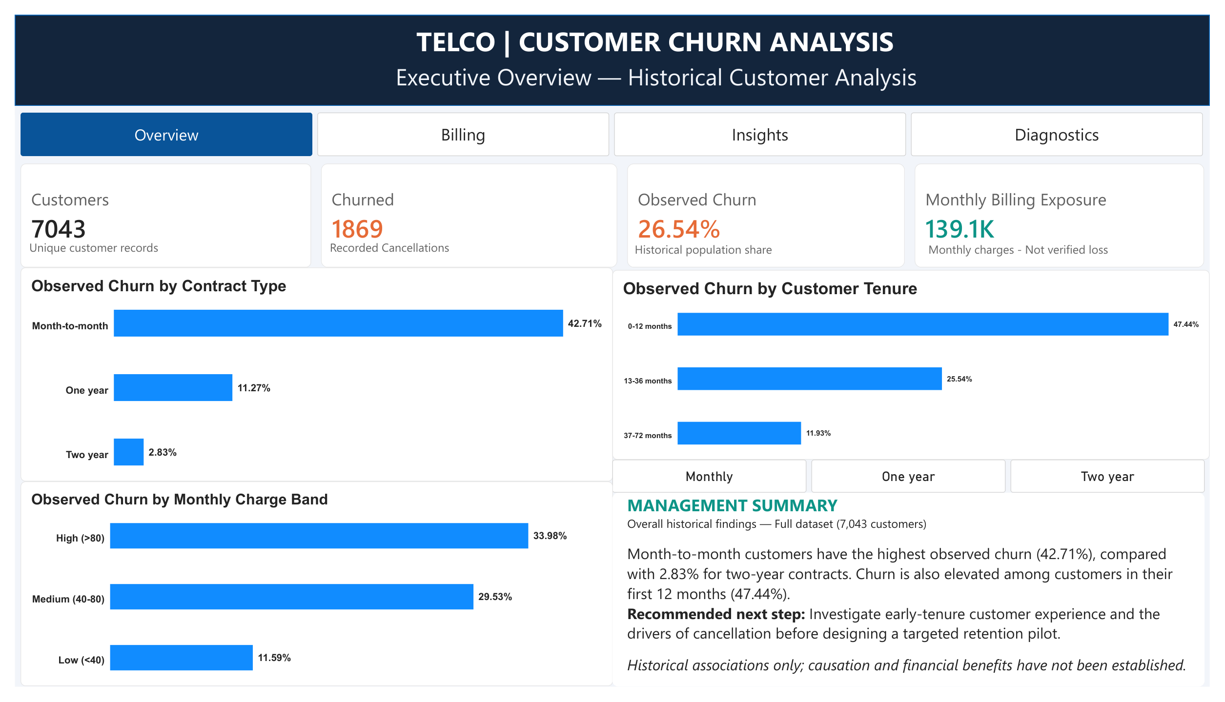
APPENDIX / POWER BI EVIDENCE
Executive Overview
Source: updated four-page Power BI export • historical sample data

Slide 16
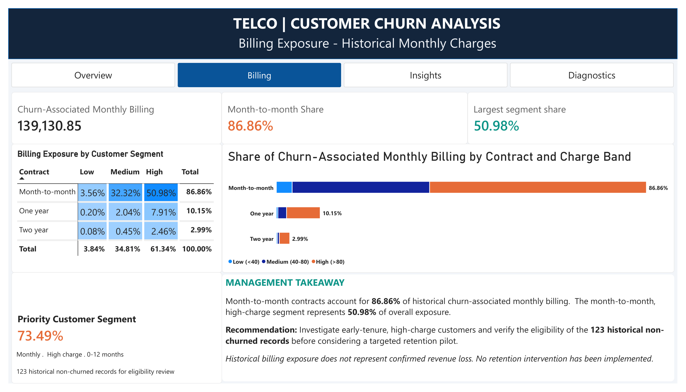
APPENDIX / POWER BI EVIDENCE
Billing Exposure
Source: updated four-page Power BI export • historical sample data

Slide 17
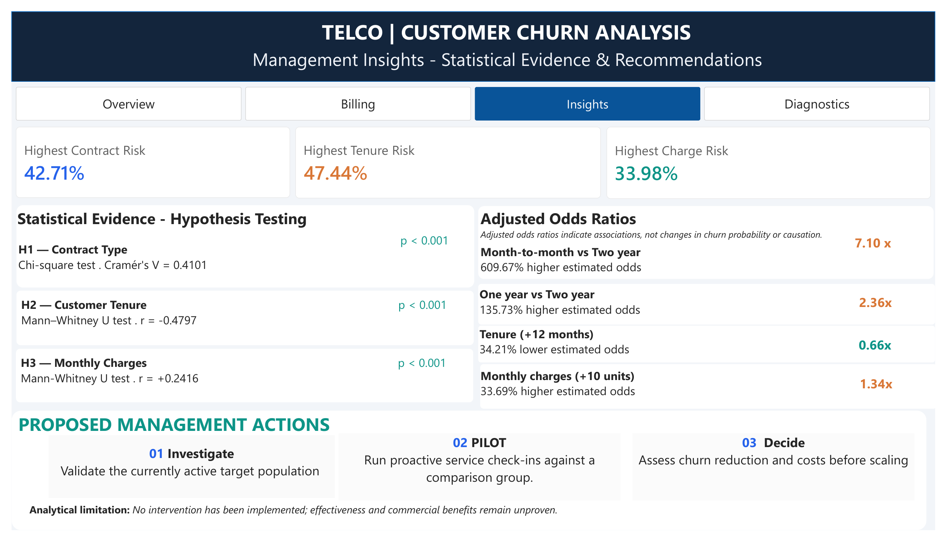
APPENDIX / POWER BI EVIDENCE
Management Insights
Source: updated four-page Power BI export • historical sample data

Slide 18
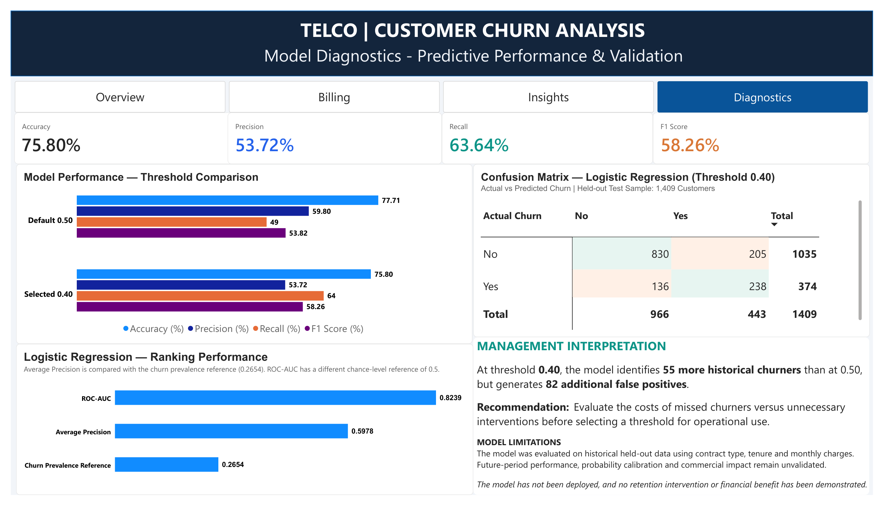
APPENDIX / POWER BI EVIDENCE
Model Diagnostics
Source: updated four-page Power BI export • historical sample data

