Slide 1
VALENCIA COLLEGE
Department of Electrical & Computer Engineering Technology
EET 4910 — Senior Design Proposal
Safe Dip
A Safety-Oriented Hot-Dip Pick-and-Place System
Submitted by
Josué Bouchard | Adriano Mena
Supervised by Mayra Socarras
July 31, 2026
1
Notes:
Adriano/Josue
Welcome to the presentation of Safe Dip

Slide 2


Meet the team
Originally from Argentina
B.S. E.C.E.T., Computer concentration
Laboratory aide and embedded-systems enthusiast
Interested in robotics and aerospace
Originally from Cuba
B.S. E.C.E.T., Electrical concentration
Enjoys electrical projects and hardware design
Interested in robotics and aerospace
2
Notes:
Adriano/Josue

Slide 3
Presentation Roadmap
01
Problem & Motivation
02
System Concept & Requirements
Hazards of manual hot-dip coating
Safe Dip architecture and testable requirements
03
Mechanical Design
04
Electrical & Power
Frame, axes, motors, and end effector
Power distribution, sensing, and safety systems
05
Software & Control
06
Preliminary Work & Conclusion
Cooperative architecture and cycle sequencing
Modbus TCP and stepper signal validation
3
Notes:
Adriano

Slide 4
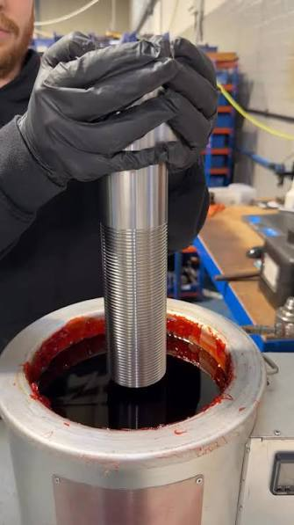
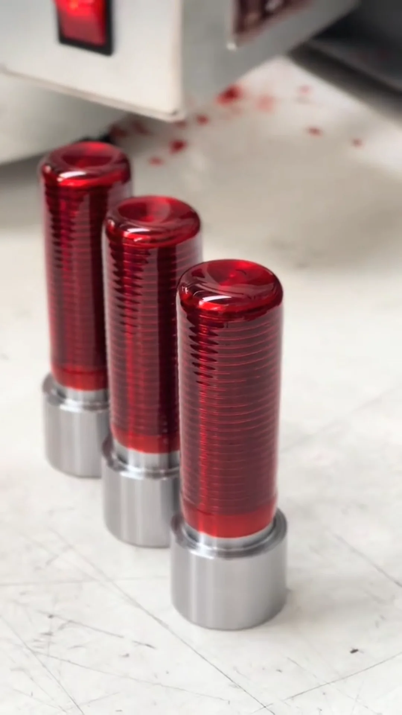
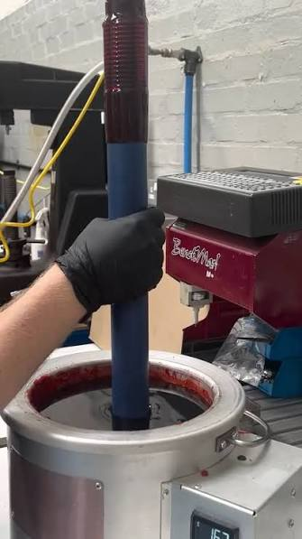
Hot Dipping
4
Notes:
Adriano

Slide 5
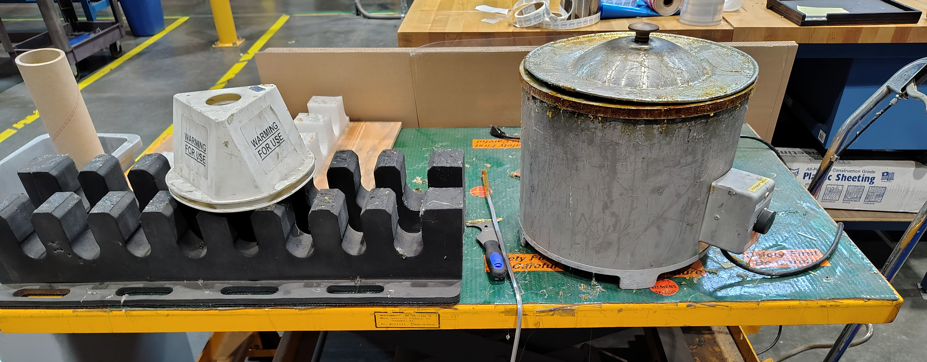
The Problem: Manual Hot-Dip Coating
Thermal Exposure
Burn & Splash Risk
Workers handle parts near molten wax or resin at elevated temperatures
Hot, viscous materials cause serious injuries from even small splashes
Repetitive Strain
Weight Limitations
Sustained repetitive motion injuries from manual dipping cycles
Tongs and clippers add physical strain beyond a few kilograms
Manual dipping remains one of the more
accident-prone tasks on the shop floor
5
Notes:
Adriano

Slide 6
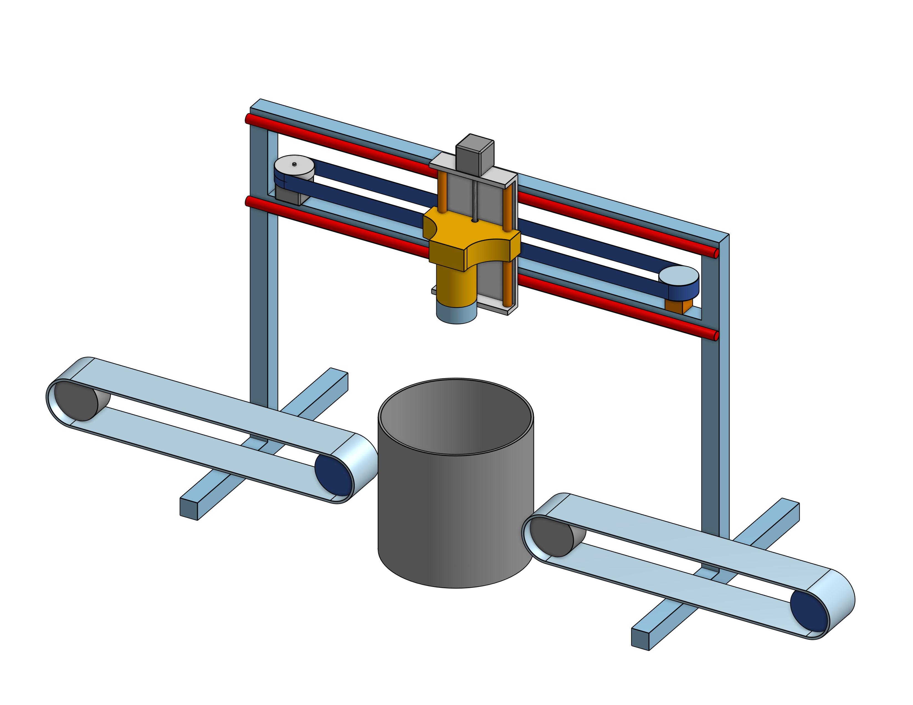
Safe Dip: System Concept
INPUT
STATION
DIPPING
BATH
OUTPUT
STATION
A two-axis Cartesian gantry that automates the pick, dip, and place cycle
→
→
Three Stations
Input, dipping bath, and output positions
Gantry beam (horizontal axis)
Safety-First
Hardwired Category 0 E-stop independent of microcontroller
Remove the Operator
Eliminates direct exposure to heat and burns
Allows for Chemical Flexibility
Same platform works with wax, resin, or any treatment chemicals
An interface will be exposed for the conveyor belts, but they are not considered part of the system
6
Notes:
Adriano

Slide 7
Similar Products: Market Gap
Product
Price
Pick & Place
Variable Dip
Chem. Flex.
Safe Dip (Ours)
~$500-$600
YES
YES
YES
EFFCO DS-250
$15k-$25k
NO
NO
YES
MS800 Tiltable
$40k-$80k
NO
NO
YES
Monorail Screw
$3k-$4k
NO
NO
Partial
Thread Coater
$20k-$30k
NO
NO
NO
Emmeti WAX-ON
$50k-$150k+
YES
YES
Partial
South Shore Dip Cell
Custom
YES
YES
YES
Safe Dip is the only system under $1,000 that combines pick-and-place, variable dip depth, and chemical flexibility
7
Notes:
Josue

Slide 8
Operational Limitations
General Limitations
Prototype-Specific Limitations
• Two-axis motion only
  Horizontal (transfer) + vertical (pick/dip/place). No rotation or lateral movement.
• Cylindrical workpieces
  Designed for cylindrical parts within specified size and payload limits.
• Ferromagnetic surface required
  Workpiece needs a clean, flat, ferromagnetic attachment area. This contact zone is not coated.
• Fixed input position
  No alignment, orientation correction, or vision-based localization.
• Max payload: 1 lb
  Validated operating range. Heavier payloads are outside the prototype's tested capacity.
• Thermal design out of scope
  Heat affects frame, wiring, sensors, motors, and lubrication. Industrial thermal design is future work.
• Focus: control & safety
  Prototype seeks to demonstrates electrical, control, sensing, comms, and orientation to safety systems.
8
Notes:
Josue

Slide 9
System Requirements (SR-01 to SR-11)
SR-01
No motion unless workpiece detected at input
SR-07
E-stop removes power from both motor drivers
SR-02
Position end effector at pickup within ±1 cm
SR-08
System stays inhibited after E-stop until reset + restart
SR-03
Retain workpiece through full cycle without dropping
SR-09
Transmit operating state and faults via comms
SR-04
Lower to immersion depth within ±1 cm
SR-10
Complete 10 consecutive cycles without failure
SR-05
Hold dwell time within ±1 s
SR-11
Full cycle with max weight of 1 lb workpiece payload
SR-06
Complete one unattended pick-dip-place cycle
Each requirement has a defined pass/fail test condition
9
Notes:
Josue

Slide 10
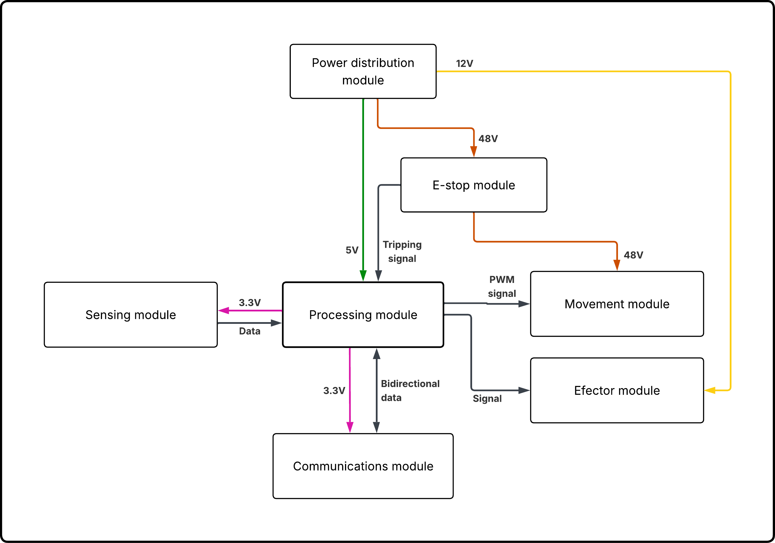
System Block Diagram
Seven Functional Modules
Power Distribution
E-Stop & Protection
Processing (MCU)
Sensing
Movement
End Effector
Communications
10
Notes:
Adriano

Slide 11
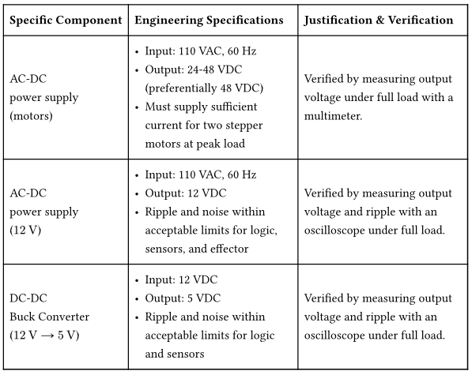
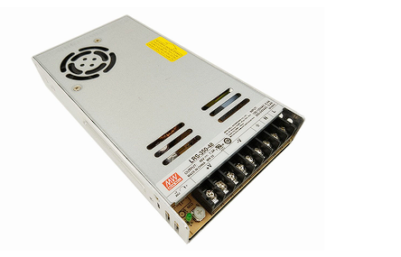
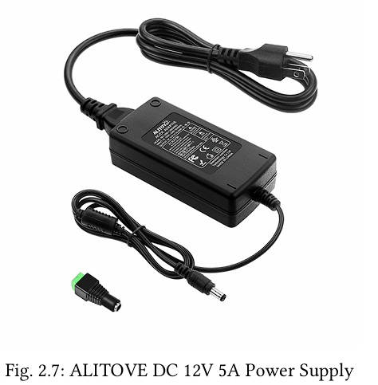
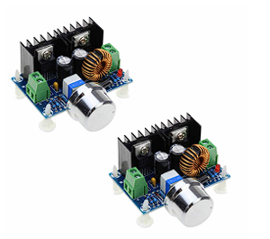
Power Distribution Specifications
Mean Well LRS-350-48 AC-DC power supply
ALITOVE DC 12V 5A Power Supply
HiLetgo buck converter
11
Notes:
Adriano

Slide 12
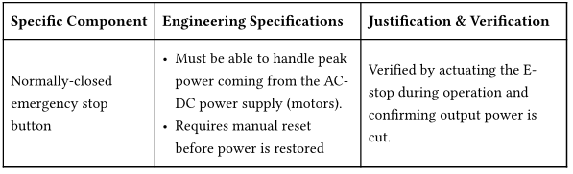
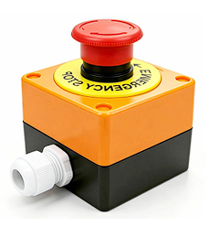
E-Stop & Protection Specifications
E-stop mushroom button
12
Notes:
Adriano

Slide 13
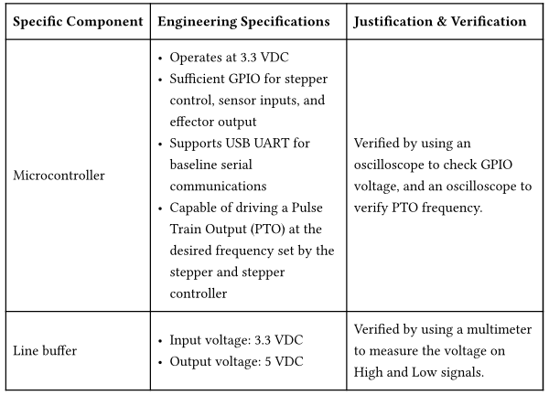
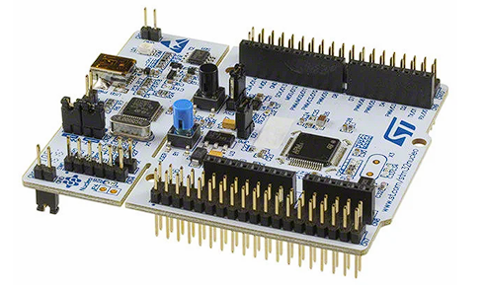
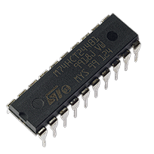
Processing Specifications
STM32 Nucleo-F446RE microcontroller board
74HCT244 Octal Buffers and Line Drivers
13
Notes:
Adriano

Slide 14
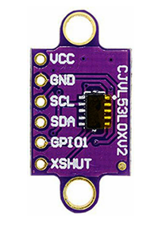
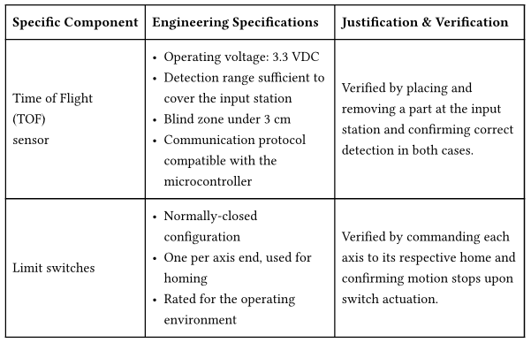
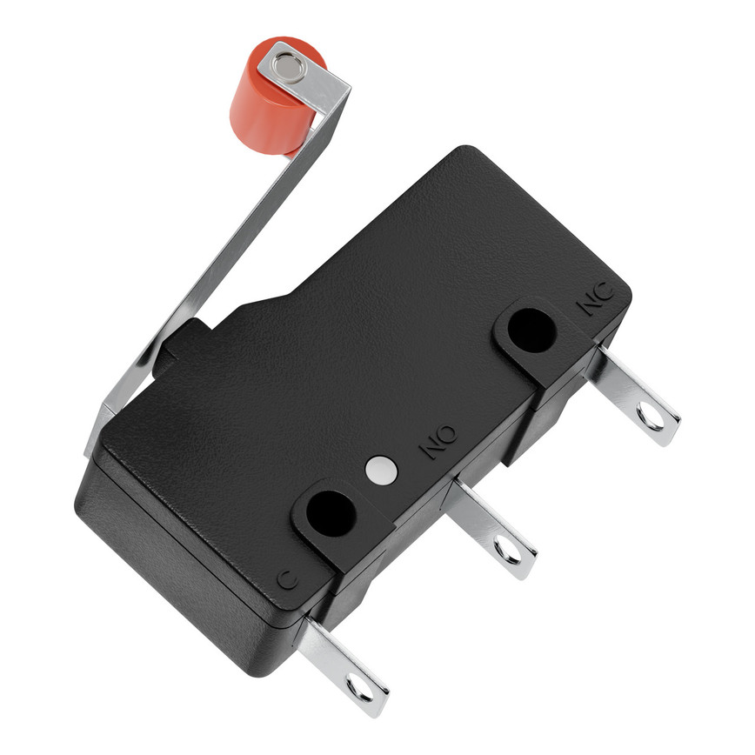
Sensing Specifications
vl53l0x ToF sensor
Limit Switch
14
Notes:
Adriano

Slide 15
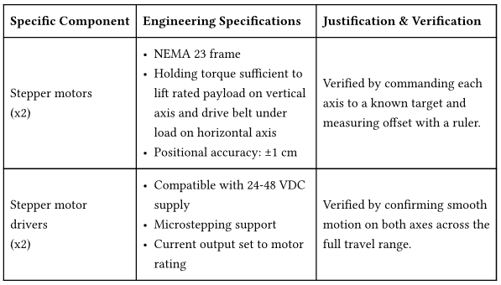
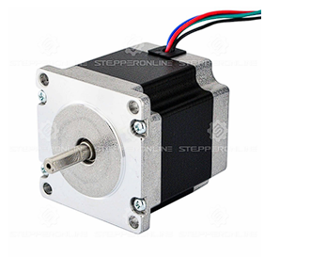
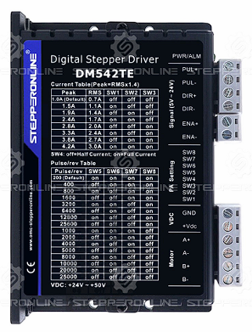
Movement Specifications
NEMA 23 23HS22-2804S stepper motor
DM542TE stepper controller
15
Notes:
Adriano

Slide 16
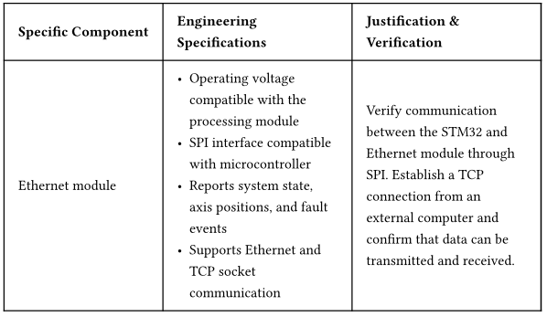
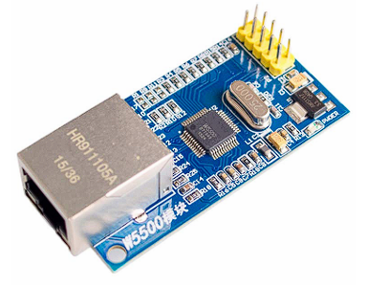
Communications Specifications
W5500 Ethernet module
16
Notes:
Adriano

Slide 17
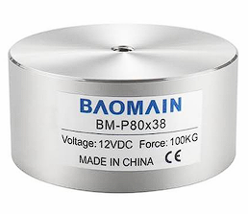
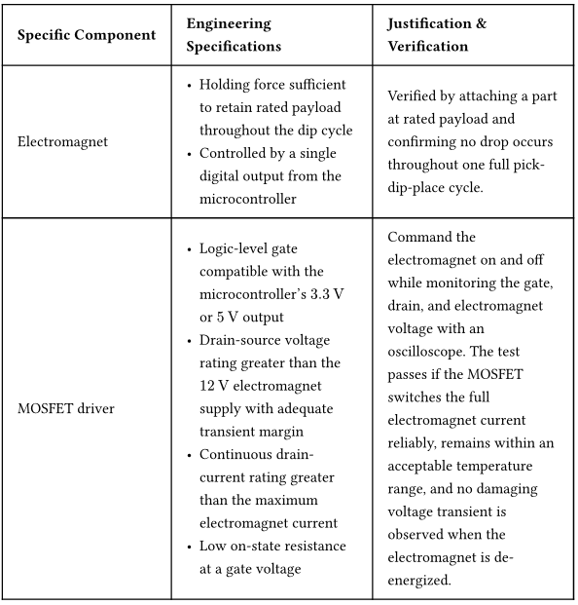
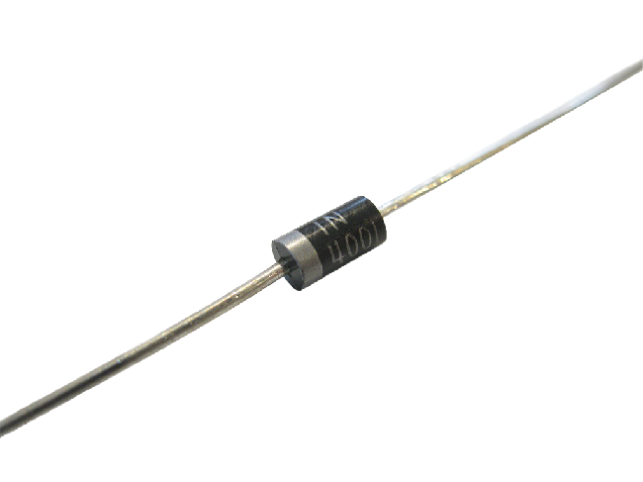
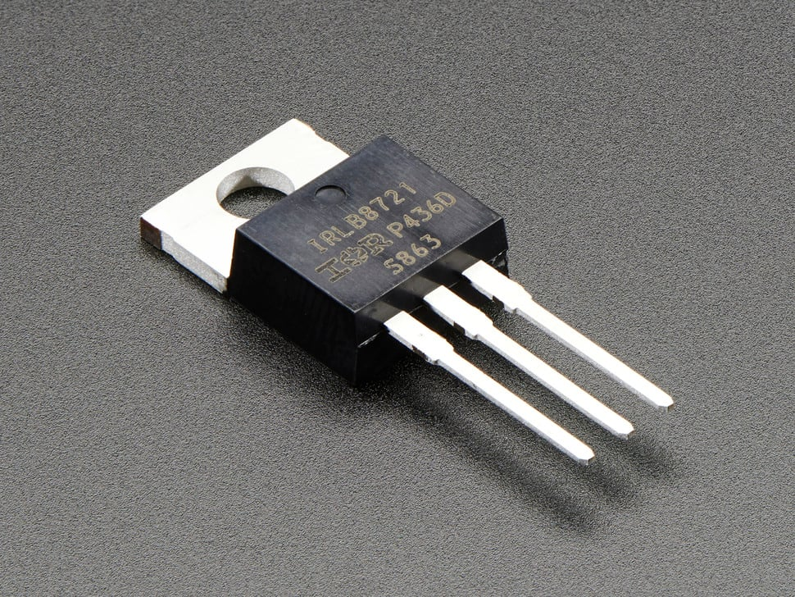
End Effector Specifications
Baomain BM-P 80-38 electromagnet
1N4007 Flyback Diode
MOSFET
17
Notes:
Adriano

Slide 18
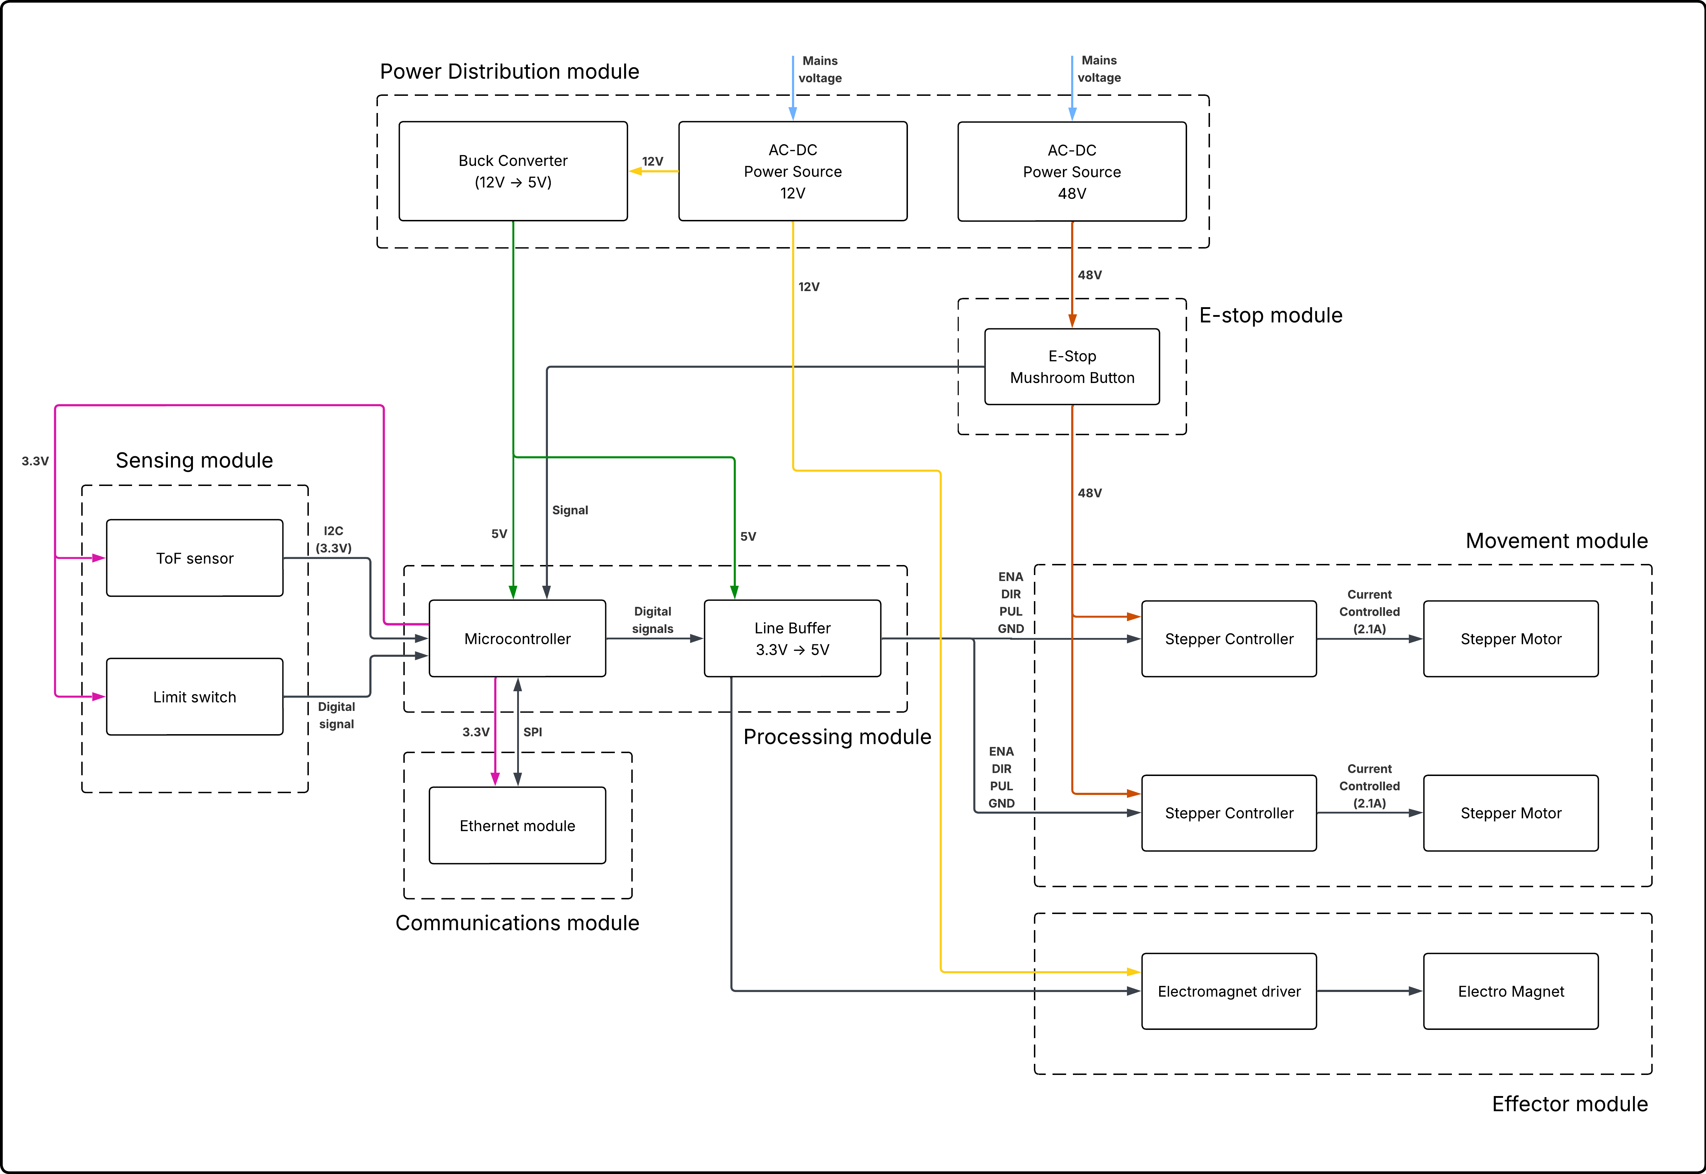
Detailed Block Diagram
18
Notes:
Adriano
Power rails en colores
Seniales en negro
Modulos con linea punteada

Slide 19
Mechanical Architecture
Built from standard commercial extrusion and linear-motion components — no custom machining required
Preliminary Dimensions
Frame
Overall size
108 × 60 × 80 cm
4040 T-slot aluminum extrusion
Horizontal beam, vertical column, supporting legs
Horizontal travel
≈100 cm
Horizontal Drive
Timing belt
Vertical travel
≈30 cm
Converts stepper rotation to fast linear travel
Vertical Drive
Bath envelope
30 × 30 × 30 cm
Leadscrew
Converts stepper rotation to precise linear travel
Clearance above bath
≈5 cm
Guides
Linear rails + carriages
Max workpiece
10 × 10 cm
Smooth movement
19
Notes:
Adriano

Slide 20
Power Distribution & Budget
Three Voltage Rails
Power Budget Summary
48V
Stepper motors + drivers
Subsystem
Power
Mean Well LRS-350-48 (7.3A, 350W)
Movement (motors)
268.8 W
12V
Electromagnet + low-voltage circuitry
Movement (drivers)
~48 W
ALITOVE DC 12V 5A (60W)
End Effector
26.88 W
Sensing + Comms + Processing
~2 W
5V
Processing module + sensors
HiLetgo buck converter (XL4016, 12V→5V)
Total Operational
~ 346 W
Available (adapters)
~ 410 W
20
Notes:
Josue

Slide 21
Monetary Budget
Generic Name | Component | Price per Unit | Price total
Single Output Switchable Power | Mean Well LRS-350-48 | $35.06 | $35.06
Microcontroler | STM32 NUCLEO-F446RE | $31.00 | $31.00
4‑channel digital buffer/line driver | SN74AHCT125N Quadruple Buffer | $0.80 | $0.80
Stepper Motor | 3HS22-2804S Nema 23 | $13.37 | $26.74
Stepper Controler | DM542TE Stepper Controller | $21.00 | $42.00
Ethernet Module | W5500 Ethernet LAN Network Module Support | $6.50 | $6.50
E-Stop | 1NC 1NO Red Mushroom Emergency Stop | $9.99 | $9.99
Transformer | ALITOVE Power Supply Adapter Converter Transformer | $14.00 | $14.00
Buck Converter | LM2596 DC a DC Buck | $1.60 | $1.60
Electro Magnet | Electromagnet Solenoid BM-P 80-38 | $44.98 | $44.98
Proximity Laser Sensor | VL53L0X ToF sensor | $2.98 | $2.98
Shaft Coupler | Shaft coupler (6.35x8mm) | $6.00 | $11.99
Limit Switch | HiLetgo Micro Interruptor de Límite KW12-3 | $0.60 | $0.60
Rail Guide | MGN12H 300mm Linear Rail Guide | $18.00 | $35.99
Lead Screw | Tr8x2 Lead Screw (300mm) | $11.99 | $11.99
Bearings | Pillow Block Bearing 4Pcs, 5/16" (8mm) | $2.12 | $8.49
Guide Rails | Linear Rail Slide SBR20-800mm | $22.45 | $44.90
Belt | 3D Printing GT2 Timing Belt | $16.88 | $16.88
Aluminum Beams | 4040 T-Slot Extruded Aluminum Profile 1000mm | $20.00 | $79.99
Relay | One Channel Relay Module Relay Switch | $3.70 | $7.39
Buzzer | Gikfun Terminals Passive Electronic Buzzer | $0.90 | $1.80
MOSFET Transistor | RLZ44N IRLZ44 MOSFET Transistors | $1.00 | $4.00
Terminal Block | Glarks Terminal Block Set | $0.13 | $0.26
Flyback Diode | BOJACK 1N4007 Rectifier Diode | $0.05 | $0.05
Wires | 22 AWG Stranded Wire Spool | $12.29 | $12.29
Cable Wrap Insulation | Eventronic Heat Shrink Tubing 2:1 | $6.99 | $6.99
Fuse Holder | FEBRYTOLD 0 Gauge Inline Fuse Holder | $4.25 | $4.25
Resistors kit | Upvivi Resistor Assortment Kit | $6.99 | $6.99
T-nuts | 4040 Series T Sliding Nuts Hammer Nut Block Square | $0.67 | $9.99
Bolt and Nuts Kit | Button Head Socket Cap Screws Bolts Nuts Kit M5 | $16.99 | $16.99
Motor Mounting | Nema 23 Stepper Motor Steel Mounting Bracket | $3.00 | $11.99
Nut Block | Lysee 3D Printer Parts & Accessories | $10.10 | $20.19
Converyor Belt | DC 12V Electric Desktop Conveyor Belt | $99.51 | $99.51
Total without conveyor: $525.37
Total with conveyor (before tax): $624.88
Other Products:
- Dip-Spin (EFFCO DS-250) est. $15k–$25k
- MS800 Tiltable Dip-Spin est. $40k–$80k
- Emmeti WAX-ON est. $50k $150k+
21
Notes:
Josue

Slide 22
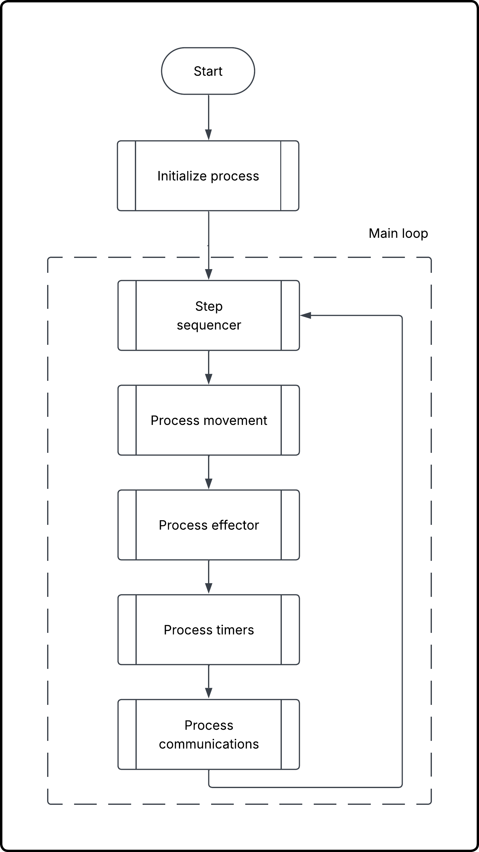
Software Architecture: Cooperative & Nonblocking
Key Principles
Nonblocking Design
Each module performs bounded work and returns immediately.
No blocking while waiting for operations to finish
Cooperative Multitasking
Main loop steps: sequencer → movement → effector → timers → communications
Encapsulation
Sequencer does not directly manipulate timer registers, GPIO, or step counts. The different modules do.
22
Notes:
Josue

Slide 23
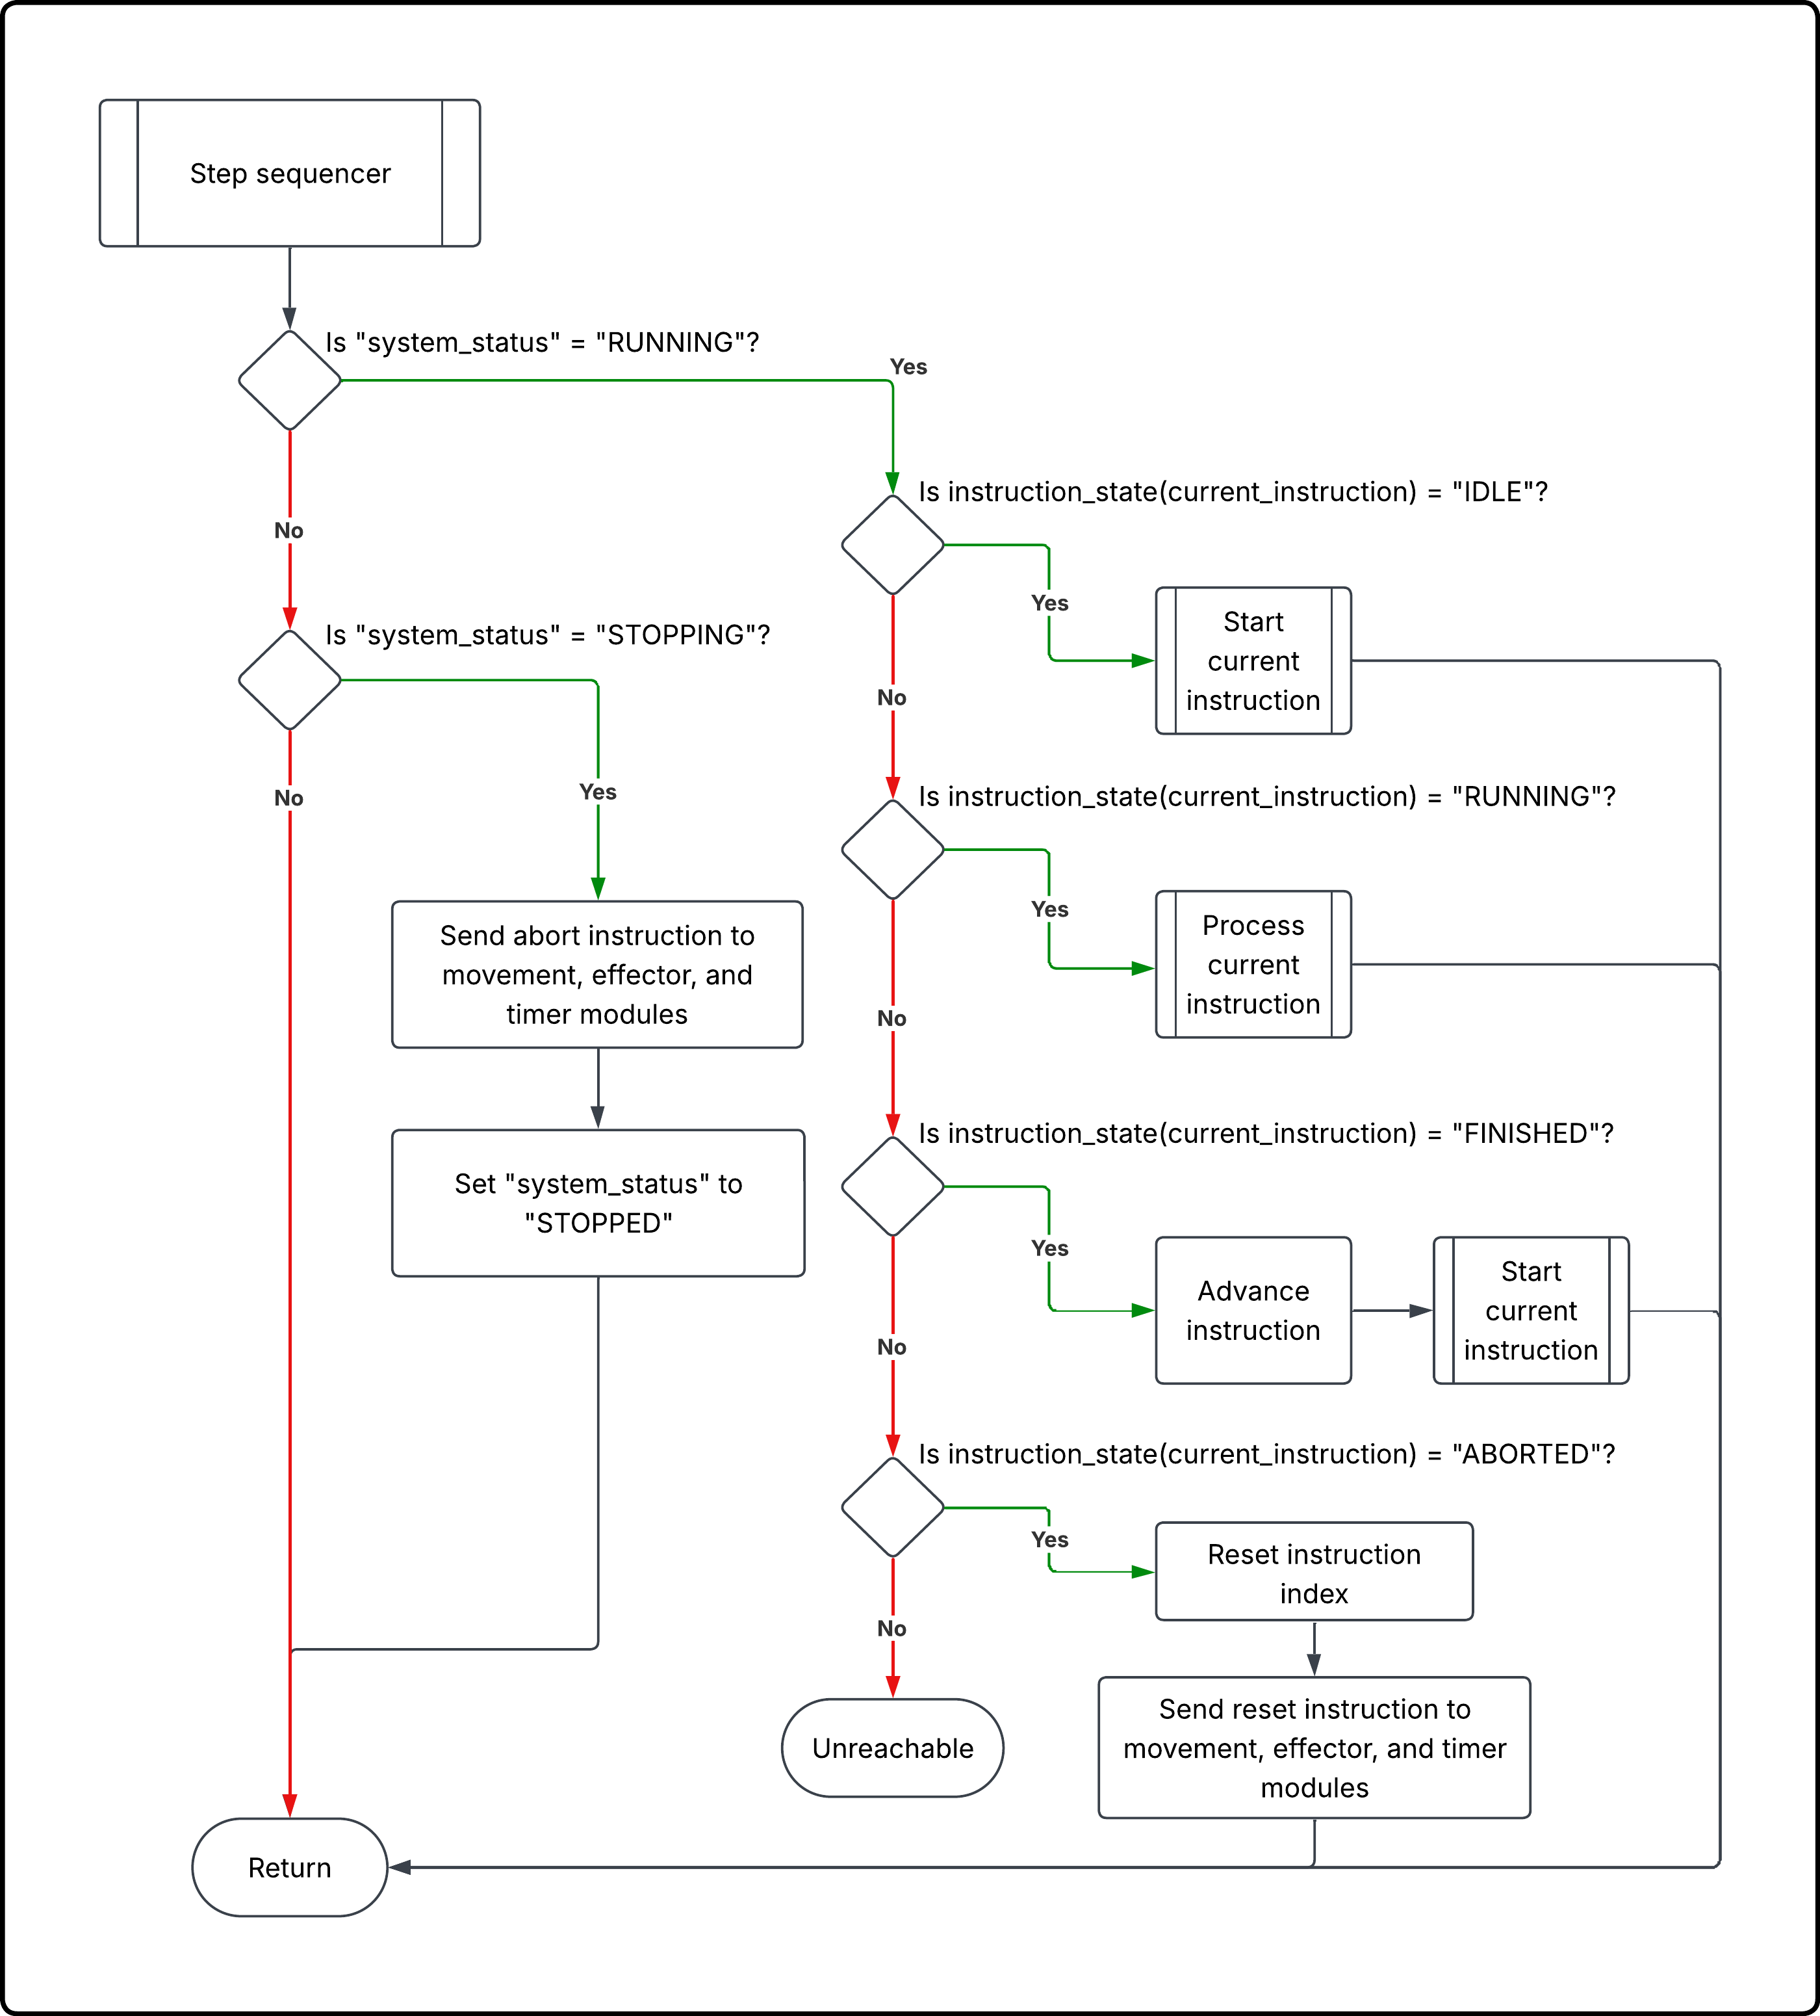
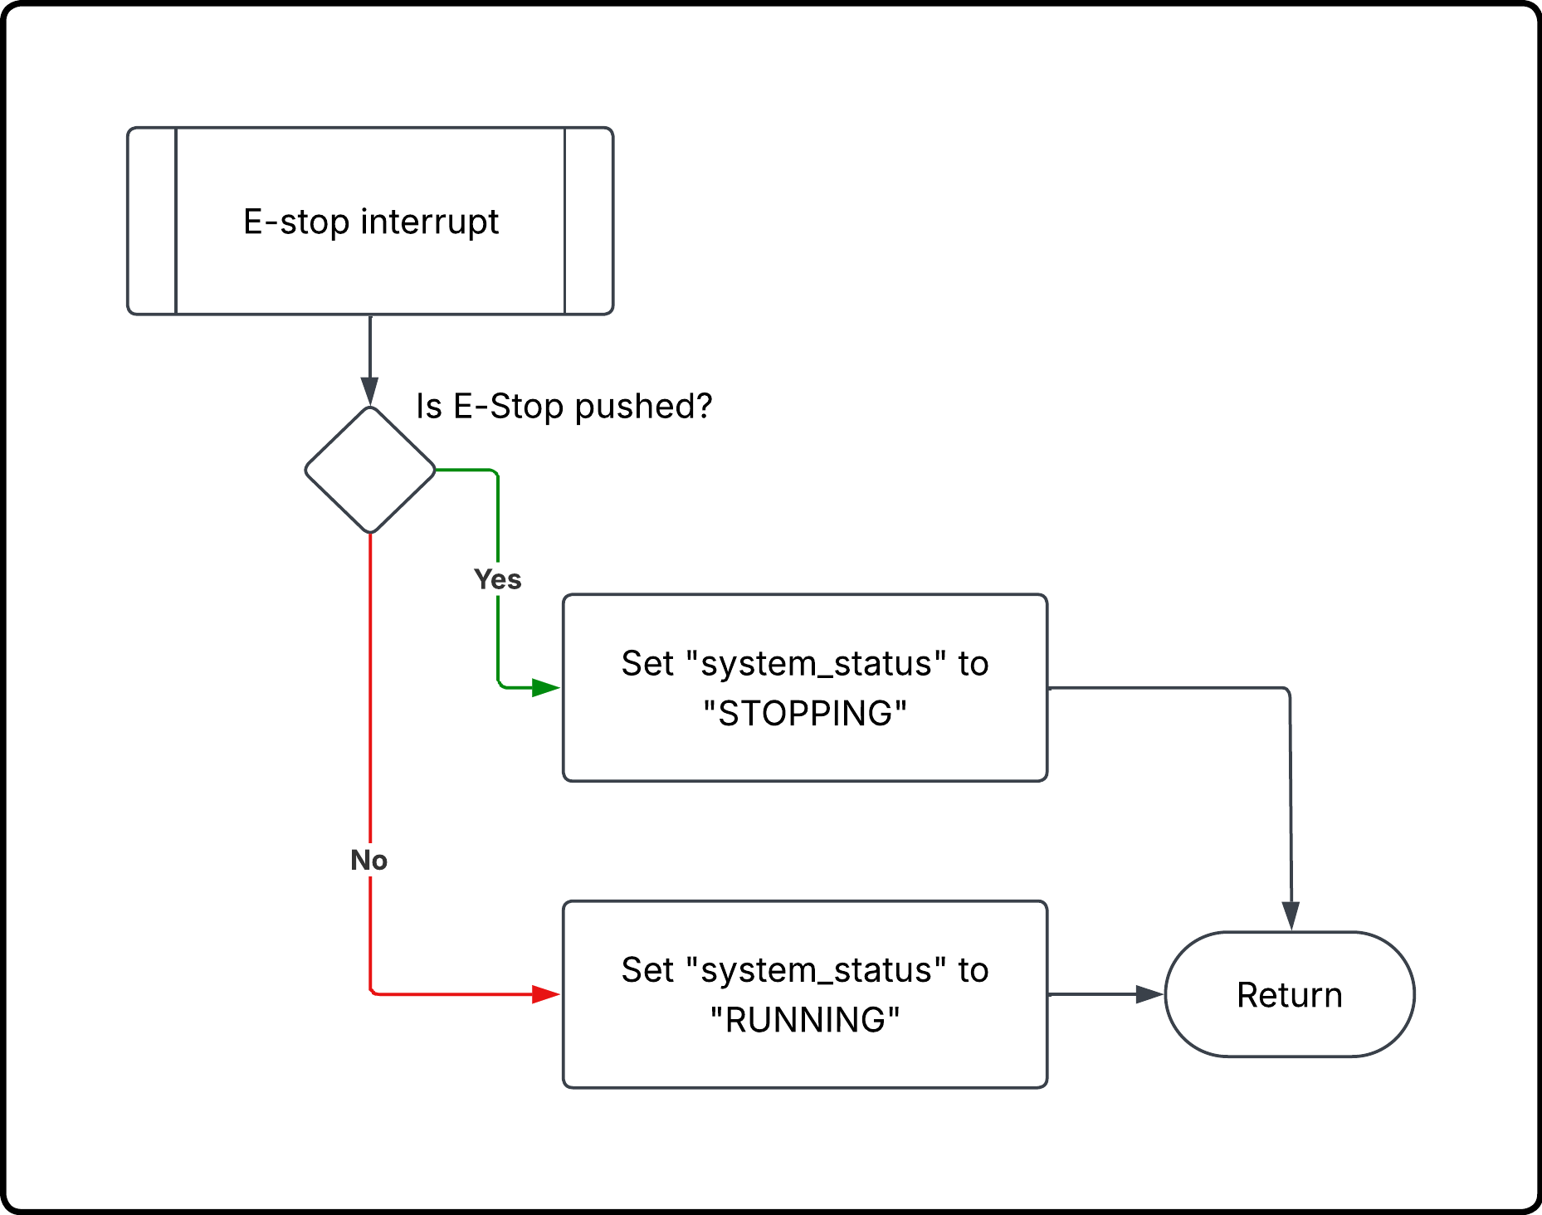
E-stop and Sequencer
23
Notes:
Josue

Slide 24
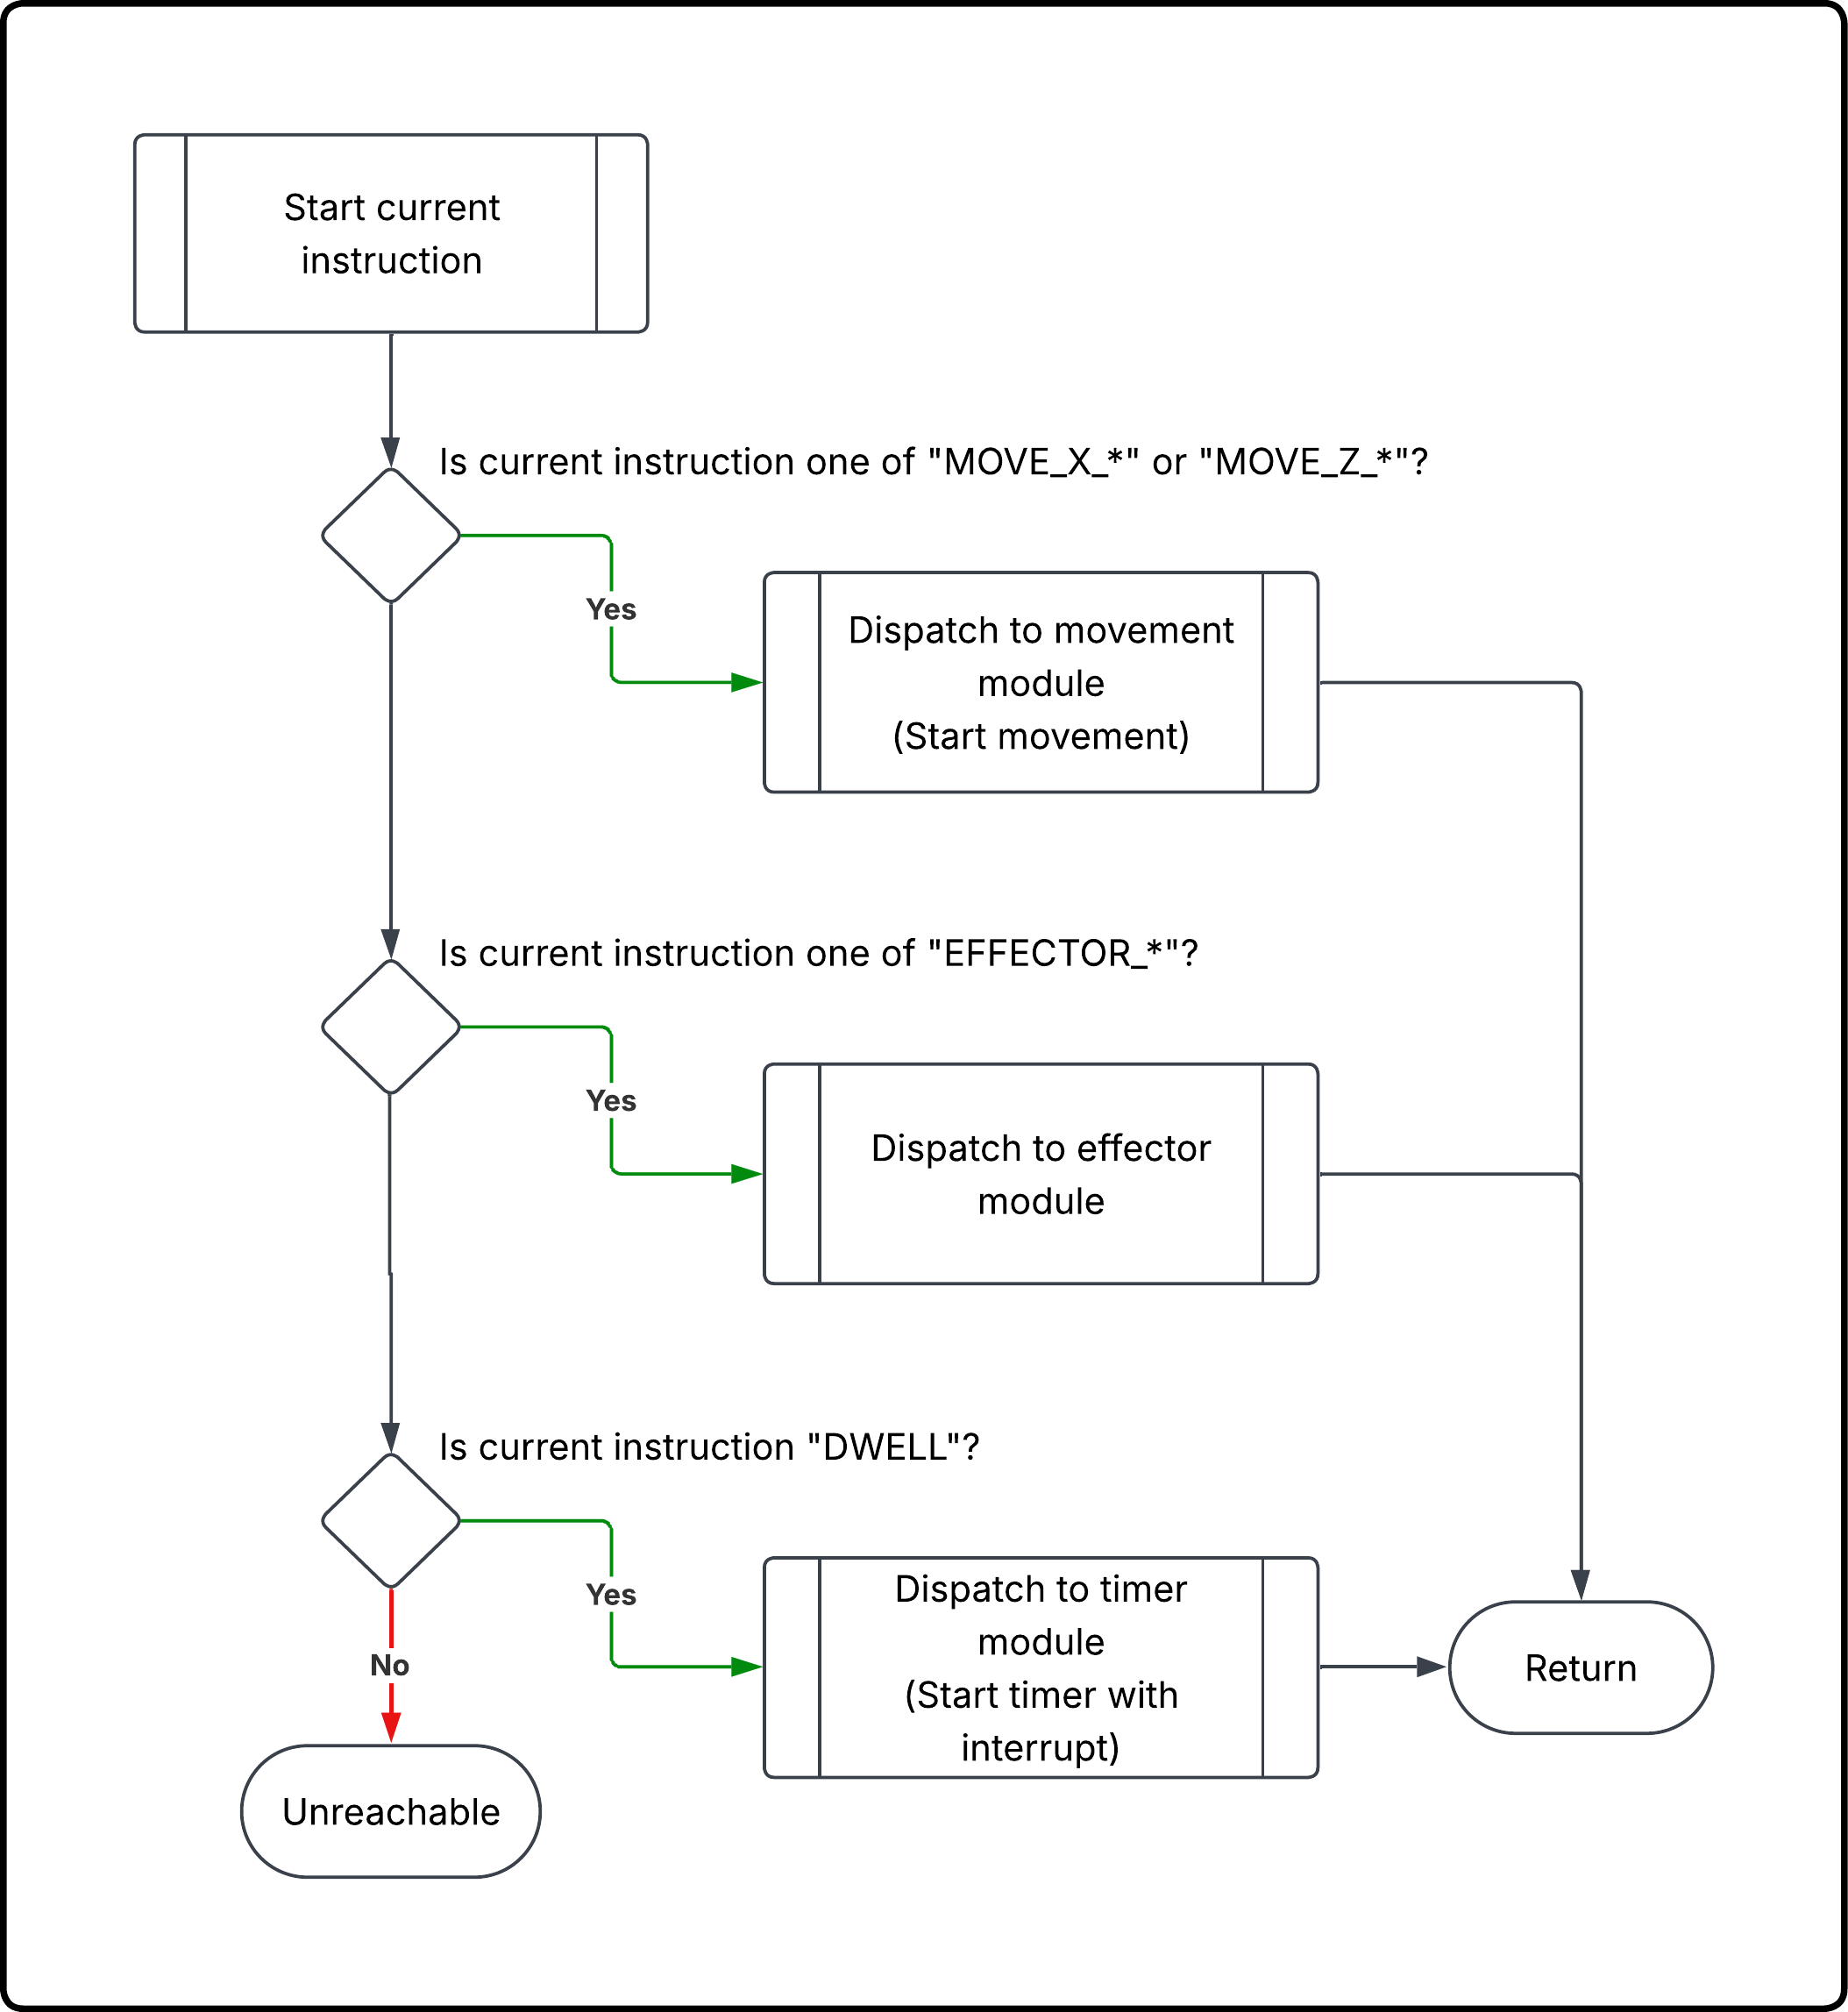
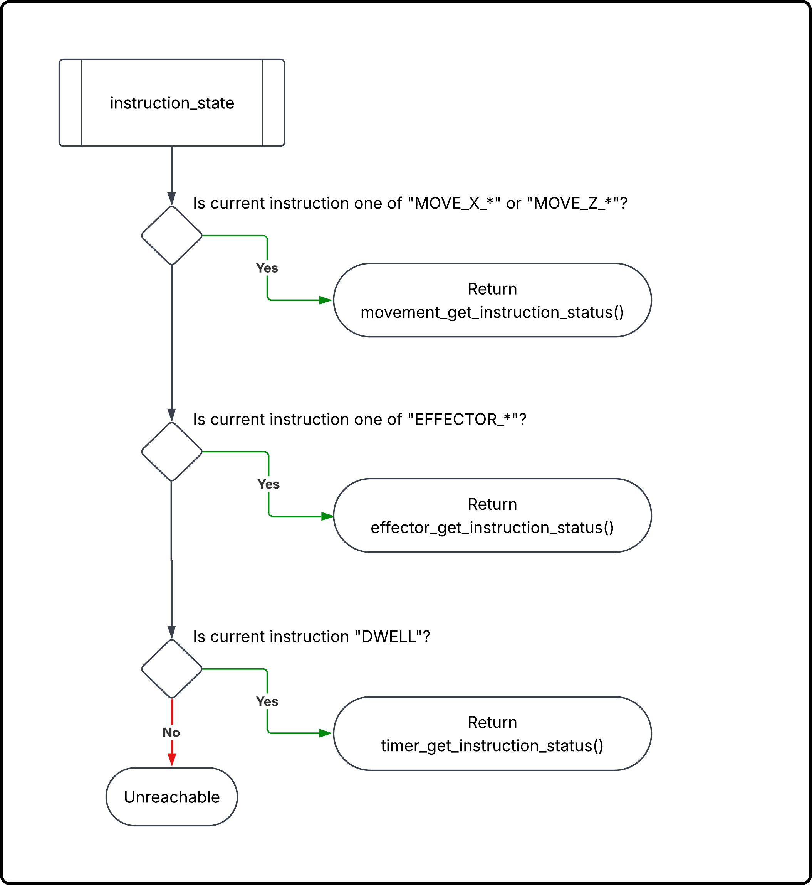
Instruction Start and Instruction
24
Notes:
Josue

Slide 25
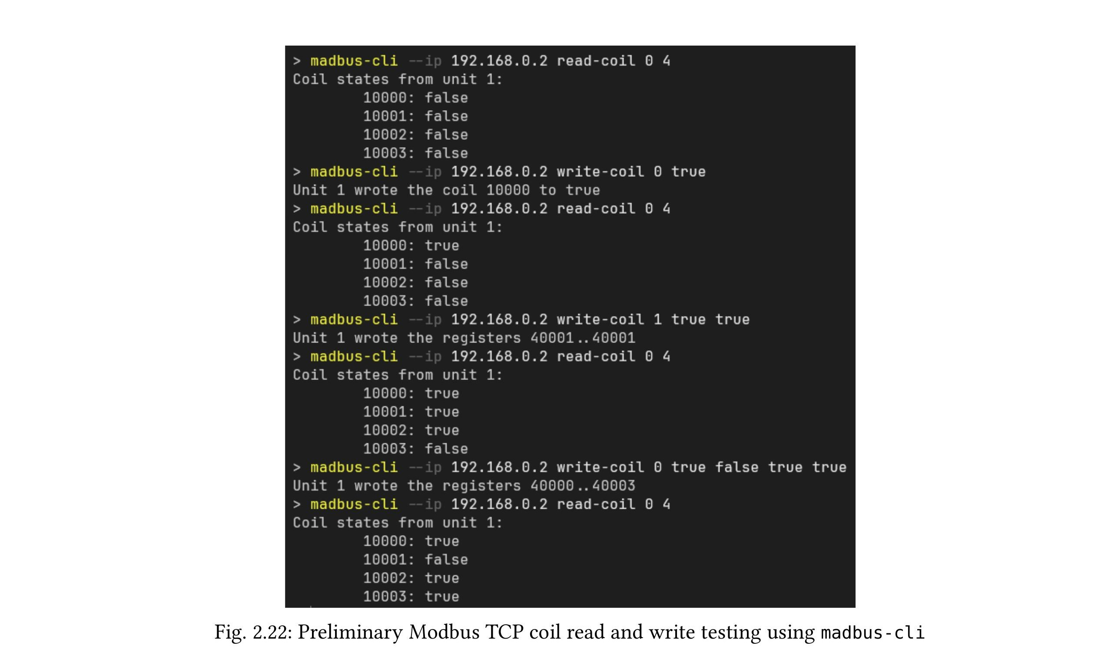
Preliminary: Modbus TCP Communications
What Was Validated
Portable Modbus server library in C with no dynamic allocation
Supports coils, discrete inputs, input registers, and holding registers
W5500 manages Ethernet/TCP sockets; STM32 polls via SPI
Successfully tested: read-coils, write-single-coil, write-multiple-coils
25
Notes:
Josue

Slide 26
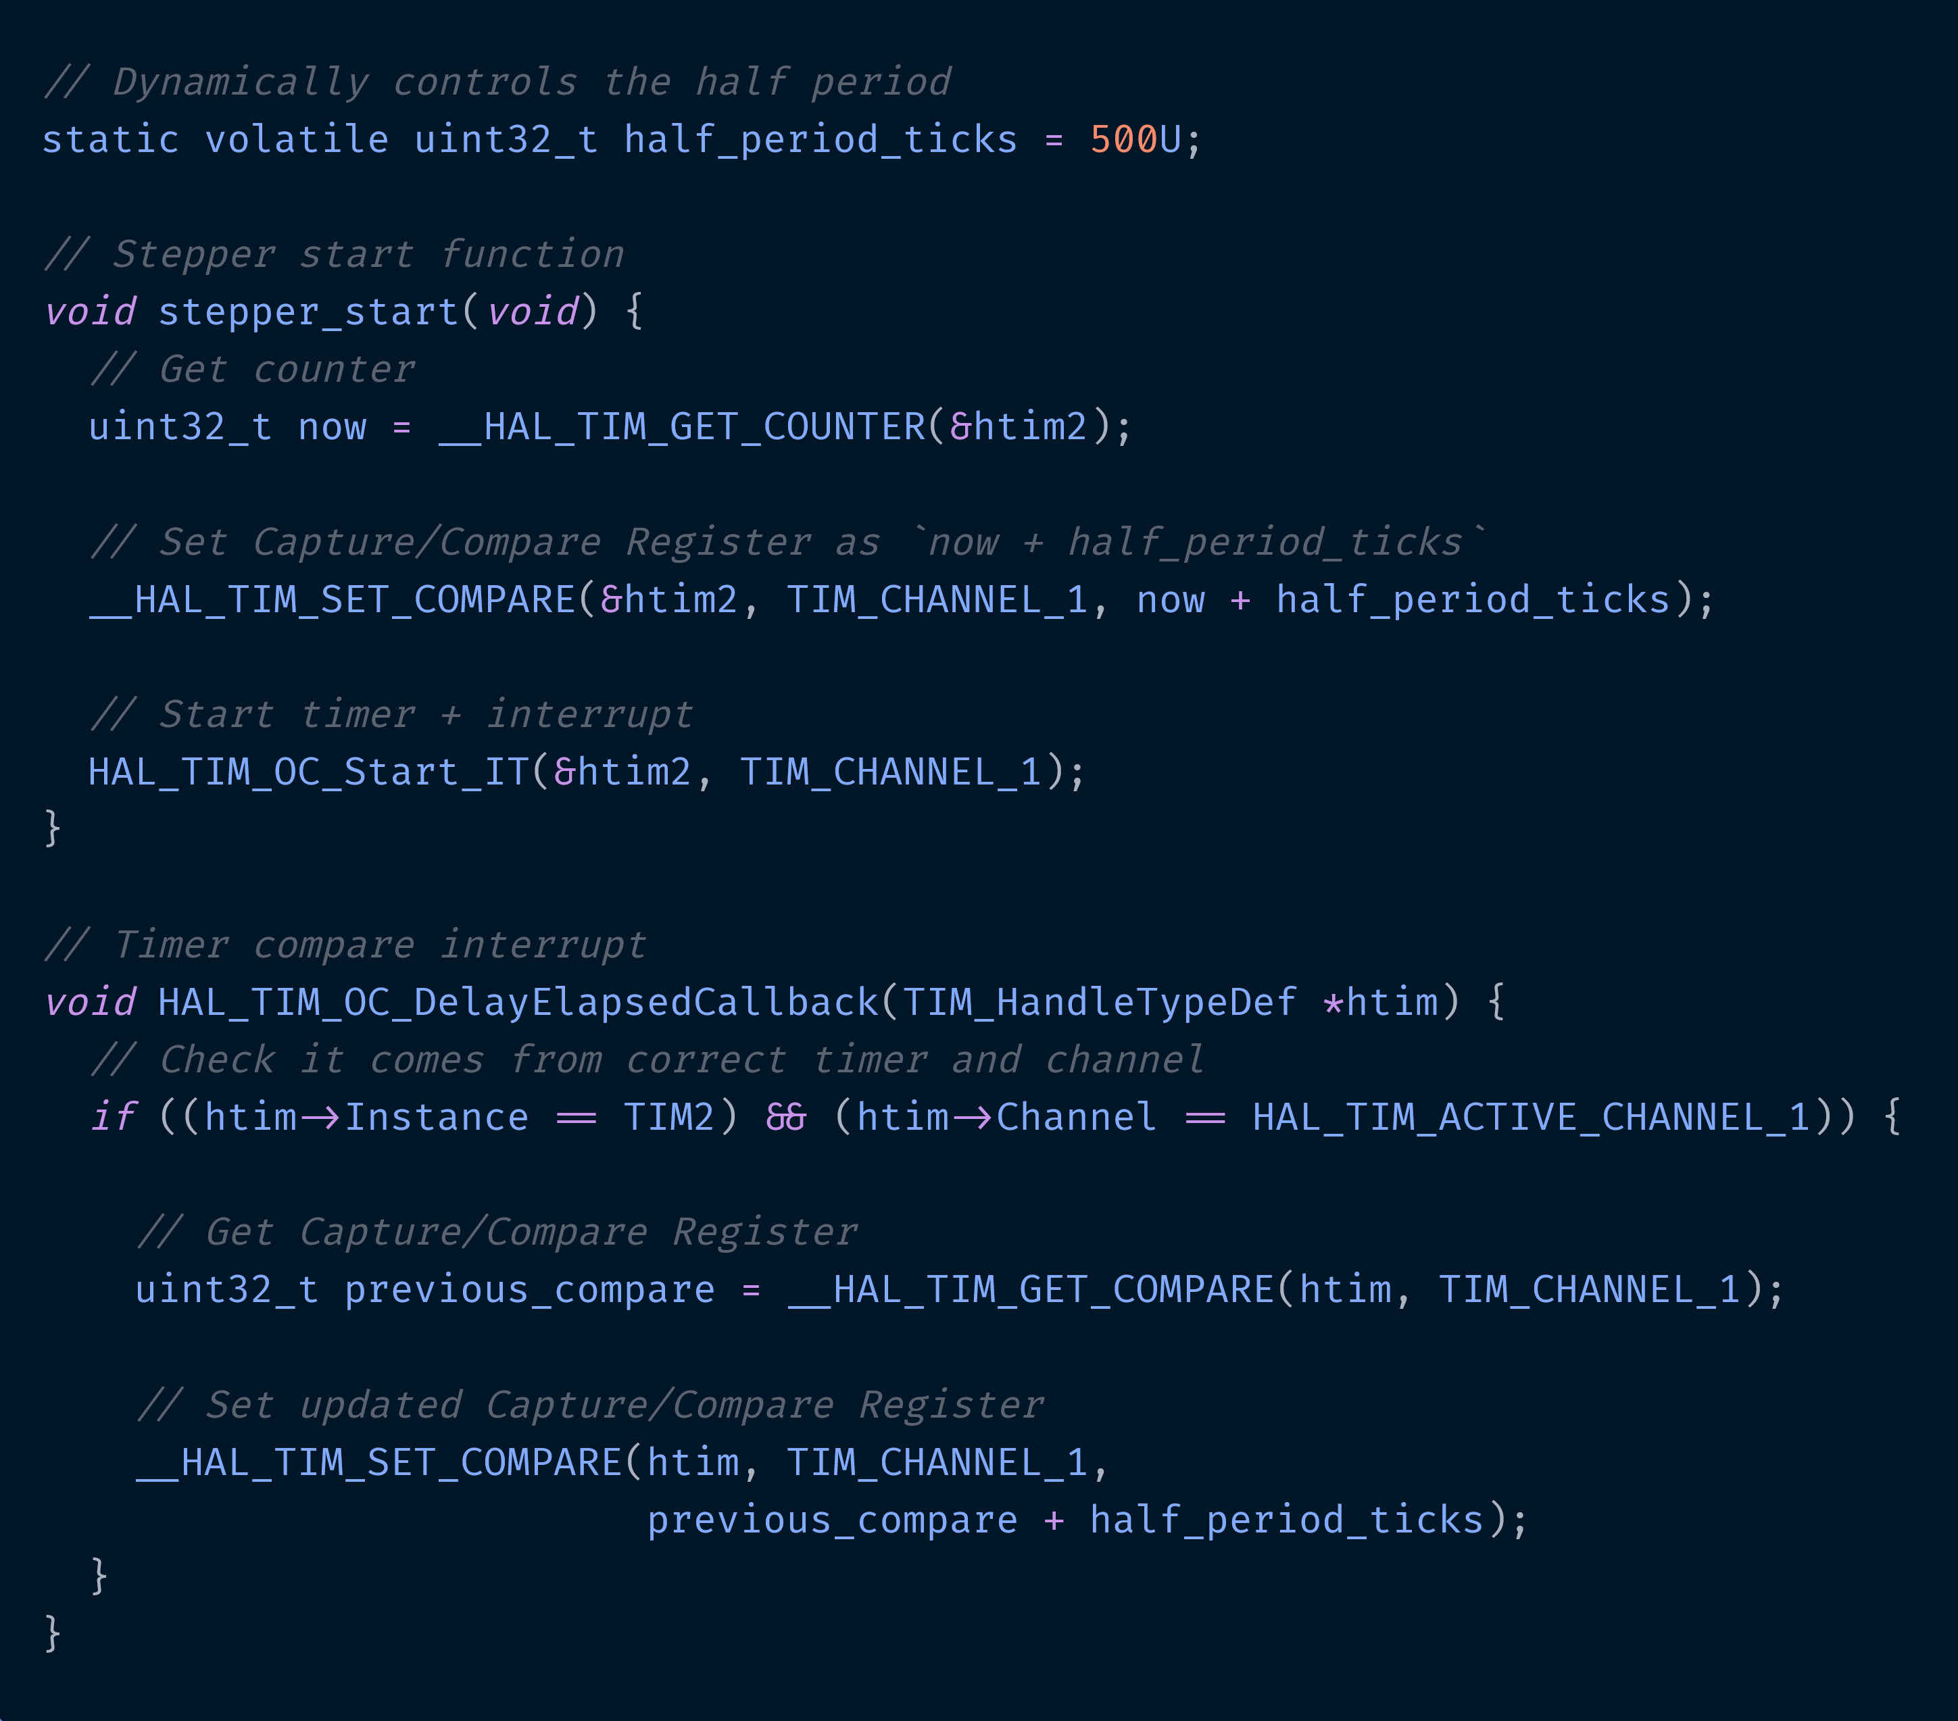
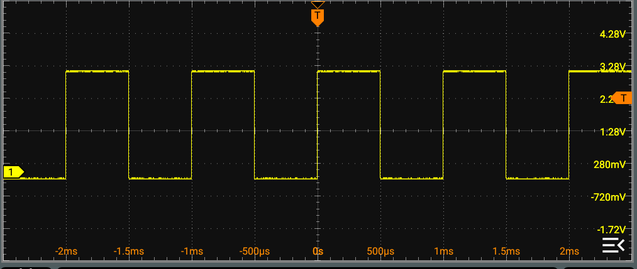
Preliminary: Stepper-Motor Signal Generation
TIM2 Output Compare Mode
Timer peripheral controls output transitions, not the main loop
Changing the half_period changes the Pulse Train Output frequency without software delays or blocking loops
26
Notes:
Josue

Slide 27
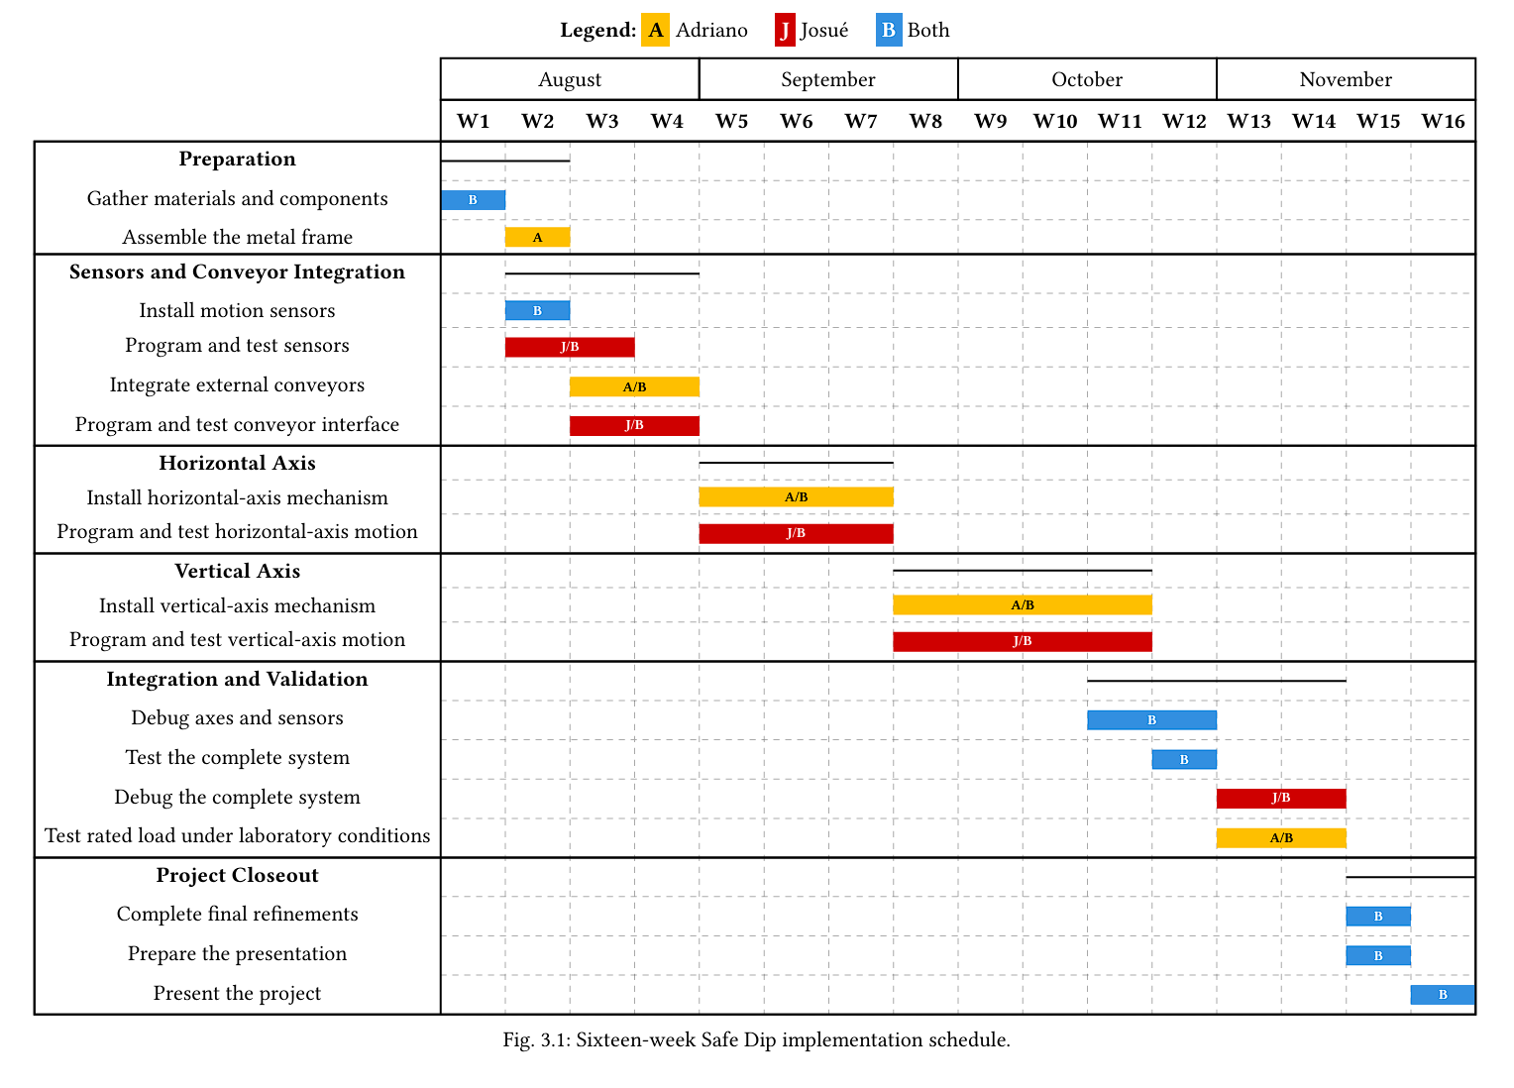
Gantt Chart
27
Notes:
Josue

Slide 28
Conclusion & Future Work
What Safe Dip Achieves
Future Improvements
Removes operator from hazardous hot-dip environment
Thermal protection for heated bath operation
Two-axis Cartesian gantry with controlled pick-dip-place cycle
Transparent physical enclosure with interlocked access
Lower-cost, modular alternative to industrial robotic systems
Electro-permanent magnet for fail-safe load retention
Backup battery on electromagnet rail for total power loss
Category 0 E-stop with load-holding magnet design
Modbus TCP + serial communications for monitoring and control
Questions & Discussion
Josué Bouchard | Adriano Mena | Supervised by Mayra Socarras
28
Notes:
Josue

Slide 29
References:
[1]“What is Hot Melt Wax Coating for Tools?,” Jul. 13, 2022, Dip Seal Plastics, Inc. Accessed: Jun. 25, 2026. [Online]. Available: https://www.dipseal.com/plastic-dipped-parts-tools and-corner/what-is-hot-melt-wax-coating-for-tools
[8] “EFFCO DS-250 Dip-Spin Coating Machine.” Accessed: Jul. 20, 2026. [Online]. Available: https://www.aramfix.com/product/effco-ds-250-dip-spin-coating-machine 250mm-basketxlxwxh-1500x1500x1890mm-steel-alloy-blue-1-pce
[2] D. Dominessy, “End Mill Hot-Dip Wax Coating.” Accessed: Jun. 25, 2026. [Online]. Available: https://www.youtube.com/watch?v=gGHxNu6oPSY
[9] “MS800 Automatic Tiltable Dip-Spin Coating Machine.” Accessed: Jul. 20, 2026. [On line]. Available: https://www.shishengst.com/shisheng-group-sale-ms800-automatic tiltable-dip-spin-coating-machine.html
[3] “What is the difference between Stop Category 0, Stop Category 1 and Stop Category 2?,” Feb. 28, 2014, Schneider Electric. Accessed: Jul. 05, 2026. [Online]. Available: https:// www.se.com/eg/en/faqs/FA225420/
[10] “TH-2004L3 Thread Coating Machine.” Accessed: Jul. 20, 2026. [Online]. Avail able: https://www.tianhaodispensing.com/products/coating-machine/thread-coating machin-TH-2004L3-D.html
[4] “Safety of machinery — Electrical equipment of machines — Part 1: General requirements,” International Electrotechnical Commission, IEC 60204-1:2016+A1:2021, Sep. 2021. Accessed: Jul. 20, 2026. [Online]. Available: https://webstore.iec.ch/en/ publication/71256
[11] “Automatic Thread Coating Machine.” Accessed: Jul. 20, 2026. [Online]. Avail able: https://www.tianhaodispensing.com/products/coating-machine/thread-coating machine-automatic.html
[5] “Thrust generation principle of a linear lead screw motor,” MOONS' Industries. Accessed: Jun. 25, 2026. [Online]. Available: https://www.moonsindustries.com/article/thrust generation-principle-linear-lead-screw-motor
[12] “Custom Automation and Specialty Equipment.” Accessed: Jul. 20, 2026. [Online]. Available: https://southshorecontrols.com/specialty-equipment/
[13] “UR5e Collaborative Industrial Robot.” Accessed: Jul. 20, 2026. [Online]. Available: https://www.universal-robots.com/manuals/EN/HTML/SW10_12/Content/ Landingpages/WebPolyX/LandingarmUR5e.htm
[6] IQS Directory Editorial Team, “Lead Screws: What Is It?, How It Works, Types, and Advantages,” Jun. 16, 2026. Accessed: Jun. 26, 2026. [Online]. Available: https://www. iqsdirectory.com/articles/ball-screw/lead-screws.html
[7] RipInPease, “madbus-cli: A modbus tui using the madbus crate,” Mar. 18, 2026. Accessed: Jul. 04, 2026. [Online]. Available: https://lib.rs/crates/madbus-cli
29
Notes:
Adriano/Josue

