Slide 1
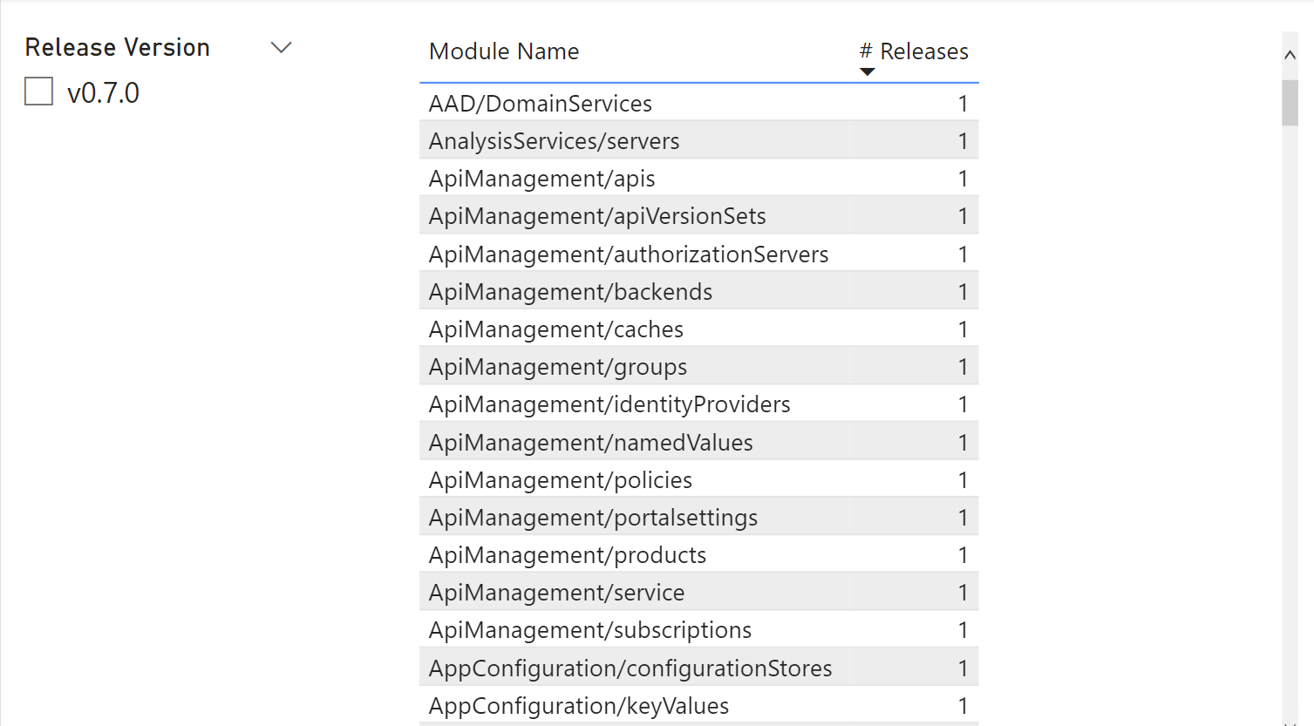
Work Done
Day 1
Kudos to Marius for the support on the SPN ☺
Get the deployment objects
Cmdlets
Rest API
Get the modules from the releases
Release 0.7.0
Generate hash
Upload data to storage account table
Initial version of PBI Dashboard (Basic Data model)
Team: Tomaz, Felix, Bram, Jose Luis, Jordi

Slide 2
.Json file
Module Name
Release
Hash
Storage Account Table
ScopeId (MG/Subscription Name)
Deployment Name
Hash
(MATCH or NOT)
Power BI

Slide 3
Work Done
Day 2
Validate Hash
Finish function to upload data to storage account table
Start working on the deployment of the backend (function/automation account)
Trigger based on number of deployments (limit 800)
Team: Limited availability*

