Slide 1

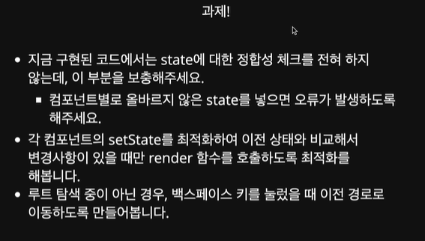

Slide 2
CardView
index
App
Storage

