Slide 1
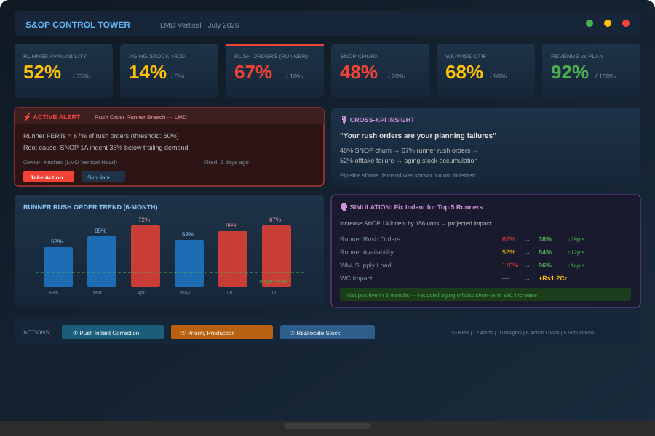





S&OP Command Center
1. Data Foundation
S&OP Control Tower unifies planning & execution into a single command center — moving from periodic monitoring to real-time decision-making across the supply chain
Real-Time Performance Monitoring
KPIs across inventory, demand, rush orders, supply & finance — single source of truth with drill-down from portfolio to individual FERT
Intelligent Alerting & Thresholds
Threshold-driven alerts with single accountable owners. Root cause identification, not just symptom flagging. Alerts fire days ahead, not months late
Cross-Functional Insights
Pattern engine connecting KPIs across domains — planning instability → rush orders → aging stock → working capital. Pipeline-indent alignment signals
Execution Path & Action Loops
Multiple action loops rush order governance, stranger FERT control, aging liquidation, supply smoothing, planning feedback, pipeline-indent alignment, Dealer financing
Simulation & Scenario Modeling
What-if analysis on demand, inventory, supply & financial trade-offs. Test indent corrections, discount strategies & supply smoothing before committing
Single Source
of Truth
From Monitoring
to Driving
Phased
Deployment
Multiple Personas
Served

